Slide 1
OpenStand and IEEE 802
Konstantinos Karachalios
Managing Director, IEEE-SA
17 November 2012

Slide 2
OpenStand Overview
IEEE, IAB, IETF, Internet Society and W3C developed a high-level set of principles for a Modern Paradigm of global, open and bottom up standards
In this Paradigm economics of global markets and societal needs, fueled by technological innovation, drive global deployment of consensual, bottom up standards regardless of their formal status. In many cases they are complementary to, but outside of, the conventional national body process.
The OpenStand initiative aims strategically at creating and orientating a robust movement towards gaining global awareness and recognition for standards and standards development processes based on the core principles
Entities and individuals can express support for and commitment to the principles

Slide 3
OpenStand Overview
Since the launch of OpenStand on 29 August, hundreds of proponents from around the globe, from industry, civil society, government and academia, as well as individual technologist and innovators, have expressed their support of the OpenStand principles
Full listing can be found at: http://open-stand.org/supporters/

Slide 4
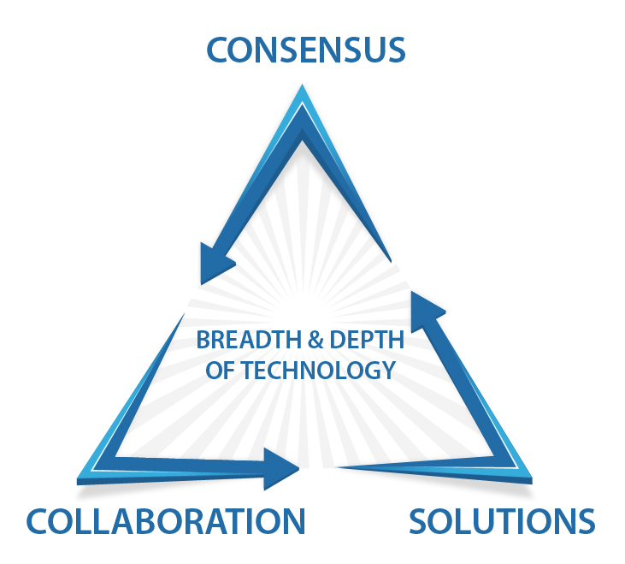
The 5 High-level Principles
1. Cooperation
Respectful cooperation between standards organizations--whereby each respects the autonomy, integrity, processes and IP of the other
2. Support of the Five Fundamentals
  Due process
  Broad consensus
  Transparency
  Balance
  Openness

Slide 5
The Principles
3. Commitment to Collective Empowerment
  Striving for standards that:
    Are based on technical merit, as judged by the contributed expertise of each participant
    Provide global interoperability, scalability, stability and resiliency
    Enable global competition
    Serve as building blocks for innovation

Slide 6
The Principles
4. Availability
  Specifications made accessible to all for implementation and deployment
5. Voluntary Adoption
  Standards are voluntarily adopted, and success is determined by the market

Slide 7
Next Steps: Living OpenStand
Exemplify and further develop what OpenStand means for each partner organization and for collaboration among them
  Self-assessments towards the 5 principles
Deepen cooperation around topical and technology issues
Streamline and simplify joint standards development processes and use partners' standards for own standards development purposes

Slide 8

OpenStand and IEEE 802 Opportunities
Tell the IEEE 802 story through the lens of OpenStand and the Modern Paradigm principles
Deepen IEEE 802 relationships with Alliances based on the Alliances' activities and innovating upon the open 802 standards

Slide 9

Next Steps: Expand and Outreach
Increase industry engagement
Engage civil society and consumer organizations active in the field of access to knowledge and open standards.
Other stakeholders: SDOs, Alliances, Academia, Government Bodies, Technology Solutionist and Entrepreneurs
Engage regionally, in particular regarding emerging economies and developing countries
Ultimately, expand OpenStand into an inclusive community dedicated to Open Knowledge and Open Innovation for the advancement of technology for the benefit of humanity

Slide 10

Implementation Measures
Continue campaign to expand SDO signatories for the Principles
Modify positioning and messaging on Website
Develop new content--highlighting the principles through examples and focusing on the societal benefit of open standards
Develop keynote and speaking engagements to support partnerships, agreements, sponsorships, events, crowd sourcing

Slide 11
OpenStand and 802 Opportunities
Deepen IEEE 802 relationships with OpenStand partners standards bodies
Create around 802 standards (possibly via the Get IEEE 802 Program) an open innovation repository whereby a community of users can share information that flows to and from the 802 standards development process
  Transform the Get IEEE 802 Program from downloading to community of engagement

Slide 12

OpenStand and 802 Opportunities
Participate in an "OpenStand Knowledge Initiative" whereby a collaboration cycle is created
  Identifying resources
  Growing skills and capacity of people involved to leverage collaboration opportunities
  Connecting people to generate new knowledge around 802 standards
  Outputs of the partnerships can be technological innovations, papers, education courses, vision documents, new standards, resource databases, etc.

Slide 13

OpenStand and 802 Opportunities
Partner with OpenStand supporters to:
  Incubate solutions within a larger community
  Connect technologists to potential new technology spaces that can leverage and innovate upon IEEE 802 standards or use IEEE 802 standards
"OpenStand Philanthropy"
  Position IEEE 802 as a benefactor to technology related social causes

Slide 14
Thank You

