Slide 1
40th Anniversary of Ethernet
30 Years of IEEE 802.3™ Ethernet Standards
Name
Title

Slide 2
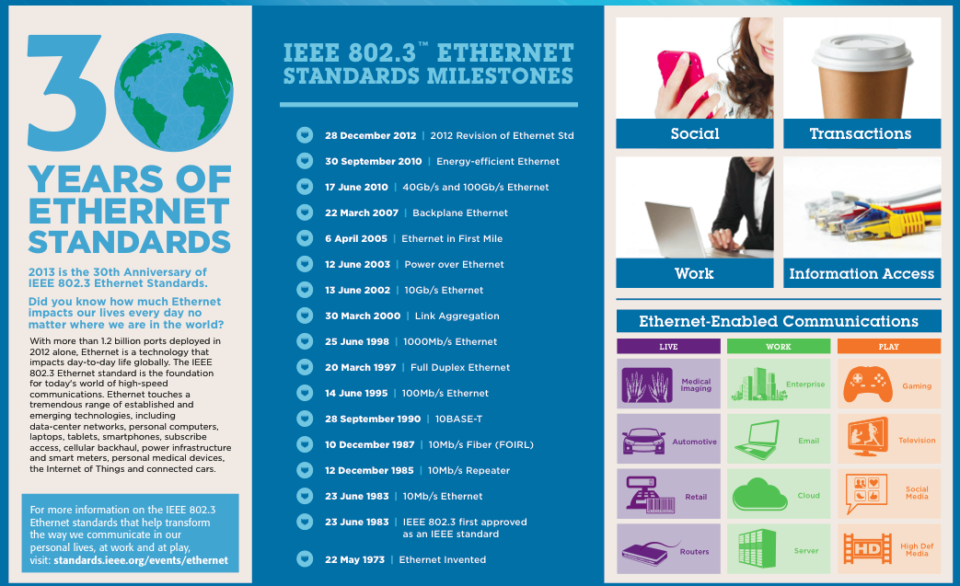
30th Anniversary of IEEE Ethernet Standards

Slide 3

Contact
Name
Title
IEEE
IEEE Standards Association
standards.ieee.org/events/ethernet/
Facebook
facebook.com/Ethernet40thAnniversaryIEEESA
LinkedIn
linkedin.com/company/ieee-sa-ieee-standards-association
Twitter
twitter.com/IEEESA
IEEE 802
http://www.ieee802.org
IEEE 802.3
http://www.ieee802.org/3

