Slide 1
IEEE Internet Initiative
Internet Governance, Cyber-security and Privacy
IEEE 802 Workshop
8 November 2014

Slide 2
Internet Initiative
Initiative approved by BoD January 2014
BoD Committee appointed by President de Marca to:
  Develop a high-level plan for IEEE involvement in global Internet governance, with focus on the technical aspects, starting already in 2014
  Lay the foundation for a long-term engagement of IEEE in the Internet governance space, with the aim to restore trust to its technical foundations and standards and preserve its global character and integrity
2014 Ad Hoc Members
  Director and President, Standards Association and Committee Chair, Ms. Karen Bartleson
  Director and Delegate, Division V, Ms. Susan K. Land
  Dr. José Luiz Ribeiro, Brazilian Internet Steering Committee
  Dr. Konstantinos Karachalios, Managing Director, IEEE Standards Association

Slide 3
Internet Initiative Context
Pursuing a vision of public policy informed by technology for the benefit of society
Connect technologist with policy experts
  Foster a network of technology leaders who understand policymaking, and are prepared to inform, develop and/or execute solutions to address societal challenges
Build capacity of technologists/engineers to effectively inform individuals and organizations that influence and determine policies and regulations
Entry point for IEEE in technology policy is IG and related areas of cyber-security and privacy

Slide 4
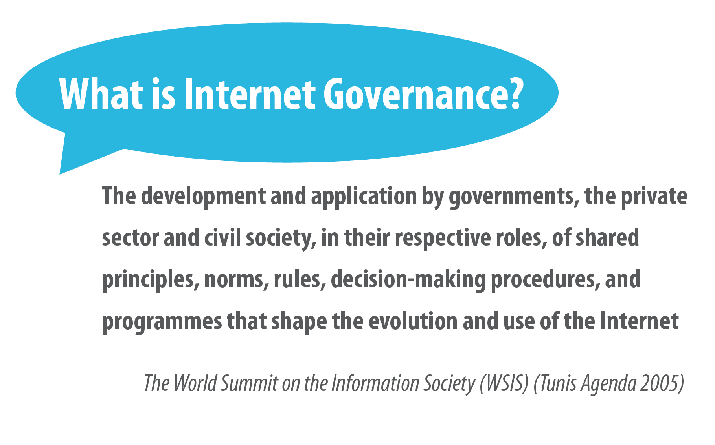
Internet Initiative

Slide 5
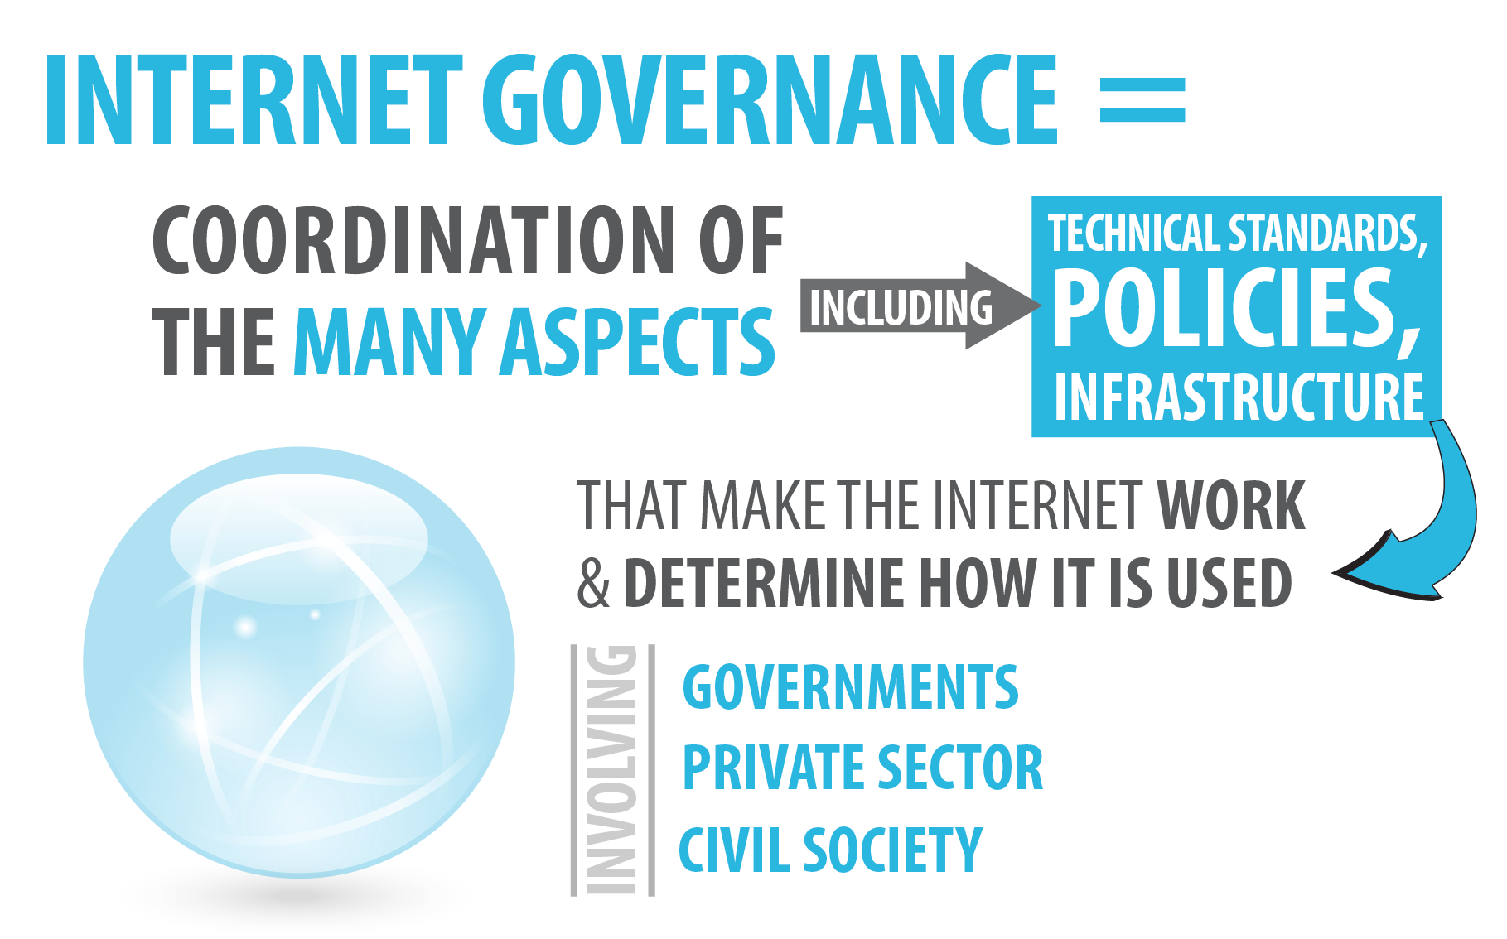
Internet Governance

Slide 6
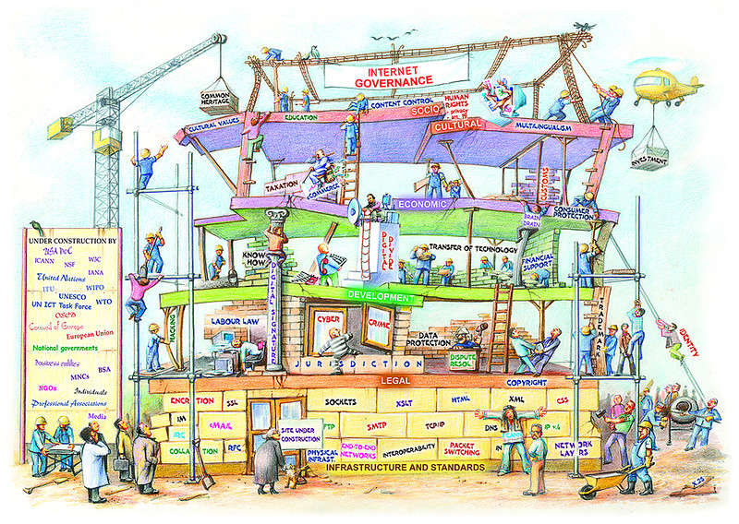
Internet Governance
Courtesy of Diplo Foundation

Slide 7
Internet Initiative Vision
Amplifying the voice of the technical community in the global technology policy making process in the areas of Internet governance, cyber-security and cyber-privacy in order to inform and influence debate and decisions and to help ensure trustworthy technology solutions and best practices.

Slide 8
Internet Initiative Mission
Raise IEEE’s influence and profile in global technology policy in the areas of Internet governance, cyber-security and cyber-privacy policy development by providing a consensus of sound technical and scientific knowledge and guidance to the process.

Slide 9
Internet Initiative Goals
Engage the technical community in shaping policies surrounding Internet governance to inform decision making that impacts the Internet ecosystem
Deliver technology policy program for cyber-security
Deliver technology policy program for cyber-privacy
Establish Initiative management processes and communications platforms

Slide 10
Initiative Framework
United collection of activities, projects and programs
Leverage
  IEEE’s Future Directions Initiatives
  Strength of IEEE’s diverse technical communities (IEEE Societies, Sections, Chapters) and volunteers
  Established relationships/partnerships
  IEEE’s activities (in expanding its global footprint) in countries and regions
  IEEE Regional Offices
  IEEE Professional Staff/IEEE Operational Units
Develop new programs under the umbrella of Internet governance, Cybersecurity, privacy and personal identity management

Slide 11
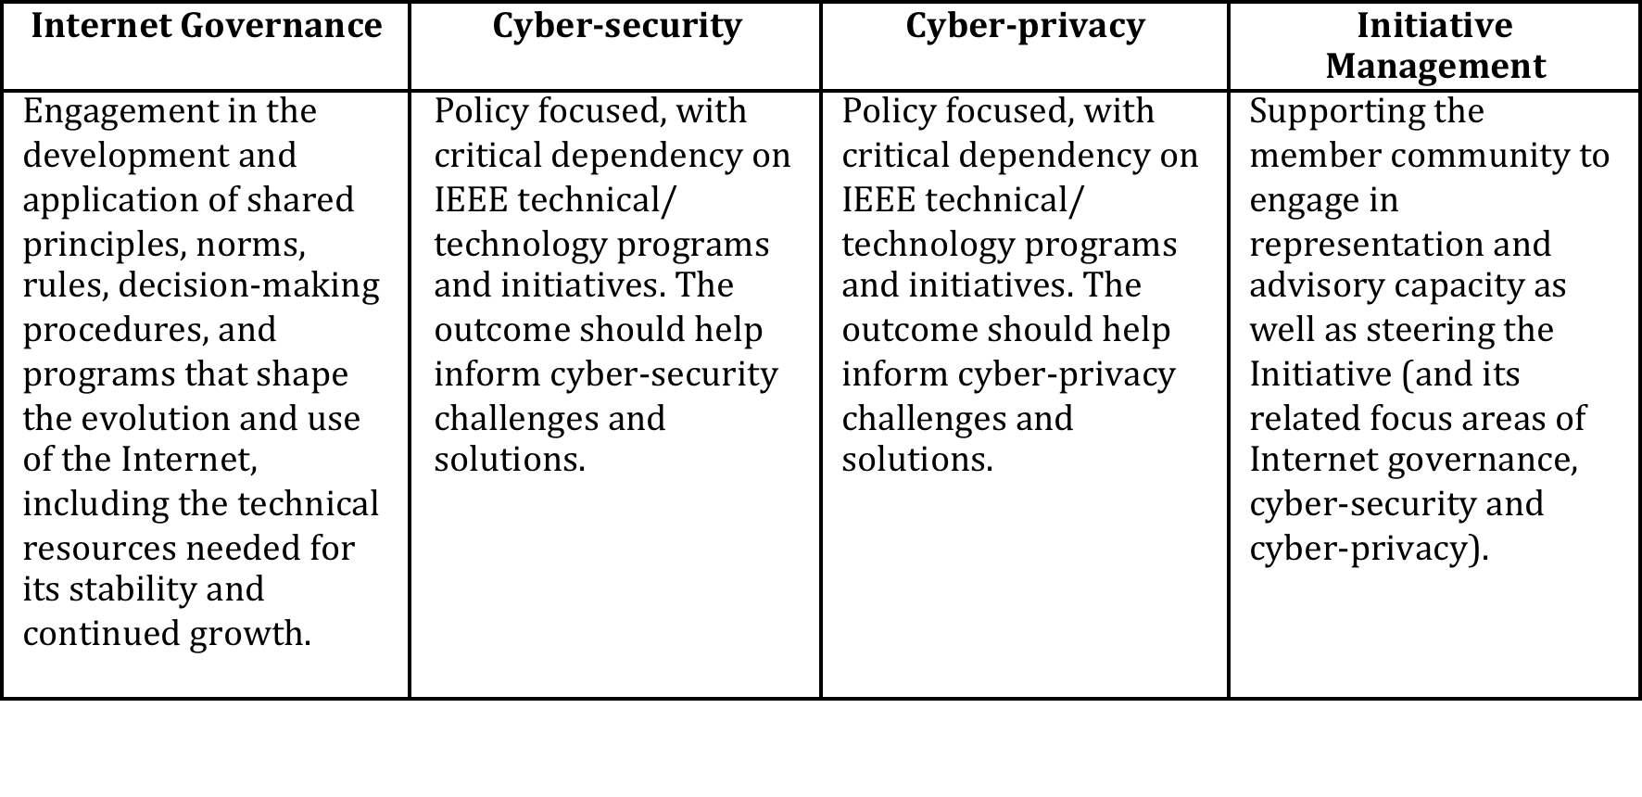
Internet Initiative Management
BoD appointed Steering committee will be established to provide strategic oversight of the Initiative
Four inter-related tracks managed and coordinated by a cross-functional and cross-organizational PMO

Slide 12
Next Steps
Internet Initiative Ad Hoc developing strategic plan for the Initiative for presentation to the IEEE BoD at its November meeting
  Prepared proposed 2015 budget
  PMO in development: dedicated staff resources to support the Internet Initiative and its activities and structure
Increase internal communication to foster awareness and understanding about the Initiative across the organization
Organize Technology Policy “round-table”

Slide 13
Technology Policy Summit
Interactive event focused on topical and timely IG, cyber-security and privacy issues at the intersection of technology, policy and innovation
Brings together global technologists and policy experts to identify and define critical and evolving issues at the intersection of technology, policy and innovation to:
  Discuss the impact of technology on policy decisions; policy decisions impact on technology implementation; and the impact of policy decisions on technology research and innovation
  Impart knowledge on potential trade-offs of technical solutions in the consideration of policy
  Identify the types of information and interaction needed by the policy experts to make informed decisions

Slide 14
Thank you!

