Slide 1
OmniRAN TG perspective on cost and benefits of 5G SC options
Max Riegel
802.1 OmniRAN TG chair
2016-03-15

Slide 2
Introduction
Current topic of OmniRAN TG:
  P802.1CF: Network Reference Model and Functional Description of IEEE 802 Access Network
    More details on content on next slide
  Generic functional model of IEEE 802 access network based on Ethernet link
    Applicable to all IEEE 802 technologies supporting Ethernet
    Kind of ‘Stage 2’ specification according to ITU-T terminology
    Purely based on existing IEEE 802 standards
    Recommended practice (only ‘should’ statements)
Intention to support broader managed deployment of IEEE 802 technologies throughout various industries
  No intention to define future mobile network architecture
  However P802.1CF applicable to part of 5G scenarios

Slide 3
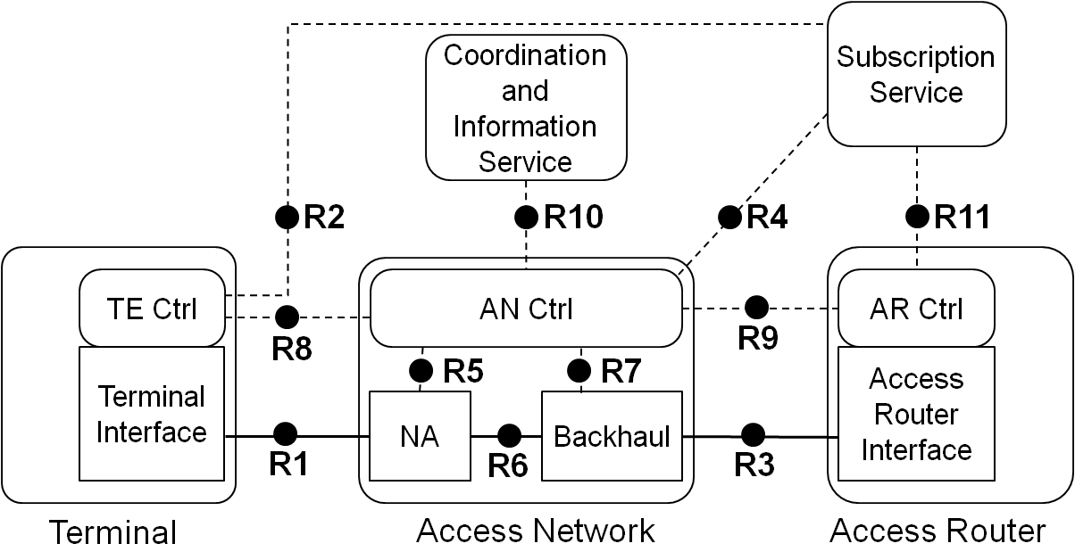
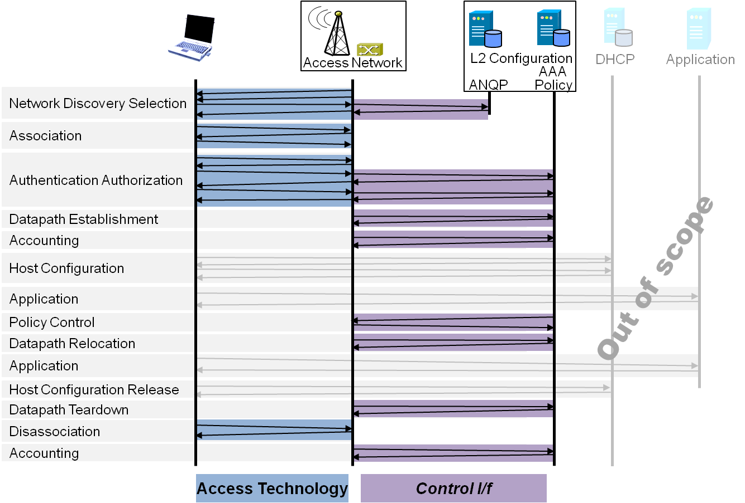
P802.1CF: Network Reference Model and Functional Description of IEEE 802 Access Network
Overview
References, definitions, acronyms and abbreviations
Conformance
Network Reference Model
  Basic concepts and terminology
  Overview of NRM
  Basic, enhanced and comprehensive NRM
  Deployment scenarios
Functional Design and Decomposition
  Access Network Setup
  Network Discovery and Selection
  Association and Disassociation
  Authentication and Trust Establishment
  Data path establishment,
  relocation and teardown
  Authorization, QoS and policy control
  Monitoring and statistics
  Fault diagnostics and maintenance
SDN Abstraction
Annex:
  Privacy Engineering
  Applicability to non-IEEE 802 PHY layer technologies
  Bibliography

Slide 4
Assumptions about network integration of the various 5G Radio Access Technologies
From the NGMN Alliance 5G whitepaper:
Fully leveraging the capabilities of IEEE 802 technologies would require an appropriate IEEE 802 network interface towards the 5G NW functions (core).

Slide 5
P802.1CF Interface option to 5G
IEEE 802 Access Network
5G NW Functions
???
Subscription
Service
Coordination and Information
Service
Network
Management
Service
R2
R10
R11
R12
R4
AN Ctrl
TE Ctrl
AR Ctrl
R8
R9
Terminal
Interface
R5
R7
Access Router
Interface
NA
Backhaul
R1
R6
R3
Terminal
Access Network
Access Router
5G Radio

Slide 6
OmniRAN P802.1CF evaluation of options
IEEE 5G
  Benefits: full deployment support of IEEE 802 technologies in
  future mobile networks
  Costs: full set of network standards to address all the
  various 5G requirements
IMT-2020 – single technology
  Benefits: (single radio technology gets IMT-2020 stamp)
  Costs: potentially an amendment to P802.1CF for
  addressing generic 5G architecture (t.b.d.)
IMT-2020 – set of technologies
  Benefits: (a few radio technologies get IMT-2020 stamp)
  Costs: potentially a bigger amendment to P802.1CF for
  addressing generic 5G architecture (t.b.d.)
IMT-2020 – external proposal
  Benefits: (IMT-2020 stamp for IEEE 802.11)
  Costs: likely none, as no IEEE 802 network has to be
  exposed in IMT-2020 application

