Slide 1
Collaborating with 3GPP for 5G
Date: 2016-06-24
Authors:
Name | Affiliation | Email
Stephen PALM | Broadcom | ieee _AT_ kiwin _DOT_ com
Florin Baboescu | Broadcom
Thomas Derham | Broadcom
Vinko Erceg | Broadcom

Slide 2
Observations
    802.11 PHY/MAC is the world wide undisputed technology for unlicensed spectrum (2.4 GHz, 5.0 GHz)
      80 to 90% of mobile data traffic today uses Wi-Fi
      60 GHz to follow with 802.11ad and 802.11ay
    IEEE, WFA and 3GPP have developed various technologies used for interworking/integration between 802.11 and existing (3G/4G) 3GPP cellular networks
      S2a/S2b, IFOM, LWA/LWIP, EAP auth., ANQP, Passpoint, …
      Many technologies are complementary, some are competitive
    Significant evolutions are expected in 3GPP 5G network architecture from 4G
    There is a new opportunity for a constructive collaboration with 3GPP in which 802.11 plays an important role

Slide 3
Proposed Approach
Complementary - Propose we only recommend world class winning technologies that already have a foothold in 3GPP to ensure credibility with ITU-R.
Focus on some specific use cases/environment. E.g. In-home entertainment, Indoor Hotspot, Outdoor Hotspot, Community
Liaise with 3GPP as the Release 13/14 features and specifications evolve into Release 15/16/NR/…
  IMT-2020 requirements will evolve in ITU-R and need to be tracked
  IEEE deliverables must ensure that a 5G network including 3GPP and IEEE/WFA technologies meets the appropriate IMT-2020 requirements
Specific strawman would specifically include and not include some existing and in-development IEEE technologies.

Slide 4
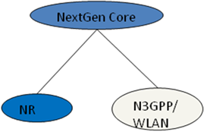
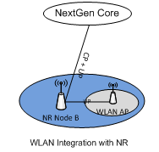
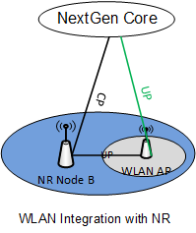
3GPP “NextGen Core” and New RAT (NR)
3GPP is developing a 5G Core Network named as “NextGen Core” and a new 5G “New RAT” (NR)
There may be several candidate architectures by which 802.11 can be integrated into 3GPP 5G network, e.g.
(1) 802.11 WLAN interfaces directly to “NextGen Core”
(2) 802.11 WLAN interfaces with “New RAT” base station e.g. similar to “dual connectivity” architecture used by LWA/LWIP
[see R2-163969]
(3) 802.11 WLAN data plane interfaces with “New RAT” base station, while control plane interfaces with “Next Gen Core”

Slide 5
Integration of 802.11 in 3GPP 5G networks
Different architectures may suit different operator deployments and use cases, e.g.
  Some architectures imply increased load on backhaul
  “Dual connectivity” architectures may not allow for macro coverage if NR base station operates at higher frequency than WLAN
Availability of specifications for the different architectures depends on future 3GPP progress, decisions and specification timeline
  Out of the control of IEEE
Commercial deployment of the different architectures depends on handset vendor roadmaps, cellular infrastructure vendor roadmaps and network operator decisions
  Out of the control of IEEE
Any technical activities for 5G undertaken by IEEE 802.11 should focus on enablers / building blocks / interfaces that are as generic as possible and can be utilized by any architecture.
  Consider gap analysis for any necessary specification work (eg: “802.11 as a component”)

Slide 6
Proposed Relationship Approach Benefits
Builds on existing credibility
Higher chance of success
Lower “cost”
  Less “marketing”/lobbying effort to convince 3GPP/ITU-R
  Fewer venues to track/convince

Slide 7
Strawman to include
Enhanced Mobile Broadband (eMBB) (2.4GHz, 5GHz)
802.11ax, 802.11ac, 802.11n
  802.11ax continues the tradition of 802.11ac and 802.11n for providing service in unlicensed spectrum
Enhanced Mobile Broadband (eMBB) (60 GHz)
802.11ay, 802.11ad, 802.11aj
  802.11ay continues the tradition of 802.11ad for providing service in unlicensed spectrum

Slide 8
Study More Strawman to include
Massive machine type communications (mMTC)
  With several 802.15 technologies already deployed, is it confusing to recommend 802.11ah?
  Should IEEE or 802 have a "bake off" of which single winning technology is recommended to 3GPP?

