Slide 1
IEEE 802 / SA Task Force Report
Paul Nikolich
IEEE 802 Chair
pnikolich@ieee.org

Slide 2
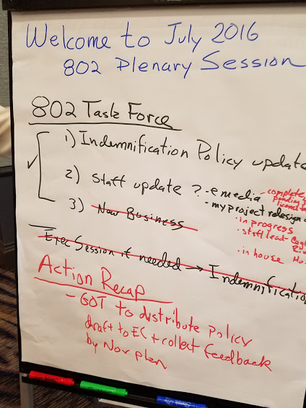

Slide 3
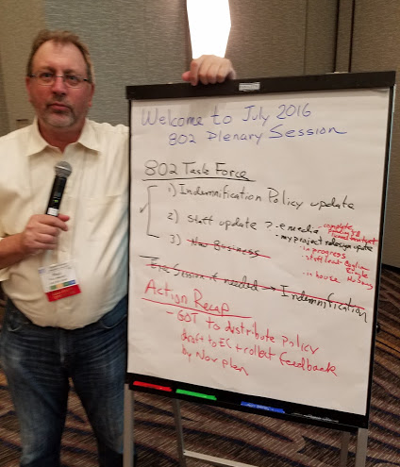
Paul by the IEEE 802 – SA Task Force Report

