Slide 1
Executive Committee Leadership Meeting
Push to Bi-directional Spectrum Sharing
Apurva N. Mody
Chair, National Spectrum Consortium
Chair, WhiteSpace Alliance
apurva.mody@ieee.org
apurva.mody@WhiteSpaceAlliance.org

Slide 2
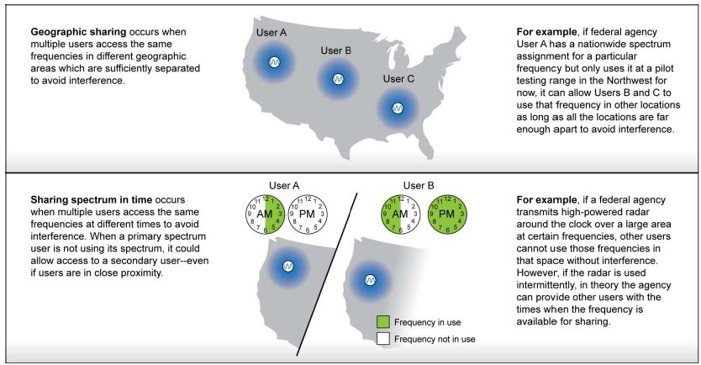
What is Bi-directional Spectrum Sharing
https://www.gao.gov/assets/650/648206.pdf

Slide 3
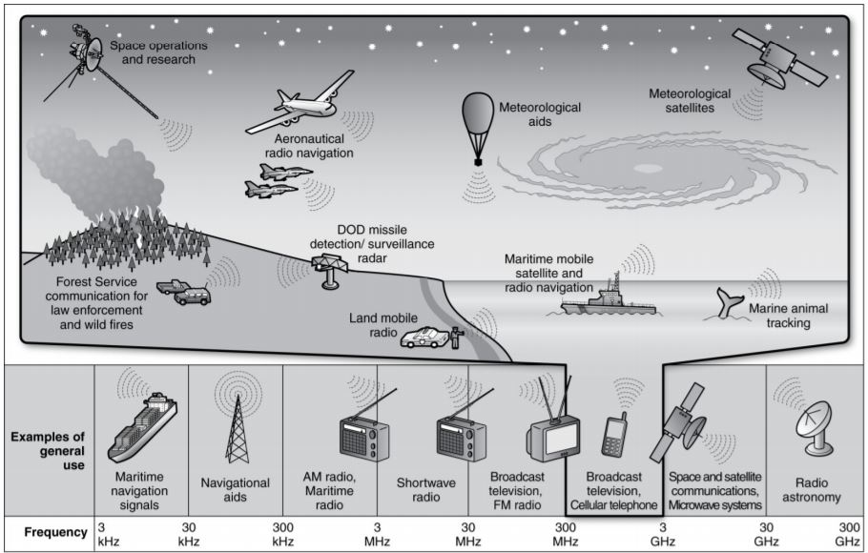
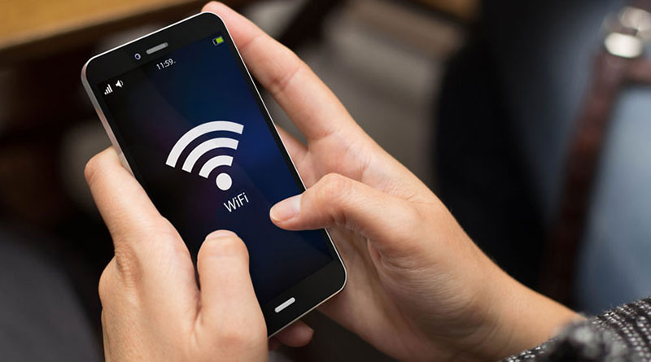
Federal to Commercial Bi-directional Spectrum Sharing
Federal
Commercial

Slide 4
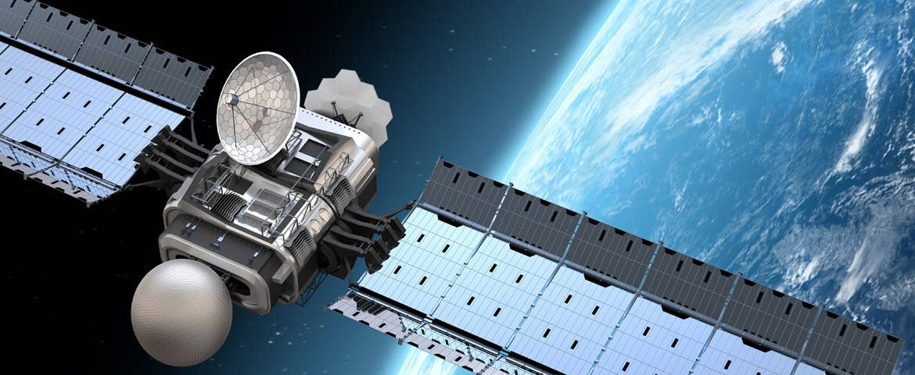
Commercial to Commercial Bi-directional Spectrum Sharing
Commercial 1
Commercial 2

Slide 5
New Technologies and Standards to make this happen
Technologies that assist in improved electromagnetic spectrum awareness, sharing and use
Spectrally efficient communications technologies
Bi-directional spectrum sharing policy and enforcement
  Spectrum Access Systems,
  Automated Frequency Control (FCC 6 GHz NPRM) also known as Dynamic Spectrum Access
  New RF Spectrum Sensing Techniques
Potential to work with licensed stake-holders (as Primary Users) and operate such that IEEE 802 technologies do not create interference to them while sharing the spectrum.

Slide 6
Why IEEE 802 should look into this
Licensed eco-system is already looking into this. AWS-1 and AWS-3 spectrum will result in bi-directional spectrum sharing between LTE networks and Federal systems
IEEE 802 has always thrived on disruption.
We need a new disruptive paradigm and policy whose time has come ……….

