Slide 1

IEEE 802 LMSC
July 2020
124th Plenary Session
(1st electronic Plenary Session)
Draft 01 DCN ec-20-0138-01-00EC

Slide 2
3.0 Participant behavior in IEEE-SA activities is guided by the IEEE Codes of Ethics & Conduct
All participants in IEEE-SA activities are expected to adhere to the core principles underlying the:
  IEEE Code of Ethics
  IEEE Code of Conduct
The core principles of the IEEE Codes of Ethics & Conduct are to:
  Uphold the highest standards of integrity, responsible behavior, and ethical and professional conduct
  Treat people fairly and with respect, to not engage in harassment, discrimination, or retaliation, and to protect people's privacy.
  Avoid injuring others, their property, reputation, or employment by false or malicious action
The most recent versions of these Codes are available at
  http://www.ieee.org/about/corporate/governance

Slide 3
3.0 Participants in the IEEE-SA “individual process” shall act independently of others, including employers
The IEEE-SA Standards Board Bylaws require that “participants in the IEEE standards development individual process shall act based on their qualifications and experience”
This means participants:
  Shall act & vote based on their personal & independent opinions derived from their expertise, knowledge, and qualifications
  Shall not act or vote based on any obligation to or any direction from any other person or organization, including an employer or client, regardless of any external commitments, agreements, contracts, or orders
  Shall not direct the actions or votes of other participants or retaliate against other participants for fulfilling their responsibility to act & vote based on their personal & independently developed opinions
By participating in standards activities using the “individual process”, you are deemed to accept these requirements; if you are unable to satisfy these requirements then you shall immediately cease any participation

Slide 4
3.0 IEEE-SA standards activities shall allow the fair & equitable consideration of all viewpoints
The IEEE-SA Standards Board Bylaws (clause 5.2.1.3) specifies that “the standards development process shall not be dominated by any single interest category, individual, or organization”
  This means no participant may exercise “authority, leadership, or influence by reason of superior leverage, strength, or representation to the exclusion of fair and equitable consideration of other viewpoints” or “to hinder the progress of the standards development activity”
This rule applies equally to those participating in a standards development project and to that project’s leadership group
Any person who reasonably suspects that dominance is occurring in a standards development project is encouraged to bring the issue to the attention of the Standards Committee or the project’s IEEE-SA Program Manager

Slide 5
4.00 IEEE Staff
Michelle Turner role: 802 lead editorial support
title: Managing Editor, Content Production Management
Jonathan Goldberg role: 802 lead
supports dot11, dot15, dot18, dot19, dot21, dot22 groups
title: Operational Program Management Manager
Jodi Haasz role: 802 support
supports: dot01, dot03, dot24, dot16 groups
title: Operational Program Management Manager

Slide 6
5.01 Chair’s Announcements
Seems like we just met a few days ago…
Today, 10 July 2020, is Nikola Tesla’s birthday, born 10 July 1856

Slide 7
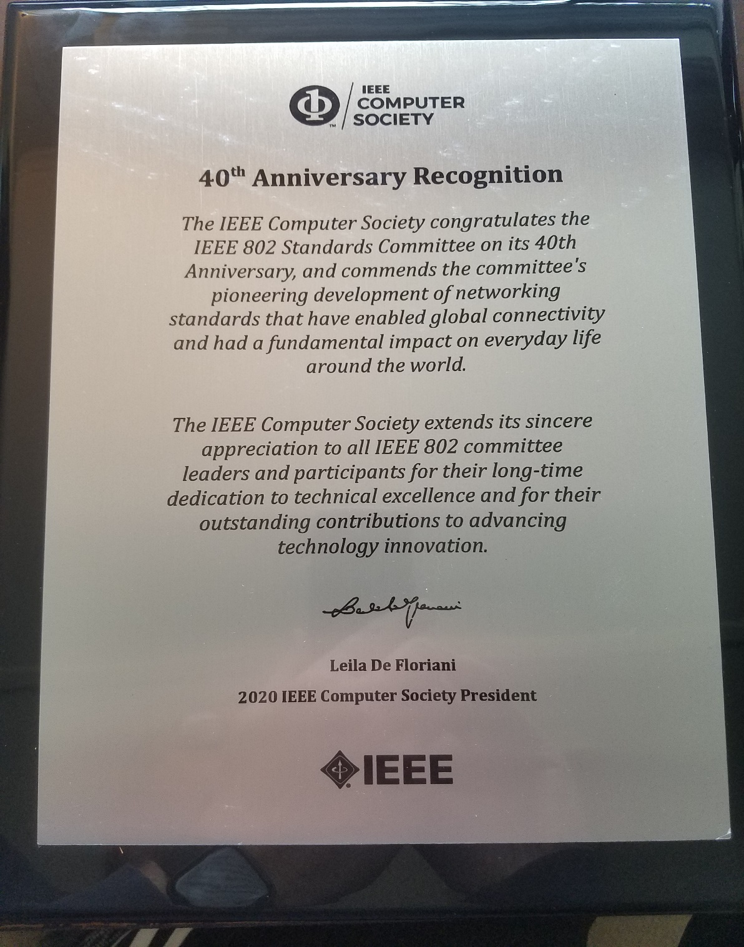
IEEE Computer Society
plaque
in recognition of
IEEE 802 LMSC’s
40th Anniversary

Slide 8
5.01 Chair’s Announcements
Chair’s opening remarks
  Reminder #1: Use IMAT to log your attendance
  Reminder #2: 2020 802 leadership elections/appointments
  Reminder #3 Interim EC meeting scheduled for 04 August 1-3PM ET

Slide 9
5.01 Chair’s Announcements
Leadership Elections: Each WG/TAG to conduct election and report results at closing EC meeting
Nikolich will stand for 802 EC Chair and plans on the following appointments
Potential appointed voting members of 802 Executive Committee
1st Vice Chair: James Gilb
2nd Vice Chair: Roger Marks
Executive Secretary: Jon Rosdahl
Recording Secretary: John D’Ambrosia
Treasurer: George Zimmerman
Potential appointed non-voting members of the 802 Executive Committee
Hibernating 802.16 WG Ch Roger Marks
Hibernating 802.21 WG Ch Subir Das
Hibernating 802.22 WG Ch Apurva Mody
Member Emeritus: Geoff Thompson
Member Emeritus Treasurer: Clint Chaplin
802/Wireless Chairs Standing Cmte: Bob Heile
802/JTC1 Standing Committee: Andrew Myles
802/ITU Standing Committee: Glenn Parsons
802/IETF Standing Committee: Dorothy Stanley
802 Ombudsman: Guido Hiertz
802 Public Visibility Standing Cmte: John D’Ambrosia

Slide 10
5.01 Chair’s Announcements
EC meetings for the plenary
Fri 10 JUL 13:00-15:00 Opening Executive Committee meeting
Mon 13 JUL 17:00-19:00 802/JTC1/SC6 Standing Committee
Wed 15 JUL 14:00-16:00 LMSC Rules Review
Wed 15 JUL 16:00-18:00 802/ITU Standing Committee
Thu 23 JUL 09:00-10:00 802 Chair’s Open Office hour
Fri 24 JUL 12:00-13:00 closing EC agenda prep
Fri 24 JUL 13:00-18:00 closing Executive Committee meeting
no meeting 802/IETF Standing Committee
No meeting Next plenary venue space allocation planning
No meeting Future venue planning

Slide 11
5.02 IEEE Boards updates
SA Standards Board resolutions June 2020
  The SASB will continue to follow-up on the SASB Ratification of the Actions taken by the IEEE 802 LMSC Sponsor in Connection with the 802.11 TGax Complaint until the project completes Sponsor ballot.
  Whereas the IEEE SA Board of Governors has terminated the IEEE SA External Representatives to NFPA as of 31 August 2020, and whereas the Scope of SCC18 will no longer be relevant at that time, the IEEE SA Standards Board hereby disbands SCC18 as of 31 August 2020.
Computer Society BoG & SAB June 2020
  CS BoG resolution unanimously in support of 802/802.3 position regarding IEEE representation at NFPA
SA BoG resolutions April/May 2020
  May: The BOG Ad Hoc Council extended the deadline for the termination of the IEEE SA External Representatives (ERs) to NFPA until 31 August 2020 [from 30 June 2020].
  April: The BOG terminates the appointments of External Representatives to the National Fire Protection Association (NFPA), effective 30 June 2020
IEEE BoD meetings June 2020
  Nothing to report directly relevant to 802 LMSC

Slide 12
5.03 SA Standards Board Actions
Project Authorization Approvals Feb/Jun 2020
New Projects: P802.3cz, P802.3cy, P802.3db, P802.3da, P802.1ASdm, P802.1AEdk, P802.3cw, P802.1f, P802.3cx, P802.16t
Modified PAR: P802.1CS, P802.3ct, P802.15.4z, P802.15.13,
Revisions: P802.1Q
Corrigendum: none
Withdrawals: none
Extensions: P802.15.12, P802.1CQ
Other: none

Slide 13
5.03 SA Standards Board Actions
Standards Ratification Actions Jan/Mar/Apr/Jun 2020
New Standards: P802.3cm, P802.3cq, P802.1AS, P802.15.4w, P802.15.4z, P802.1CMde, P802.1Qcx, P802.3ca, P802.3ch
Revised Standards: P802.1AS, P802.1AX, P802.1X, P802.15.4
Corrigendum: P802.1AE/Cor1
Extensions: none
Withdrawals: none
Other Notes: none

Slide 14
5.04
LMSC Email Ballot Recap
open date topic yes/no/abs/dnv* result
20OCT Approve 802.3 Blog 07/00/00/06 pass
25NOV Approve 802 cmts to ACMA 08/01/00/04 pass
06JAN Approve 802 cmts to Ofcom 10/00/00/03 pass
21FEB Approve 802 cmts to FCC on DSRC 08/02/00/03 pass
05MAR Cancel March 2020 plenary 08/01/02/02 pass
14MAR Approve Nov 2019 minutes 10/00/00/03 pass
20MAR Rescind Nov 2019 motions #8 & #9 10/00/00/03 pass
20MAR Approve 802.3 press releases 08/00/00/06 pass
24MAR Approve 802 reply cmts to FCC on DSRC 01/05/0/07 fail
26MAR Funding for webcon services 09/00/00/04 pass
* 802 chair is counted as DNV unless his vote is required

Slide 15
5.04
LMSC Email Ballot Recap
open date topic yes/no/abs/dnv* result
10APR Approve 802 reply cmts to FCC on DSRC 08/00/0/05 pass
27MAY Approve LMSC OpsMan changes#1 11/00/00/02 pass
04JUN Approve LMSC OpsMan changes#2 07/05/00/01 fail
10JUN Approve July electronic plenary 11/00/00/02 pass
11JUN Approve rules suspension for ICAIDs 11/00/00/02 pass
* 802 chair is counted as DNV unless his vote is required

Slide 16
5.05 EC Affiliation Update
IEEE 802 Executive Committee Members
Position | Name | Affiliation
Chair | Paul Nikolich | Self, HPE, Huawei, Itron, YAS BBV Origin Wireless, Wyebot, octoScope
First Vice Chair | James P. K. Gilb | General Atomics Aeronautical Systems, Inc.
Second Vice Chair | Roger Marks | EthAirNet Associates, Huawei
Treasurer | George Zimmerman | CME Consulting, Analog Devices, Marvell, BMW, Cisco Systems, CommScope, Sen Tekse LLC
Recording Secretary | John D'Ambrosia | Futurewei, a U.S. subsidiary of Huawei
Executive Secretary | Jon Rosdahl | Qualcomm Technologies, Inc.
P802.1 High Level Interface (HILI) | Glenn Parsons | Ericsson
P802.3 Ethernet | David Law | Hewlett Packard Enterprise
P802.11 Wireless Local Area Network (WLAN) | Dorothy Stanley | Hewlett Packard Enterprise
P802.15 Wireless Personal Area Network (WPAN) | Bob Heile | Wireless Communication Consulting, LLC.
P802.18 Radio Regulatory TAG | Jay Holcomb | Itron Inc.
P802.19 Wireless Coexistence | Steve Shellhammer | Qualcomm Technologies, Inc.
P802.24 Vertical Network Applications TAG | Tim Godfrey | Electric Power Research Institute
Member Emeritus Member Emeritus | Geoff Thompson Clint Chaplin | Self, GraCaSI Standards Advisors Self, Samsung Research America
Hibernating Working Groups
P802.16 Broadband Wireless Access | Roger Marks | EthAirNet Associates
P802.21 Media-independent Handover | Subir Das | Perspecta Labs
P802.22 Wireless Regional Area Networks | Apurva Mody | A10 Systems, White Space Alliance

Slide 17
5.05 EC Affiliation Update
Changes in affiliation among EC members from previous slide?

Slide 18
5.06 Drafts to Sponsor Ballot
802.01: none
802.03: none
802.11: none
802.15: P802.15.13
802.19: none

Slide 19
5.07 Drafts to RevCom
802.01: P802E, P802.1Qcr
802.03: none
802.11: none
802.15: P802.15.22.3 possibly
802.19: none

Slide 20
5.08 Draft Documents for EC to consider
802.EC: tbd
802.01: liaisons to 802.3, MEF, BBF, ETG, 3GPP, JTC1, etc.
802.03: liaison to IEC
802.11: none (possibly 3 from JTC1)
802.15: press release for 802.15.4z
802.18: none (possibly 1 or 2 to FCC)
802.19: none
802.24: none
802/JTC1 SC: several liaisons
802/ITU SC: none
802/IETF SC: none
802/Wireless Chairs SC: none
802 Public Visibility Standing Committee: none
20

Slide 21
5.09 Draft PARs to NesCom
P802.1ASdn Amendment: YANG Data Model, PAR and CSD
P802.3 Industry Connections - New Ethernet Applications, Endorsement Letter & ICAID to ICCom
P802.3 Revision (potential)
P802.11ax Amendment: High Efficiency WLAN, PAR Extension
P802.11ba Amendment: Low-power wake-up radio operation, PAR Extension
P802.11bf Wireless Local Area Sensing (SENS), PAR and CSD
P802.22.3 possible extension
P802.15.4/Corr
PAR withdrawal requests:
none

Slide 22
5.10 Pre-PAR activity
Group | New | Existing
dot01 | - Joint work item with SAE proposal (profile of TSN for aerospace) JodiH. | - Industries Connections deliberations on IEEE 802 network enhancements for the next decade..
dot03 | - | ICAID: New Ethernet Applications ad hoc (beyond 400G Ethernet)
dot11 | - | Wireless Sensing (SENS) SG - Advanced Access Network Interface (AANI) Standing Committee - Wireless Next Generation Standing Committee - Random and Changing MAC Address SG (MAC Address and privacy topics)
dot15 | - Japanese rate extension to 802.15.4 | (yet to be named): TeraHertz activity Interest Groups: Vehicle Assisted Technology, Link Dependability SC: IETF/6tisch.

Slide 23
5.10 Pre-PAR activity
dot18 | None. | None.
dot19 | None. | None.
dot24 | None. | None.
dot ECSG | None. | None.

Slide 24
5.11 EC Action Item recap
Review Recording Secretary’s list of Open Action Items

Slide 25
5.12 Identify 802 Task Force Topics
802 Task Force Electronic Meeting Monday17 August 2020 2-3pm ET
  Possible Topics
  Open portion of meeting:
    IEEE SA tools update & discussion
      Remote meeting tools: web conferencing, remote voting, etc.
        802.1 is trialing DirectVote Live for July 2020 elections
      Mentor replacement investigation – status update
      SA to potentially fund Framemaker licenses – status update
    Schedule next meeting (possibly 21 DEC 2020)
    Any other business, 5 min, all?
    Action item review, 5 min, Nikolich
  Closed portion of meeting:
    None at this time
  Adjourn

Slide 26
End of Opening EC Meeting

Slide 27
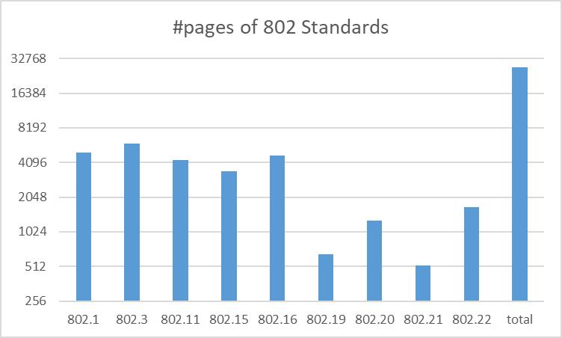
Chair’s Closing Remark
To everyone that has contributed to 802 Standards over almost four decades – well done!

