Slide 1
IEEE 802 LMSC 06 October 2020
802 Executive Committee
Electronic Meeting
DCN ec-20-0196-00EC

Slide 2
1.00 Meeting called to order
      Please use IMAT to record attendance
2.00 Review/approve agenda
2.01 Participation Slide Set URL:
https://ieee802.org/sapolicies.shtml
https://standards.ieee.org/content/dam/ieee-standards/standards/web/documents/other/Participant-Behavior-Individual-Method.pdf
Participant behavior is guided by IEEE Code of Ethics & Conduct
Participants shall act independently of others, including employers
Standards activities shall allow the fair & equitable consideration of all viewpoints

Slide 3
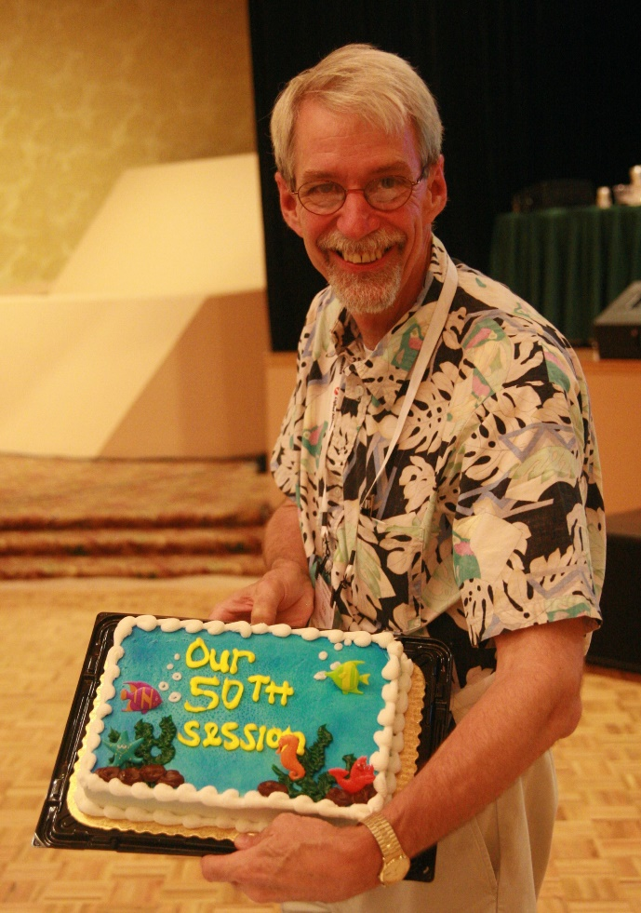
IEEE 802.15 In memoriam: Dr Robert F. Heile
Bob was a contributor to various IEEE 802 WGs since the 1980s in the areas 802.3, 802.11, and 802.15. He was the Chair of IEEE 2030.5 Working Group for Smart Energy Profile, Co-Chair IEEE P2030 Task Force 3 on Smartgrid Communications, Chair of the ZigBee Alliance, and Director of Standards for the Wi-SUN Alliance. Bob was heile active in the wireless community and globally regarded for his expertise and evangelism of mesh networks.
He will be missed by many for his guidance, expertise, and friendship.
Our deepest condolences to Bob’s family: his wife Bonnie and daughters Sarah and Beth.
May he rest in peace (but I really think he’s going to be active in other arenas).

Slide 4
Top 10 Reasons for Bob Not Attending the 2013 Geneva Plenary Session.
There was a part of Bob that was very private, and he kept his illness a secret from most people starting with the Geneva session. This mystery caused many in the WG to speculate why he wasn’t there. Clint Powell captured the top ten reasons for his absence…

Slide 5
10. Forgot to register early
9. Didn’t want to take the heat for Nanjing...or fall out from Geneva
8. Didn’t want to take anymore heat on Okinawa
7. American Airlines frequent flier miles roll-over after 10M
6. Wanted internet connectivity
5. Fell behind in his yodeling lessons
4. Didn’t want to miss the East Coast Hurricane Season
3. No (free) coffee at breaks
2. Wanted to tick off Pat and make sure he never wants to Chair the WG
1. Suddenly had an epiphany -“This wireless #&^% just don’t work”

Slide 6

So Long and Thanks for All the Fish!

Slide 7
3.00 Chair’s Announcements
Please use IMAT to record your attendance
November 2020 plenary schedule layout
(see next slide)

Slide 9
3.03 Monthly EC telecons
Continuation of monthly 1-3pm ET 802 EC telecons on the 1st Tuesday of each month, unless otherwise notified.
Remaining 2020 schedule: 01 Dec.
2021 schedule:
05 Jan., 02 Feb., 02 Mar., 06 Apr., 04 May, 01 Jun., 06 Jul., 03 Aug., 07 Sep., 05 Oct., 02 Nov., 07 Dec.

Slide 10
3.04 Elimination of Ombudsman role
The IEEE SA is unable to grant complete confidentiality to the 802 Ombudsman role.
In order not to mislead anyone that complete confidentiality is provided by the 802 Ombudsman, the role is eliminated.
Regardless, all 802 leaders have always been open to anyone expressing concerns and to help resolve them, we shall continue this best practice in lieu of the 802 Ombudsman
Thank you to Guido Heirtz for his service.

Slide 11
3.05 802 Leadership Appointments
As announced by my 18 Sept. 2020 email:
  Appointed: Pat Kinney to serve as Temporary 802.15 WG Chair and Rick Alfvin to serve as Temporary 802.15 WG Vice Chair until elections can be held sometime within the next six months.
  Appointed: Dorothy Stanley to serve as the Wireless Chairs Standing Committee Chair.

