Slide 1

IEEE 802 LMSC
01DEC 2020
Electronic Meeting
1-3pm ET
DCN ec-20-0249-01-00EC

Slide 2
1.00 Meeting called to order
2.00 Review/approve agenda
2.01 Participation Slide Set URL:
https://ieee802.org/sapolicies.shtml
https://standards.ieee.org/content/dam/ieee-standards/standards/web/documents/other/Participant-Behavior-Individual-Method.pdf
Participant behavior is guided by IEEE Code of Ethics & Conduct
Participants shall act independently of others, including employers
Standards activities shall allow the fair & equitable consideration of all viewpoints

Slide 3
3.00 Chair’s Announcements
Reminders
  Reminder #1: Use IMAT to log your attendance
  Reminder #2: Please enable mute when you are not speaking
  Reminder #3: Please use the Chat function to request being put in the queue
  Reminder#4: Interim EC meeting scheduled for 05 JAN 2021 2 hours

Slide 4
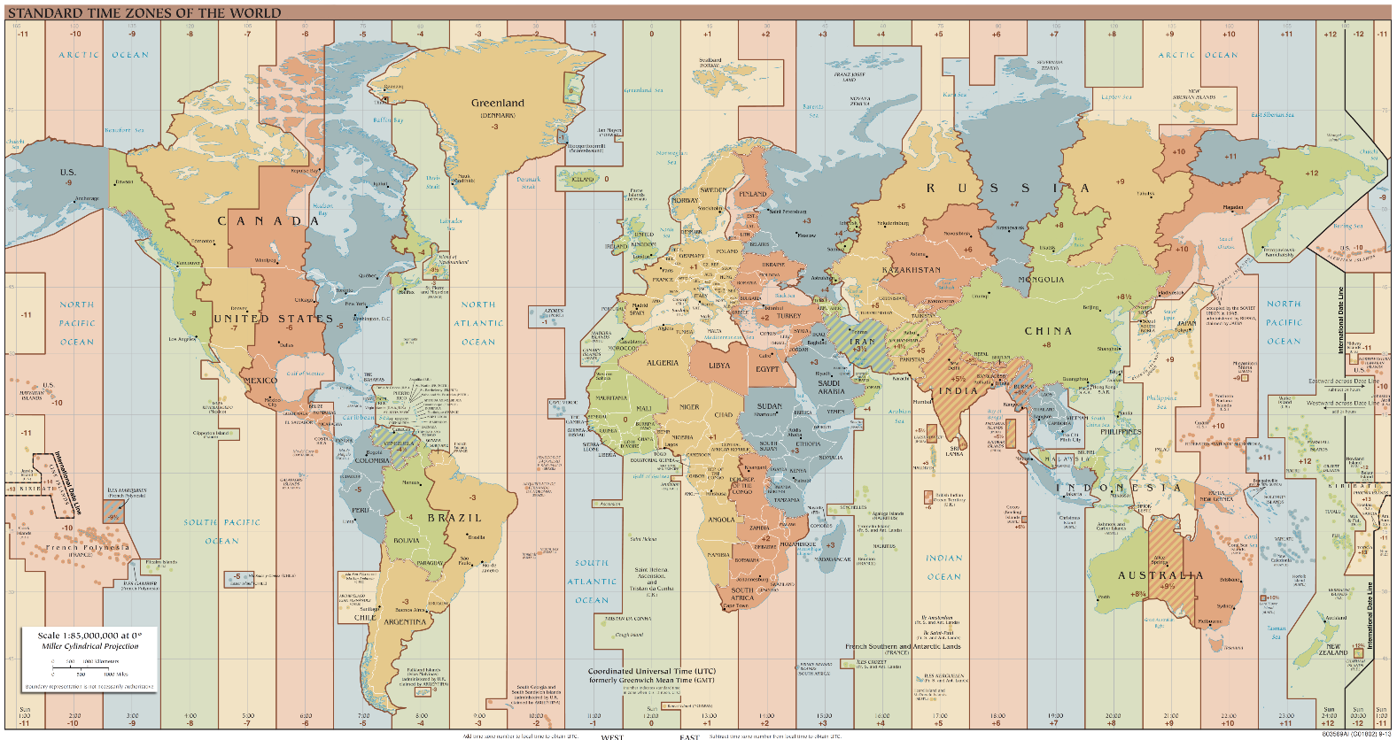
3.01 Rotating time of monthly EC call
The monthly 802 EC calls have been scheduled for 18:00-20:00 UTC on the first Tuesday of each month
In consideration of the fact 802 EC participants live in a wide range of time zones, there is a proposal to rotate the start time of the calls
Draft Proposal
  Rotate across three start times
  Feedback?

Slide 5
3.03 802 ad hoc to evaluate restructuring options
Restructuring objective – increase efficiency and responsiveness of 802 LMSC
  Give WGs and TAGs more autonomy
    Submit PARs and completed draft standards directly to Standard Board for approval.
    Meet independently whenever, wherever and however is best for their participants. One “All-802” gathering per year.
    Consider converting well established WGs to Standards Committees.
  Re-charter the 802 Executive Committee
    Established 40 years ago, the 802 EC is subject to significantly different volunteer, market and technology drivers in 2020.
    Less direct operational oversight responsibility – let the WG/TAG manage themselves.
    Become more strategic, less operational – more akin to a Board of Directors.
    Focus on long term growth, fostering new work, high level interactions with external organizations and public visibility.
Next Steps
  Solicit input via EC reflector
  Hold 1 hour meetings at least once per month, report out status each plenary
    1st meeting scheduled for 13:00-14:00 ET 15 DEC 2020
  Deliverable: a well vetted and socialized recommendation for EC consideration within 12 months.

Slide 6
3.03 802 ad hoc to evaluate restructuring options
Ad Hoc membership
  Nikolich to chair.
  Any 802 EC Member indicating interest eligible to participate
  Plus one additional member per WG/TAG as designated by the WG/TAG chair
Draft Agenda
  Discuss, refine and agree on the scope of the ad hoc: consider the pros and cons of various restructuring options
  Agree on 1 hour meetings at least once per month for 2021, (with rotating times to maximize convenience across multiple time zones)
  discuss the proposed deliverable: a well vetted and socialized recommendation for EC consideration within 12 months

Slide 7
3.03 802 ad hoc to evaluate restructuring options
EC Comments to date
  Steve: suggests adding specifying what problem(s) we are trying to solve
  Clint: suggests that yes, we have been productive in the way we have done tasks and work in the past, but do we know that our current processes and procedures are the best way? Perhaps something new might indeed help us more...
  George:
Steve, I think you’ve put your finger on the main delay I see, but it is less a delay of the EC and more a delay in how the WG’s interact to review PARs, i.e., the WG PAR review process. The EC could theoretically approve PARs at any meeting (probably would require a simple rules change), but the input/feedback process to provide review by other WGs only happens during a plenary cycle.
I think this highlights the main restructuring issues, which relate to working-group interaction-
- On what issues do we feel it is important to have cross-working group collaboration
- On what issues do we feel it is important to have cross-working group review
- On what issues do we need an executive ‘steering function’ to resolve differences or allocate work within the working groups? [or, conversely, if we don’t have an EC steering function, what conflicts emerge]
and, with those in mind, what is the most efficient structure and process to accomplish it.

Slide 8
3.05 EC Action Item recap
Review Recording Secretary’s list of Open Action Items

Slide 9
6.01 Identify 802 Task Force Topics
802 Task Force Electronic Meeting scheduled for Monday 21 December 2020 2-3pm ET
Draft Agenda
  Open portion of meeting:
    IEEE SA tools update & discussion
      Remote meeting tools: web conferencing, remote voting, etc.
      Mentor replacement investigation – status update
      SA to potentially fund FrameMaker licenses – status update
    Schedule 2021 meetings (possibly 29MAR, 21JUN, 27SEP, 13DEC)
    Possible item from Public Visibility Standing Committee
    Any other business, 5 min, all?
    Action item review, 5 min, Nikolich
  Closed portion of meeting:
    None at this time
  Adjourn

Slide 10
6.02 Substitute Chair’s Guideline Text for Ombudsman
Substitute text for an Ombudsman Guideline
  Consider adding a new subclause 2.16 “Addressing Participants Concerns”
  Provides guidance to 802 participants and 802 officers
  https://mentor.ieee.org/802-ec/dcn/20/ec-20-0236-00-00EC-addressing-participants-concerns.docx
Next Steps
  Request review by 802 EC colleagues
  Collect comments, revise as appropriate, once consensus is achieved, submit for 802 EC approval

Slide 11
Adjourn EC Meeting

