Slide 1
IEEE 802WCSC Meeting Venue Manager Report
Date: 2021-09-01
Authors:
Notes:
R2 was created during discussion with MTG Events after the Wireless Chairs Meeting on Feb 11.
R3 – Mar 3 802 WCSC telecon
R4 – May 5 802 WCSC Telecon –
R5 – May 5 802 WCSC Telecon - - Updated with Motion information during the telecon.
R6 – July 7 802 WCSC Telecon
R7 – July 7 802 WCSC Telecon – Updated with Motion information during the telecon.
R8 – Sept 1 802 WCSC Telecon
R9 – Sept 1 802 WCSC Telecon – Updated with Motion information during the telecon.

Slide 2
Abstract
Current Status of 802 Wireless Interim Session venue plans as of September 1, 2021.

Slide 3
Future Venue Status – Sept 1, 2021
2021-09 802W Electronic Interim
2022-01 Panama – Contract with IEEE – Discussion Today (Sept 1)
2022-05 Warsaw
2022-09 Waikoloa, HI
2023-01 Baltimore, MD
2023-05 open – TBD – Target Asia Venue (Osaka?)
2023-09 Atlanta – Buckhead, GA
2024-01 Irvine, CA – Venue has cancelled
2024-05 open – TBD – Target Europe
2024-09 Waikoloa, HI
MTG Events has Starred Venues
Notes:
Future Wireless Interim Meetings: review and status Sept 1, 2021
Jan 16-21, 2022, Hilton Panama – contract in negotiations – Hotel Irvine contract moving to 2024 in process.
May 15-20, 2022, Warsaw Marriott– Contract executed, in repository (802WFIN-20/22r0)
Sept 11-16, 2022, Hilton Waikoloa Village– Contract executed, in repository (802WFIN-20/32r0)
Jan 15-20, 2023, Baltimore Marriott Waterfront – Contract executed, in repository (802WFIN-20/18r0)
May 2023 - open
September 10-15, 2023, Atlanta Buckhead – Contract executed, in repository (802WFIN-21/1r0)
Jan 2024 – Hotel Irvine – Contract in the final signature process (May 2021 – 802WFIN-21/17r5)). – VENUE CANCELLED
May 2024 Open
Sept 2024 Hilton Waikoloa Village – Contract executed, in repository (802WFIN-20/12r0)
Sept 2025 Hilton Waikoloa Village – Approved March 2020 by 802WCSC – in negotiations
Sept 2026 Hilton Waikoloa Village – Approved March 2020 by 802WCSC – in negotiations

Slide 4
2022-01/2024-01 - Hotel Irvine
We had a contract in place for January 2022.
  This was cancelled due to Pandemic and a possible replacement of Panama selected (deferred from May 2021).
Contract was sent IEEE for changing to 2024 and executed May 2021
  Subsequently, the Hotel has notified us that they are closing and being sold.
  They are formally cancelling the contract.
  We are working with the IEEE Emergency Response Team and MCE to negotiate the potential penalties for the Hotel Irvine.
  This leave open 2024 January for another venue.

Slide 5
2022-01 Hilton Panama
Working with Mtg Events and the hotel for planning and contract.
Initial Contract room block, and meeting space plan is underway.
IEEE Contract Legal Review and Execution in process.
This could complete immediately but was put off until after today (9-1-2021) for Wireless Chairs Discussion.
See later slides.

Slide 6
2025 Sept and 2026 Sept Interim
One of the last set of Contracts that Bob worked on was to book the Hilton Waikoloa Village – This action was approved during the March 2020 by 802WCSC –
The Hotel Contact reached out to find out the status.
We are in negotiations to close the contracts.
Sept 2021 – Still working to execute the contract.
Expected close before end of 2021. (delayed)

Slide 7
Open Dates – as of Sept 1, 2021
May 2023 (Asia)
January 2024 (NA)
May 2024 (Europe)

Slide 8
2022 January 802 Wireless Interim
Location: Panama Hilton, Panama City, Panama

Slide 9
Items to Consider
Safety of Attendees
Travel authorizations from/to Countries
Travel authorizations from Companies
Number possible to attend
Social Distancing impacts on meeting space.

Slide 10
Discussion - Panama City, Panama
Panama is open to all travelers vaccinated and non-vaccinated.
  Passengers traveling to Panama must comply with certain requirements related to COVID-19 test, quarantine and forms detailed in the sections shown below.
  Medical insurance is not a requirement in Panama but is highly recommended.
  Sources of information:
    IATA
    UNHCR - UN Refugee Agency

Slide 11
Local Restrictions
The following measures are currently in place (9-1-2021):
Restaurants and businesses will be able to extend their opening hours until 11:00 p.m. The schedule for beaches, rivers and spas will be 6:00 a.m. to 6:00 p.m. everyday. Bars with outdoor terraces will be allowed to open.
Cinemas may open at 50% of their capacity while keeping the appropriate health measures.
It is possible to hold seminars, forums, congresses, conventions, exhibitions and training sessions with a capacity of 25% of the venue's capacity in Panama, Colon, Panama Oeste, Herrera and Los Santos.
Presentations of local musical groups may be held in restaurants, restaurant-bars, authorized bars and other premises that allow these activities to be held with an audience of up to 25%, following the pertinent health measures.
Sources of information:
Executive Decree 828
UNHCR - UN Refugee Agency
COVID-19 Bulletin CCIAP | Decrees

Slide 12
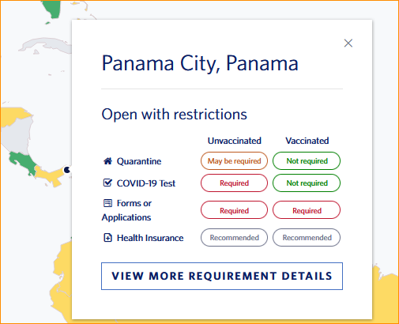
Travel Status as of 9-1-2021
Connection from destinations may apply specific regulations.

Slide 13
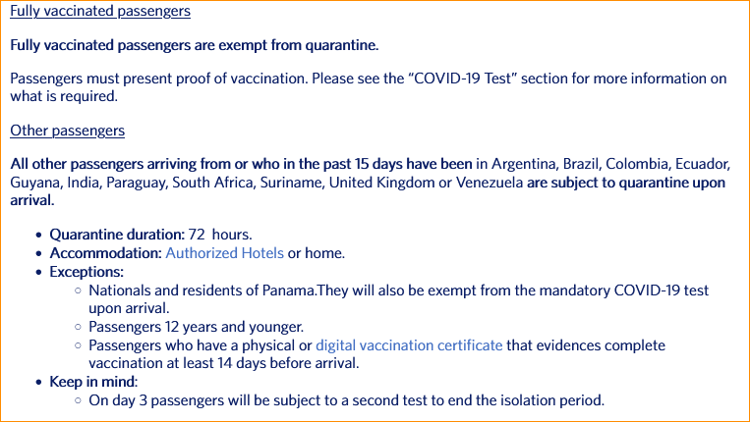
Quarantine:

Slide 14
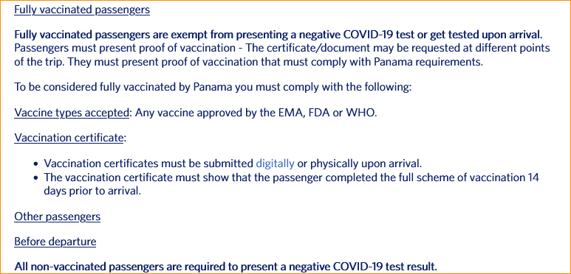
COVID-19 Test Requirements

Slide 15
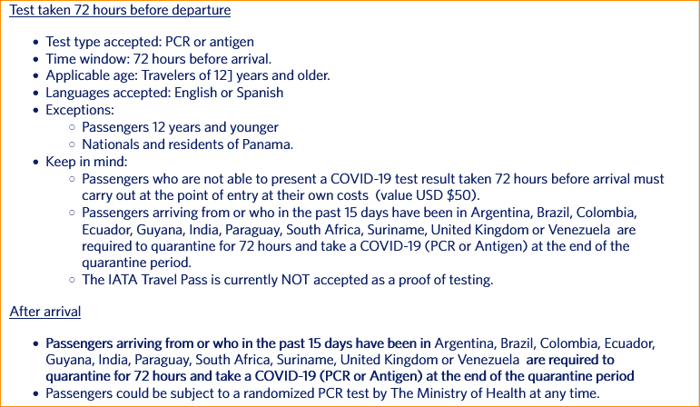
COVID-19 Test Requirements (cont)

Slide 16
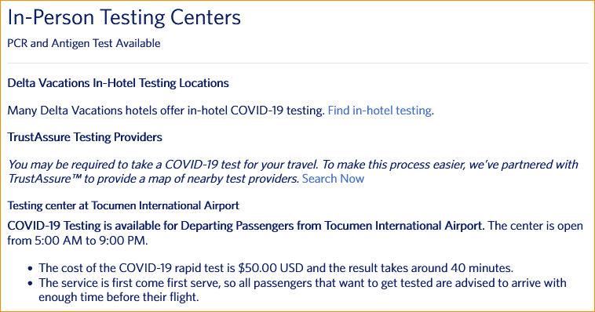
COVID-19 Testing options

Slide 17
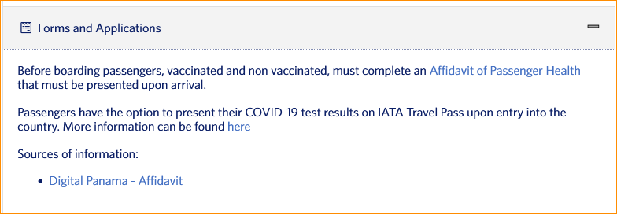
Forms and Applications

Slide 18
Panama Information Resources
Sources of information:
  IATA
  UNHCR - UN Refugee Agency
  Ministry of Health of Panama | Executive Decree No° 833
  Digital Panama – Affidavit
  Executive Decree 828
  UNHCR - UN Refugee Agency
  COVID-19 Bulletin CCIAP | Decrees

Slide 19
Straw Poll Results:
802.11: 90/140/13
802.15:
802.18: 15/19/1
802.19: 12/17
802.24:
Total: 107 possible – 61% of expected minimum
Expected Minimum Attendance:
  802.11: 175
  802.15: 45
  802.18: 20
  802.19: 10 (15-20 typical attendance)
  802.24: 7 (5-7 typical)

Slide 20
Some comments received
My company policy is travel to group events are not permitted until January 22 at the earliest, I cannot commit to January travel at this time
With all the new delta cases and unclear quarantine requirement, International travel in January 2022 still looks unlikely.
Currently Panama is on the UKs red list of countries and the guidance is that UK residents should not travel there. There are test and quarantine complications for travel to Panama. (Note the USA is listed as Amber)
Travel is based on company policy. At present travel is restricted. It is not clear if this travel restriction will be removed on or before Jan 2022.
Unsure – today unlikely – in January unknown.

Slide 21
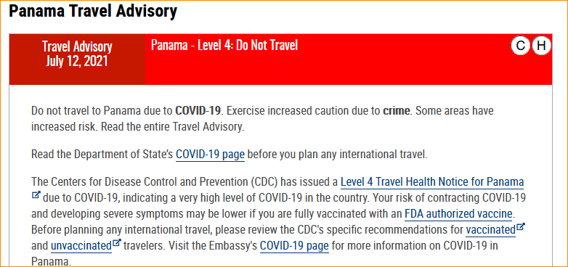
US Department of State (Travel.State.Gov)

Slide 22
Visit Panama -
https://www.visitpanama.com/information/travel-guidelines/
SAFETY GUIDELINES FOR YOUR NEXT TRIP TO PANAMA
Panama is open to international travelers, keeping the safety and health of both tourists and locals our top priority.
Visitors from all countries are welcome to visit Panama, however, a negative COVID-19 test is required for entry for non-vaccinated travelers. For more information on entry requirements as well as per country restrictions, please refer to the “Prior to Traveling” section.
Non-vaccinated travelers arriving from or that have transited through High Risk countries in the last 15 days will be required to take an additional COVID-19 test upon arrival and quarantine for 72 hours in a hotel, and the cost of the stay must be fully covered by the traveler. However, travelers arriving from these countries that can present a complete vaccination scheme, equal to or greater than 14 days after the last dose, will be exempt from the 72-hour quarantine. For more information on these restrictions and country list, click here.
Currently, mobility restrictions are in place as well as mandatory curfew at night time. Please refer to the “Getting Around” section for more information
Last updated on August 31, 2021
Protocols will be updated on an as-needed basis.

Slide 23
My Recommendation
Postpone going to Panama:
  Change contract under negotiations now to be January 2024
Make January 2022 802 Wireless Interim
  Electronic
  Consider new Attendance Credit designation.

Slide 24
802WCSC Motion 2021-09-01-01
Whereas the ongoing restrictions of the COVID-19 Pandemic has impacted the ability to hold a viable in-person meeting in January 2022, (Attendees not able to travel, less than 47% potential minimum attendance, Travel Restrictions, Space available).
Move to Cancel the 2022 January 802 Wireless Interim at the Hilton Panama, Panama City, Panama, in person event.
Moved: Jon Rosdahl
Second: Stephen McCann
Results: Approved by Unanimous Consent (14 Members of 802WSC)

Slide 25
802WCSC Motion 2021-09-01-02
Whereas the 802 Wireless treasury has been funding costs associated with supporting 802 Wireless activities (session contracting costs - both in person and electronic, group costs, etc.) from the reserves without any income for the past 18 months,
Move to hold the 2022 January 802 Wireless Electronic Interim with a meeting fee of USD$50 payable 15 days prior to start and USD$75 until the start of the Interim Session, and USD$125 thereafter.
Moved: Jon Rosdahl
Second: Ben Rolfe
Results: Approved Unanimous Consent (9 - 802W Executive Committee members)

Slide 26
802WCSC Motion 2021-09-01-03
Approve Panama Hilton – January 2024
Move to approve the Panama Hilton, Panama City, Panama as the venue location for the 2024 January 802Wireless Interim.
Moved: Jon Rosdahl
Second: Rick Alfvin
Results: Approved 11-0-3 (14 Members of 802WSC)

Slide 27
References
https://www.delta.com/us/en/travel-planning-center/find-your-destination/explore-top-destinations?mkcpgn=EM_MKTG_TNUP_CL_210830_AA900989_A01A_P0_DDM
https://travel.state.gov/content/travel/en/traveladvisories/traveladvisories/panama-travel-advisory.html
https://www.visitpanama.com/information/travel-guidelines/

