Slide 1
IEEE 802 July 2021
Public Visibility
Standing Committee Report
IEEE 802 Jul 2021 Plenary
Opening Mtg – 09 July 2021

Slide 2
Agenda – Wed, July 21
Time: 3pm to 4:00pm ET, Meeting Info
Agenda
  Review of Social Media Stats
  Public Visibility Metrics
  Future Tech Talks
  Preparations - Ethernet 50th Anniversary in 2023
  Other content

Slide 3
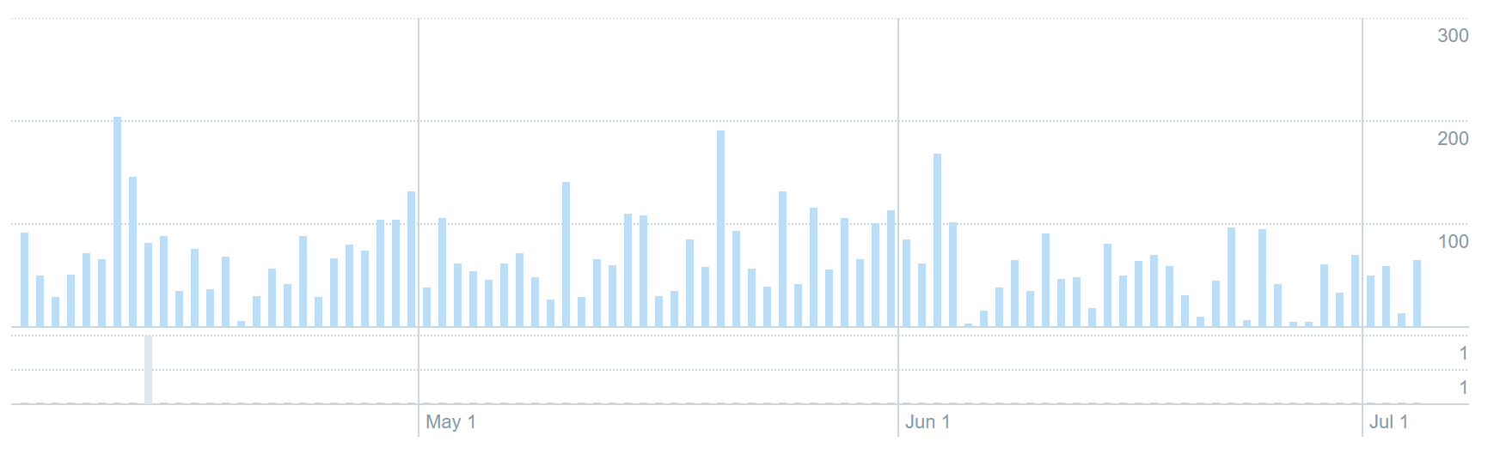
Social Media Related Tools
Twitter
Twitter (@IEEE802)
  216 followers
  Last 90 days (Apr 5 – Jul 6)
    6k impressions
LinkedIn
  229 followers (+21% since Mar 21)

Slide 4
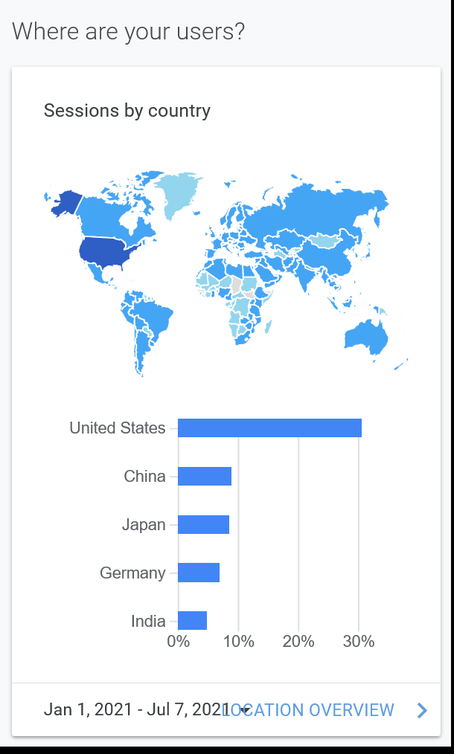
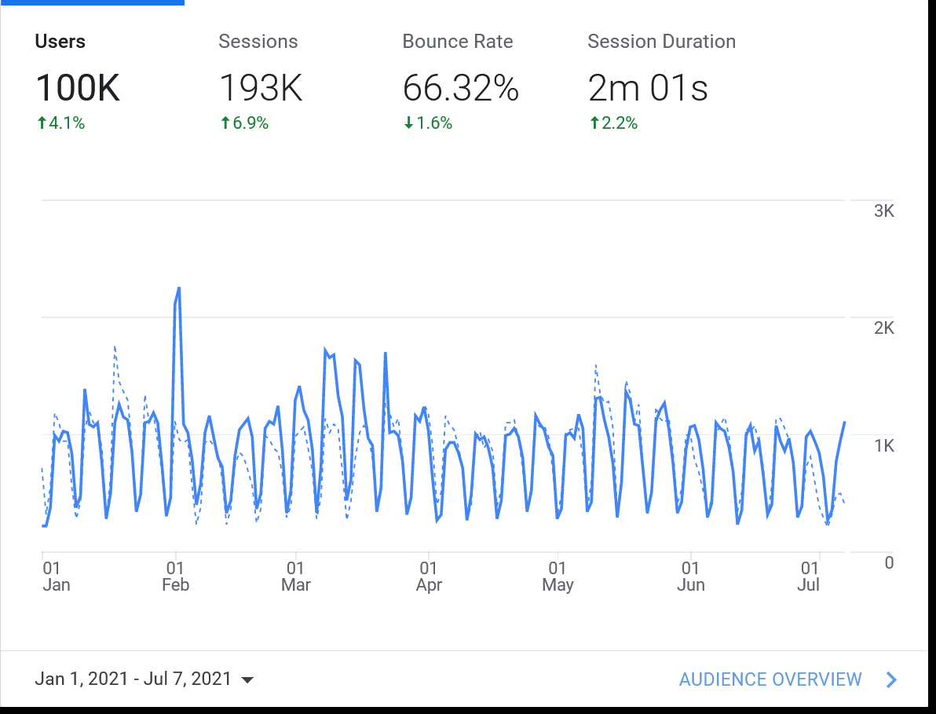
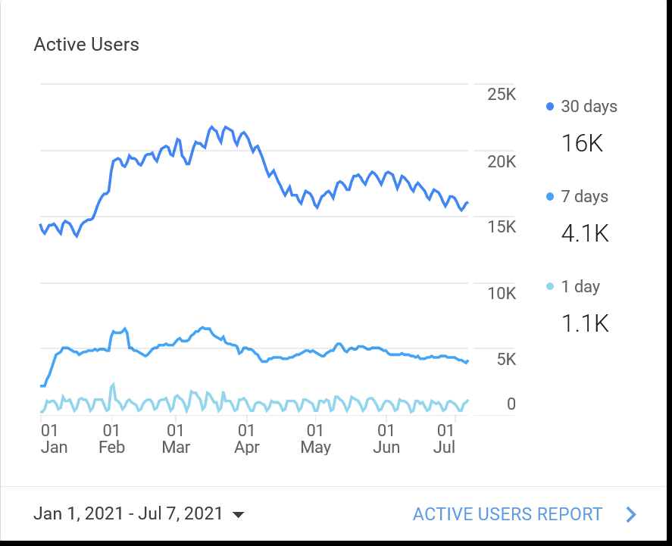
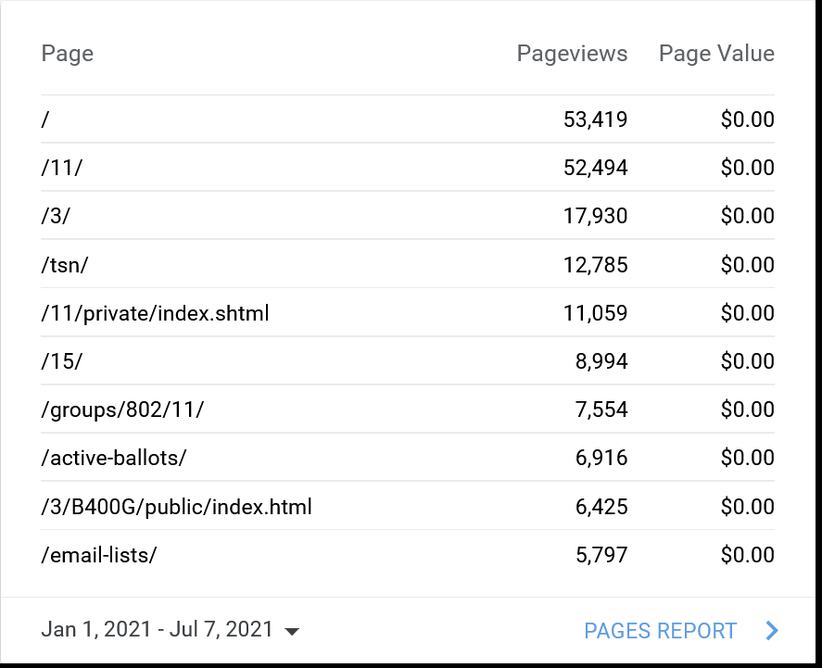
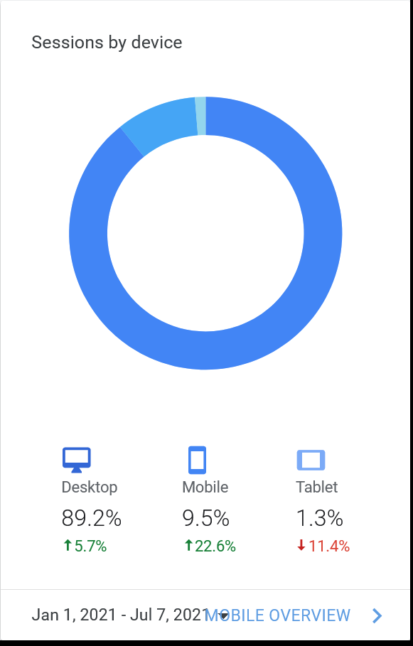
Google Analytics 802 (Jan 1 – Jul 7, 2021)

Slide 5
Content Efforts - IEEE EA Tech Talks
Reference - https://innovationatwork.ieee.org/events/techtalk-panel-802/
    Recordings of Tech Talks available at above URL
Past Talks Views as of 7/7
  IEEE 802: Connecting the World Views - 434
  Ethernet Broadband Assessment Views - 154
  Industrial Ethernet Views – 116
  WLAN Sensing (Hanxiao, Da Silva) Views - 146
  IEEE 802.22: TV White Space (Mody) Views - 98
  IEEE 802.3: State of Ethernet (Law) Views - 181
  IEEE 802.18: 802 and the Regulatory World (Holcomb) Views – 89
  IEEE 802 & 802.24 (Godfrey) Views – 105
  IEEE 802.11: State of Wireless (Stanley) Views – 120
Preparations for new 2021- 2022 series underway

Slide 6
Closing Report Update
Review of social media stats
  Are these the right stats?
  What do they mean?
  Are we measuring the right thing?
  Some things require manual analysis between multiple systems
What are trends we want to measure?
  Exposure of 802 to potential stakeholders
  Conversation rate to new meeting attendees
    IMAT Analysis starting July 2020?
  1st Time visitors on 802 website
Review / discussion of future tech talks – IEEE 802 Next Gen Efforts
Potential for PV SC to communicate potential speaking opportunities on IEEE 802 efforts
Opportunity for PV SC to develop public visibility “campaign” on Ethernet 50th
  Messaging Opportunities?
  Funding?

Slide 7
Backup

Slide 8
802 Public Visibility SC Scope, Duties, Membership
  Scope and Duties
  To raise industry awareness in timely fashion of IEEE 802 WG / TAG activities
  Develop social media content based on IEEE 802 WG / TAG activities
    Twitter - https://twitter.com/ieee802
    LinkedIn – https://www.linkedin.com/company/ieee802
    IEEE-SA 802 - https://standards.ieee.org/featured/802/index.html
  Content
    Review Pre 802 Plenary meetings for social media messaging: PARs to be considered, Tutorials, [802.3] Call-for-Interests, New Task Force formations
    Review Post 802 Plenary meetings for social media messaging: Study Group formations, IEEE 802 Position Approvals
    Other 802 related material for social media messaging: Press Releases, White Paper publications, Other 802 approved news, 802 WG / TAG Activities with IEEE-SA
    IEEE-SA Standards Board Related - PAR Approvals, Standards Approval, Standards Publication,
  Membership
  Membership in the Standing Committee is open to anyone that wishes to participate (ideally at least one participant from each 802 WG and TAG)

