Slide 1


Registration and Event Delivery Platform
Prepared by MTG Events

Slide 2
MTG’S Registration and Event PLATFORM
MTG’s registration software (EventsAIR) now has the ability to provide the capability to create fully Virtual or Hybrid Meetings via the OnAIR platform
Unified solution for in-person, virtual and hybrid
EventsAIR has been delivering the back-end to events for over 20 years
Secure with GDPR Toolkit and PCI Compliant
Integrated registration, attendee management and event delivery in the one software

Slide 3
OnAIR Virtual Event Delivery Capabilities
Ability to run 10+ concurrent sessions, which can be grouped in Streams/Themes
Attendees can ‘Favourite sessions’ to create personalised itinerary
Individual presentations, panel discussion, group collaborative discussions
Mix pre-recorded, live content from any location
AV style ability to mix, blend and combine content
Combine in-person and remote speakers
Integrated Q&A, discussion forum, polls - all of which are available for online attendees as well as in-person attendees at the same time
Ability to stream via multiple streaming platforms
Virtual Attendees can still network via the Meeting Hub or publish a comment on
the EventStream, knowing content stays within the platform

Slide 4
OnAIR and Hybrid Event Delivery Capabilities
Input speakers via a laptop webcam, venue AV or invite any attendee to join as a speaker
Sessions can be configured for single presenter, panel discussion, breakout rooms or large group discussions or even link to external.
Manage access to sessions to ensure only those that should be there can see the session, including the setup of private meetings
Live Support available through the platform
Integrated functionality across mobile and online to provide equal access to online and in-person attendees.

Slide 5
Registration and Event Delivery Platform
OnAIR Example

Slide 6
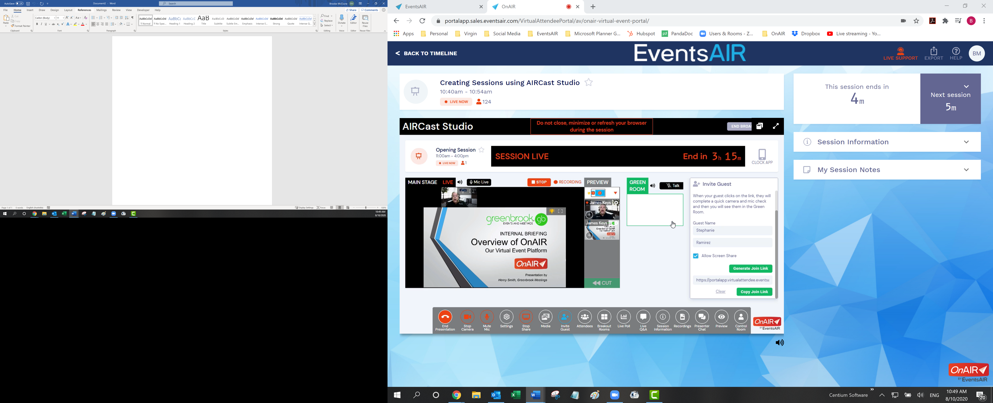
Live Support
Invite guests
Mix speakers
And content
Toolbox of functionality

Slide 7
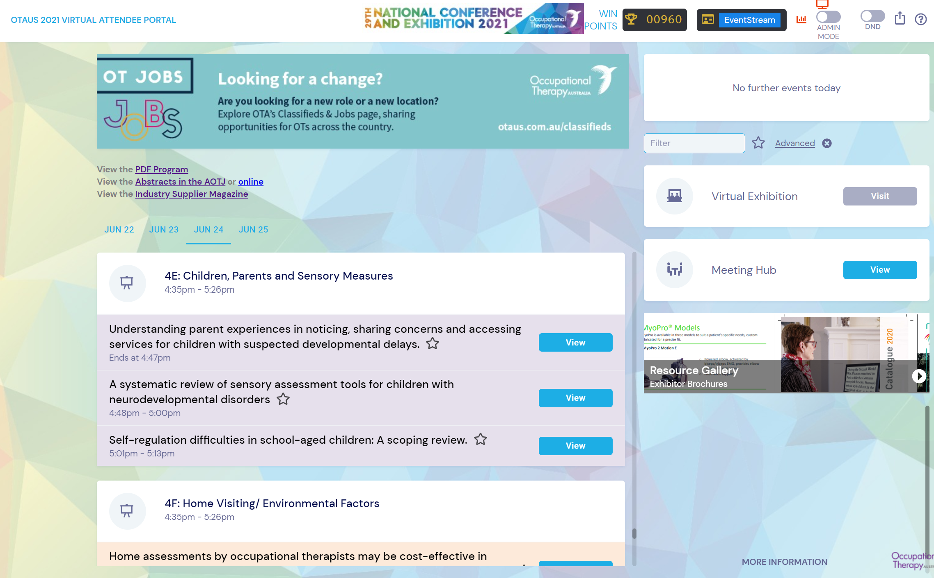
Customisable banners
Filter to only see desired sessions
Link to external content
Meet with fellow attendees
Build agenda across multiple days
Group sessions
Share content (still or video) with others to peruse, review and comment
Colour code
Themes/streams

