Slide 1
802 Wireless Groups Overview
Date: 2022-05-06
Authors:

Slide 2
Abstract
This document contains background information on IEEE standards development, IEEE 802 LAN/MAN Standards Committee and the Wireless subgroups.
R1: Slide 8 format edits

Slide 3
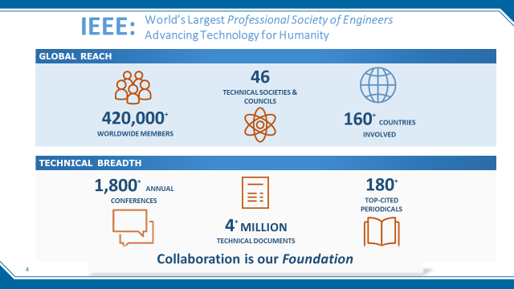
IEEE and opportunities for global participation, see https://www.ieee.org/
Notes:
IEEE is the worlds largest professional society of engineers, dedicated to advancing technology for global participation.
Description of items in the graphic.
IEEE includes standards development, educational programs, conferences and more. Data is pre-Covid.

Slide 4
Standards development within IEEE
May 2022
IEEE MEMBERS
Board of Directors (BOD)
Exec Director & Staff
Technical
Activities
Publication
Activities
Standards Association
Board of Governors (BOG)
Member & Geographic
Activities
Educational
Activities
IEEE USA
SA Managing Director & Staff
Computer Society
Stds Committee
Power & Energy
WG
WG
Stds Committee
Strategic Management and Delivery Committees (SMDCs) (8)
WG
WG
WG
Standards Board
(SASB)
Corporate Advisory Group (CAG)
Nominations & Appointments Committee (N&A)
Communications Society
Stds Committee
WG
Stds Committee
WG
WG
WG
Administrative Committee
(AdCom)
Audit Committee
(AudCom)
Patent Committee
(PatCom)
Procedures Committee
(ProCom)
New Standards Committee
(NesCom)
Standards Review Committee
(RevCom)

Slide 5

IEEE Standards Association
May 2022
Individual membership
Maintaining
the Standard
Initiating the
Project
9,000 individual members in 90 countries
Corporate Memberships
Gaining Final
Approval
Mobilizing
the Working Group
  400 member corporations in 23 countries
Standards Developers
Balloting the
Standard
Drafting the
Standard
  ~20,000 participants;
  all interested parties are welcome
Notes:
This slide summarizes the IEEE standards association membership and development process.
IEEE Society Standards Committees propose new projects, and projects are developed according to the chart on the right.
Describe the chart.

Slide 6
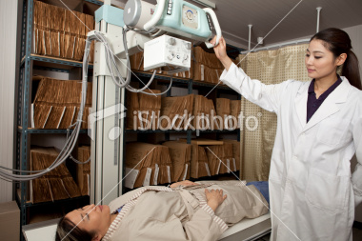
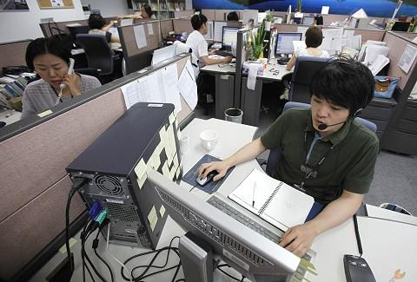



Standards Improve Quality of Life
Standards are integral to the mission of IEEE
  Deliver technology to the marketplace
  Benefit humanity
  The development of technical standards and related activities enables and promotes the collaborative application of technical knowledge to advance economic and social well-being
Notes:
Standards are critical.
Standards improve everyone’s quality of life.
Standards are integral to the mission of IEEE. They are the vehicle through which we can advance technology to the marketplace, for the significant benefit of humanity.
Standards developed through IEEE-SA contribute across a range of areas:
enhancing health and medicine,
connecting people across the globe,
reducing environmental impact and
keeping people safe.
IEEE works in all of these fields and many more.

Slide 7
IEEE 802 LAN/MAN Standards Committee standard development covers both Wireless & Wired Media
May 2022
Focus on link and physical layers of the network stack
Leverage IETF protocols for upper layers
OSI Reference
Model
IEEE 802
Local and Metropolitan Area Networks
Standards Committee (LMSC)
[Computer Society]
Application
Presentation
Session
802.1
Higher
Layer
LAN
Protocols
802.3
CSMA/CD
Ethernet
802.11
Wireless
WLAN
802.15
Wireless
Specialty
Networks
802.16
Wireless
Broadband
Access
802.18
Radio
Regulatory
TAG
802.19
Co-existence
WG
802.21
Media
Independent
Handoff
802.22
Wireless
Regional
Area
Networks
802.24
Vertical
App.
TAG
Transport
Network
IEEE
802
Data Link
Physical
Medium
Notes:
802.11 is one of the Working Groups in 802. 802.3 develops Ethernet standards, other shown here.
802.1 is developing standards for Time Sensitive networking. Also 802.24 looking at vertical applications including IoT.

Slide 8
802 Wireless Connectivity: Rate vs Range
May 2022
802.15.3 THz
Gbps
802.11
5G
Mbps
802.15.7 VLC
Wi-Fi mesh
4G
802.22
802.15.4 2.4 GHz
802.16s
802.15.16t
Licensed Narrowband
Body Area
Home Area
Building Area
Neighborhood Area
Wide Area
802.15.4 SUN
Wi-SUN mesh
802.15.4f, 4z UWB
Kbps
802.15.6 BAN
802.15.4k LECIM
802.15.4w LPWA
bps
Unlicensed
Spectrum RF Power Limit
IEEE 802 Wired Infrastructure
IEEE 802 Wireless Standards
Notes:
Rate versus range chart showing application of various 802 standards. This chart was developed in 802.24.

Slide 9
References

