Slide 1
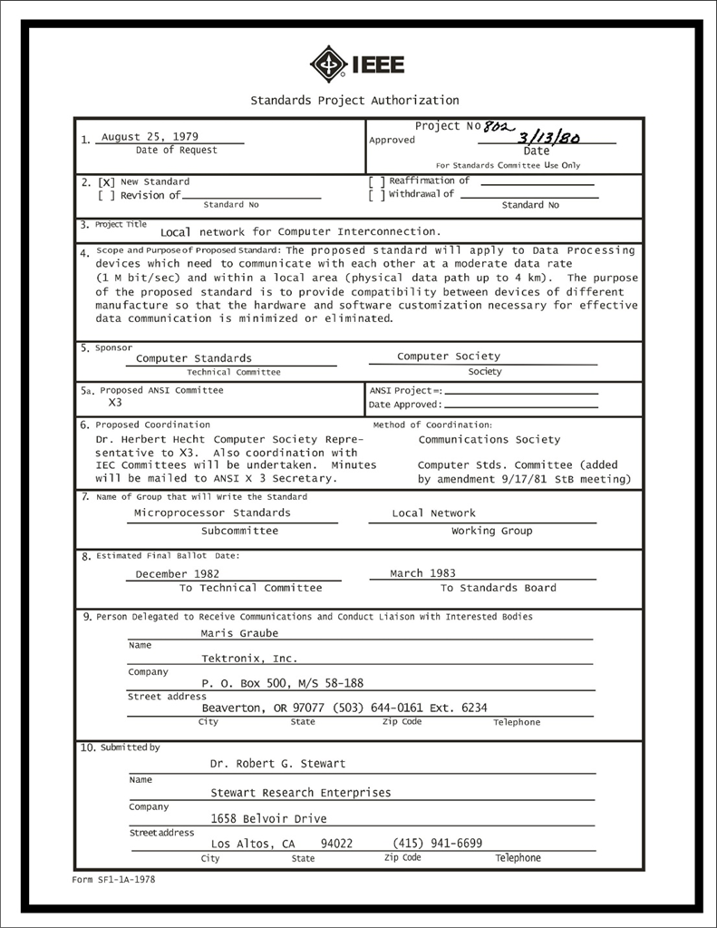
IEEE 802 LMSC
Executive Committee
07 June 2022
Electronic Meeting
19:00-21:00 UTC
15:00-17:00 ET
DCN ec-22-120-00-00EC

Slide 2
1.00 Meeting called to order/role call
2.00 Review/modify/approve agenda
2.01 Participation Slide Set URLs:
https://ieee802.org/sapolicies.shtml
https://standards.ieee.org/content/dam/ieee-standards/standards/web/documents/other/Participant-Behavior-Individual-Method.pdf
Participant behavior is guided by IEEE Code of Ethics & Conduct
Participants shall act independently of others, including employers
Standards activities shall allow the fair & equitable consideration of all viewpoints

Slide 3
3.00 Chair’s Announcements
  Proforma:
    Use IMAT to log your attendance
    Please enable mute when you are not speaking
    Please use the chat function to request being put in the queue
  Reminders
    Next 802/SA Task Force meeting scheduled for 11 July 2022 4-5pm ET
      Contact 802 chair with potential agenda items
    Leadership Workshop Schedule for Saturday 16 July 2022
      George Zimmerman and Ben Rolfe co-leads

Slide 4
6.1 IEEE Milestone for IEEE 802 LMSC
Seeking a volunteer to help Geoff Thompson complete the IEEE Milestone process for IEEE 802 LMSC

Slide 5
9.0 EC Action Item Status Review
Review Action Items from this meeting
tbd

Slide 6
Adjourn EC Meeting

Slide 7
802 Leadership Workshop history
Index | Date | Location | Co-lead | Co-lead
8 | 2022 July 16 | Montreal Sheraton | George Zimmerman | Ben Rolfe
7 | 2018 July | San Diego Hyatt | John D’Ambrosia | Glenn Parsons James Gilb
6 | 2016 January | Atlanta Hyatt | David Law
5 | 2014 November | San Antonio Hyatt | Subir Das | Apurva Mody
4 | 2013 November | Dallas Hyatt | Adrian Stephens
3 | 2012 November | San Antonio Hyatt | Roger Marks | Steve Shellhammer
2 | 2011 November | Atlanta Hyatt | Bruce Kraemer | Jon Rosdahl
1 | 2009 July | San Francisco Hyatt | James Gilb | Geoff Thompson

