Slide 1
Executive Secretary Report for
2022 June Telecon
Jon Rosdahl
IEEE 802 Executive Secretary
jrosdahl@ieee.org

Slide 2
2022 June IEEE 802 Telecon – June 7
3.01 MI Future Venue Update Rosdahl 10
    Future Venue Contract Status
    March 2022 – Orlando Contract status
    Executed/Pending Contract Report
    Items to Consider for In-person Sessions
    July 2022 – Montreal, Canada
    Pickup report vs straw poll

Slide 3
Future Venue Contract Status
2022 – July 10-15 – Sheraton Le Centre Montreal, Montreal, Quebec, Canada
2022 – Nov 13-18 – Marriott Marquis Queen’s Park, Bangkok, Thailand (Nov 2020)
2023 – March 12-17 –Hilton Atlanta, Atlanta, GA, United States (1 of 2 – March 2020)
2023 – July 9-14 – Estrel Berlin, Berlin, Germany
2023 – Nov 12-17 – Hawaiian Village, Oahu, Hawaii, United States
2024 – March 10-15 – Hyatt Regency Denver at Colorado Convention Center, Denver, CO, United States (March 2021)
2024 – July 14-19 – Sheraton Le Centre Montreal, Montreal, Quebec, Canada (July 2020)
2024 – Nov 10-15 –Hyatt Regency Vancouver – (Nov 2021)
2025 – March 9-14 –Hilton Atlanta, Atlanta, GA, United States (2 of 2 – March 2020).
2025 – July 13-18 –Marriott Madrid Auditorium, Madrid, Spain (July 2021)
2025 – Nov 9-24 -- Open
https://mentor.ieee.org/802-ec/dcn/20/ec-20-0001-05-00EC-802-plenary-future-venue-contract-status.xlsx
Notes:
Yellow Highlight – Potential deferral identified.
Blue Highlight – replacement dates for venues deferred.
Light Green highlight – potential targets for possible deferrals.
Dark Green Highlight – rebooking due to COVID
Red – Cancelled – Electronic Plenary
No highlight – pre Covid assigned dates/venues.

Slide 4
March 2022 – Orlando Contract Status
2022 – Mar 13-19 – Hilton Orlando Lake Buena Vista, Orlando, FL, United States
  Dec 2021 - Contract Cancelled
  Jan 2022 - Cancellation Penalty paid
  28 Jan 2022 - Meeting Contract for 2023 May Submitted for signature by Hilton Hotel
    Cancellation required contract by Jan 31, 2022
  23 May 2022 - Contract Finally Executed for 2023 May Interim.

Slide 5
Executed/Pending Contract Report
All potential New Future Venues not already approved are on hold.
Final Signatures for Vancouver 2024 November completed (24 Jan 2022)
Final Signatures for Estrel Hotel, Berlin, Germany 2023 July completed (3 March 2022)
Final Signatures for Sheraton Montreal, 2024 July completed (5 June 2022)
Negotiations on Madrid (2025 July) on hold for now.

Slide 6
July 2022 – Montreal, Canada
2022 – July 10-15 – Sheraton Le Centre Montreal, Montreal, Quebec, Canada
  Booked prior to Covid-19 Pandemic
  2020 July instance rebooked to 2024 July.
  Began in December to work on logistics
  Have been meeting every 2-3 weeks with the Hotel and onsite vendors.
  Have shared requirements (next 3 slides).

Slide 7
Mixed Mode Meeting requirements - (1)
1. Local room requirements:
  hear local participants (some microphones may be needed and the number is per size of room).
  See presentations (projection of central machine or chair's machine for local observation).
  Local Queue management is by lining up to microphone.
  Provide local audio and screen presentation to remote participants (WebEx, Zoom, Proprietary)
  Hear remote participants (audio from remote should seamlessly be injected in the local room.)
  Remote Queue management to be integrated with local participants queue (Chair may need a VP to watch and manage fair queue access)
  Remote presentations need to be presented to Local room. (central machine or chair's machine to project remote shared screen).

Slide 8
Mixed Mode Meeting requirements- (2)
2. Remote access requirements:
  Hear local participants (Local participants need to speak into microphone to ensure injected into remote system)
  See Local or Remote presentations ( projection of central machine or chair's machine into remote access tool).
  Request remote queue (need to indicate desire to speak and be called on when appropriate).
  Speak - Need to be able to speak to the Local and remote participants
  Present - Need to be able to have a remote presenter (this can be done by the central machine or chair's machine or sharing of remote screen).

Slide 9
Mixed Mode Meeting requirements - (3)
3. General requirements
  Local room to integrate local and remote audio
  Local room to have a method of sharing remote info to local screen
  No requirement for local participants to login to "see" remote information.
  Explicitly preclude local participants from connecting audio to prevent audio feedback loop.

Slide 11
Summary of Key Points
Meeting is to be run as an in-person meeting:
  Local time zone schedule for meetings
  Local participants attend as an in-person meeting
  Remote access is provided to remote participants to view/present/interact similarly to on-line meetings (best effort)
In-person participants are admonished (stronger than encouraged) to stay OFF the Audio interface from the Webex/zoom/teams/conference tool of your choice –
Presentation/room computer is logged into conference tool (ideally from a volunteer-supplied PC), and the web-conferencing tool is presenting what is being presented by the local projector.
A chair, vice-chair, or designate, is logged into the conference tool and monitoring the queue (based on experience this is probably a second room log in, since monitoring the queue doesn’t work well when presenting) – this person manages the online queue for the chair to integrate with the floor queue. Fairness for local and remote attendees is responsibility of the officer.
Audio comes from a floor mic or the chair/dias mic which is mixed into room speakers and outgoing sound by the sound board is then connected to the local computer that shares to the remote conference tool.
Working groups need to decide voting rules, etc. for subgroups (some use different rules for electronic meetings than in person – what to use for hybrid?)

Slide 12
July 2022 – Montreal, Canada
Canadian government has expanded the list of accepted vaccines to enter Canada. You can find the full list at the following link:
https://travel.gc.ca/travel-covid/travel-restrictions/foreign-sept7-vaccine
Updated Travel requirements April 5, 2022:
    Canada Removed Testing For Entry April 1st
    “Once the new test-free rules come into effect on April 1, 2022, fully vaccinated passengers will no longer need to show proof of a negative antigen or PCR test prior to boarding their flight. The ArriveCan app will still need to be used, as well as random testing on arrival happening at select airports”
  Canadian government has expanded the list of accepted vaccines to enter Canada. You can find the full list at the following link:
    https://travel.gc.ca/travel-covid/travel-restrictions/foreign-sept7-vaccine
  The Government of Québec announced that meetings and conventions can resume as of February 28 and can be held at full capacity as of March 14.
    For the latest updates and links to resources for additional information, visit our COVID information page.
    Please check the COVID information page for testing and travel requirements.

Slide 13
The Latest Updates on International Gathering and Travel Restrictions
Canada has dropped pretravel testing requirements for vaccinated visitors, while New Zealand and Italy are relaxing vaccine passport rules.
  27 country status reported:
northstarmeetingsgroup.com/coronavirus-countries-cities-reopening-COVID-19-new-cases?utm_source=eNewsletter&utm_medium=Email&utm_campaign=eltrMtgNews&oly_enc_id=0895B1365067B7U

Slide 14
Straw Poll #2 for 2022 July
2. If the 2022 July Plenary Session is held in Montreal, Canada as a mixed-mode session, will you attend:
Attend In-person Attend Virtually (remotely) Will not attend plenary
802.1 34 36 2
802.3 91 153 8
802.11 74 118 7
802.15 20 25 1
802.18 15 8 0
802.19 16 14 0
Totals 250 354 = 604
(41% attend in person)
Notes:
20% drop.

Slide 15
July 2022 IEEE 802 Plenary Session - Mixed Mode
Registration Summary By Working Group
In Person Virtual Total
802.1 59 38 97
802.3 142 115 257
802.11 169 239 408
802.15 50 49 99
802.18 8 6 14
802.19 3 6 9
802.24 4 1 5
Grand Total 435 454 889
Current As of June 7, 2022
Numbers reflect some attendees may have selected more than one primary working group.

Slide 16
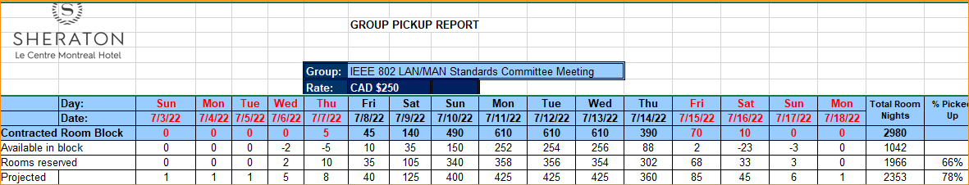
Sheraton Group Pickup Report

Slide 17
July 2022 IEEE 802 Plenary Session - Mixed Mode
Registration Summary
In Person Virtual Total
Early Registration: 402 416 818
Standard Registration: 9 12 21
Late Registration
Student Registration 4 4
Totals: 415 428 843

Slide 18
2022 July Mixed Mode Plenary Fee Deadlines
Fees/dates for 2022 July IEEE 802 Mixed Mode Plenary for either in person or remote attendance:
  $500 until Friday, May 20, 2022
  $700 until Friday, June 24, 2022
  $900 after Friday, June 24, 2022
  Cancellation Policy:
    (fully refundable until May 20)
    (refundable with $150 cancellation fee after May 20 until June 24th)
    (non-refundable after June 24th, 2022)

Slide 19
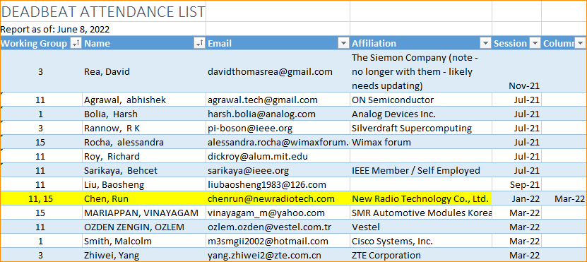
802 Deadbeats

