Slide 1

IEEE 802 LMSC
130th Plenary Session
(1st mixed mode Plenary Session)
11 July 2022 to
15 July 2022
DCN ec-22-0156-01-00EC

Slide 2
2.01 Participant behavior in IEEE-SA activities is guided by the IEEE Codes of Ethics & Conduct
All participants in IEEE-SA activities are expected to adhere to the core principles underlying the:
  IEEE Code of Ethics
  IEEE Code of Conduct
The core principles of the IEEE Codes of Ethics & Conduct are to:
  Uphold the highest standards of integrity, responsible behavior, and ethical and professional conduct
  Treat people fairly and with respect, to not engage in harassment, discrimination, or retaliation, and to protect people's privacy.
  Avoid injuring others, their property, reputation, or employment by false or malicious action
The most recent versions of these Codes are available at
  http://www.ieee.org/about/corporate/governance

Slide 3
2.01 Participants in the IEEE-SA “individual process” shall act independently of others, including employers
The IEEE-SA Standards Board Bylaws require that “participants in the IEEE standards development individual process shall act based on their qualifications and experience”
This means participants:
  Shall act & vote based on their personal & independent opinions derived from their expertise, knowledge, and qualifications
  Shall not act or vote based on any obligation to or any direction from any other person or organization, including an employer or client, regardless of any external commitments, agreements, contracts, or orders
  Shall not direct the actions or votes of other participants or retaliate against other participants for fulfilling their responsibility to act & vote based on their personal & independently developed opinions
By participating in standards activities using the “individual process”, you are deemed to accept these requirements; if you are unable to satisfy these requirements then you shall immediately cease any participation

Slide 4
2.01 IEEE-SA standards activities shall allow the fair & equitable consideration of all viewpoints
The IEEE-SA Standards Board Bylaws (clause 5.2.1.3) specifies that “the standards development process shall not be dominated by any single interest category, individual, or organization”
  This means no participant may exercise “authority, leadership, or influence by reason of superior leverage, strength, or representation to the exclusion of fair and equitable consideration of other viewpoints” or “to hinder the progress of the standards development activity”
This rule applies equally to those participating in a standards development project and to that project’s leadership group
Any person who reasonably suspects that dominance is occurring in a standards development project is encouraged to bring the issue to the attention of the Standards Committee or the project’s IEEE-SA Program Manager

Slide 5
3.00 Chair’s Announcements

Slide 6
3.00 Chair’s Announcements
  Reminder #1: Please use IMAT to log your attendance
  Reminder #2: Interim EC meeting scheduled for 19:00-21:00 UTC 02 August (15:00-17:00 ET)
  Reminder #3:
  closing EC consent agenda items due 17:00 UTC Wednesday 13 July 2022 (13:00 ET)
  -- 48 hours prior to the start of the closing EC meeting.
  vote tallies in support of consent agenda items due 15:00 UTC Friday 15 July 2022 (11:00 ET)
  -- 2 hours prior to the start of the closing EC plenary meeting.
  Reminder #4:
  2022-2024 is Paul Nikolich’s final term as 802 Chairman. Candidates for 802 Chair and the 802 EC Appointed positions are sought as soon as possible. Candidates should contact the holder of the position they seek to enable them to fully understand the responsibilities of the positions (Vice Chairs, Treasure, Recording Secretary, Executive Secretary and Chair). Please announce this at your opening meetings.

Slide 7
3.00 Chair’s Announcements
  Reminder #5: Thank you to Glenn’s students Basma, Amir and Mohammed for their support this week.
  Poll #1: Once around the (mixed-mode) table:
  Was this mixed mode plenary session successful?
  ONE word response please: Yes or No
  Reminder #6
  I have reserved 30 minutes at the end of the meeting for more detailed discussion (if desired)
  Item 8.07 Feedback from 802 Leadership on Mixed Mode Meetings

Slide 8
8.07 802/SA Task Force Update
802/SA Task Force Meeting held Monday 11 July 2022 16:00-17:00 ET
Meeting notes at ec-22-0157-00-00EC-11jul2022-802-sa-tf-notes.docx
Next meeting tentatively scheduled for 4-5pm ET Monday 24 October 2022

Slide 9
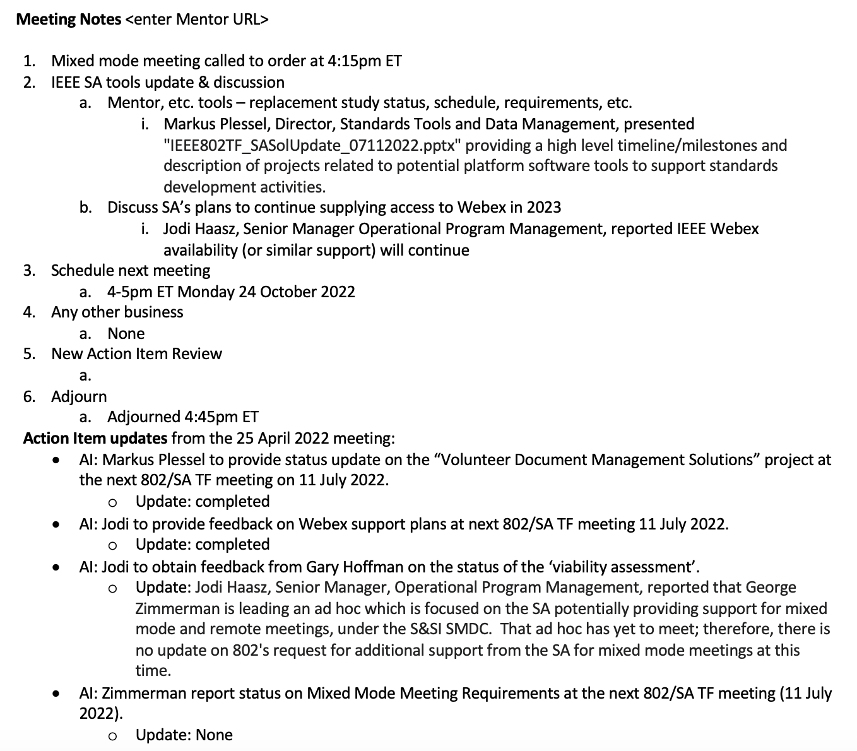

Slide 10
End of Closing EC Meeting

