Slide 1
Agenda –
Ad hoc Meeting
Future Meetings Subcommittee Ad Hoc Rescoping
John D’Ambrosia
Futurewei, US Subsidiary of Huawei
08 Dec 2022
DCN ec-22-0258-00-00EC

Slide 2
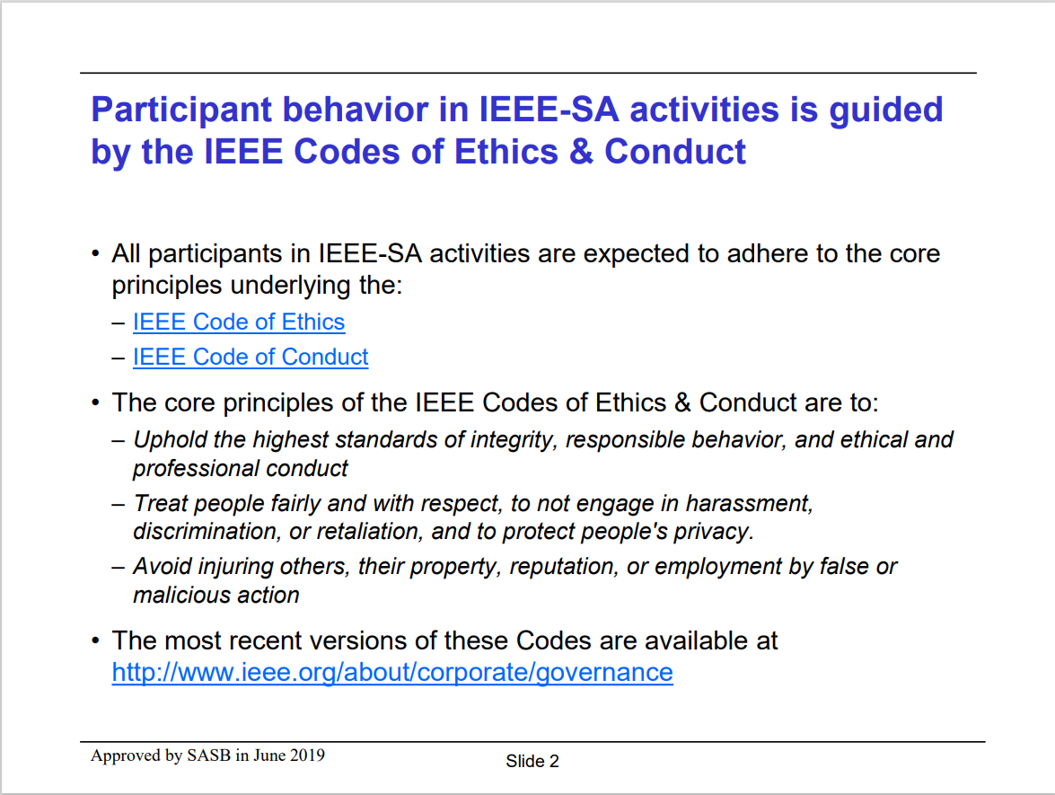

Slide 3
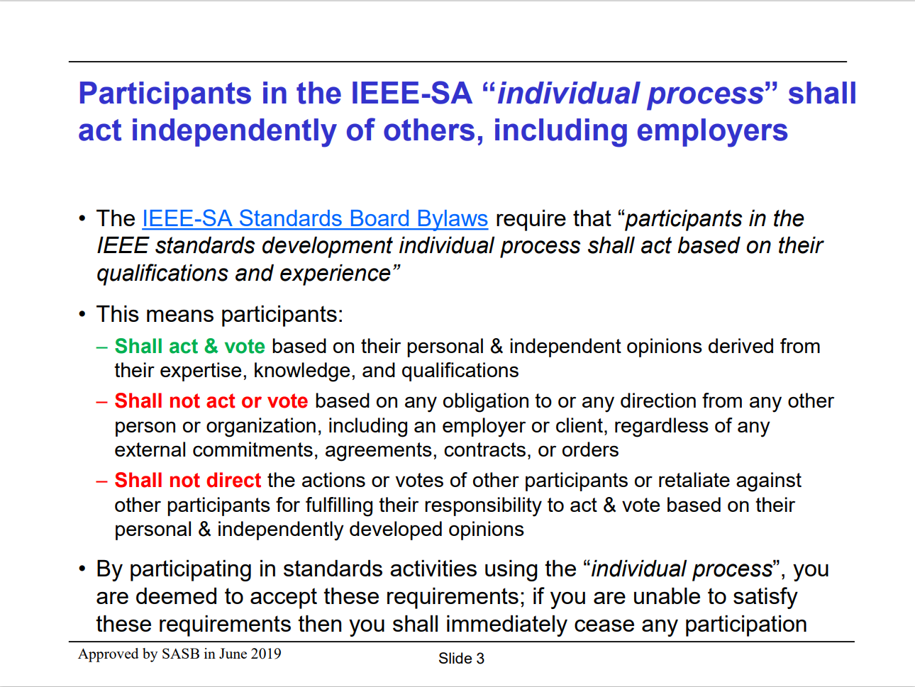

Slide 4
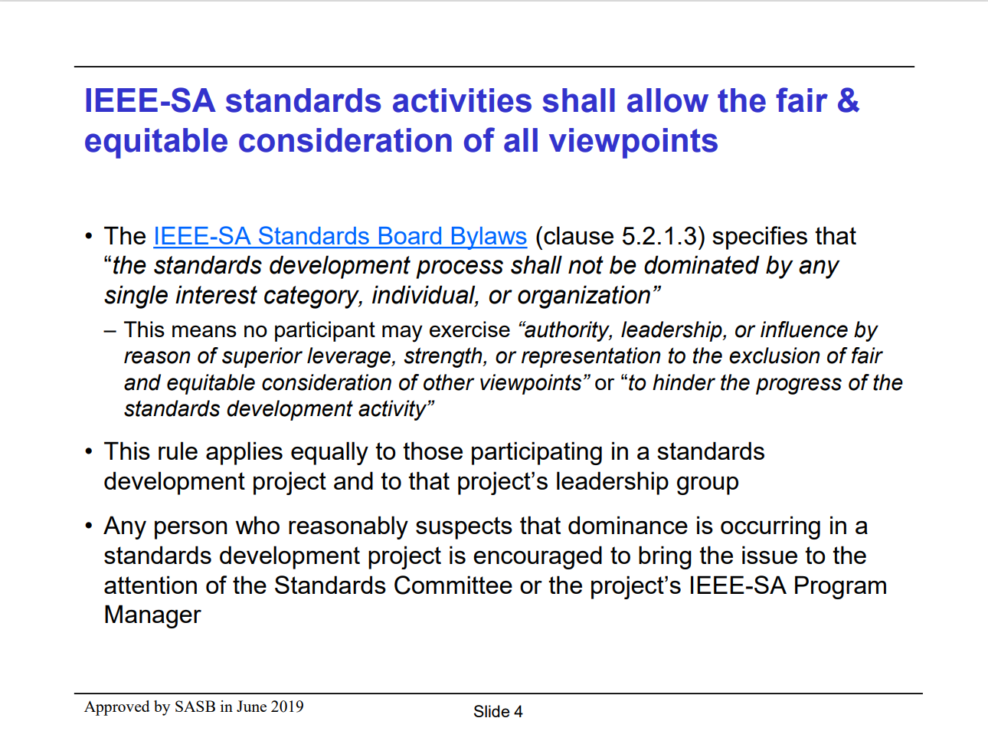

Slide 5
Attendance
Please log your attendance
  IMAT
  Sending email to jdambrosia@ieee.org

Slide 6
Ad Hoc Charter –
Future Meetings Subcommittee Ad Hoc Rescoping
Action Item : IEEE 802 Nov 2022 Closing Plenary
  John D’Ambrosia work with Andrew Myles to set up an ad hoc meeting to discuss the rescoping of the Future Meetings Subcommittee ad hoc and bring a recommendation to the December 802 EC meeting
Focus of this ad hoc is discussion of rescoping of the Future Meetings Subcommittee ad hoc – not the discussions underway in this ad hoc

Slide 7
Current Future Meeting Vision Ad Hoc Scope
  Establish a long term vision for how IEEE 802 meetings might operate effectively in the future, possibly challenging the historical assumption that IEEE 802 WGs meeting F2F six times per year is optimal
  The immediate goal of the ad hoc will be to understand what has worked well and what has not worked well with remote meetings over the last 18 months, and what would be needed to allow remote meetings to operate better in the future
  This understanding will then assist the ad hoc explore the longer term question of how often IEEE 802 WGs should meet F2F, remotely or in a hybrid mode in the future

Slide 8
Questions to Consider
Meetings that should be addressed by this ad hoc
  IEEE 802 is responsible for 3 plenaries a year
  Working groups are responsible for 3 or more meetings a year
  What meetings should be addressed? Should the number of meetings be fixed or considered at this time?
“… what would be needed to allow remote meetings to operate in the future”
  Definition of “future”?
    Future Plenary Sessions that are planned / contracted-
    Future Plenary Sessions to be negotiated
“… will then assist the ad hoc explore the longer term question of how often IEEE 802 WGs should meet F2F, remotely or in a hybrid mode in the future.”
  Multiple F2F meetings through Nov 27 contracted –
    will remote access be provided at these meetings?
    Consideration of providing remote access on meeting planning?
  For meetings not contracted – reconsider if F2F / remote / hybrid?

Slide 9
Summary of Meeting -Attendees
Au, Edward | Huawei
D'Ambrosia, John | Futurewei Technologies
Haasz, Jodi | IEEE
In, Kiwi
Kerry, Stuart | OK-Brit; Self
Law, David | HPE
Levy, Joseph | InterDigital
Myles, Andrew | Cisco Systems, Inc.
Nikolich, Paul | self employed/various
Palm, Stephen | Broadcom Corporation
Parsons, Glenn | Ericsson
Petrick , Al
Powell, Clint | Meta
Rolfe, Benjamin | Blind Creek Associates
Rosdahl, Jon | Qualcomm Incorporated
Shellhammer, Stephen | Qualcomm Incorporated
Taori, Rakesh | Infineon Technologies
Thompson, Geoffrey | GraCaSI S.A./Independent
Zimmerman, George | CME Consulting/APL Group, Cisco, CommScope, Marvell, OnSemi, SenTekSe LLC

Slide 10
Ad Hoc Output (12/8/2022)
Propose to update future-meeting adhoc scope to:
  Establish recommendations to be presented at the March 802 EC plenary on guidelines for meeting requirements (for 802 plenaries) beyond 2026, including:
    Planned annual format for 802 plenary sessions, i.e., in-person, mixed-mode, electronic-only, or some combination
    Any modification to the rule of three 802 plenary sessions per year
    Any modification to the rule of all working groups meeting in-person at the 802 plenary sessions
Recommend December 2022 EC to decide:
  Whether currently contracted meetings offer remote access by default

Slide 11
Backup

Slide 12
Future Venue Contract Status
2022 – Nov 13-18 – Marriott Marquis Queen’s Park, Bangkok, Thailand (Nov 2020)
2023 – March 12-17 –Hilton Atlanta, Atlanta, GA, United States (1 of 2 – March 2020)
2023 – July 9-14 – Estrel Berlin, Berlin, Germany
2023 – Nov 12-17 – Hawaiian Village, Oahu, Hawaii, United States
2024 – March 10-15 – Hyatt Regency Denver at Colorado Convention Center, Denver, CO, United States (March 2021)
2024 – July 14-19 – Sheraton Le Centre Montreal, Montreal, Quebec, Canada (July 2020)
2024 – Nov 10-15 –Hyatt Regency Vancouver, Vancouver, Canada (Nov 2021)
2025 – March 9-14 –Hilton Atlanta, Atlanta, GA, United States (2 of 2 – March 2020).
2025 – July 13-18 –Marriott Madrid Auditorium, Madrid, Spain (July 2021)
2025 – Nov 9-24 – Possible need for penalty offset- Le Centre Sheraton Montreal, Montreal (July 2022)
2026 March 8-13 - Hyatt Regency Chicago, Chicago, IL, United States (March 2024) – (Contract pending)
2027 – Nov 14-19 – Hawaiian Village, Oahu, Hawaii, United States
https://mentor.ieee.org/802-ec/dcn/20/ec-20-0001-05-00EC-802-plenary-future-venue-contract-status.xlsx
Notes:
Yellow Highlight – Potential deferral identified.
Blue Highlight – replacement dates for venues deferred.
Light Green highlight – potential targets for possible deferrals or offset penalties.
Dark Green Highlight – rebooking due to COVID
Red – Cancelled – Electronic Plenary
No highlight – pre Covid assigned dates/venues.
Note: 2026 March - RFP -2019 - Hyatt Regency Chicago selected for March 2023, Contract not signed due to PSAV - Moved to 2024 March - then moved to 2026 due to agreement with rebooking Denver.

