Slide 1

IEEE 802 LMSC
132nd Plenary Session
(3rd mixed mode Plenary Session)
13 -17 March 2023
DCN ec-23-0038-02-00EC

Slide 2
3.0 Participant behavior in IEEE-SA activities is guided by the IEEE Codes of Ethics & Conduct
All participants in IEEE-SA activities are expected to adhere to the core principles underlying the:
  IEEE Code of Ethics
  IEEE Code of Conduct
The core principles of the IEEE Codes of Ethics & Conduct are to:
  Uphold the highest standards of integrity, responsible behavior, and ethical and professional conduct
  Treat people fairly and with respect, to not engage in harassment, discrimination, or retaliation, and to protect people's privacy.
  Avoid injuring others, their property, reputation, or employment by false or malicious action
The most recent versions of these Codes are available at
  http://www.ieee.org/about/corporate/governance

Slide 3
3.0 Participants in the IEEE-SA “individual process” shall act independently of others, including employers
The IEEE-SA Standards Board Bylaws require that “participants in the IEEE standards development individual process shall act based on their qualifications and experience”
This means participants:
  Shall act & vote based on their personal & independent opinions derived from their expertise, knowledge, and qualifications
  Shall not act or vote based on any obligation to or any direction from any other person or organization, including an employer or client, regardless of any external commitments, agreements, contracts, or orders
  Shall not direct the actions or votes of other participants or retaliate against other participants for fulfilling their responsibility to act & vote based on their personal & independently developed opinions
By participating in standards activities using the “individual process”, you are deemed to accept these requirements; if you are unable to satisfy these requirements then you shall immediately cease any participation

Slide 4
3.0 IEEE-SA standards activities shall allow the fair & equitable consideration of all viewpoints
The IEEE-SA Standards Board Bylaws (clause 5.2.1.3) specifies that “the standards development process shall not be dominated by any single interest category, individual, or organization”
  This means no participant may exercise “authority, leadership, or influence by reason of superior leverage, strength, or representation to the exclusion of fair and equitable consideration of other viewpoints” or “to hinder the progress of the standards development activity”
This rule applies equally to those participating in a standards development project and to that project’s leadership group
Any person who reasonably suspects that dominance is occurring in a standards development project is encouraged to bring the issue to the attention of the Standards Committee or the project’s IEEE-SA Program Manager

Slide 5
3.02 Fee Waivers
Motion: Approve waiving this LMSC plenary session registration fee for the following individuals:
Mover: tbd Seconder: tbd
Participant | Affiliation | Rationale
John Hawkins | Past 802 LMSC Treasurer | John lives in the Atlanta area, 802 Chair invited John to the anniversary celebration

Slide 6
5.13 In Memoriam: Donna Ferguson

Slide 7
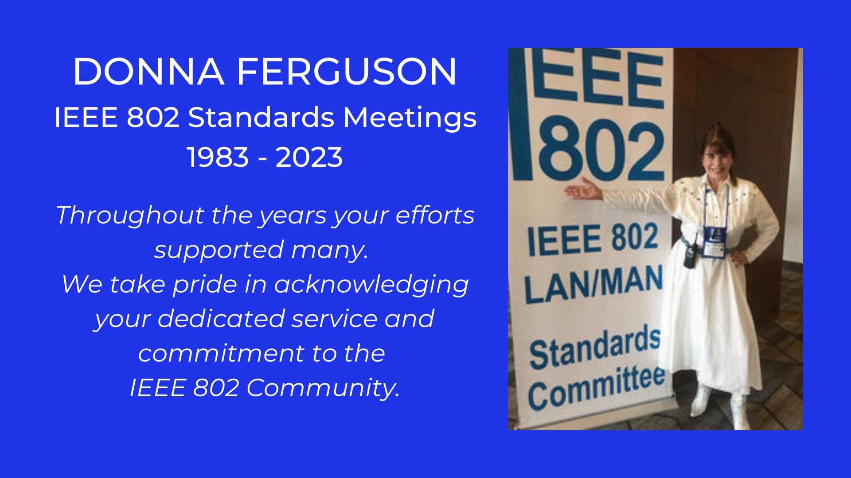

Slide 8
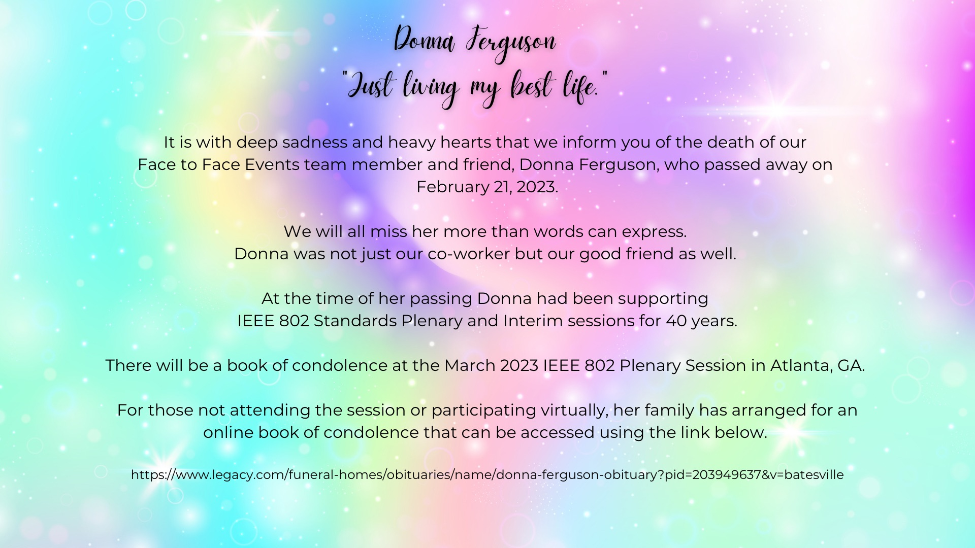

Slide 9
4.00 IEEE Staff
In Person
Jodi Haasz role: 802 lead, supports dot03 and dot18 groups
title: Operational Program Management Senior Manager
Ron Hotchkiss role: supports dot01group (arriving Wednesday)
title: Operational Program Management Program Manager
Christy Bahn role: supports dot11, dot15, dot19 and, dot24 groups
title: Operational Program Management Senior Program Manager
Catherine Berger role: 802 editorial support
title: Senior Program & Special Project Manager
Ian Barbour role: 802 editorial support
title: Content Editor
Remote
Christian Orlando role: assist Jodi, Christian and Christy
title: Operational Program Management Program Manager
Available for editorial guidance questions via email
Michelle Turner role: 802 lead editorial support
title: Managing Editor, Content Production Management
NOTE additional staff support:
Erin Morales, Director, Operational Program Managerment (e.spiewak@ieee.org)

Slide 10
5.01 Chair’s Announcements

Slide 11
5.01 Chair’s Announcements
  Reminder #1: Please use IMAT to log your attendance
  Reminder #2: Interim EC meeting scheduled for 19:00-21:00 UTC 07 April (15:00-17:00 ET).
  Reminder #3:
  closing EC consent agenda items due 17:00 UTC Wednesday 15 March 2023 (1300 ET)
  -- 48 hours prior to the start of the closing EC meeting.
  vote tallies in support of consent agenda items due 15:00 UTC Friday 18 March 2023 (11:00 ET)
  -- 2 hours prior to the start of the closing EC plenary meeting.
  Reminder #4:
  2022-2024 is Paul Nikolich’s final term as 802 Chairman. Candidates for 802 Chair and the 802 EC Appointed positions are sought as soon as possible. Candidates should contact the holder of the position they seek to enable them to fully understand the responsibilities of the positions (Vice Chairs, Treasure, Recording Secretary, Executive Secretary and Chair). Please announce this at your opening meetings.

Slide 12
5.02 IEEE SA BoG Update
SA BoG December 2022
  Approved the consolidation of the IEEE SA Products and Services Innovation and Standards Market and Business Development groups into a single Strategic Management and Delivery Committee (SMDC) with an initial working title of “Global IEEE SA Products, Services, and Marketing (GPSM) SMDC” along with the chair of the new SMDC as proposed by the incoming IEEE SA President.
  The IEEE SA BOG approved donating $25,000 to the International MOVE Fund held by the IEEE Foundation during fiscal year 2022.
802 EC members that are members of the 2023 SA BoG
  David Law, SASB Chair, Glenn Parson MaL, Dorothy Stanley MaL, Paul Nikolich IEEE SA Treasurer

Slide 13
5.02 IEEE Boards Updates
Standards Association Standards Board February 2023
  The SASB resolved that the Understanding IEEE SA’s Antitrust, Competition, and Commercial Terms Policies training shall be completed by Standards Committee/Working Group Officers within 90 days of appointment as such or by 31 December 2023, whichever is later.
  802 Members on SASB:
  David Law, Joseph Levy, Guido Hiertz, Andrew Myles, Lei Wang, Karl Weber, Paul Nikolich
Computer Society BoG & SAB December 2022
  SA Staff internally met with legal, risk, and a few key volunteers to discuss the definition of a “Standards Development Meeting” and if there is a difference between standards development and other SA meetings. Matt Ceglia, SA staff, will continue to provide updates related to the discussion. No update available at this time.
IEEE Technical Activities and BoD meetings February 2023
  Technical Activities Board (TAB) Committee on Standards (CoS) encourages initiation of standards activities across all TAB Societies and Councils. It is developing/curating Standards Process Education materials, developing a OpsMan, and participating in IEEE Strategic Planning. Please contact Edward Au, 2023 TAB CoS chair for details.
  IEEE New Initiatives Committee (NIC) considers proposals for new initiatives and seed grants, reviews continuing initiatives, and manages the IEEE New Initiatives Process. NIC is a potential source of funding – check it out.
  IEEE has a new President & CEO, Saifur Rahman, and Executive Director & COO, Sophie Muirhead, as of 01 January 2023

Slide 14
5.03 SA Standards Board Actions
802 Project Authorization SASB Approvals December 2022
P802.3df Ethernet Amendment: MAC for 800 Gb/s and PHY for 400 Gb/s and 800 Gb/s
P802.3dj Ethernet Amendment: MAC for 1.6 Tb/s and PHY for 200 Gb/s, 400 Gb/s, 800 Gb/s, and 1.6 Tb/s
P802.3dk Ethernet Amendment: Greater than 50 Gb/s Bidirectional Optical Access PHYs
P802.11bk Wireless LAN MAC and PHY Amendment: 320MHz Positioning
- Corrigenda: none
- PAR Modifications: none
SASB 802 Standards Approved in DEC 2022 & FEB 2023
Std. 802.15.13-2023 IEEE Multi-Gigabit per Second Optical Wireless Communications (OWC)
Std. 802.11az-2022 WLAN MAC & PHY Amendment 4: Enhancements for Positioning
Std. 802.11bd-2022 WLAN MAC & PHY Amendment 5: Enhancements for Next Generation V2X

Slide 15
5.04
LMSC Email Ballot Recap
open date topic yes/no/abs/dnv* result
22NOV Australia ACMA submission approval 07/00/01/05 pass
25JAN China MIIT submission approval 10/00/01/02 pass
23FEB Singapore IMDA submission approval 07/00/01/06 pass
* 802 chair is counted as DNV unless his vote is required

Slide 16
5.05 EC Affiliation Update
IEEE 802 Executive Committee Members
Position | Name | Affiliation
Chair | Paul Nikolich | Self, HPE, YAS BBV, Origin Wireless, Wyebot
First Vice Chair | James P. K. Gilb | General Atomics Aeronautical Systems Inc., USD
Second Vice Chair | Roger Marks | EthAirNet Associates
Treasurer | George Zimmerman | CME Consulting, On Semi, Marvell, Cisco Systems, CommScope, Sen Tekse LLC, APL Group
Recording Secretary | John D'Ambrosia | Futurewei, a U.S. subsidiary of Huawei
Executive Secretary | Jon Rosdahl | Qualcomm Technologies, Inc.
P802.1 High Level Interface (HILI) | Glenn Parsons | Ericsson
P802.3 Ethernet | David Law | Hewlett Packard Enterprise
P802.11 Wireless Local Area Network (WLAN) | Dorothy Stanley | Hewlett Packard Enterprise
P802.15 Wireless Specialty Networks | Clint Powell | Powell Wireless Consulting, Meta.
P802.18 Radio Regulatory TAG | Edward Au | Huawei
P802.19 Wireless Coexistence | Steve Shellhammer | Qualcomm Technologies, Inc.
P802.24 Vertical Network Applications TAG | Tim Godfrey | Electric Power Research Institute
Member Emeritus Member Emeritus | Geoff Thompson Clint Chaplin | Self, GraCaSI Standards Advisors Self, Samsung Research America
Hibernating Working Groups
P802.16 Broadband Wireless Access | Roger Marks | EthAirNet Associates
P802.21 Media-independent Handover | Subir Das | Peraton Labs
P802.22 Wireless Regional Area Networks | Apurva Mody | A5 Systems, AiRANACULUS, White Space Alliance

Slide 17
5.05 EC Affiliation Update
Changes in affiliation among EC members from previous slide?

Slide 18
5.06 Drafts to SA Ballot
802.01: 802.1ASdr
802.03: none
802.11: none
802.15: none
802.19: none

Slide 19
5.07 Drafts to RevCom
802.01: P802.1AEdk MAC Privacy, P802.1Qcz Congestion Isolation
802.03: P802.3cy Greater than 10 Gb/s Electrical Automotive Ethernet (conditional)
802.11: P802.11bb Light Communications, P802.11bc Enhancements for Broadcast Svcs.
802.15: none
802.19: none

Slide 20
5.08 Draft Documents or Actions for EC to consider
802.EC: reminder regarding Student outreach for July
802.01: report on 802 O&A revision status
802.03: tbd
802.11: Approve formation of an 802.11 Ambient Power SG
802.15: tbd
802.18: IEEE 802 Regulatory Report, Approval of draft Position Statement on 802 Wireless, Liaison to ETSI on Terahertz
802.19: none
802.24: none
802/JTC1 SC: report
802/ITU SC: report
802/IETF SC: report
802/Wireless Chairs SC: none
802 Public Visibility Standing Committee: verbal update
20

Slide 21
5.09 Draft PARs to NesCom
802.1CS-2020/Cor 1- Link-local Registration Protocol - Corrigendum 1 Corrections to Management Modules and Protocol Encoding, PAR modification
802.1ASdm - Amendment: Hot Standby and Clock Drift Error Reduction, PAR modification and CSD
802.1Qdt - Amendment: Priority-based Flow Control Enhancements, PAR modification and CSD
802.1Qdx - Amendment: YANG Data Models for the Credit-Based Shaper, PAR and CSD
802.1DU - Standard: Cut-Through Forwarding Bridges and Bridged Networks, PAR and CSD
802.15.4 - Amendment: Privacy Enhancements, PAR and CSD
48 hour maintenance policy PARs
802.1Qrevision roll-up (tentative)
PAR withdrawal requests:
None

Slide 22
5.10 Pre-PAR activity
Group | New | Existing
dot01 | none | SG: none IC: Nendica: EEE 802 Network Enhancements for the Next Decade
dot03 | none | SG: none IC: New Ethernet Applications (NEA)
dot11 | SG: Ambient Power | SG: Ultra High Reliability SC: WNG TIG: AI/ML, and Ambient Power
Legend:
IC – Industry Connection, SC – Standing Committee,
SG – Study Group, TIG – Topic Interest Group, WNG -- Wireless Next Gen, and
AI/ML – Artificial Intelligence/Machine Learning

Slide 23
5.10 Pre-PAR activity
Group | New | Existing
dot15 | none | SG: Privacy SC: IETF, Industry Activities in Terahertz, and WNG
dot19 | none | none
dot24 | none | none
dot ECSG | none | none
Legend:
IC – Industry Connection, IG – Interest Group, SC – Standing Committee,
SG – Study Group, TIG – Topic Interest Group, WNG Wireless Next Gen

Slide 24
5.11 802/SA Task Force Topics
802/SA Task Force Electronic Meeting
Monday 30 January 2023 16:00-17:00 ET was canceled due to lack of agenda items
Next 802/SA Task Force Electronic Meeting
Tentatively scheduled for 16:00-17:00 ET Monday 17 April 2023
Please submit agenda items to the 802 EC Reflector as appropriate

Slide 25
5.12 802 IEEE Milestone Project Status Update
Geoff Thompson

Slide 26
GraCaSI
IEEE 802 LAN/MAN
STANDARDS COMMITTEE
Milestone Project
Monday, Mar. 13, 2023
Status Report
Geoff Thompson
GraCaSI S.A.

Slide 27
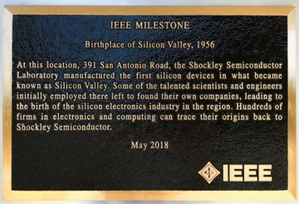
What is a MILESTONE?
GraCaSI
  Commemoration of a historic event in
  the history of engineering.
  A bronze plaque placed at the site of the
  event.
  Example:
Notes:
SKU: Stock Keeping Unit

Slide 28
Proposed Plaque Text:
GraCaSI
SEE NEXT SLIDE
Notes:
SKU: Stock Keeping Unit

Slide 29
IEEE Milestone
IEEE 802 LAN/MAN Standards Committee, 1980
In February 1980, industry representatives first met in San Francisco, California, to standardize Local Area Networks (LANs) for computers. This led to creation of the IEEE 802 LAN/MAN Standards Committee, and three of its Working Groups (WGs) were particularly important in transforming the nature of computing: 802.3 (Ethernet), 802.5 (Token Ring), and 802.11 (Wi-Fi). These WGs created standards which made wired and wireless communication between computing devices an essential functionality.
Date of Plaque
IEEE [LOGO]

Slide 30
STATUS:
GraCaSI
  ACCOMPLISHMENTS:
    Submission complete
    Submission includes proposed text
    (See backup slide for rules)
    Agreement from Proposed Site: CHM
    (per Marc Weber, Curatorial Dir., Internet History Pgm)
  Agreement from sponsoring local section:
    Santa Clara Valley Section
    Obtained support letter from Chair
  The rest is up to “the process”
Notes:
SKU: Stock Keeping Unit

Slide 31
GraCaSI
See the application for yourself:
https://ieeemilestones.ethw.org/Milestones_Status_Report#Completion
Docket Number 2021-11
or directly at:
https://ieeemilestones.ethw.org/Milestone-Proposal:IEEE_802
Notes:
SKU: Stock Keeping Unit

Slide 32
Latest report from “Advocate”:
GraCaSI
Geoff
I won't be able to work on this until April, but in time for what would likely be a late May/early June History Committee meeting. I will ensure that it has smooth sailing for that process. I would not expect that a dedication date could not occur until late this year or early 2024. The SCV Section can be relied upon for funding the plaque, which I will ensure is able to be mounted at the CHM. As you know, this is an unusual situation as we are putting this together assuming it can be mounted at the CHM, which is somewhat unorthodox. However, I know the ropes enough that I feel I can make this happen. The optimal dedication venue is the CHM itself, but renting Hahn Auditorium is somewhat costly - all told with an evening event and food and drink, that can cost in excess of $10-12K. I do know how to publicize these things widely, and so we can join forces and get a good crowd to attend. Tom Coughlin will be IEEE President in 2024, and so we should ensure that the dedication fits with his busy schedule. I have worked with some party planners by way of the CHM, so that is one way to help put it all together, and they have a list of good food suppliers. Including alcohol of course makes it more expensive, and I am not sure how to price this all. The idea of t-shirts is up to you, but I don't think they get worn more than once anymore frankly. Let me know if you have other questions. It's great to work with you, and I feel we will have great success. BTW, see https://www.price.utah.edu/ieee-milestone-events for a big event I have been planning for late this month in Utah. As such, I have very extensive experience with planning these events, frankly more than probably anyone else in the world.
Cheers, Brian
Notes:
SKU: Stock Keeping Unit

Slide 33
GraCaSI
THANK YOU !

Slide 34
GraCaSI
Standards Advisors
Geoffrey O. Thompson
Principal
Mountain View, CA
94043-5286 USA
E-mail: <thompson@ieee.org>

Slide 35
GraCaSI
BACKUP SLIDES

Slide 36
PROPOSED SITE:
GraCaSI
The approved site for the Milestone Plaque
is the entrance garden for
The Computer History Museum
1401 N Shoreline Blvd
Mountain View, CA 94043
There is a wall of (currently) 10 Milestone plaques.
Most of these are duplicates of ones at now obscure
or hard to visit sites.
See a video of the wall at:
https://tinyurl.com/ygsybzam

Slide 37
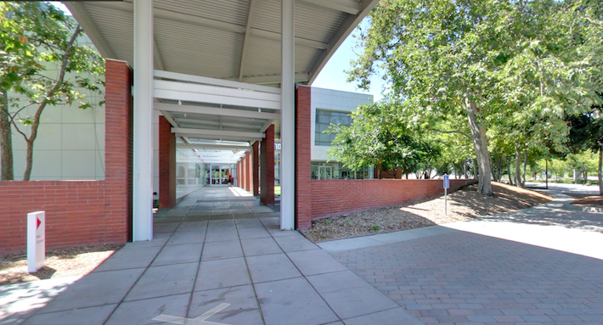
SITE:
GraCaSI
This is the main entrance to the Museum.
The plaques are on the other side of the wall to the right.

Slide 38
GraCaSI
SITE of the Milestone Plaques
is the entrance garden for
The Computer History Museum
1401 N Shoreline Blvd
Mountain View, CA 94043
https://tinyurl.com/ygsybzam

Slide 39
Plaque text rules:
GraCaSI
The achievement must be more than 25 years old.
It honors the achievement, rather than the person or place.
(i.e. Names of persons is generally forbidden)
The body text is limited to 70 words, 60 preferred.
Everybody down the line tends to fiddle with the text
More complete rules and on-line "help" is at:
ieeemilestones.ethw.org/Milestone_Guidelines_and_How_to_Propose_a_Milestone

Slide 40
11.0 Cross 802 Activities EC Meeting Schedule
(all times/days ET)
LMSC Rules 19:30- 20:30 Sun
Opening EC Meeting 08:00- 10:15 Mon
Tutorial #1 Light Communications 18:00- 19:20 Mon
Tutorial #2 Open Source 19:30- 20:50 Mon
Tutorial #3 none 21:00- 22:30 Mon
802/JTC1 Stdng Cmte 16:00- 18:00 Tues
802 Public Visibility Stdng Cmte none
802/IETF Stdng Cmte none
802/ITU Stdng Cmte 16:00- 18:00 Wed
802revC O&A revision comment resolution 08:00- 10:00 Wed
Future Venues Ad Hoc 07:30- 08:30 Thu
Long Term 802 Session structure discussion 08:30- 09:00 Thu
Closing EC Meeting 13:00- 18:00 Fri

Slide 41
End of Opening EC Meeting

Slide 42
Parking Lot Items

Slide 43
Future 802 meeting ad hoc updates
Future 802 meeting ad hoc update; tbd.
We are also considering alternative mechanisms to make progress on this topic.

