Slide 1
IEEE 802 in Social Media
Date: 2023-06-06
Authors:

Slide 2
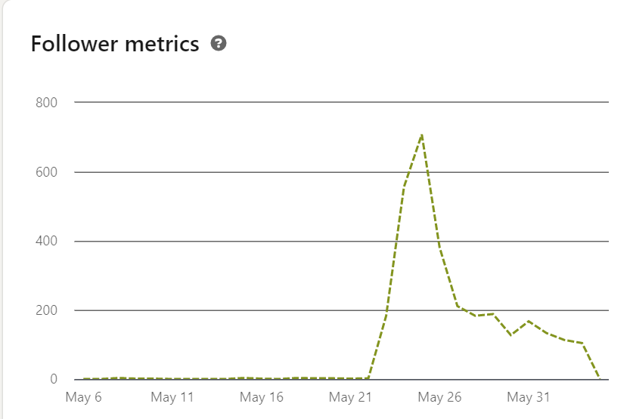
IEEE802 Group in Linkedin
It is the main group of IEEE 802.
It had 891 members
In MAY 2023
Total followers 3964
Total unique impressions 40000

Slide 3
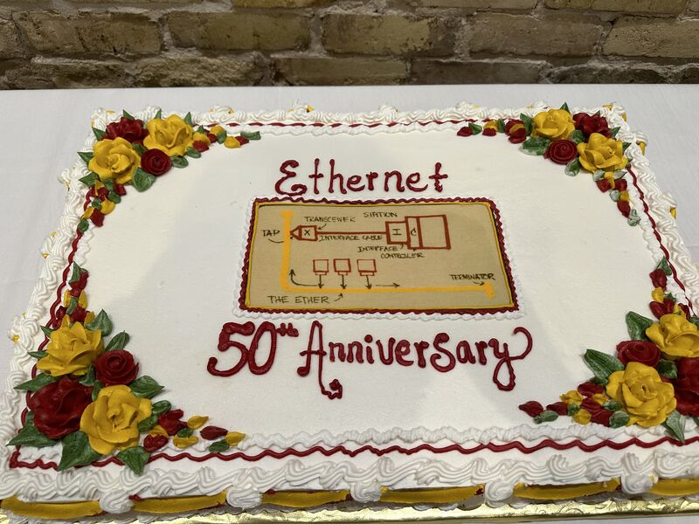
IEEE802 Group in Linkedin
All thanks to
14374 likes, 196 comments, 791 reposts

Slide 4
What Else is Posted?
Future of IEEE 802.11 Standards #webinar – 21 June | Register Now! –
The Evolution of Wi-Fi Technology and Standards standards.ieee.org
New bands for #IEEE802 communication systems in South Africa.
The Networking Industry recognizes the juggernaut that is Ethernet
The July 2023 Plenary meeting
For the Computer Society May 2023 standards webinar,

Slide 5
What Else is Posted?
Future of IEEE 802.11 Standards #webinar – 21 June | Register Now! –
The Evolution of Wi-Fi Technology and Standards standards.ieee.org
New bands for #IEEE802 communication systems in South Africa.
The Networking Industry recognizes the juggernaut that is Ethernet
The July 2023 Plenary meeting
For the Computer Society May 2023 standards webinar,

Slide 6
What else would I like to post?
Responses to Regulatory Bodies
Pictures from Award Ceremonies
  From WG Webpages
Presentations about IEEE 802 such as
  Introduction to 802.11be , Laurent Cariou to IEEE Comsoc Oregon.
  https://www.youtube.com/watch?v=afQzEoJ7zAo
  We will also add a note:
  "The views expressed in this video are the personal views of the presenter, and are not the formal position, explanation, or interpretation of IEEE, IEEE SA, the LAN/MAN Standards Committee, or the IEEE 802.11 Working Group.”

