Slide 1
Executive Secretary Agenda Items
2023 July Plenary
Jon Rosdahl
IEEE 802 Executive Secretary
jrosdahl@ieee.org

Slide 2
Event Conduct and Safety Statement
IEEE believes that science, technology, and engineering are fundamental human activities, for which openness, international collaboration, and the free flow of talent and ideas are essential. Its meetings, conferences, and other events seek to enable engaging, thought-provoking conversations that support IEEE’s core mission of advancing technology for humanity. Accordingly, IEEE is committed to providing a safe, productive, and welcoming environment to all participants, including staff and vendors, at IEEE-related events.

Slide 3
Event Conduct and Safety Statement
IEEE has no tolerance for discrimination, harassment, or bullying in any form at IEEE-related events. All participants have the right to pursue shared interests without harassment or discrimination in an environment that supports diversity and inclusion. Participants are expected to adhere to these principles and respect the rights of others.
IEEE seeks to provide a secure environment at its events. Participants should report any behavior inconsistent with the principles outlined here, to onsite staff, security or venue personnel, or toeventconduct@ieee.org.

Slide 4
IEEE 802 Opening EC Mtg – July 10
Agenda Item 6.02 - II
  Current / Future venues 10 Mins
    Event Summary and Important Information
    Registration Reminder
    Straw Poll for WGs
    Future Venue Contract Status
    Other Future Sessions

Slide 5
2023 July 802 Plenary Registration report as of 07/10/23 – 01:51 CEST
Registrations
Working Group | In-Person Attendee | Student | Student Activities Committee | Virtual Attendee | Grand Total
802.1 | 71 |  |  | 26 | 97
802.11 | 241 | 6 | 13 | 225 | 485
802.15 | 65 | 1 | 9 | 30 | 105
802.18 | 4 |  |  | 1 | 5
802.24 | 5 |  |  |  | 5
802.3 | 158 |  |  | 102 | 260
Grand Total | 544 | 7 | 22 | 384 | 957

Slide 6
2023 July IEEE 802 Plenary Session
Event Summary and Important Information
Prepared By: Face to Face Events, July 7, 2023

Slide 7
Meeting Planner and Network Contacts
Meeting Planner: Face to Face Events
Dawn Slykhouse
Mobile: +1 (408) 594-1342
Email: dawns@facetoface-events.com
Lisa Ronmark
Mobile: +1 (604) 316-4947
Email: lisa@facetoface-events.com
Network Provider: Linespeed Events
Richard Alfvin
Mobile: +1 (585) 781-0952
Email: rick@linespeed.com
Meeting Planner and Network Office
Room 6, 1st Floor, Estrel Congress Centre

Slide 8
In Person Registration Times and Location
Auditorium Foyer, Level 1
Sunday
  3:00 PM - 7:00 PM
Monday - Wednesday
  7:30 AM - 5:00 PM
Thursday
  7:30 AM - 1:30 PM
ESTREl CONGRESS CENTRE ROOM 6
Mtg Planner/Network office:
Thursday
  1:30 PM - 5:00 PM
Friday
  7:30 AM - 1:30 PM

Slide 9
Food and Beverage Breaks
FOR REGISTERED ATTENDEES ONLY
Auditorium Foyer, Level 1 and Level 2
Morning Coffee & Tea Break*
  Monday - Thursday
  9:50 AM - 10:35 AM
Afternoon Coffee & Tea Break*
Monday - Thursday
3:15 PM - 4:00 PM
*Light Snacks shall accompany beverage service.
Convention Hall 2
Lunch
Monday - Thursday
12:00 PM - 1:30 PM
Lunch Friday:
12:00PM – 1:00PM
(802 EC Closing Plenary meeting, or " IEC/IEEE 60802" meeting attendees )

Slide 10
Schedule of Sessions and Attendance
SCHEDULE OF SESSIONS
In Person Room Assignments: Schedule QR codes posted outside each meeting room and on your badge hand out. http://schedule.802world.com/schedule/schedule/show
Virtual Participation: https://ieee802.org/802tele_calendar.html
ATTENDANCE TOOL (IMAT)
https://imat.ieee.org/my-site/home
REGISTRATION FEE REQUIREMENT REMINDER
Payment of the session registration fee is required for all individuals who participate in any meeting associated with the July 2023 IEEE 802 Plenary Session. Registration: https://cvent.me/ewEaVD

Slide 11
Audio Visual Support - In Person Sessions
WHO TO CONTACT IF AUDIO VISUAL EQUIPMENT ISN’T WORKING IN YOUR ONSITE MEETING ROOM
Please contact the Meeting Planner directly if you have any issues with the audio visual equipment in your meeting room. The Meeting Planner will contact support and the appropriate technician will be sent to assist as soon as possible.
Meeting Planner can be reached at:
Registration and Information Desk: Foyer 4, Level 1 Estrel Congress Centre
Event Office: Room 6, Level 1 Estrel Congress Centre
Via Text or Call: Dawn Slykhouse: +1 (408) 594-1342
WEBEX AUDIO IN THE ONSITE MEETING ROOM
If you are a local participant, PLEASE, select “Don’t connect to audio” when joining the WebEx session. Connecting to the audio, may cause an audio feedback loop that prevents the meeting from proceeding

Slide 12
Network Access Information and Support
Encryption Type: WPA2/WPA3
SSID: IEEE802 Password: ieeeieee
Does not Support 6Ghz WiFi
Encryption Type: WPA3 Only
SSID: IEEE802-6G Password: ieeeieee
Supports 6Ghz WiFi
IEEE 802 Documents: Local Document Server
http://ieee802.linespeed.com/
Onsite Network Support
The July 2023 IEEE 802 Plenary Session Network Provider is Linespeed.
Members of the Linespeed team can be dispatched by contacting the Meeting Planner directly or by placing a request at the event registration desk.
Network Help Desk is available in Room 6.

Slide 13
IEEE 802 Plenary Networking Social
Summer Barbeque (Oktoberfest) on the Waterfront
WHO
Registered In-Person attendees and guests.
Guest Badges shall be distributed at the registration desk.
  The badges will be available until 1:30 PM Wednesday.
WHEN
Wednesday July 12th , 6:30 PM - 8:30 PM
WHERE
Estrel Summer Garden (Waterfront), located across the access road in the front of the hotel.
WHAT
Food, Drinks, Games (Kubb, Moloki, Giant Janga)

Slide 14
Discounted Tickets for Stars in Concert at the Estrel
DIVAS - The Show
DIVAS - The Show" brings together the greatest divas in music history in a spectacular live performance. First-class artists present glamorous and powerful-voiced divas such as Amy Winehouse, Jennifer Lopez, Whitney Houston, Donna Summer, Marilyn Monroe, Madonna, Diana Ross, Bette Midler and more.
They are accompanied by dancers and a terrific live band. You will be transported into a world of music and glamour that will never let you go.
SHOW SAMPLE VIDEO: https://youtu.be/L5s6NcbqmVI
TICKET DISCOUNT: 20% Discount for Guests of the Estrel Berlin
TICKET PURCHASE INSTRUCTIONS
Contact for bookings or inquiries
+49 30 6831 6831 │ ticket@estrel.com

Slide 15
Thanks for helping us make this session a success, we look forward to working with you again!
The next IEEE 802 Plenary Session will be November 12-17, 2023. The session will be a Mixed Mode with In-Person participation at the Hilton Hawaiian Village in Honolulu, Hawaii USA.
Session Information and Registration Link will be available in August 2023
If you have any questions about the current session or the November 2023 IEEE 802 Plenary please contact us:
Face to Face Events
IEEE 802 Wireless Meeting Planner
Email: 802info@facetoface-events.com

Slide 16
Friday F&B Straw poll
If you will attend one of the three meetings on Friday, July 14, 2023
( 802 EC Closing Plenary, the 802.11 Closing Plenary or
the 802.1 " IEC/IEEE 60802" meeting )
will you participate (eat/drink) :
    with the AM Break? -
    With lunch? -
    with the PM Break? -

Slide 17
Basic Room Resource Allocation
Big meetings
(≥ 100, e.g., WG plenaries)
Medium meetings
(35-100, e.g., Task Forces)
Smaller meetings
(30 or less)
Head table (5)
1 projector/screen
2 tables mics
1 or 2 floor mics
Sound system
(speakers, sound board, etc.)
Ethernet/HDMI/USB
Scarlett Audio Interface
Head table (3)
1 projector/screen
1 table mic
1 floor mic
Sound system
(speakers, sound board, etc.)
Ethernet/HDMI/USB
Scarlett Audio Interface
U-shaped or board meeting setup
1 room microphone
  Portable or speakerphone-type
Sound system
(speakers, sound board, etc.)
Ethernet/HDMI/USB
Scarlett Audio Interface

Slide 18
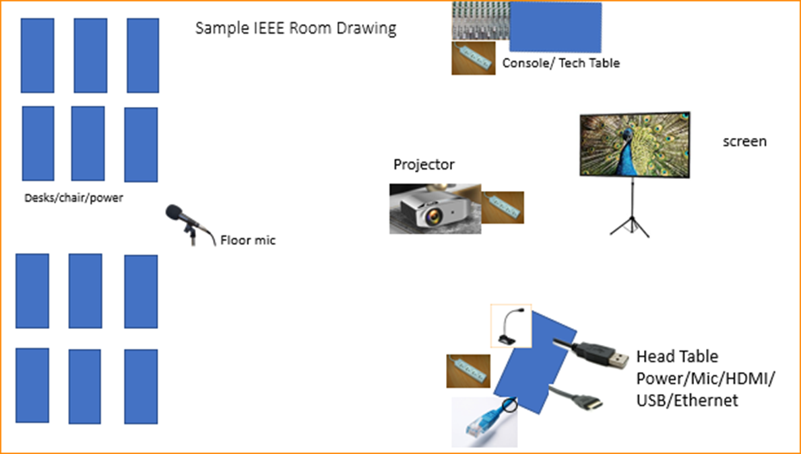

Scarlett
Notes:
This Photo by Unknown Author is licensed under CC BY-NC
This Photo by Unknown Author is licensed under CC BY-SA-NC
This Photo by Unknown Author is licensed under CC BY-SA

Slide 19
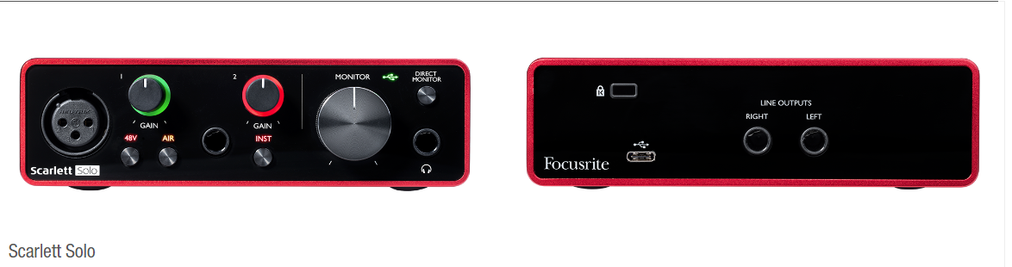
Scarlett Solo – Audio Interface by Focusrite
Thanks to Linespeed for obtaining a set of Scarlett Solo Audio Interface boxes to help provide a more consistent experience in our Sessions.

Slide 20
Estrel AV Differences
Meeting rooms in Auditorium area (Room 6-15) do not use the Scarlett box. They have an HDMI and a USB direct to the built-in AV system.
Select as Speaker properties – Move Volume to 100%
When using WebEx, you can adjust volume in WebEx.
Check that Audio is “Allowed”
Select Creston –if that does not work then change to “Echo Cancelling telephone”
I found that changing the WebEx mode to “Optimize for All Voices” worked (only the laptop connected to the system.
When Starting a meeting the host should do the following:
  Select “Meeting” -> “Meeting Options” -> [Disable] “Allow Participant to turn on Video”
  Select “Participant” -> [Enable] “Mute on Entry”.

Slide 21
Suggested best practices
One central laptop/computer per meeting connects at head table.
Local speakers queue/speak only at a microphone when called on.
Remote speakers request to speak via chat window and only speak when called on.
Presenters have chair (central laptop) share the presentation
Local attendees when logged into WebEx SHALL NOT connect Audio.
When Starting a meeting the host should do the following:
  Select “Meeting” -> “Meeting Options” -> [Disable] “Allow Participant to turn on Video”
  Select “Participant” -> [Enable] “Mute on Entry”.
For the Host and Remote Attendees connecting to Webex, Configure Webex Audio to use “Music Mode”.

Slide 22
Mixed-mode Meeting Protocol
Sample Intro Meeting Slide
In-room Attendees:
  In Webex choose connect without audio before you join
  Use the Webex queue to indicate you want to speak
  Wait to be called on while standing/holding a microphone to make a comment
  Repeat any questions that are inadvertently asked away from the microphone
Remote Attendees:
  Join Webex and set Webex audio as ‘music’
  Use the Webex chat window to indicate you want to speak (“q”)
  Wait to be called on to speak

Slide 23
Request for 802 WG Straw Polls -1
Request for WG SP about current Venue (Estrel Hotel, Berlin)
  How many people would like to come back to this venue?
    Yes/No
  Did you go to the social?
    Yes/No
  Did you like the social?
    Yes/No

Slide 24
Request for 802 WG Straw Polls -2
802 WG Chairs, Please Straw Poll your membership:
  1 If the 2023 November 802 Plenary Session were held at the Hilton Hawaiian Hotel in Honolulu, HI as an in-person only session, would you attend?
    Yes –
    No –
    Abstain -
  2. If the 2023 November 802 Plenary Session were held at Hilton Hawaiian Hotel in Honolulu, HI as mixed-mode session, will you attend:
    Attend In-person --
    Attend Virtually (remotely) -
    Will not attend plenary -

Slide 25
Request for 802W WG Straw Polls - 3
  1.If the 2023 Sept 802 Wireless Interim Session were held at the Grand Hyatt Buckhead, Atlanta, GA as an in-person only session, would you attend?
    Yes –
    No –
    Abstain -
  2. If the 2023 Sept 802 Wireless Interim Session were held at the Grand Hyatt Buckhead, Atlanta, GA as mixed-mode session, will you attend:
    Attend In-person --
    Attend Virtually (remotely) -
    Will not attend plenary -

Slide 26
Future Venue Contract Status
2023 Nov 12-17 – Hawaiian Village, Oahu, Hawaii, United States
2024 March 10-15 – Hyatt Regency Denver at Colorado Convention Center, Denver, CO, (March 2021)
2024 July 14-19 – Sheraton Le Centre Montreal, Montreal, Quebec, Canada (July 2020)
2024 Nov 10-15 –Hyatt Regency Vancouver, Vancouver, Canada (Nov 2021)
2025 March 9-14 –Hilton Atlanta, Atlanta, GA, United States (2 of 2 – March 2020).
2025 July 13-18 –Marriott Madrid Auditorium, Madrid, Spain (July 2021)
2025 Nov 9-24 – Open
2026 March 8-13 - Hyatt Regency Chicago, Chicago, IL, United States (March 2024)
2026 July 13-18 – Le Centre Sheraton Montreal, Montreal (July 2022 attrition offset)
2026 Nov 8-13 - Open
2027 March –Hilton Atlanta, Atlanta, GA, United States ( offset potential shortfall 2023/2025)
2027 July 11-16 - Open -
2027 Nov 14-19 – Hawaiian Village, Oahu, Hawaii, United States
802 EC Approved – Contract is being Negotiated.
Notes:
Yellow Highlight – Potential deferral identified.
Blue Highlight – replacement dates for venues deferred.
Light Green highlight – potential targets for possible deferrals or offset penalties.
Dark Green Highlight – rebooked due to COVID
Red – Cancelled – Electronic Plenary
No highlight – pre Covid assigned dates/venues.
Note: 2026 March - RFP -2019 - Hyatt Regency Chicago selected for March 2023, Contract not signed due to PSAV - Moved to 2024 March - then moved to 2026 due to agreement with rebooking Denver 2024.
Executed Contract
items are Venues approved by IEEE 802 EC, but Contract not complete.
These are open Calendar items I am working with potential venues.
Calendar open
https://mentor.ieee.org/802-ec/dcn/20/ec-20-0001-05-00EC-802-plenary-future-venue-contract-status.xlsx

Slide 27
Future Session AdHocs
All potential New Future Venues not already approved are on hold.
Negotiations on Madrid (2025 July) on Hold
Negotiations on Chicago (2026 March) expect to complete by end of summer.
Future Venue AdHoc: Next Plenary
  Thursday 7:30am Room 8 (Auditorium1st Floor)
    Review Resources for 2023 November Plenary
    Review requirement expectations/actuals for this week
Future Venue Ad-Hoc: Futures
  Thursday 8:00 am Room 8 (Auditorium1st Floor)
    Review requirements for future sessions.
    Review RFP being sent out.

Slide 28
Notes
Note Mtg Fees
  for Nov 2023 - $500/800/1100 in hotel –
  For Nov 2023 – $800/1100/1400 out of Hotel
Lunches at Plenary Sessions –
  Determined on a venue specific basis
RFP plan for about 2400 room nights ok.

Slide 29
IEEE 802 University Outreach Program for Berlin July 2023
  Student Outreach Program for Berlin July 2023
The purpose of our Student Outreach program is to give students a chance to see firsthand how the Standards process works. We realize it is like getting a drink from a fire-hose, but it does give a good first look into the process.
It is a one-day event Tuesday of the Plenary Week:
  7:30-9:00 – sign in and get badge
  9:00am Start with an introduction meeting with a couple of the 802 Leadership members to orient the students to what activities may be of most interest to them that day – Room 10
  10:30am (AM2) the students attend actual working meetings and can meet and participate in the discussions.

Slide 30
Student Outreach Program for Berlin July 2023 (2)
17:00 (5pm) Debrief: Room 13
  A short debrief meeting at the end of the day is provided to answer questions and help provide closure to the experience.
The Outreach Student fee is USD$25 per student
The program is limited to 25 Students. (22 registered)
Note that membership attendance credit is not granted for student activities.
The Students are invited to join for Lunch and breaks as our guests.
Previous material prepared for 2015 and 2017 programs:
  https://www.ieee802.org/Univ_Outreach.shtml
A motion to approve program for July 2023 was made during the 802 Closing Plenary Nov 17.

Slide 31
Future Venue AdHocs --

Slide 32
Next Venue Meeting planning – Thurs 7:30 am
Proposed Agenda:
  Start time 7:30 am
  Review meeting space plan for 2023 November Plenary
    Hilton Hawaiian Hotel, Honolulu, HI
  Adjourn 8:00am

Slide 33
Notes from Discussion
Hawaiian Hotel Venue
  Meeting space is primarily together.
  Hotel Website: Hilton Hawaiian Village
  Room Block set at 2400 – 1920 is the magic no attrition number.
  Meeting fee discussion:
    Set in-Hotel fees at $500/800/1100
    Set Out of Hotel Fees at $800/1100/1400
  Need to watch for swapping types – changes fees.

Slide 34
Future Venues AdHoc – Thurs 8 am
Proposed Agenda:
  Start time – 8:00 am
    Review Contract Status
    Review requirements for future sessions.
    .
  End time – 9:00am

Slide 35
Future Venue Contract Status
2023 Nov 12-17 – Hawaiian Village, Oahu, Hawaii, United States
2024 March 10-15 – Hyatt Regency Denver at Colorado Convention Center, Denver, CO, (March 2021)
2024 July 14-19 – Sheraton Le Centre Montreal, Montreal, Quebec, Canada (July 2020)
2024 Nov 10-15 –Hyatt Regency Vancouver, Vancouver, Canada (Nov 2021)
2025 March 9-14 –Hilton Atlanta, Atlanta, GA, United States (2 of 2 – March 2020).
2025 July 13-18 –Marriott Madrid Auditorium, Madrid, Spain (July 2021)
2025 Nov 9-24 – Open
2026 March 8-13 - Hyatt Regency Chicago, Chicago, IL, United States (March 2024)
2026 July 13-18 – Le Centre Sheraton Montreal, Montreal (July 2022 attrition offset)
2026 Nov 8-13 - Open
2027 March –Hilton Atlanta, Atlanta, GA, United States ( offset potential shortfall 2023/2025)
2027 July 11-16 - Open -
2027 Nov 14-19 – Hawaiian Village, Oahu, Hawaii, United States
802 EC Approved – Contract is being Negotiated.
Notes:
Yellow Highlight – Potential deferral identified.
Blue Highlight – replacement dates for venues deferred.
Light Green highlight – potential targets for possible deferrals or offset penalties.
Dark Green Highlight – rebooked due to COVID
Red – Cancelled – Electronic Plenary
No highlight – pre Covid assigned dates/venues.
Note: 2026 March - RFP -2019 - Hyatt Regency Chicago selected for March 2023, Contract not signed due to PSAV - Moved to 2024 March - then moved to 2026 due to agreement with rebooking Denver 2024.
Executed Contract
items are Venues approved by IEEE 802 EC, but Contract not complete.
These are open Calendar items I am working with potential venues.
Calendar open
https://mentor.ieee.org/802-ec/dcn/20/ec-20-0001-05-00EC-802-plenary-future-venue-contract-status.xlsx

Slide 36
IEEE 802 Closing EC Mtg – July 14
802 Closing EC Agenda Items:
  4.02 MI Future Meetings 30 mins
  4.021-II Student Outreach Program July 2023 5 mins
  8.033 II Executive Secretary Report 0 mins
  8.04 MI Announcement of 802 EC Interim Telecon 5 mins
  8.05 II Call for Tutorials for July 2023 Plenary 3 mins

Slide 37
Future Venue Contract Status
2023 Nov 12-17 – Hawaiian Village, Oahu, Hawaii, United States
2024 March 10-15 – Hyatt Regency Denver at Colorado Convention Center, Denver, CO, (March 2021)
2024 July 14-19 – Sheraton Le Centre Montreal, Montreal, Quebec, Canada (July 2020)
2024 Nov 10-15 –Hyatt Regency Vancouver, Vancouver, Canada (Nov 2021)
2025 March 9-14 –Hilton Atlanta, Atlanta, GA, United States (2 of 2 – March 2020).
2025 July 13-18 –Marriott Madrid Auditorium, Madrid, Spain (July 2021)
2025 Nov 9-24 – Open
2026 March 8-13 - Hyatt Regency Chicago, Chicago, IL, United States (March 2024)
2026 July 13-18 – Le Centre Sheraton Montreal, Montreal (July 2022 attrition offset)
2026 Nov 8-13 - Open
2027 March –Hilton Atlanta, Atlanta, GA, United States ( offset potential shortfall 2023/2025)
2027 July 11-16 - Open -
2027 Nov 14-19 – Hawaiian Village, Oahu, Hawaii, United States
802 EC Approved – Contract is being Negotiated.
Notes:
Yellow Highlight – Potential deferral identified.
Blue Highlight – replacement dates for venues deferred.
Light Green highlight – potential targets for possible deferrals or offset penalties.
Dark Green Highlight – rebooked due to COVID
Red – Cancelled – Electronic Plenary
No highlight – pre Covid assigned dates/venues.
Note: 2026 March - RFP -2019 - Hyatt Regency Chicago selected for March 2023, Contract not signed due to PSAV - Moved to 2024 March - then moved to 2026 due to agreement with rebooking Denver 2024.
Executed Contract
items are Venues approved by IEEE 802 EC, but Contract not complete.
These are open Calendar items I am working with potential venues.
Calendar open
https://mentor.ieee.org/802-ec/dcn/20/ec-20-0001-05-00EC-802-plenary-future-venue-contract-status.xlsx

Slide 38
Straw Poll #1: Return to this Venue (Estrel Hotel)
          Yes No N/A
    1 31 21 20
    3 23 9
    11 46 14
    15 - -
    18 - -
    19 - -
Poll total 102 44 20

Slide 39
Straw Poll #2 2023 July Attend Social
6. Did you go to the social?
          Yes No N/A
    1 42 6 24
    3 - -
    11 70 3
    15 22 10
    18 - -
    19 - -
Poll total 134 19 24

Slide 40
Straw Poll #3 2023 July “Like” social
7. Did you like the social?
          Yes No N/A
    1 32 10 31
    3 - -
    11 62 1
    15 22 2
    18 - -
    19 - -
Poll Total 116 13 31

Slide 41
Straw Poll #4 for 2023 November 802 Plenary
1. If the 2023 November 802 Plenary Session is held in Honolulu, HI as an in-person only session, would you attend?
Working Group | Yes | No | Minimum Viable
802.1 | 30 | 26 | 90
802.3 | 74 | 58 | 150
802.11 | 67 | 40 | 175
802.15 | 21 | 8 | 45
802.18 |  |  | 20
802.19 | 12 | 4 | 10
Totals | 204 | 136 | 490
Notes:
Minimum Attendance for Viable Meeting:
WG Chairs reported 2020-11-20:
802.1 90
802.3 150
802.11 175
802.15 45
802.18 20
802.19 10
802.24 7
Total: 497

Slide 42
Straw Poll #5 for 2023 November 802 Plenary
2. If the 2023 July 802 Plenary Session is held in Honolulu, HI as a mixed-mode session, will you attend:
Working Group | Attend in Person | Attend Remote | Will not Attend
802.1 | 28 | 27 | 6
802.3 | 68 | 60 | 4
802.11 | 65 | 58 | 5
802.15 | 20 | 12 | 0
802.18 | 9 | 6 | 0
802.19 | 12 | 4 | 2
Totals | 202 | 167 | 17
Notes:
20% drop.

Slide 43
Straw Poll #6 for 2023 Sept 802W Interim
1. If the 2023 Sept 802W Interim Session is held at the Grand Hyatt Buckhead, Atlanta, GA as an in-person only session, will you attend?
Yes, No Minimum Viable
802.11 57 57 175
802.15 17 13 45
802.18 - - 20
802.19 14 4 10
Totals 88 74 250
Notes:
Minimum Attendance for Viable Meeting:
WG Chairs reported 2020-11-20:
802.1 90
802.3 150
802.11 175
802.15 45
802.18 20
802.19 10
802.24 7
Total: 497

Slide 44
Straw Poll #7 for 2023 Sept 802W Interim
2. If the 2023 Sept 802W Interim Session is held in Grand Hyatt Buckhead, Atlanta, GA as a mixed-mode session, will you attend:
Attend In-person Attend Virtually (remotely) Will not attend plenary
802.11 56 68 9
802.15 16 13 3
802.18 9 4 2
802.19 12 5 1
Totals: 93 90 15
Notes:
20% drop.

Slide 45
4.02 November Mixed-mode Plenary Fee Motion
Motion to approve fees/dates for 2023 November IEEE 802 Mixed Mode Plenary for either in person or remote attendance:
  Cancellation Policy:
    fully refundable September 22, 2023
    refundable with $150 cancellation fee after September 22 until October 27, 2023
    non-refundable after October 27, 2023
Moved: Rosdahl
2nd: Zimmerman
Results: Unanimous – Motion Passes
Attendee Type | Early-Bird | Standard | Late
 | Until 2023-09-22 | 2023-09-23 to 2023-10-27 | After 2023-10-27
In Hotel | 500 | 800 | 1100
Not in Hotel | 800 | 1100 | 1400

Slide 46
4.02 Motion to Approve Exec Site Visit
Site Visits are included in the SOW for the Meeting Planner and Network Service Providers, the IEEE 802 Executive Secretary is requesting approval to attend a potential Site visit.
Move to approve a Hyatt Regency Denver Hotel Site Visit for IEEE 802 Executive Secretary not to exceed USD$2,000.
Move: Rosdahl
Second: Clint Powell
Results: Unanimous – Motion Passes
Notes:
Airfare = $300
Transfers = $200
Food = $250
Hotel = $900
Misc = $350
Total = $2,000 per person

Slide 47
4.021 Student Outreach Report
We had 22 Students from 4 different Universities register.
We had 12 Students attend
4 Professors assisted in getting their students here
Feedback from Student was it was worth it.
Thank You!!

Slide 48
4.021 Student Outreach/Student University Outreach
Form AdHoc:
  Chair Jon
    Members:
      Paul Nikolich, Edward Au, Geoff Thompson, Clint Powell, David Law, Tuncer Baykays, George Zimmerman, Subir Das, Guido Hiertz
Deliverables:
  Jon and Paul to prepare Scope by August 15th
  AdHoc initial proposal by Oct Interim Telecon.

Slide 49
Things to improve
2 student programs
  (Student Outreach and University Outreach was confusing).
  Consider format to allow more flexibility
  Consider orientation prior to arrival (like new members).
Change Student Outreach fee's structure.
  Change from $150 to some other value but continue to allow repeat usage.

Slide 50
8.033 – Executive Secretary Report
Meetings efficiency
  Network Report
Meeting venue management
Assist Chair as requested

Slide 51
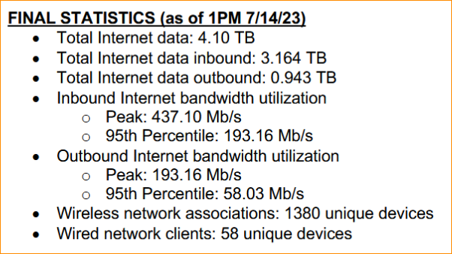
Network Report – Linespeed
Network Report posted to mentor: 802 EC-23/0144r0:
https://mentor.ieee.org/802-ec/dcn/23/ec-23-0144-00-00EC-ieee802-network-services-report-berlin-jul-2023.pdf
The local area network (LAN) supporting the meeting space is comprised of a main
distribution frame (MDF) and eight intermediate distribution frames (IDFs). Linespeed’s
wireless local area network (WLAN), comprised of 39 IEEE 802.11 a/g/n/ac/ax
compliant WiFi 6 access points is currently providing Wi-Fi connectivity to 1200 unique
devices (laptops, tablets, smartphones, smartwatches, etc.) at this session (Figure 1.)

Slide 52
8.04 Monthly IEEE 802 EC Telecons
Announcement of 802 EC Interim Telecons
Tuesday 1 August 2023 – HOLIDAY
Tuesday 5 September 2023, 19:00-21:00 UTC
Tuesday 3 October 2023, 19:00-21:00 UTC
Call Time: 3:00 PM - 5:00 PM Tuesday, (UTC-04:00) Eastern Time (US & Canada)
Recurrence: Occurs Generally the first Tuesday of every month.
From 7:00 PM to 9:00 PM, (UTC+00:00) Monrovia, Reykjavik time zone.
Calls after Nov to be Scheduled during 2023 Nov IEEE 802 EC Closing Plenary meeting.
Notes:
802 Interim Telecons – 1st Tuesday of the following Months: January/February/April/May/June/August/September/October

Slide 53
8.05 Call for Tutorials for November 2023
Tutorials may be held electronic: TBA
In person/Mixed-mode Tutorials: November (Mon/Tues)
Tutorial Request form:
  Generic: http://www.ieee802.org/802_tutorials/802_Tutorial_Request_Form.doc
As a reminder, please refer to Chair's Guidelines section 2.5 Tutorials for the logistics for participating in sponsoring/presenting a Tutorial.
Note that Tutorial times are limited to 80 minutes with 10 minutes to allow for presenters to setup and depart. (Starting at 18:15).
All requests for Tutorials must be made by 29 September 2023
Notes:
All official tutorial request forms must be submitted no later than 45 days in advance of the Plenary Session.
Approved Tutorial Requests will be assigned a time slot based on the order in which they were received.
The Final Tutorial Schedule will be posted at http://802world.org/plenary and http://ieee802.org no less than 30 days in advance of the Plenary Session.
Mentor Link to 2023 Tutorial Request form: https://mentor.ieee.org/802-ec/dcn/23/ec-23-0128-00-00EC-802-tutorial-request-form-2023.docx

