Slide 1
IEEE 802WCSC Meeting Venue Manager Report 2024
Date: 2023-06-12
Authors:
Notes:
R0 – New report for 2024 –January 802W Interim.
R1 – Update presented to 802WCSC Feb 14 Telecon.
R2 – Captured discussion/motions from 802WCSC Feb 14 Telecon.
R3/R4 – Update Presented to 802WCSC March 10.
R5 – Update Presented to 802WCSC May 12, 2024
R6 – Update presented to 802WCSC June 12, 2024
R7 – Captured Discussion/motions from 802WCSC June 12 Telecon.
R8 - Update presented to 802WCSC July 14, 2024

Slide 2
Abstract
Current Status of 802 Wireless Interim Session venue plans as of June 12, 2024, as presented to the IEEE 802 Wireless Chairs Standing Committee during the 2024 June IEEE 802 Wireless Telecon and posted link to Mentor to IEEE 802 Wireless Chairs Standing Committee reflector.

Slide 3
Status of IEEE 802 Plenary Contracts
2024 November – Hyatt Regency Vancouver
– Amendment 1 contract in DocuSign 1 signature left).
2025 July - Site Visit completed at Melia Castilla Madrid – May 21-25
– Draft Contract sent to hotel.
2025/2026 November – Terms and Conditions agreed to, need contract from Face to face Events.
– Target to complete by end of June 2024
2027 March – Hilton Atlanta – need to get contract formalized – Face to Face Events to finalize
– Target end of July 2024
2027 July – Gothia Towers – Site Visit Scheduled – 17-23 Aug 2024
– Contract pending site visit

Slide 4
Future 802 Plenary Venue Contract Status
2024 March 10-15 – Hyatt Regency Denver at Colorado Convention Center, Denver, CO, (March 2021)
2024 July 14-19 – Sheraton Le Centre Montreal, Montreal, Quebec, Canada (July 2020)
2024 November 10-15 –Hyatt Regency Vancouver, Vancouver, Canada (Nov 2021)
2025 March 9-14 –Hilton Atlanta, Atlanta, GA, United States (2 of 2 – March 2020).
2025 July 27-August 1 –Melia Castilla Madrid, Madrid, Spain (NOTE: Week of July 27)
2025 November 9-14 – Marriott Marquis Queen’s Park, Bangkok, Thailand
2026 March 8-13 - Hyatt Regency Vancouver, Vancouver, Canada (Change from Chicago)
2026 July 12-17 – Le Centre Sheraton Montreal, Montreal (July 2022 attrition offset)
2026 November 8-13 - Marriott Marquis Queen’s Park, Bangkok, Thailand
2027 March 14-19 – Hilton Atlanta, Atlanta, GA, United States ( offset potential shortfall 2023/2025)
2027 July 11-16 - Gothia Towers, Gothenburg, Sweden
2027 November 14-19 – Hawaiian Village, Oahu, Hawaii, United States
802 EC Approved – Contract is being Negotiated.
Contracts Executed
As of June 12,2024
Notes:
2025 July - Site Visit planned for Melia Castilla Madrid (May 21-25) – Draft Contract sent to hotel.
2025/2026 November – Terms and Conditions agreed to, need contract from Hotel (expect complete by end of June)
2026 March – Hyatt Regency Vancouver Contract - 802Fin-24/0005r0 – April 5, 2024
2027 March – Hilton Atlanta – need to get contract formalized – Targeted by end of July
2027 July – Gothia Towers – Site Visit Scheduled Aug 17-23

Slide 5
Recap of 802WCSC Decisions since November Plenary
The 802WCSC made the following tentative two choices in November 2023:
  2025 May - Hilton Prague, Prague, Czech Republic
  2027 September - Grand Hyatt Atlanta, Buckhead, GA - (repeat for Covid considerations).
The 802WCSC made the following three choices during February 2024 Telecon:
  2026 January IEEE 802W Interim: Victoria Conference Centre & Fairmont Empress, Victoria, Canada
  2027 January IEEE 802W Interim: Hyatt Regency Irvine, Irvine, California, USA
  2027 May IEEE 802W Interim: Cordis Hotel, Auckland, New Zealand
  2028 January IEEE 802W Interim: Hilton Panama, Panama City, Panama
The 802WCSC made the following Choice during the April 10 2024 Telecon:
  2026 May IEEE 802W Interim: Hilton Antwerp Old Town, Antwerp, Belgium

Slide 6
802W Site Visit Report
Feb 2024 – Site Visit to Warsaw – prepare for 2024 May 802W Interim.
April 2024 – Site Visit to Prague – prepare to negotiate Contract for 2025 May 802W Interim.
April 2024 – Site Visit to Victoria – prepare to negotiate Contract for 2026 Jan 802W Interim
Also completed 802 Site Visits:
Vancouver – prepare for 2024 Nov 802 Plenary.
Madrid – prepare for 2025 July 802 Plenary

Slide 7
Future 802W Interim Venue Status
As of June 12, 2024
2024-09 (8-13) Hilton Waikoloa, Waikoloa, HI, USA
2025-01 (12-17) Kobe, Japan – TBC (Moved from May 2023) (Contract TBC)
2025-05 (11-16) Hilton Prague, Prague, Czech Republic (Contract TBC) ( In Jeopardy)
2025-09 (14-19) Hilton Waikoloa, Waikoloa, HI, USA
2026-01 (11-16) Victoria Conference Centre & Fairmont Empress, Victoria, Canada (Contract TBC)
2026-05 (10-15) Hilton Antwerp Old Town, Antwerp, Belgium (Contract TBC)
2026-09 (13-18) Hilton Waikoloa, Waikoloa, HI, USA
2027-01 (10-15) Hyatt Regency Irvine, Irvine, CA, USA (Contract TBC)
2027-05 (9-14) Cordis Hotel, Auckland, New Zealand (Contract TBC)
2027-09 (12-17) Grand Hyatt Atlanta, Buckhead, GA, USA (Contract w/IEEE)
2028-01 (16-21) Hilton Panama, Panama City, Panama (Contract TBC)
Meeting Planner:
Dotted Venues: Face to Face Events
Starred Venues :MTG Events
Notes:
Future Wireless Interim Meetings: review and status June 12, 2024
In General, Each year one Session must be Non-NA/US
– Odd years Asia – Even Years Europe
2024 Sept 8-13 – Hilton Waikoloa Village – Contract (802WFIN-20/12r0)
2025 Jan 12-17 – Kobe, Japan – in negotiations -
2025 May 11-16 – Hilton Prague, Prague, Czech Republic Contract See next slide
2025 Sept 9-14 - Hilton Waikoloa Village, Waikoloa, HI – Contract (802WFIN-22-0007r0)
2026 Jan 11-16 –Victoria Conference Centre & Fairmont Empress, Victoria, Canada – in process
2026 May 10-15–Hilton Antwerp Old Town, Antwerp, Belgium – Contract TBC
2026 Sept 13-18 Hilton Waikoloa Village, Waikoloa, HI – Contract (802WFIN-22-0008r0)
2027 Jan 10-15 – Hyatt Regency Irvine– Contract draft ready to send to IEEE
2027 May 9-14 – Auckland, New Zealand – Contract TBC – pending Site Visit
2027 Sept 12-17 – Grand Hyatt Atlanta, Buckhead, GA, USA – in DocuSign – one signature left.
2028 Jan 16-21 – Hilton Panama, Panama City, Panama – Contract TBC – Mtg Events to complete – Target end of July.

Slide 8
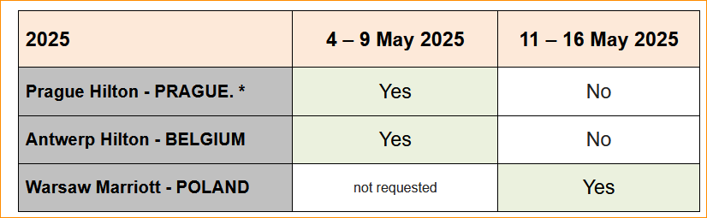
2025 Prague Hilton – Schedule change
The Prague Hilton has informed us that they cannot have our meeting the week of 11-19 May 2025. We have looked for other options.
Keep hotel but move date.
Keep date but change to Warsaw Marriot
Change date and venue to Antwerp Hilton

Slide 9
Motion #1 2025 May Interim Update
– 2024-06-12
Move to schedule the 2025 May IEEE 802 Wireless Interim as follows:
the date of the 2025 May IEEE 802 Wireless Interim as 11-16 May 2025 with the venue changed to Marriott Warsaw, Warsaw, Poland.
Moved: Jon Rosdahl
Second: Ben Rolfe
Results: 5-0-0
Notes:
From 802 WCSC Ops Man 2.5: All decisions related to or affecting the Joint Treasury shall be delegated to the Executive Committee of the Joint Treasury. Examples of such decisions include approval to spend funds and venue selection.

Slide 10
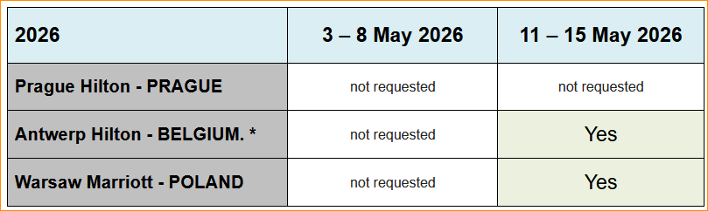
Potential Adjustment for May 2026
If a change was made in Motion #1, We have options to look at for 2026 May:
Keep Antwerp Hilton for 11-15 May 2026
Change to Warsaw Marriott for 11-15 May 2026

Slide 11
Motion #2 Adjustment May 2026
– 2024-06-12
Motion #2 to change the Venue for May 2026 from Antwerp to Warsaw, Changing the Venue for the 2026 May 802 Wireless Interim to Warsaw Marriott, Warsaw, Poland – 11-15 May 2026.
Moved:
Second:
Results:
Cancelled – Motion not made
Notes:
From 802 WCSC Ops Man 2.5: All decisions related to or affecting the Joint Treasury shall be delegated to the Executive Committee of the Joint Treasury. Examples of such decisions include approval to spend funds and venue selection.

Slide 12
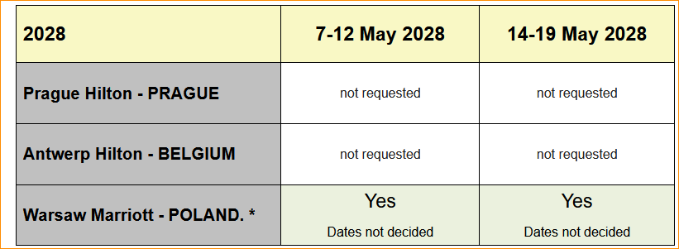
2028 May option to consider
We have a couple alternatives to consider for May 2028:
1. Warsaw Marriott has indicated availability
2. Question on if Prague Hilton has availability
MTG Events to confirm with both Hotels the options, Will bring back to July 14, 2024 802WCSC meeting.

Slide 13
Motion #3 – Set 2028 May IEEE 802 Wireless Interim Venue – 2024-06-12
Move to set the 2028 May IEEE 802 Wireless Interim to be held at the Warsaw Marriott, Warsaw, Poland with the date to be held [7-12] or [14-19] May 2028.
Moved:
Seconded:
Results:
Did not make Motion
Delay until July 802WCSC meeting in Montreal
Notes:
From 802 WCSC Ops Man 2.5: All decisions related to or affecting the Joint Treasury shall be delegated to the Executive Committee of the Joint Treasury. Examples of such decisions include approval to spend funds and venue selection.

Slide 14
Motion #4 – Site Visit – Hyatt Regency Irvine –
2024-06-12
Move to authorize the 802W Venue Manager, Jon Rosdahl, to go on a site visit with Linespeed and Face to Face Events with the purpose to prepare for 2027 January IEEE 802 Wireless Mixed-mode Interim at the Hyatt Regency Irvine Hotel in Irvine, California for the purpose of completing the contract.
Expenses not to exceed: $1,000.
Moved: Stephen McCann
Seconded: Clint Powell
Results: Unanimous Consent (5 present)
Notes:
From 802 WCSC Ops Man 2.5: All decisions related to or affecting the Joint Treasury shall be delegated to the Executive Committee of the Joint Treasury. Examples of such decisions include approval to spend funds and venue selection.

Slide 15
Motion #5 – Site Visit – Antwerp Hilton –
2024-06-12
Move to authorize the 802W Venue Manager, Jon Rosdahl, to go on a site visit with Linespeed and MTG Events with the purpose to prepare for 2026 May IEEE 802 Wireless Mixed-mode Interim at the Antwerp Hilton, Antwerp, Belgium, for the purpose of Preparing the Contract
Expenses not to exceed: $5,000.
Moved: Ann Krieger
Seconded: Stephen McCann
Results: Unanimous Consent (5 Present)
Notes:
From 802 WCSC Ops Man 2.5: All decisions related to or affecting the Joint Treasury shall be delegated to the Executive Committee of the Joint Treasury. Examples of such decisions include approval to spend funds and venue selection.

Slide 16
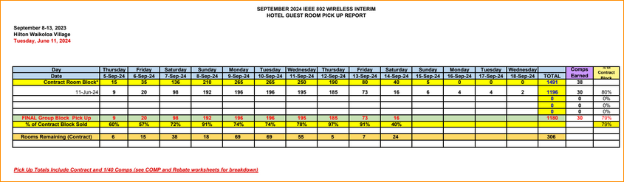
2024 Sept 802 Wireless Interim:
Waikoloa Hilton Hotel Pickup – 2024-06-12
Currently at 79% - 70% to avoid Attrition fees.

Slide 17
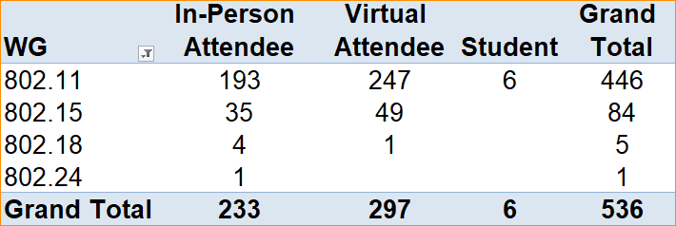
2024 Sept IEEE 802 Wireless Interim Registration as of 12 June 2024

Slide 18
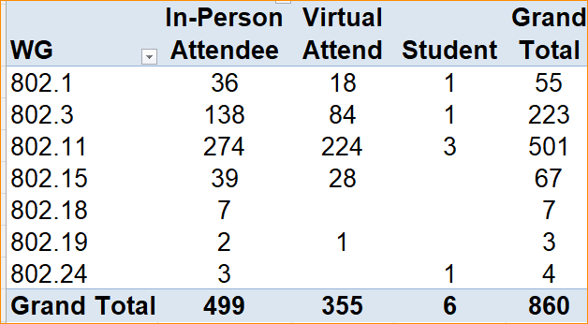
2024 July 802 Plenary Registration status as of
June 12, 2024

Slide 19
Future 802W Interim Venue Status
As of June 12, 2024, after the 802WCSC
2024-09 (8-13) Hilton Waikoloa, Waikoloa, HI, USA
2025-01 (12-17) Kobe, Japan – TBC (Moved from May 2023) (Contract TBC)
2025-05 (11-16) Warsaw Marriott, Warsaw, Poland (Contract TBC)
2025-09 (14-19) Hilton Waikoloa, Waikoloa, HI, USA
2026-01 (11-16) Victoria Conference Centre & Fairmont Empress, Victoria, Canada (Contract TBC)
2026-05 (10-15) Hilton Antwerp Old Town, Antwerp, Belgium (Contract TBC)
2026-09 (13-18) Hilton Waikoloa, Waikoloa, HI, USA
2027-01 (10-15) Hyatt Regency Irvine, Irvine, CA, USA (Contract TBC)
2027-05 (9-14) Cordis Hotel, Auckland, New Zealand (Contract TBC)
2027-09 (12-17) Grand Hyatt Atlanta, Buckhead, GA, USA (Contract w/IEEE)
2028-01 (16-21) Hilton Panama, Panama City, Panama (Contract TBC)
Meeting Planner:
Dotted Venues: Face to Face Events
Starred Venues: MTG Events
Notes:
Future Wireless Interim Meetings: review and status June 12, 2024
In General, Each year one Session must be Non-NA/US
– Odd years Asia – Even Years Europe
2024 Sept 8-13 – Hilton Waikoloa Village – Contract (802WFIN-20/12r0)
2025 Jan 12-17 – Kobe, Japan – in negotiations -
2025 May 11-16 – Warsaw Marriott, Warsaw, Poland – new venue plan
2025 Sept 9-14 - Hilton Waikoloa Village, Waikoloa, HI – Contract (802WFIN-22-0007r0)
2026 Jan 11-16 –Victoria Conference Centre & Fairmont Empress, Victoria, Canada – in process
2026 May 10-15–Hilton Antwerp Old Town, Antwerp, Belgium – Contract TBC
2026 Sept 13-18 Hilton Waikoloa Village, Waikoloa, HI – Contract (802WFIN-22-0008r0)
2027 Jan 10-15 – Hyatt Regency Irvine– Contract draft ready to send to IEEE
2027 May 9-14 – Auckland, New Zealand – Contract TBC – pending Site Visit
2027 Sept 12-17 – Grand Hyatt Atlanta, Buckhead, GA, USA – in DocuSign – one signature left.
2028 Jan 16-21 – Hilton Panama, Panama City, Panama – Contract TBC – Mtg Events to complete – Target end of July.

Slide 20
References
  From the WCSC Operations Manual 2.8 Meeting Venue Manager
The Meeting Venue Manager is responsible for the following tasks:
Ensure that WCSC sponsored sessions are compliant with the IEEE Finance Operations Manual (FOM). The FOM contains policies and information related to IEEE finances, including policies and information related to financial stability, reporting requirements, asset and liability management, reserves, insurance coverage, business expense reporting, fund-raising, and contracts and purchase orders.
Work with the Professional Conference Organizer (PCO) to get a Request for Proposal (RFP) for the assigned dates.
Work with the PCO to send the RFP to one or more venues.
Review RFP responses from venue(s).
Perform venue site visits as needed, potentially with the PCO and network service provider, to determine suitability of a venue.
Present summaries of venue options to the WCSC for WCSC decision/selection.
Negotiate contract proposals on behalf of the WCSC.
Review venue contract terms and conditions with the WCSC.
Submit venue contract(s) to the IEEE Meetings Contracts and Events (MCE), IEEE legal and IEEE-SA Procurement to formally execute the contract.
Coordinate with the PCO and the WCSC chair on major decisions.
Attend the venue pre-conference meeting, walk the venue space with the PCO and meet with the hotel staff as the IEEE 802 WCSC point of contact. The PCO is the primary hotel contact.
Monitor the terms of the contract to ensure that IEEE 802 WCSC meets its obligations, and that the venue meets theirs.
  If the contract requires deposits, confirm that the Treasurer will make the deposits on time.
  Monitor contract review points (room block, food and beverage minimum requirements) and file contract addendums as necessary.

Slide 21
1. Motion approve location for the 2026 May IEEE 802W Interim: Antwerp, Belgium (2024-04-10)
Motion: Approve the location of the 2026 May IEEE 802W Interim: Antwerp, Belgium 2026 May 10-15.
Moved: Stephen McCann
2nd: Clint Powell
Motion for ECJT.
Results: 5-0-2
Notes:
From 802 WCSC Ops Man 2.5: All decisions related to or affecting the Joint Treasury shall be delegated to the Executive Committee of the Joint Treasury. Examples of such decisions include approval to spend funds and venue selection.

Slide 22
2. Motion to Reset the date for 2025 January– Kobe, Japan
2024-02-14
    Motion: Approve the date change (reversion) of the 2025 January 802W Interim to January 12-17, 2025, in Kobe (was subsequent week). [Note: this rescinds the 2024 January date change approval and 2023 May location/date approval, due to hotel availability]
  Moved: Jon Rosdahl
  Second: Ben Rolfe
  · Note: This is a wireless chairs’ motion.
  Results: Unanimous w/1 abstain (Stuart Kerry). (Voter's present = 14)
Notes:
From 802 WCSC Ops Man 2.5: All decisions related to or affecting the Joint Treasury shall be delegated to the Executive Committee of the Joint Treasury. Examples of such decisions include approval to spend funds and venue selection.
Motion #1 was to approve purchase of 802.15 Anniversary shirts.

Slide 23
3. Motion to approve Site Visit for 2025 May 802W Interim - Hilton Prague, Prague, Czech Republic
2024-02-14
Move to authorize the 802W Venue Manager, Jon Rosdahl, to go on a site visit with Linespeed and Mtg Events with the purpose to prepare for 2025 May IEEE 802 Wireless Mixed-mode Interim in Prague, Czech Republic.
Expenses not to exceed: $5,000.
  Moved: Jon Rosdahl
  Second: Ben Rolfe
  · Note: This is a EJTC motion.
  Results: Unanimous . (Voter's present = 7-0-0)
Notes:
Airfare: $3,500
Transfers: $200
Meals: $500
Hotel: $800
From 802 WCSC Ops Man 2.5: All decisions related to or affecting the Joint Treasury shall be delegated to the Executive Committee of the Joint Treasury. Examples of such decisions include approval to spend funds and venue selection.

Slide 24
4. Motion approve location for the 2027 May IEEE 802W Interim: Auckland, New Zealand
2024-02-14
Motion: Approve the location of the 2027 May IEEE 802W Interim as Auckland, New Zealand 2027 May 9-14.
Moved: Jon Rosdahl
2nd: Stephen McCann
Motion for ECJT.
Results: Unanimous – (Voters = 6-0-0)
Notes:
From 802 WCSC Ops Man 2.5: All decisions related to or affecting the Joint Treasury shall be delegated to the Executive Committee of the Joint Treasury. Examples of such decisions include approval to spend funds and venue selection.

Slide 25
5. Motion to approve Location for 2028 January–
Panama Hilton, Panama City
2024-02-14
  Approve holding the 2028 January IEEE 802 Wireless Interim Session at the Panama Hilton, Panama City, Panama on January 16-21, 2028.
  Moved: Jon Rosdahl
  Second: Robert Stacey
  · Note: This is a ECJT motion.
  Results: Unanimous Consent (Voter's present = 6-0-0)
Notes:
From 802 WCSC Ops Man 2.5: All decisions related to or affecting the Joint Treasury shall be delegated to the Executive Committee of the Joint Treasury. Examples of such decisions include approval to spend funds and venue selection.

Slide 26
6. Motion to approve Location for 2026 January–
Victoria, Canada 2026 Jan 11-16
2024-02-14
  Approve holding the 2026 January IEEE 802 Wireless Interim Session at Victoria, Canada 2026 Jan 11-16 and Authorize Jon Rosdahl to conduct a Site visit with F2F Events and Linespeed prior to contracting not to exceed $3,000.
  Moved: Jon Rosdahl
  Second: Stephen McCann
  · Note: This is a ECJT motion.
  Results: Unanimous Consent (Voter's present = 6-0-0)
Notes:
From 802 WCSC Ops Man 2.5: All decisions related to or affecting the Joint Treasury shall be delegated to the Executive Committee of the Joint Treasury. Examples of such decisions include approval to spend funds and venue selection.

Slide 27
7. Motion to approve Location for 2027 January–
Hyatt Regency Irvine – 2027 January 10-15
2024-02-14
  Approve holding the 2027 January IEEE 802 Wireless Interim Session at the Hyatt Regency Irvine, CA on Jan 10-15, 2027, and Authorize Jon Rosdahl to conduct a Site visit with F2F Events and Linespeed prior to contracting not to exceed $3,000.
  Moved: Jon Rosdahl
  Second: Ann Krieger
  · Note: This is a ECJT motion.
  Results: Unanimous Consent (Voter's present = 6-0-0)
Notes:
From 802 WCSC Ops Man 2.5: All decisions related to or affecting the Joint Treasury shall be delegated to the Executive Committee of the Joint Treasury. Examples of such decisions include approval to spend funds and venue selection.

Slide 28
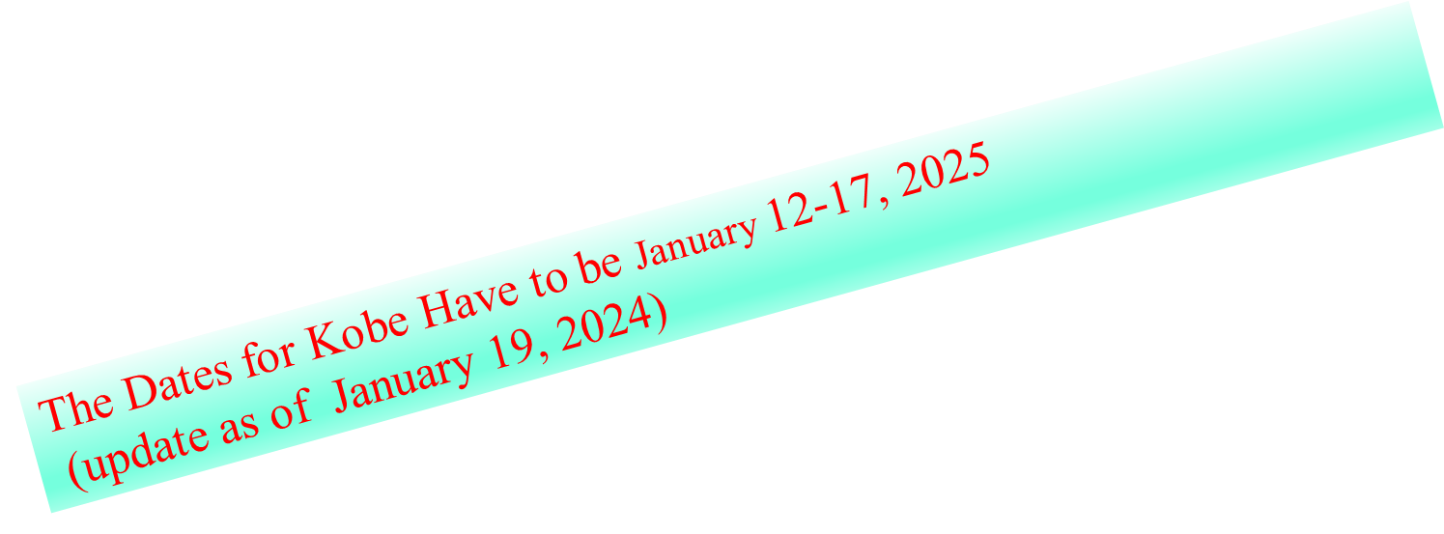
12. Motion to approve date change for 2025 January IEEE 802 Wireless Interim – 2024-01-06
Motion: Approve the date change to January 19-24, 2025 in Kobe (was prior week)
· Moved: Jon Rosdahl, Second: Ben Rolfe

Slide 29
1. Motion to approve Location for May 2025 –
Hilton Prague, Prague, Czech Republic
2023-12-13
Motion: Approve the location of the 2025 May IEEE 802W Interim to be held at the Hilton Prague, Prague, Czech Republic.
  Moved: Jon Rosdahl
  Second: Ann Krieger
  · Note: This is a ECJT wireless chairs’ motion.
  Results: Unanimous Consent
Notes:
During the 2023 November 802WCSC meeting, no objection to proceed with this venue, but a formal decision to be taken 2023 Dec 13 802WCSC Telecon.
From 802 WCSC Ops Man 2.5: All decisions related to or affecting the Joint Treasury shall be delegated to the Executive Committee of the Joint Treasury. Examples of such decisions include approval to spend funds and venue selection.

Slide 30
2. Motion to approve Location for 2027 September –
Grand Hyatt Atlanta, Buckhead, GA
2023-12-13
Motion: Approve the location of the 2027 September IEEE 802W Interim to be held at the Grand Hyatt Atlanta, Buckhead, GA.
  Moved: Jon Rosdahl
  Second: Clint Powell
  · Note: This is a ECJT wireless chairs’ motion.
  Results: Unanimous Consent
Notes:
During the 2023 November 802WCSC meeting, no objection to proceed with this venue, but a formal decision to be taken 2023 Dec 802WCSC Telecon.
From 802 WCSC Ops Man 2.5: All decisions related to or affecting the Joint Treasury shall be delegated to the Executive Committee of the Joint Treasury. Examples of such decisions include approval to spend funds and venue selection.

Slide 31
1. Motion to approve 2024 802W Interim Registration Fees
2023-09-10
Move to approve Session fees for the 2024 802 Wireless Mixed-mode Interims:
January at the Hilton Panama, Panama City, Panama;
May at the Marriot Warsaw, Warsaw, Poland, and
September at the Hilton Waikoloa, Waikoloa, HI, USA
at $600/$800/$1000 for any in-person or virtual attendee
with a $300 discount for staying at least 3 nights in the session hotel.
  Moved: Ben Rolfe
  2nd: Clint Powell
  Results: 8-0-0 (ECJT voters)

Slide 32
2. Motion to approve Site Visit for Kobe, Japan
2023-09-10
Move to authorize the 802W Venue Manager, Jon Rosdahl, to go on a site visit with Linespeed and Mtg Events with the purpose to prepare for 2025 January IEEE 802 Wireless Mixed-mode Interim in Kobe, Japan.
Expenses not to exceed: $10,000.
Moved: Ben Rolfe
2nd: Robert Stacey
Results: 7-0-1 (ECJT voters)
Notes:
Airfare: $8,800
Transfers: $200
Meals: $400
Hotel: $600

Slide 33
3. Motion to approve Site Visit for Warsaw, Poland
2023-09-10
Move to authorize the 802W Venue Manager, Jon Rosdahl, to go on a site visit with Linespeed and Mtg Events with the purpose to prepare for 2024 May IEEE 802 Wireless Mixed-mode Interim in Warsaw Poland.
Expenses not to exceed: $5,000.
  Moved: Ben Rolfe
  2nd: Stephen McCann
  Results: 7-0-1 (ECJT voters)
Notes:
Airfare: $3,800
Transfers: $200
Meals: $400
Hotel: $600

Slide 34
Email Ballot: Motion to approve Site Visit for Panama
2023-08-08
Ballot opens 2023-08-08 and closes either 2023-08-18 or when sufficient votes have been received to know the outcome:
Move to authorize the 802W Venue Manager, Jon Rosdahl, to go on a site visit with Mtg Events with the purpose to prepare for 2024 January IEEE 802 Wireless Mixed-mode Interim.
Expenses not to exceed: $3,000
Moved: Jon Rosdahl
2nd: Ben Rolfe
Results: 6-0-0 (ECJT – 6/8 responded)

Slide 35
1. Motion to set Interim Session Type for 2024
2023-07-09
Motion: Hold the 2024 Wireless Interim sessions in mixed mode (in-person
and electronic)
  o Moved: Tuncer Baykas, 2nd: Ann Krieger
  o No objection to approving by unanimous consent
  o [Voters - WC standing committees (WG and TAGs chairs, vice-chairs and
  secretaries)] [13 present]

Slide 36
1. Motion to approve Location for Jan 2025 – Kobe, Japan
2023-05-14
  Approve holding the January 19-24, 2025, Wireless Interim session in Kobe, Japan.
  Moved: Jon Rosdahl
  Second: Stephen McCann
  · Note: This is a wireless chairs’ motion.
  Results: Approve by unanimous consent. (Voter's present = 11)
The Dates for Kobe Have to be January 12-17, 2025
(update as of January 19, 2024)
Notes:
From 802 WCSC Ops Man 2.5: All decisions related to or affecting the Joint Treasury shall be delegated to the Executive Committee of the Joint Treasury. Examples of such decisions include approval to spend funds and venue selection.

