Slide 1
IEEE 802 October 2024
Public Visibility
Standing Committee Report
IEEE 802 October 2024

Slide 2
802 Public Visibility SC Scope, Duties, Membership
  Scope and Duties
  To raise public visibility and industry awareness in timely fashion of IEEE 802 WG / TAG activities
  Develop social media content based on IEEE 802 WG / TAG activities
    LinkedIn – https://www.linkedin.com/company/ieee802
    IEEE-SA 802 - https://standards.ieee.org/featured/802/index.html
  Content
    Review Pre 802 Plenary meetings for social media messaging: PARs to be considered, Tutorials, [802.3] Call-for-Interests, New Task Force formations
    Review Post 802 Plenary meetings for social media messaging: Study Group formations, IEEE 802 Position Approvals
    Other 802 related material for social media messaging: Press Releases, White Paper publications, Other 802 approved news, 802 WG / TAG Activities with IEEE-SA
    IEEE-SA Standards Board Related - PAR Approvals, Standards Approval, Standards Publication
  Membership
  Membership in the Standing Committee is open to anyone that wishes to participate (ideally at least one participant from each 802 WG and TAG)

Slide 3
Linkedin Report
  4,895 total followers.
  Between 1/1/2024 and 29/9/2024
  60,271 Impressions
  1309 Reactions
  Latest Posts
  November meeting
  Completion of 6 projects
  2024 TSN/ Projects

Slide 4
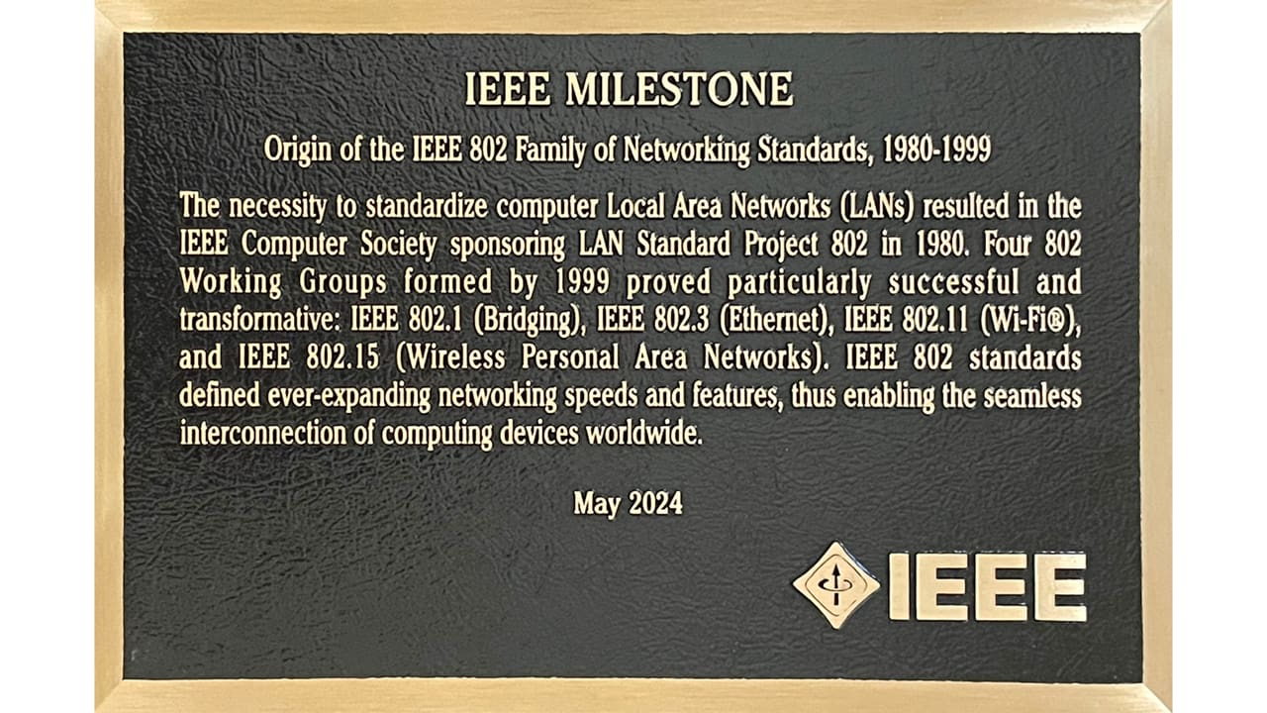
New Efforts
Creation of IEEE 802 Stickers
Suggestion creation of a clean version of the milestone plaque.
Total cost around < 200 USD for 1000 highest quality credit card size stickers

