Slide 1
Kobe 2025-Jan-802W-mixed-mode-Interim-Session-av-training
Date: 2025-01-11
Authors:

Slide 2
Abstract
The 2025 January IEEE 802 Wireless Mixed-mode Interim Session will provide for remote attendance. This Training deck is to help with the discussion on what to expect when running a meeting in this fashion.
A training session is planned for January 11 (14:30 JPT), 2025 to be held in room 504 of the Kobe International Conference Center and online:
– Meeting number (access code): 2339 108 4585
– Meeting password: training
  – Meeting Link: https://ieeesa.webex.com/ieeesa/j.php?MTID=mca462054924ddfd3fce73704e598e2ff

Slide 3
Summary of Key Points
Meetings are to be run as an in-person meeting.
  Local time zone schedule for meetings
  Local participants attend as an in-person meeting
  Remote access is provided to remote participants to view/present/interact similarly to on-line meetings (best effort)
In-person participants are admonished (stronger than encouraged) to stay OFF the Audio interface from the Webex/zoom/teams/conference tool of your choice –
Presentation/room computer is logged into conference tool (ideally from a volunteer-supplied PC), and the web-conferencing tool is presenting what is being presented by the local projector.
A chair, vice-chair, or designate, is logged into the conference tool and monitoring the queue (based on experience this is probably a second room log in, since monitoring the queue doesn’t work well when presenting) – this person manages the online queue for the chair to integrate with the floor queue. Fairness for local and remote attendees is responsibility of the officer.
Audio comes from a floor mic or the chair/dias mic which is mixed into room speakers and outgoing sound by the sound board is then connected to the local computer that shares to the remote conference tool.
Working groups need to decide voting rules, etc. for subgroups (some use different rules for electronic meetings than in person)

Slide 4
Mixed Mode Meeting requirements - (1)
1. Local room requirements:
  Hear local participants
  (the number of microphones required is determined by the size of room).
  See Local presentations
    (projection of a central laptop or chair’s laptop for local presentation on local screen).
  Local Queue management is facilitated by lining up to or passing a microphone.
  Hear remote participants
  (audio from remote should seamlessly be injected in the local room.)
  Remote Queue management to be integrated with local participants queueing
  (Chair may need a VP to watch and manage fair queue access)
  Remote presentations need to be presented in Local room.
  (central laptop or chair’s laptop to project remote shared screen).
  Provide local audio and screen presentation to remote participants
  (WebEx, Zoom, Teams, or other proprietary conferencing program)

Slide 5
Mixed Mode Meeting requirements- (2)
2. Remote access requirements:
  Hear local participants
  (Local participants need to speak into microphone to ensure injected into remote system)
  Speak - Need to be able to speak to the Local and remote participants
  (Remote Audio is shared on conference system and locally.)
  Request remote queue
  (Need to indicate desire to speak and respond when called on as appropriate)
  (This can be done by electronic hand raise or indicate in chat window).
  See Local or Remote presentations
  (projection of central laptop or chair’s laptop into remote access tool).
  Present - Need to be able to have a remote presenter
  (this can be done by the central laptop or chair’s laptop or sharing of remote screen).

Slide 6
Mixed Mode Meeting requirements - (3)
3. General requirements
  Local room to have sound mixer to integrate local and remote audio
  Local room to have a method of sharing remote info to local screen
  No requirement for local participants to login to "see" remote information.
  Explicitly preclude local participants from connecting audio to prevent audio feedback loop.
  Hardware connection expectations:
    4 Connections at head table to controlling laptop
      Power
      Ethernet (Wi-Fi alternative)
      HDMI to local projector
      USB cable from Scarlett Audio Interface
        2 XLR cables for Audio in/out to local Sound mixer board.

Slide 7
Draft Room Resource Allocation
Big meetings
(≥ 100, e.g., WG plenaries)
Medium meetings
(35-100, e.g., Task Forces)
Smaller meetings
(30 or less)
Head table (5) Schoolroom
1 projector & screen
2 tables mics
1 or 2 floor mics
Sound system
(speakers, sound board, etc.)
Ethernet/HDMI/USB
Scarlett Audio Interface
Head table (3) Schoolroom
1 projector & screen
1 table mic
1 floor mic
Sound system
(speakers, sound board, etc.)
Ethernet/HDMI/USB
Scarlett Audio Interface
U-shaped/boardroom
1 projector & screen
1 Table mic
2 Wireless microphone
Sound system
(speakers, sound board, etc.)
Ethernet/HDMI/USB
Scarlett Audio Interface

Slide 8
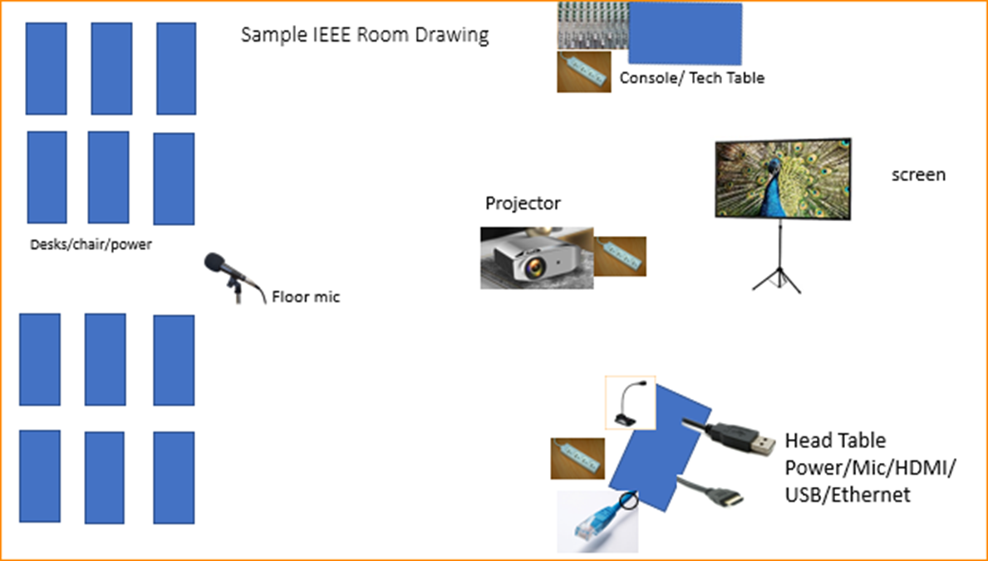

Scarlett
Notes:
This Photo by Unknown Author is licensed under CC BY-NC
This Photo by Unknown Author is licensed under CC BY-SA-NC
This Photo by Unknown Author is licensed under CC BY-SA

Slide 9
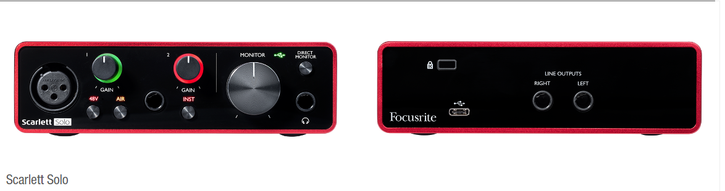
Focusrite Scarlett Solo – Audio Interface

Slide 10
Suggested Best Practices
One central laptop/computer per meeting connects at head table.
Local speakers queue/speak only at a microphone when called on.
Remote speakers request to speak via chat window and only speak when called on.
Presenters share the presentation via conferencing tool or have chair (central laptop) present for them.
Local attendees when logged into WebEx SHALL NOT connect Audio.
When Starting a meeting the host should do the following:
  Select “Meeting” -> “Meeting Options” -> [Disable] “Allow Participant to turn on Video”
  Select “Participant” -> [Enable] “Mute on Entry”.
For those Remote Attendees connecting to Webex, Configure Webex Audio to use “Music Mode”.
Treat All Microphones as hot and live – Conversations in a room may be heard online.

Slide 11
Webex Helps
Cisco has setup a website with lots of information:
https://help.webex.com/en-us
Slido-Webex Integration tutorial:
https://blog.slido.com/introducing-slido-in-webex/
Please Note: Your mileage may vary, Batteries not included, This is my experience.

Slide 12
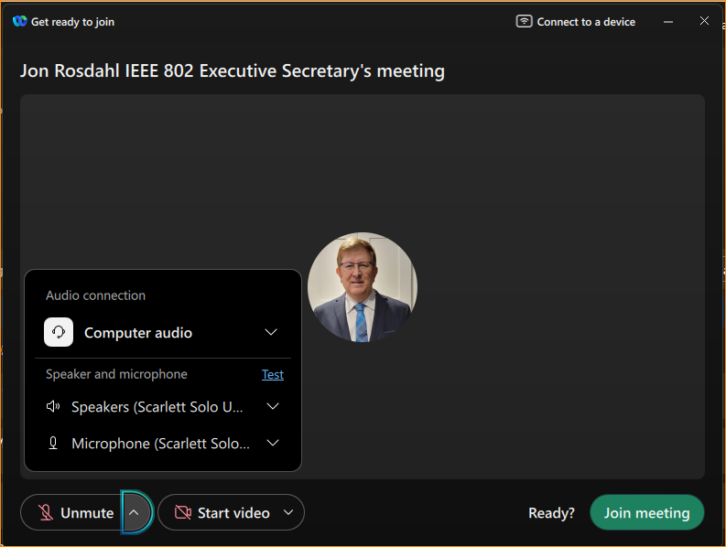
When starting WebEx, make sure you can see that it is the account you expect, and that the “Scarlet Solo” is the speaker and microphone selected.

Slide 13
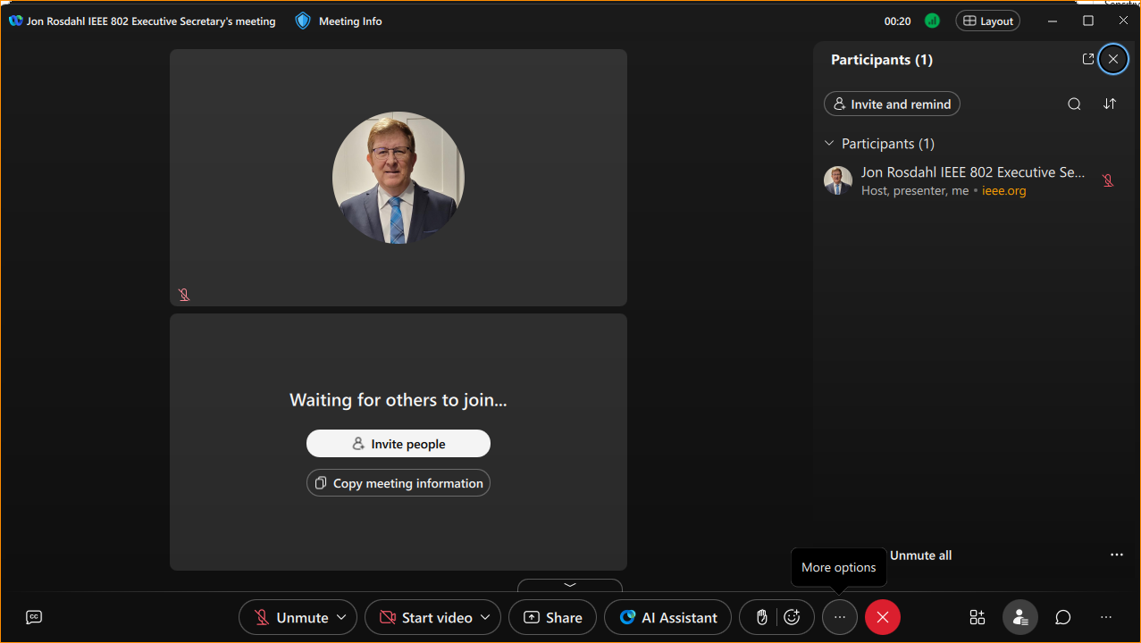
On the bottom, you will see 3 dots just below “more options.

Slide 14
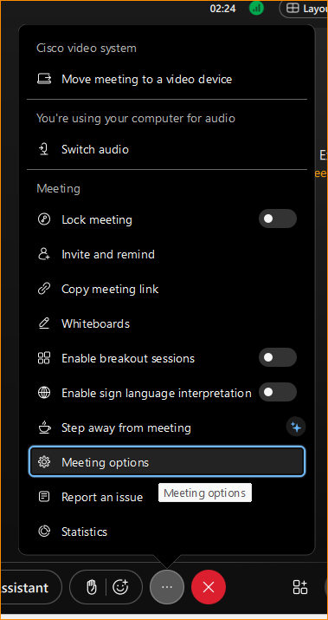
Select Meeting options

Slide 15
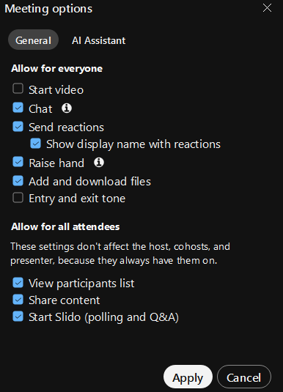
Make sure that “Start Video” and “Entry and exit tone” are not checked.
Make sure Start Slido is checked.

Slide 16
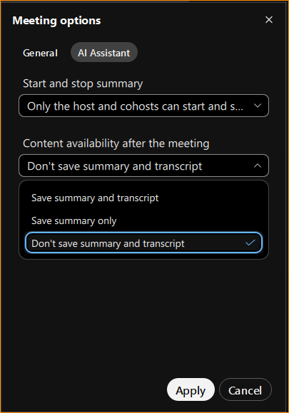
Select the “AI Assistant” and change Content Availability after the meeting –
Select “Don’t save summary and transcript”.

Slide 17
On the bottom far right, you will see 3 dots. Select Slido

Slide 18
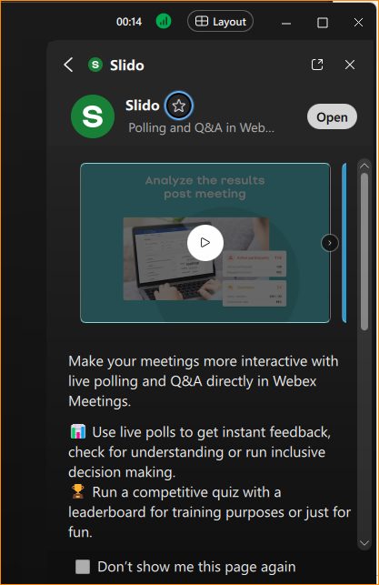
Once Slido is selected you may see the screen to the right.
Select open, (or view tutorial).

Slide 19
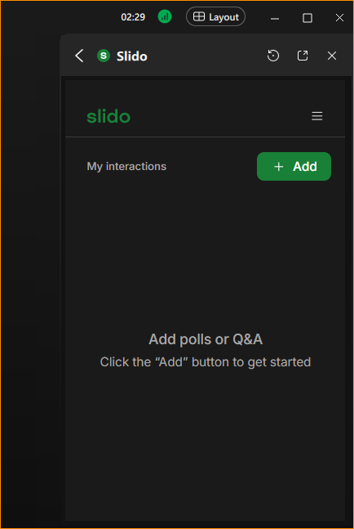
My view may be a bit different, but you should be able to “Add” “Add polls or Q&A”

Slide 20
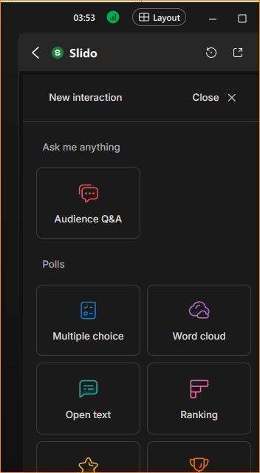
This is the main choice location for Slido.
Most of the time we will be choosing “Multiple Choice”

Slide 21
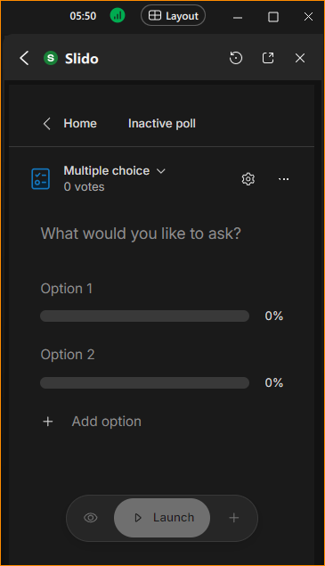
Now you will create your straw poll.
You will type in the straw poll:
“What would you like to ask?”
Then change option 1 to “yes”
Option 2 to “no” and “add option” for “Abstain”.

Slide 22
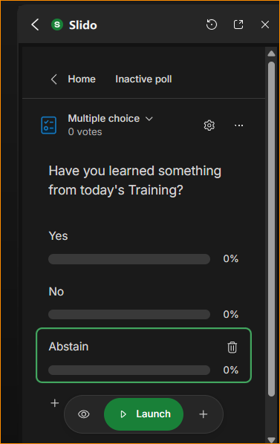
Please notice that as you have your question and options filled in, then the “Launch” button will change to green and active.
BEFORE you hit it, notice the little “eye icon” to the left.
Click it. This will hide the live results from being shown while the poll is open.
You can preload polls if you want.
Launch the poll

Slide 23
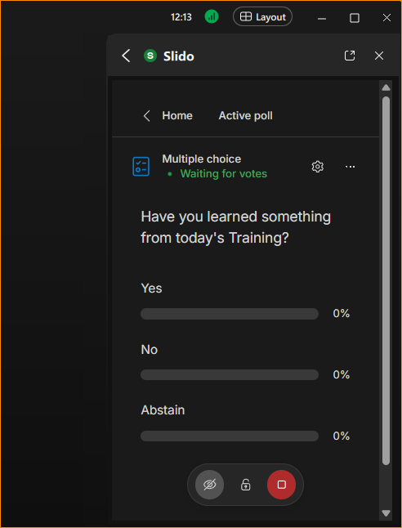
While the poll is open, you will see the live tally. Note that the eye icon has a line through it so others will not see the live tally. When ready to close the voting, click the lock.

Slide 24
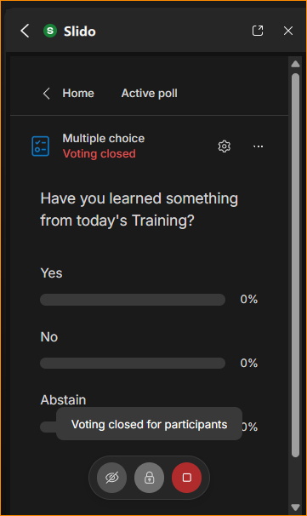
When you click the unlock icon, it will close the voting in Slido for the participants. You can reopen it if there is an extraordinary need, but normally once closed, it should stay closed.
You can now click on “Home”

Slide 25
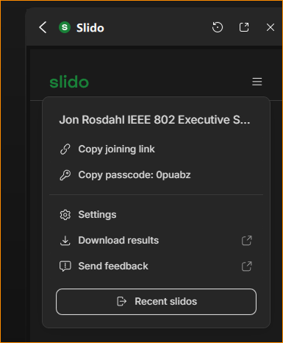
From Home, select the stack menu icon, and then “Download Results”.
Slido will open a new window with the analytics of the polls you have run.
You will be able to see the voters and the voting results.

Slide 26
Save the Slido results
Click Home
Click the pancake
Click Download results
Click Export
Click Download Export
Click Poll results per participant
Click the Save button it turns into
Complete the pop-up dialog and save the file

Slide 27
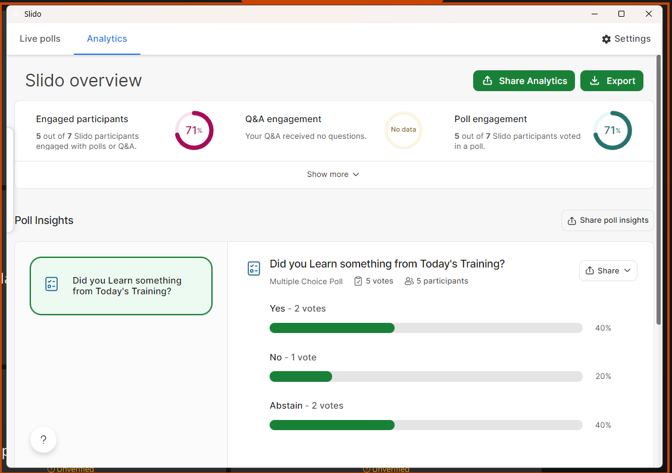

Slide 28
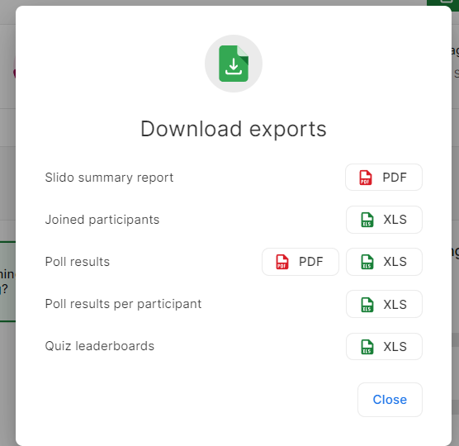

Slide 29
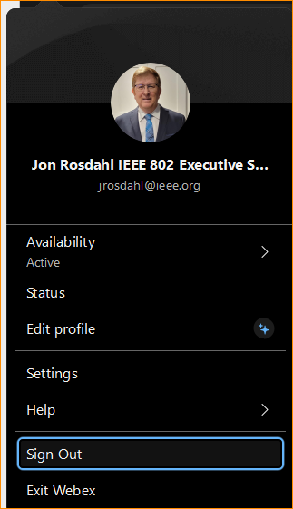
When you are finished with WebEx Desktop, remember that exiting WebEx will leave you setup/logged in as the user you were when you started when your return. You must Sign Out of you are wanting to change the account (User) that you are logging in as next time.

Slide 30
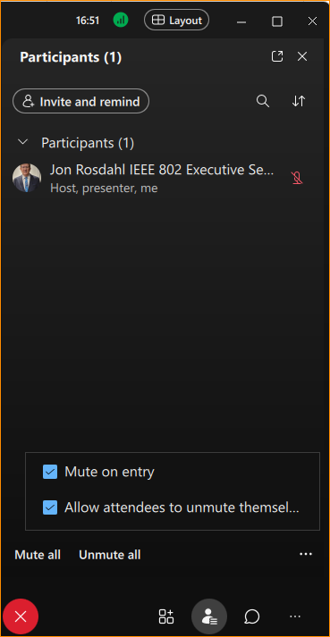
Remember to enable Mute on Entry
Click Participants icon: lower right
Then click on 3 dots in Participant window
Then Check “Mute on Entry”

Slide 31
When Starting a meeting the host should do the following:
Chair’s quick checklist
  Select three dots -> “Meeting Options” -> [Disable/uncheck] “Start Video”
  Select three dots -> “Meeting Options” -> [Disable/uncheck] “Entry and exit tone”
  Select three dots-> “Meeting Options” -> Select the “AI Assistant” and change Content Availability after the meeting – then Select “Don’t save summary and transcript”.
  Select “Participant” ->click 3 dots in new window -> [Enable] “Mute on Entry”.
  Select “Unmute”
  Ensure Scarlet Audio choices have been made for Audio settings.
  Remind local attendees to not connect to Audio

Slide 32
References

Slide 33
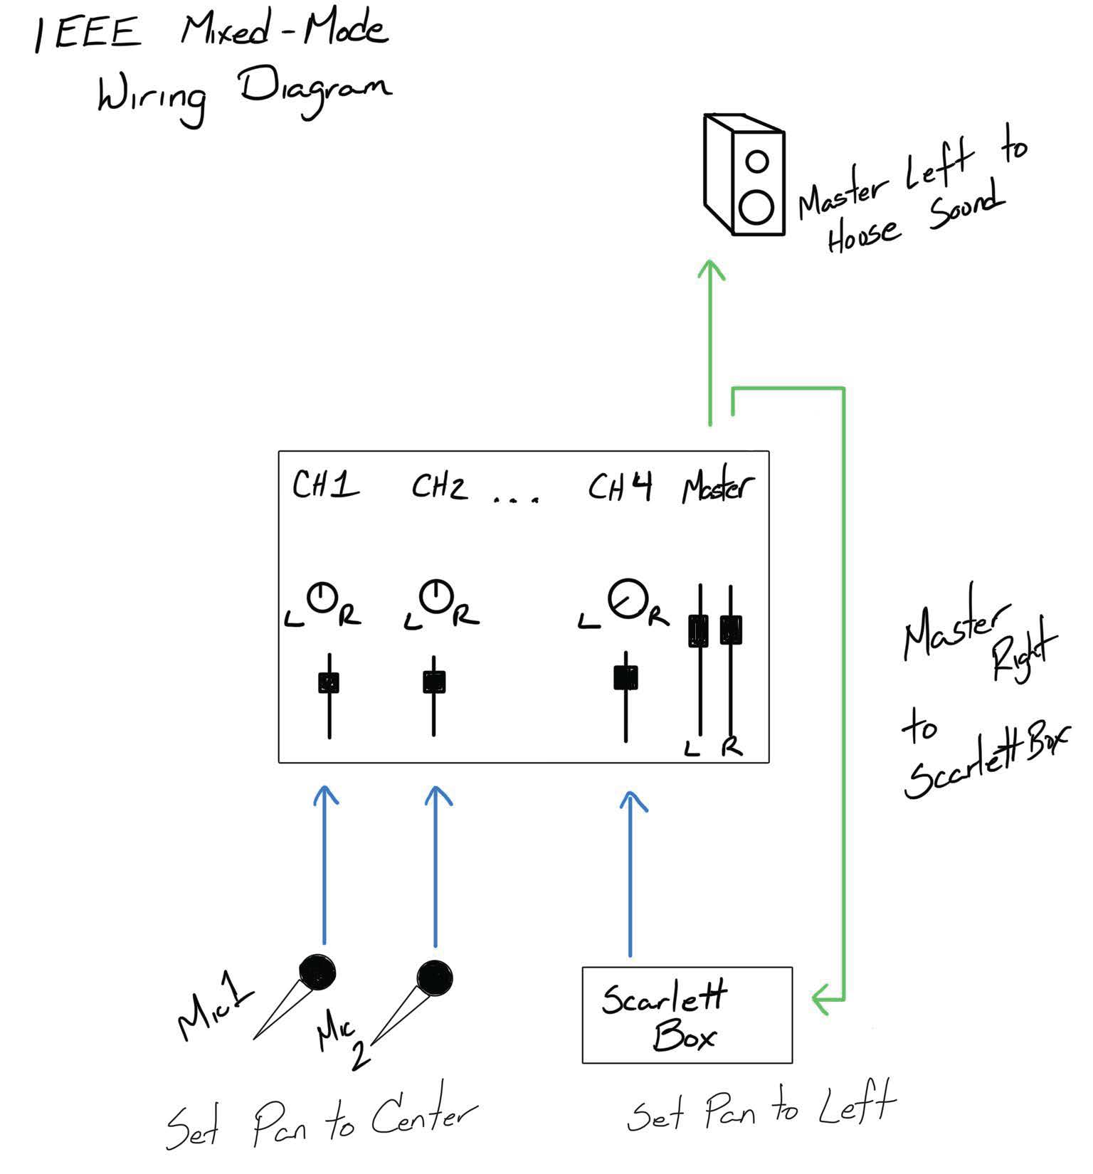
This wiring diagram is provided to assist the AV Engineer at the venue.
Attendees should not adjust the sound mixing panel settings.

