Slide 1
IEEE 802 February 2025
Public Visibility
Standing Committee Report
February 2025

Slide 2
802 Public Visibility SC Scope, Duties, Membership
  Scope and Duties
  To raise public visibility and industry awareness in timely fashion of IEEE 802 WG / TAG activities
  Develop social media content based on IEEE 802 WG / TAG activities
    LinkedIn – https://www.linkedin.com/company/ieee802
    IEEE-SA 802 - https://standards.ieee.org/featured/802/index.html
  Content
    Review Pre 802 Plenary meetings for social media messaging: PARs to be considered, Tutorials, [802.3] Call-for-Interests, New Task Force formations
    Review Post 802 Plenary meetings for social media messaging: Study Group formations, IEEE 802 Position Approvals
    Other 802 related material for social media messaging: Press Releases, White Paper publications, Other 802 approved news, 802 WG / TAG Activities with IEEE-SA
    IEEE-SA Standards Board Related - PAR Approvals, Standards Approval, Standards Publication
  Membership
  Membership in the Standing Committee is open to anyone that wishes to participate (ideally at least one participant from each 802 WG and TAG)

Slide 3

Linkedin Report
  https://www.linkedin.com/company/ieee802
  4,967 total followers
  Last 365 days
    71717 Impressions
    1508 Reactions
  Latest Posts
    January meeting reports
    March Meeting
    802.15 THz demo

Slide 4
IEEE Computer Society Standards Activities Board Seminar: Standards Development Opportunities & Leadership Experiences (Feb 20th, Tokyo and Online)
IEEE Computer Society’s Strategic Activities and Products including SWEBOK Guide
Hironori Washizaki (IEEE Computer Society President, Waseda University)
Introduction of IEEE Computer Society Standards Activities
Edward Au (IEEE Computer Society Vice President for Standards Activities)
Introduction of how to get involved in IEEE Standards Association and its standards development process Lei Wang (IEEE Standards Association Standards Board Chair)
Introduction of IEEE 802.11 (Wi-Fi) and how involvement in standards development shapes career
Dorothy Stanley (IEEE 802.11 Working Group Chair, IEEE Standards Association Board of Governors)
http://www.washi.cs.waseda.ac.jp/10133-2/

Slide 5
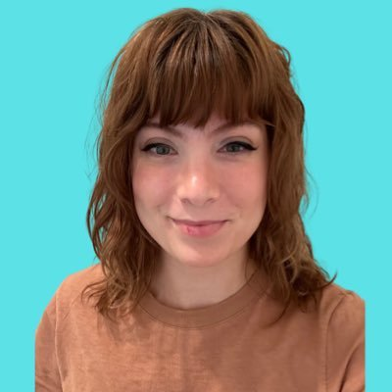
Reaching Young Engineer through Content Creators
Paul Nikolich introduced:
Lexie Cooper
TikTok https://www.tiktok.com/@tracketpacer
She works at Blue Origin as a Network Integration Engineer
Her Tik Tok channel has around 92K followers
Her content ranges from technical explanations to technical parody to cultural commentary with a technical lens.
Her primary area of expertise is in Ethernet, switching, and she has some familiarity with Wifi as well.

Slide 6
Possible 802 March Visit
She is interested to attend the March meeting Tuesday and Wednesday.
Paul and I are indicated that no recordings are allowed during sessions.
She would like to have some interviews with standards leaders and contributors.

Slide 7
Questions to IEEE 802 EC
What are your opinions of giving her an interview during the March meeting?
What are your opinions providing a fee waiver?

