Slide 1
Your IEEE 802 LMSC and You!
Date: 2025-07-04
Author:

Slide 2
Have you seen a motion with the format…
Study Group formation motion
Request approval by IEEE 802 LMSC to form an 802.11 <group> Study Group to <description> [as described in doc 11-yy-xxxx] with the intent of creating a PAR and CSD.
Moved: <name>, Seconded: <name>
Who/What is this?
What do they do?
How can I get involved?

Slide 3
Who/What is the IEEE 802 LMSC?
Working Groups, Technical Advisory Groups, Study Groups, and Standing Committees, such as IEEE 802.1, IEEE 802.3, etc are subgroups of IEEE 802 LMSC.

Slide 4
IEEE 802 within IEEE and IEEE SA Structure
IEEE MEMBERS
Board of Directors (BOD)
Staff
Technical Activities
Defines Technical Scope
Standards Association
  Defines Stds Dev Process
Educational Activities
Publications
Member & Geographic
IEEE Computer Society
publications, conferences, standards
IEEE SA Board of Governors
(BOG)
Standards Activities
IEEE 802 LMSC
Standards Board
(SASB)
IEEE 802 LMSC is a Standards Committee of the IEEE Computer Society.
A little more about these later on …
New Standards Committee (NesCom)
Standards
Review Committee (RevCom)

Slide 5
IEEE 802 Organization
Chair
James Gilb
Appointed Officers
Standing Committees
Voting Members
1st Vice Chair
Dave Halasz
2nd Vice Chair
George Zimmerman
IEEE 802/ISO/IEC/JTC1/SC6
Peter Yee
Working Group,
with Chair
802.1 WG
Higher Layer LAN Protocols
Glenn Parsons
802.3 WG
Ethernet
David Law
Executive Secretary
Jon Rosdahl
Recording Secretary
John D’Ambrosia
IEEE 802/IETF
Dorothy Stanley
802.11 WG
Wireless LAN
Robert Stacey
802.15 WG
Wireless Specialty Networks
Clint Powell
802.19 WG
Coexistence
Tuncer Baykas
Treasurer
Clint Chaplin
IEEE 802/ITU
Glenn Parsons
Technical
Advisory Group,
with Chair
802.18 TAG
Radio Regulatory
Edward Au
802.24 TAG
Vertical Applications
Tim Godfrey
Member Emeritus
Associate Recording Secretary (non-voting) Beth Kochuparambil
Member Emeritus
Associate Treasurer
(non-voting)
Jason Potterf
IEEE 802 Public Visibility
Tuncer Baykas
Hibernating WGs (non-voting)
802.16
WMAN
Roger Marks
802.21 WG
Media Access independent Services
Subir Das
802.22 WG
WRAN
Apurva Mody
Member Emeritus
(non-voting)
Geoff Thompson
Member Emeritus
(non-voting)
Paul Nikolich
IEEE 802 Wireless Chair
Dorothy Stanley

Slide 6
Member Emeritus
People that previously held a position or office.
They don’t have voting rights.
But they can give insights into how similar issues were handled in the past.

Slide 7
Associate
They don’t have voting rights.
They assist an officer.
Some positions have a larger learning curve. (Recording Secretary, Executive Secretary & Treasurer) Spreading out the work helps keep activities moving forward. And provides a source for new officers.
People that may hold a position or office in the future.

Slide 8
Policies and Procedures
3. Officers their responsibilities
3.4.3 Recording Secretary
  a) Scheduling meetings in coordination with the Standards Committee Chair and distributing a meeting notice in conformance with Clause 6.0.
  b) Distributing the agenda at least 14 calendar days1 before the meeting—notification of the potential for action shall be included on any distributed agendas for meetings.
  c) Recording minutes of each meeting …
3.4.6 Executive Secretary
  a) Scheduling meetings in coordination with the Standards Committee Chair and distributing a meeting notice at least 30 days before the meeting
  b) Oversee all activities related to Standards Committee sponsored meeting facilities and services
  c) With the Treasurer, ensure that Standards Committee sponsored sessions are compliant with IEEE financial policies
  d) Present summaries of venue options to the Standards Committee, select venues with approval of the Standards Committee, and sign approved proposals on behalf of IEEE 802
  e) Coordinate with conference service providers and Standards Committee Chair on major decisions …
  … and a whole bunch of stuff. See also the Chairs Guideline section 2.10.

Slide 9
Chair’s Guidelines
2.10. Officers their responsibilities
First Vice Chair
  Assist the chair
  Orientation
  Handle Framemaker license
  Backup to the Recording Secretary
  …
Second Vice Chair
  Assist the chair
  Lead policy and procedure changes “Rules”
  …
Treasurer
  Establishment and maintenance of accounts
  Prepare budget
  Collect and disburse money
  …

Slide 10
Standing Committees https://www.ieee802.org/802SC.shtml
IEEE 802 LMSC JTC1 SC
  Provides a forum for IEEE 802 members to discuss issues relevant to both IEEE 802 and ISO/IEC JTC 1/SC 6
IEEE 802 LMSC IETF SC
  Coordinate 802 activities with IETF activities as appropriate.
IEEE 802 LMSC ITU SC
  Provide IEEE 802 input into IEEE SA engagements with ITU
IEEE 802 LMSC Public Visibility
  To raise public visibility and industry awareness in timely fashion of IEEE 802 WG / TAG activities
IEEE 802 LMSC Wireless Chairs
  The WCSC manages the operation of Wireless Interim meetings and provides a venue for the joint treasury of the wireless groups to meet and solicit input from non-joint treasury groups. It also provides a forum for the leadership of the 802 Wireless Groups to discuss matters of mutual interest and formulate positions/recommendations as appropriate.

Slide 11
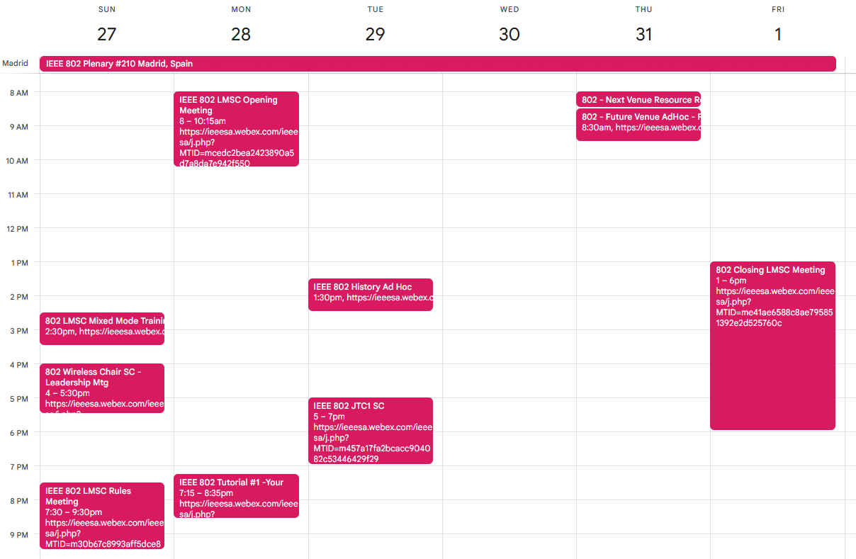
IEEE 802 Plenary sessions
Opening meeting starts on Monday at 8 am.
Closing meeting starts on Friday at 1 pm.
If attend closing meeting, join us for lunch!
Note: There’s also monthly telecons
https://calendar.google.com/calendar/embed?src=b1i61797rqce8ks5fd9fi7k2nc%40group.calendar.google.com&ctz=America%2FNew_York

Slide 12
IEEE 802 Plenary sessions
Who typically attends the IEEE 802 Plenary sessions
IEEE 802 LMSC Members from slide 5
From the Chair’s Guideline section 2.8,
  Working Group Vice Chairs should attend
People that have an interest in an agenda topic
  Task Group Chairs are typically asked to attend by Working Group Chairs if their Task Group has an agenda item.
If you paid your registration fee for the meeting, you are welcome to attend!

Slide 13
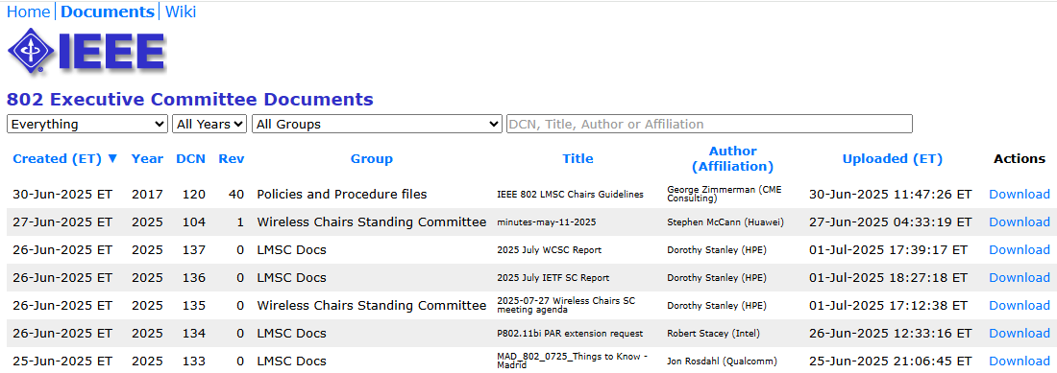
IEEE 802 LMSC Website, docs, etc
The website has pointers to information,
  https://www.ieee802.org/
Mentor is used for document repository,
  https://mentor.ieee.org/802-ec/documents
Minutes, Agendas, Reports, etc

Slide 14
Policies and Procedures
Scope
https://ieee.box.com/v/PandP-LMSC
1.7 IEEE Standards Committee Scope
  The scope of the Standards Committee is to develop and maintain networking standards,
  recommended practices and guides for local, metropolitan, and other area networks, using an
  open and accredited process, and to advocate them on a global basis. Its technical scope is
  intended to be flexible and is ultimately determined by the sum of its approved PARs.

Slide 15
Policies and Procedures
2.0 Responsibilities of the Standards Committee
  The Standards Committee shall be responsible for at least the following:
  a) Developing proposed IEEE standards and ensuring that they are within the scope of the Standards Committee.
  b) Initiating and overseeing ballots of proposed IEEE standards within its scope, including:
    1) Approving Project Authorization Requests (PARs) from a subgroup or the Standards Committee.
    2) Submitting a proposed PAR to the IEEE-SA Standards Board for consideration.
      Following approval of the PAR, the Standards Committee shall submit necessary requests for extension, modification, or withdrawal of the PAR as required by the IEEE-SA Standards Board Operations Manual.
    3) Submitting draft standards from a subgroup or the Standards Committee to the IEEE-SA for Standards Association ballot.
  c) Maintaining the standards developed by the Standards Committee.
  …

Slide 16
Policies and Procedures
5.5 Project Authorization Request (PAR)
PAR Study Group may be a subgroup to IEEE 802 LMSC or an existing Working Group.
IEEE 802 LMSC submits the PAR for IEEE-SA Standards Board approval.

Slide 17
Operations Manual
4.1 The IEEE 802 LMSC Function
The function of the IEEE 802 LMSC is to oversee the operation of the committee in the following ways:
a) Charter PAR Study Groups (Standards Committee and Working Group), Working Groups, and Technical Advisory Groups.
b) Provide procedural and, if necessary, technical guidance to the Working Groups and Technical Advisory Groups as it relates to their charters.
c) Oversee Working Group and Technical Advisory Group operations to ensure that it is within the scope of IEEE 802 LMSC, and its established charter.
d) Examine and approve Working Group draft standards for Standards Association ballot and submission to RevCom, and for conformance with the approved Project Authorization Request (PAR) and Criteria for Standards Development (CSD) documents.
e) Consider complaints of Working Group and Technical Advisory Group.
f) Approve press releases and other external communications.
g) Manage IEEE 802 LMSC logistics, e.g., concurrent Working Group and Technical Advisory Group meetings, finances, etc.
h) Oversee formation of Standards Association ballot groups and Standards Association ballot process.

Slide 18
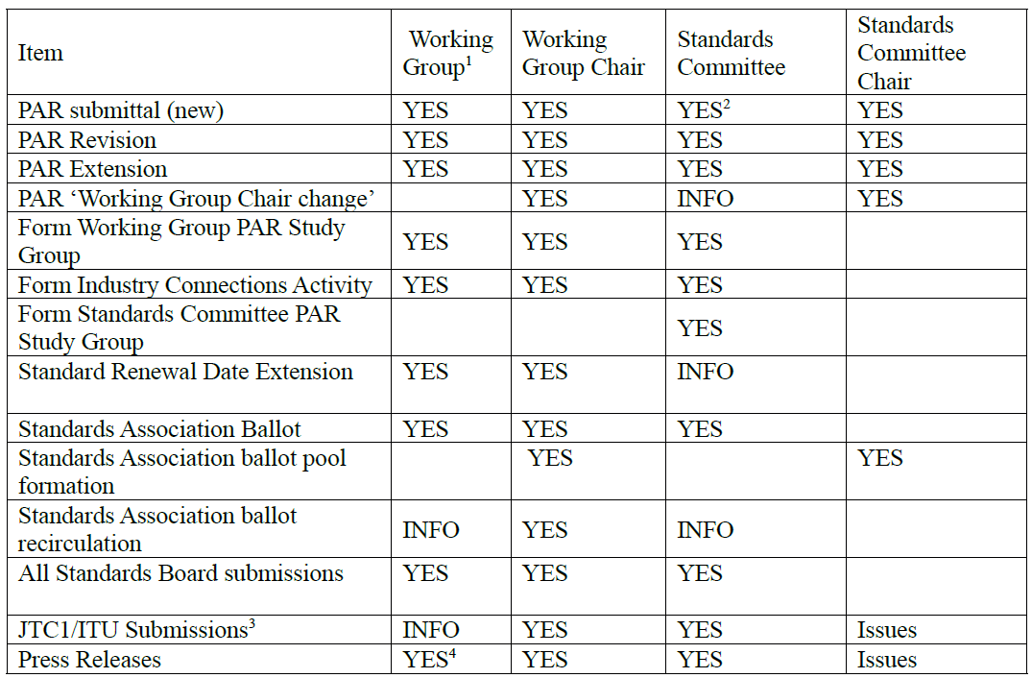
Chair’s Guidelines
2.1 IEEE 802 Approvals

Slide 19
Operations Manual
10 Procedure for ICAIDs
An industry connections activity is authorized by the IEEE-SA Standards Board upon recommendation by the Industry Connections Committee (ICCom). ICCom requires the IEEE 802 LMSC to approve the Industry Connections Activity Initiation Document (ICAID).
Information on ICCom and the ICAID form can be found at: http://standards.ieee.org/about/sasb/iccom/index.html
e.g., User Experience in WLAN Network
https://standards.ieee.org/industry-connections/activities/user-experience-in-wlan-network/

Slide 20
IEEE 802 within IEEE and IEEE SA Structure
IEEE MEMBERS
Board of Directors (BOD)
Staff
Technical Activities
Defines Technical Scope
Standards Association
  Defines Stds Dev Process
Educational Activities
Publications
Member & Geographic
IEEE Computer Society
publications, conferences, standards
IEEE SA Board of Governors
(BOG)
Standards Activities
IEEE 802 LMSC
Standards Board
(SASB)
What about these groups?
New Standards Committee (NesCom)
Standards
Review Committee (RevCom)

Slide 21
IEEE SA Board of Governors
The IEEE SA Board of Governors (BOG) directs the IEEE Standards Association (IEEE SA) – establishing policy, providing financial oversight, and conducting standards-related activities within IEEE technological fields. It may also establish and appoint boards, committees, and other organizational units as needed to carry on the work of the IEEE SA.
https://standards.ieee.org/about/bog/

Slide 22
IEEE SA Standards Board (SASB)
Established and appointed by the IEEE SA Board of Governors (BOG) the IEEE SA Standards Board encourages and coordinates the development and revision of IEEE standards. This includes approving the initiation of IEEE standards projects and to reviewing them for consensus, due process, openness, and balance.
The SASB gives final approval to IEEE standards prior to publication and processes all necessary appeals.
https://standards.ieee.org/about/sasb/

Slide 23
New Standards Committee (NesCom)
NesCom is responsible for ensuring that proposed standards projects are within the scope and purpose of IEEE, assigned to the proper Society or other organizational body, and interested parties are appropriately represented in the development of IEEE standards.
The committee examines Project Authorization Requests (PARs) and makes recommendations to the IEEE SA Standards Board regarding approval.
https://standards.ieee.org/about/sasb/nescom/

Slide 24
Review Committee (RevCom)
RevCom makes recommendations on the approval or disapproval of standards submitted for IEEE SA Standards Board approval or adoption.
Approval or adoption requires agreement from RevCom members that RevCom and IEEE SA Standards Board procedural requirements have been satisfied.
https://standards.ieee.org/about/sasb/revcom/

Slide 25
How you can get involved
Attend IEEE 802 LMSC meetings
  Opening/Closing and telecons
  Rules meetings
  Future venue meetings
Attend a standing committee meeting
  IEEE 802 Wireless Chairs
  IEEE 802 JTC1 SC
  IEEE 802 IETF SC
  IEEE 802 ITU SC
  IEEE 802 Public Visibility
Get involved with the IEEE SA Board of Governors, IEEE SA Standards Board and/or one of the IEEE SA Standards Boards Committees

Slide 26
References
IEEE 802 LMSC Policies & Procedures (link to AudCom, approved by IEEE-SA Standards Board 8 February 2021)
IEEE 802 LMSC Operations Manual
IEEE 802 LMSC Chairs Guidelines (Provides guidance)
IEEE 802 LMSC website

Slide 27
From the IEEE 802 Operation Manual
1.2 Precedence of documents
The operation of the IEEE 802 LMSC is subject to regulations contained in a number of documents, including this OM. The regulating documents are identified in the following list and are given in their order of precedence from highest to lowest. If any two documents in this list contain conflicting regulations, the conflict shall be resolved in favor of the document of higher precedence. Note that the IEEE 802 LMSC P&P references other precedence documents.
  IEEE 802 LMSC Policies and Procedures
  IEEE 802 LMSC Operations Manual
  IEEE 802 LMSC Working Group Policies and Procedures
  IEEE 802 LMSC Chair’s Guidelines and EC Policies Decisions
Robert's Rules of Order Newly Revised (latest edition) is the recommended guide for parliamentary procedures not covered in the documents identified above.

