Slide 1
IEEE 802 July 2025
Public Visibility
Standing Committee Updates
July 2025

Slide 2
802 Public Visibility SC Scope, Duties, Membership
  Scope and Duties
  To raise public visibility and industry awareness in timely fashion of IEEE 802 WG / TAG activities
  Develop social media content based on IEEE 802 WG / TAG activities
    LinkedIn – https://www.linkedin.com/company/ieee802
    IEEE-SA 802 - https://standards.ieee.org/featured/802/index.html
  Content
    Review Pre 802 Plenary meetings for social media messaging: PARs to be considered, Tutorials, [802.3] Call-for-Interests, New Task Force formations
    Review Post 802 Plenary meetings for social media messaging: Study Group formations, IEEE 802 Position Approvals
    Other 802 related material for social media messaging: Press Releases, White Paper publications, Other 802 approved news, 802 WG / TAG Activities with IEEE-SA
    IEEE-SA Standards Board Related - PAR Approvals, Standards Approval, Standards Publication
  Membership
  Membership in the Standing Committee is open to anyone that wishes to participate (ideally at least one participant from each 802 WG and TAG)

Slide 3
Linkedin Report
  https://www.linkedin.com/company/ieee802
  5469 total followers
  Last 365 days
    78000 Impressions
    1427 Reactions
  Latest Posts
    802.11be is published
    802.3 Call for Interest
    IEEE 802 July meeting

Slide 4
Linkedin Posts for WGs
  WG/TIGs can post their short meeting reports.
  I received reports from 802.11, 802.18, 802.19 and 802.24 after May meeting.

Slide 5

IEEE SA Standards Awards Nominations
Submit your nominations of deserving honorees today
https://standards.ieee.org/about/awards/nominate/
The nomination period is now open and will run until 31 July 2025.
IEEE SA CONFORMITY ASSESSMENT AWARD IEEE SA CORPORATE AWARD
IEEE SA STANDARDS BOARD DISTINGUISHED SERVICE AWARD
IEEE SA LIFETIME ACHIEVEMENT AWARD
IEEE SA INTERNATIONAL AWARD IEEE SA STANDARDS COMMITTEE AWARD FOR OUTSTANDING CONTRIBUTION TO ENTITY STANDARDS IEEE SA STANDARDS MEDALLION

Slide 6
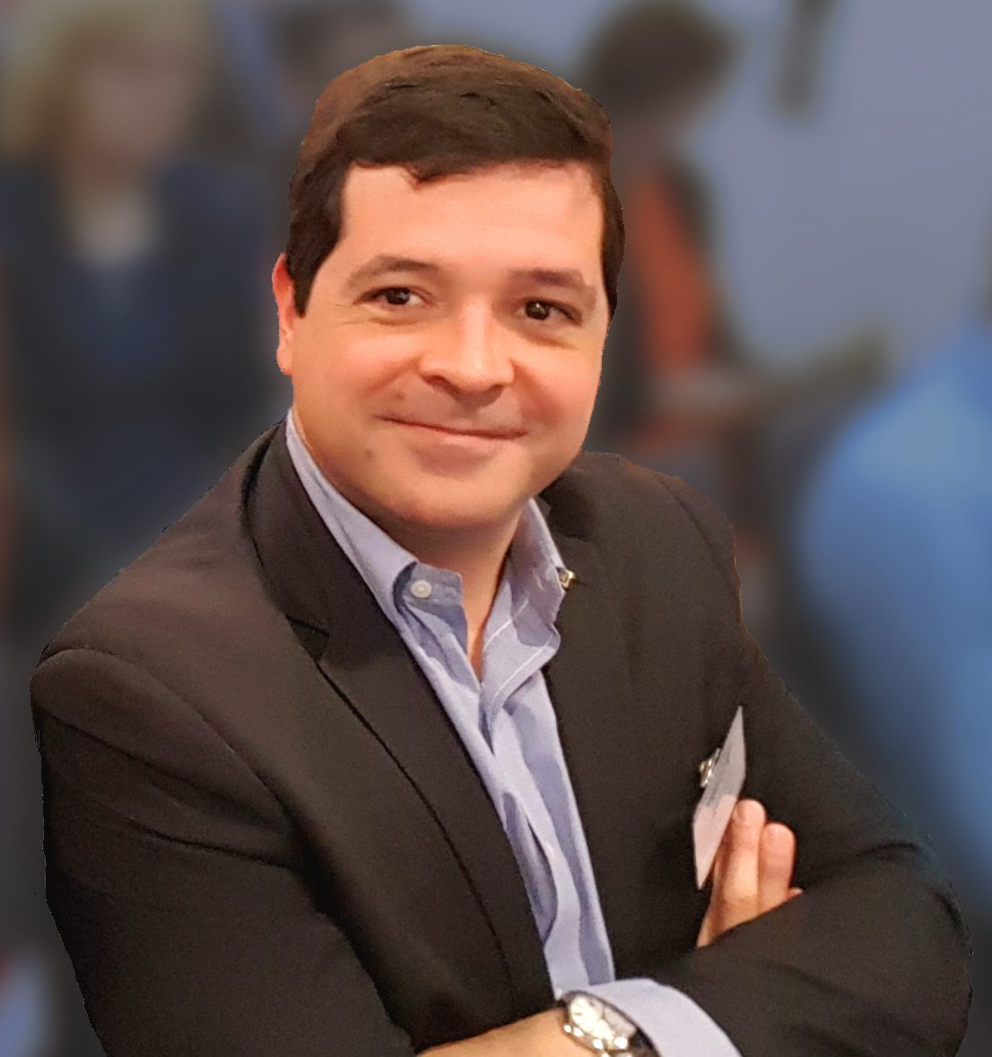
Antonio Luque Presentation during 802.11 Midweek Plenary
Antonio Luque is the Vice-President for Member and Geographical Activities of IEEE and former IEEE Region 8 director.
He indicated his interest on IEEE 802 LMSC and will make a presentation during 802.11 Midweek plenary.

