Slide 1
doc.: IEEE 15-13-0436-00-0led
Project: IEEE P802.15 Working Group for Wireless Personal Area Networks (WPANs)
Submission Title: [Study Items for LED-ID Standardization]
Date Submitted: [July, 2013]
Source: [Yeong Min Jang*, Tuan Nguyen*, Nirzhar Saha*, and Jae Sang Cha**]
Address [*Kookmin University, Seoul, Korea]
[**SNUT]
Voice:[82-2-910-5068], FAX: [82-2-910-5068], E-Mail:[yjang@kookmin.ac.kr]
Re: []
Abstract: [Study Items for LED-ID Standardization]
Purpose: [Contribution to IEEE 802.15 IG-LED]
Notice: This document has been prepared to assist the IEEE P802.15. It is offered as a basis for discussion and is not binding on the contributing individual(s) or organization(s). The material in this document is subject to change in form and content after further study. The contributor(s) reserve(s) the right to add, amend or withdraw material contained herein.
Release: The contributor acknowledges and accepts that this contribution becomes the property of IEEE and may be made publicly available by P802.15.
Notes:
doc.: IEEE 802.15-09-0117-00-0007
<month year>

Slide 2
Contents
doc.: IEEE 15-13-0436-00-0led
CamCom Based LED-ID
Data Continuity
A CamCom Application: LED-ID Based Digital Signage
Broadcasting Based LED-ID Networks
Use Case of Broadcasting LED-ID Networks: LBS
MIMO Concept
Conclusions

Slide 3
CamCom Based LED-ID
doc.: IEEE 15-13-0436-00-0led
CamCom (Camera Communications) uses image sensor within a camera for data reception.
Using one or multiple LEDs as source of data transmission.
Without uplink
With uplink

Slide 4

Data Continuity
doc.: IEEE 15-13-0436-00-0led
Fast link switching for mobility support under downlink environment
Fast link switching and link recovery for seamless data continuity.
Problem: signal differentiation in overlapping area.
Sender
Receiver
Relay node
Link recovery
Link switching

Slide 5
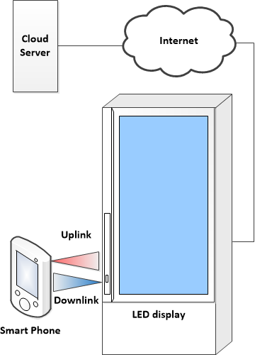
A CamCom Application: LED-ID Based Digital Signage
doc.: IEEE 15-13-0436-00-0led
Digital signage employs a network connection to deliver information, entertainment, merchandising and advertisement to digital displays.
Camera and LEDs are used for data communication.
Optional Uplink: WiFi or Cellular or IR

Slide 6
Broadcasting Based LED-ID Networks
doc.: IEEE 15-13-0436-00-0led
Only downlink is deployed → No need to change user devices’ hardware.
Use cases:
  2D and 3D Indoor localization
  Broadcasting services

Slide 7
Use cases of Broadcasting LED-ID Networks: LBS
doc.: IEEE 15-13-0436-00-0led
Based on downlink signals, readers can determine their locations using a localization technique, such as cell-ID, fingerprinting, and etc.

Slide 8
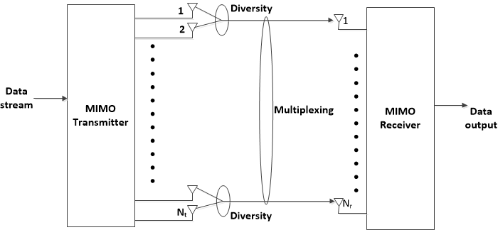
MIMO Concept
doc.: IEEE 15-13-0436-00-0led
Each LED used as transmitting antenna.
Multiple detectors constituting receiver arrays are used for reception.

Slide 9
Conclusions
doc.: IEEE 15-13-0436-00-0led
It is needed to consider the practical usage of LED-ID networks for the standardization.
A call for contribution about use cases and requirements in next meeting.
Acknowledgement: This work is done with the help of Dr. Richard D. Roberts (Intel Labs, Oregon, USA) and Dr. Joachim W. Walewski (Siemens AG, Munich, Germany)

