Slide 1
Doc: IEEE 802.15-13-0722-00-0led
Project: IEEE 802.15 LED(Light Emitting Diode) Interest Group (IG-LED)
Submission Title: [Camera Positioning Technology]
Date Submitted: [14th Nov, 2013]
Source: [Jaesang Cha]
[Seoul National Univ. of Science & Technology]
Address : [Seoul National University of Science & Technology, Seoul, Korea]
Voice: [82-2-970-6431], FAX: [82-2-970-6123], E-Mail:[chajs@seoultech.ac.kr]
Re: []
Abstract: [Camera Positioning Technology concept and its example is introduced.]
Purpose: [Contribution to IEEE 802.15 IG-LED]
Notice: This document has been prepared to assist the IEEE 802.15. It is offered as a basis for discussion and is not binding on the contributing individual(s) or organization(s). The material in this document is subject to change in form and content after further study. The contributor(s) reserve(s) the right to add, amend or withdraw material contained herein.
Release: The contributor acknowledges and accepts that this contribution becomes the property of IEEE and may be made publicly available by IEEE 802.15
Slide 1
Notes:
doc.: IEEE 802.15-09-0117-00-0007
<month year>

Slide 2
Contents
Doc: IEEE 802.15-13-0722-00-0led
What is Camera Positioning Technology?
Requirement of Lighting source based Camera Positioning System
Lighting sources (LED-ID etc) based Indoor Camera Positioning example
Experiments Result of example system of Camera Positioning Technology
Conclusion

Slide 3
Doc: IEEE 802.15-13-0722-00-0led
What is Camera Positioning Technology?
High-precision Lighting Sources based Camera Positioning
  Lighting Source based Indoor Positioning technology is more precise than RF based Indoor Positioning technology
  Positioning services and related technology applications in the field of GPS, RF based Indoor Position have a better performance in comparison
Key issue in the Lighting Sources (e.g. : LED-ID Tag etc) based Camera Positioning recognition
  - Existing Light source infrastructure could be a Positioning Source.
  Camera Image Sensor could be a Positioning Devices
Camera Positioning Technology could be more precise LBS solution comparing with conventional RF solution
Camera Positioning Technology use Camera image sensor for Positioning Detector

Slide 4
Doc: IEEE 802.15-13-0722-00-0led
Camera Positioning(CamPo) System
  CamPo is more precise than RF based Positioning Technology
  especially in the short rand environments
  Lighting sources (LED-ID Tag etc) based Indoor CamPo technology could be a complementary solution with RF(WiFi etc) based Indoor Positioning Technology
CamPo system has the advantages in high precision and environment-friendly wireless Technology

Slide 5
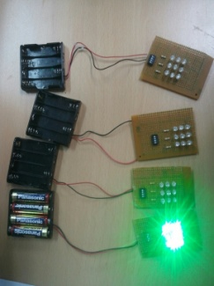
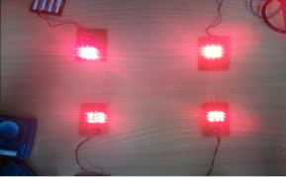
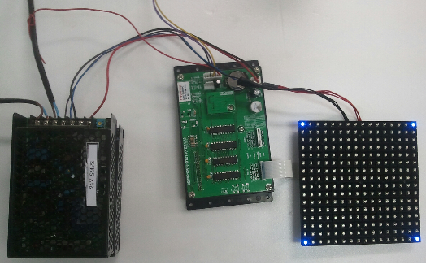
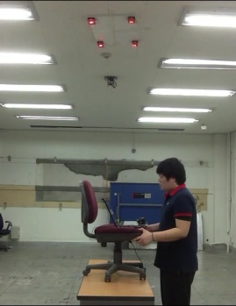
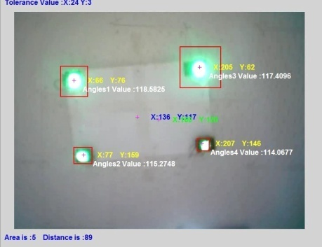
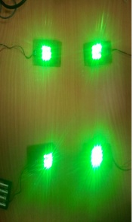
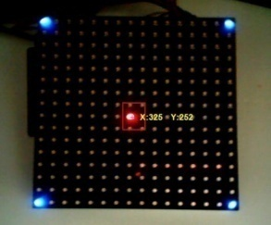
Doc: IEEE 802.15-13-0722-00-0led
Experiments Result example of CamPo
(LED lighting source and controller configuration for experiments of Indoor CamPo)
Using lighting Source attached in ceil and Camera , we recovered Positioning Data
This concept could be enlarged to various Camera (e.g. Smart Device Camera)
Slide 5

Slide 6
Doc: IEEE 802.15-13-0722-00-0led
Conclusion
I suggested Camera Positioning (CamPo) Technology
CamPo system has the advantages in high precision and environment-friendly wireless Technology
Using lighting Source attached in ceil and Camera , we recovered Positioning Data
Especially, Light Source s( LED-ID ) based Indoor CamPo System has the advantages in high precision and environment-friendly wireless Technology
This concept could be enlarged to various Camera (e.g. Smart Device Camera)

