Slide 1
Project: IEEE P802.15 Working Group for Wireless Personal Area Networks (WPANs)
Submission Title: [MAC Protocol with Interference Mitigation Using Negotiation among Coordinators in Multiple Wireless Body Area Networks(BANs)]
Date Submitted: [18 May 2021]
Source: [Shunya Ogawa1, Minsoo Kim1, Ryuji Kohno1,2] [1;Yokohama National University, 2;Centre for Wireless Communications(CWC), University of Oulu,]
Address [1; 79-5 Tokiwadai, Hodogaya-ku, Yokohama, Japan 240-8501
2; Linnanmaa, P.O. Box 4500, FIN-90570 Oulu, Finland FI-90014]
Voice:[1; +81-45-339-4115, 2:+358-8-553-2849], FAX: [+81-45-338-1157],
Email:[1: ogawa-shunya-md@ynu.jp, kohno@ynu.ac.jp, 2: Ryuji.Kohno@oulu.fi]
Re: []
Abstract: [A dependable MAC protocol for wireless body area network(WBAN) in presence of multiple overlaid BANS is introduced, A scheme of negotiation among coordinators could improve overall performance.]
Purpose: [information]
Notice: This document has been prepared to assist the IEEE P802.15. It is offered as a basis for discussion and is not binding on the contributing individual(s) or organization(s). The material in this document is subject to change in form and content after further study. The contributor(s) reserve(s) the right to add, amend or withdraw material contained herein.
Release: The contributor acknowledges and accepts that this contribution becomes the property of IEEE and may be made publicly available by P802.15.

Slide 2
MAC Protocol with Interference Mitigation Using Negotiation among Coordinators in Multiple Wireless Body Area Networks(BAN’s)
Shunya Ogawa*, Minsoo Kim*, Ryuji Kohno*†
＊Graduate School of Engineering Yokohama National University, Japan
† Centre for Wireless Communications(CWC), University of Oulu, Finland

Slide 3
1. Introduction

Slide 4
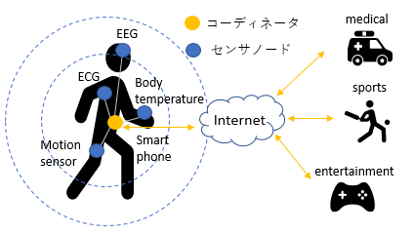
1.1 Introduction
From the development of an aging society and wireless communication technology, researches on medical information communication technology are thriving
One solution is a WBAN (Wireless Body Area Network)
WBAN
IEEE802.15.6
A network consisting of sensor nodes and coordinators installed around the human body
International standard of WBAN
Defined for physical layer and MAC layer
Coordinator
This study changes the MAC layer
Sensor Node
Hardware already sold
MAC layer can be changed by software
Fig1. Overall picture of WBAN network
WBAN can control priority according to importance of data packet
In this research, we focus on the MAC layer of IEEE 802.15.6 and propose a MAC protocol that reduces inter-BAN interference

Slide 5
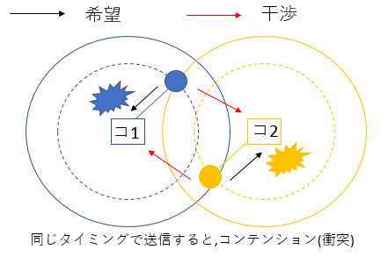
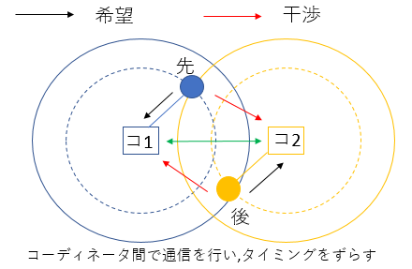
1.2 Issues in the standard
Issue
Interference problem in the case where multiple BANs overlap (specifically, situations where people with BAN approaching)
Because the schedule adjustment between the coordinators has not been done
Proposal
Negotiation between coordinators, scheduling between different BANs, to prevent deterioration due to inter-BAN interference
Desired Packet
Interfering Packet
Desired Packet
Interfering Packet
What is interference at the MAC layer
Sensor nodes within the communication range try to transmit packets at the same timing, causing collisions, making it impossible to communicate correctly
1st
C1
C2
C1
C2
2nd
In case of no negotiation of Coordinators of overlapped BANs, contention happens among packets of the BANs
In case of negotiation of Coordinators of overlapped BANs, contention can be resolved
Fig2. Issue and proposal

Slide 6
2. Proposed method

Slide 7
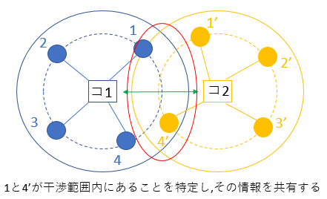
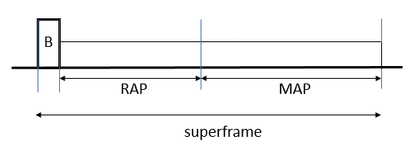
2.1 Outline of proposed method
Purpose
Increase the throughput of each BAN in case of interference
Communication should be guaranteed in descending order of User Priority
Proposal
Negotiate between coordinators, share the overlap situation of the sensor nodes, and identify the sensor nodes that will cause contention
Do not send them at the same time
1 and 4 'are not sent at the same time
コ1
C1
C1
C2
コ2
C2
By detecting overlapped nodes, e.g. 1 and 4, coordinators e.g. C1 and C2 negotiate in order to minimize contentions
Fig3. Outline of proposed method

Slide 8



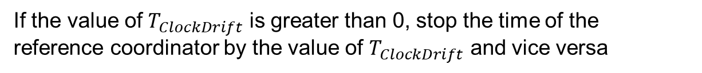
2.2 Time synchronization method between coordinators
The time difference between receiving the beacon frames of the two coordinators is used as the offset value.
$$T_{offset}=T_{1}−T_{0}⋯(1)$$
$T_{1}$:Overlap coordinator beacon time
$T_{0}$:Reference coordinator beacon time
Calculate the amount of time adjustment ($T_{ClockDrift}$) based on the offset value
$$T_{ClockDrift}=T_{offset,1}−T_{offset,0}⋯(2)$$
$T_{offset,1}$ :Offset value obtained from the reception of previous beacon frame
$T_{offset,0}$ :Offset value obtained from the reception of the current beacon frame
If the value of $T_{ClockDrift}$ is greater than 0, stop the time of the reference coordinator by the value of $T_{ClockDrift}$ and vice versa

Slide 9
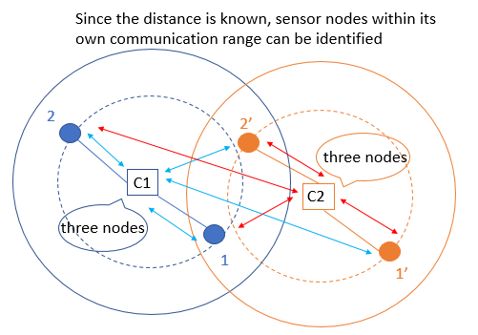
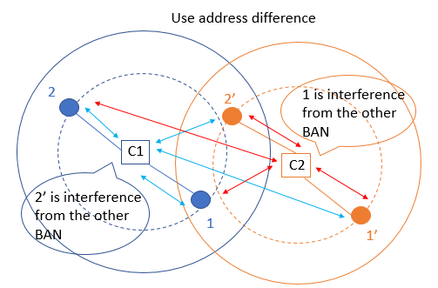
2.3 procedure of how to identify overlap situations
Proposal method
Analysis
Conclusion
Since BAN uses UWB communication, it uses physical layer information that indicates the distance (between coordinators and sensor nodes)
By knowing the distance between a sensor node and the coordinator, it is possible to identify whether or not the node is within its communication range
Use the address of the sensor node given for each BAN
By sharing this address among the coordinators, it is possible to identify whether a sensor node within the trust range is under its own control or under the control of another BAN
Fig4. how to identify overlap situations

Slide 10
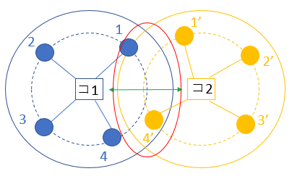
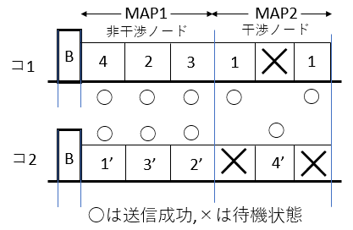
2.4 MAC protocol of MAP(Managed access period)
Proposal
(Adopt polling for MAP)
Divide Superframe's MAP structure into two parts, MAP 1 and MAP 2
In MAP 1, sensor nodes not related to interference are allocated
Send at the same time
In MAP 2, sensor nodes related to interference are allocated
When one BAN attempts to transmit at MAP 2, the other BAN is placed in a standby state
Non Overlapped Nodes
Overlapped Nodes
C1
C1
C2
C2
Fig4. MAC protocol of MAP
By separating by interference and non-interference, packet collision does not occur and efficient transmission can be done
Notes:
MAP1とMAP2に分ける理由を口頭で

Slide 11
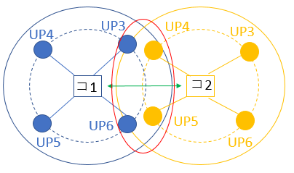
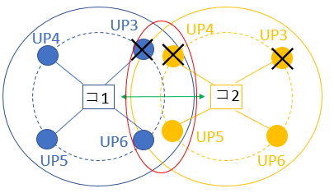
2.5 MAC protocol of RAP(Random Access Period)
Proposal
(Adopt CSMA / CA for RAP)
The Superframe's RAP protocol is as follows
If the interfering node is low UP (4 or less), do not conflict transmission rights (those with lower UP than competing nodes do not compete)
If the interference node is high UP (5 or more), compete transmission rights of normal CSMA/CA
Although contention will occur, it will guarantee in descending order of UP
C1
C2
C1
C2
Fig5. MAC protocol of RAP
It is possible to reduce the contention of packets while guaranteeing in descending order of UP

Slide 12
3.MAC protocol with 3WBANs or more(scalability)

Slide 13
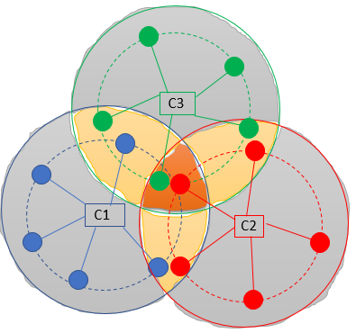
3.1 MAC protocol with 3WBANs
Area1
No overlap
Area2
Overlap 2 coordinator
Area3
Overlap 3 coordinator

Slide 14
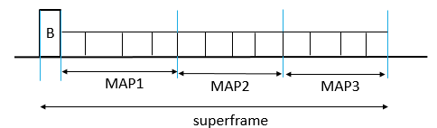
3.2 MAC protocol of MAP
Divide CFP into three phases and allocate slots by area
× is standby state
1”
Area1
Area2
Area3
C1
2
3
×
2”
1
5
4
×
×
5”
3”
5
5’
C2
4’
2’
1’
3’
×
5’
×
1
4”
1’
2
C3
2”
4’
3”
5”
4
1”
×
×
4”
2’
3
3’

Slide 15
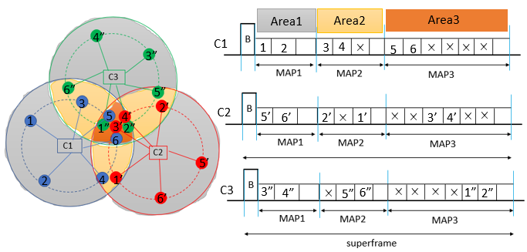
3.3 Ratio of MAP1,2,3
It is necessary to change the ratio according to the number of nodes belonging to each area
Consider the case where there are two nodes in each area (ideal case)
× is standby state
The number of nodes in Area3 ÷3:
The number of nodes in Area3 ÷1.5:
The number of nodes in Area3
MAP1:MAP2:MAP3 =
15

Slide 16
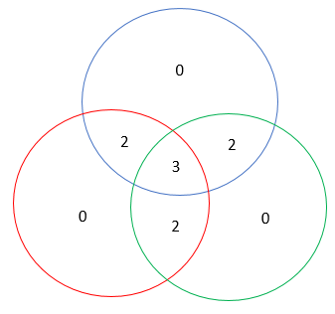
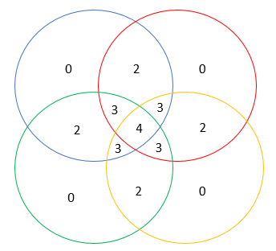
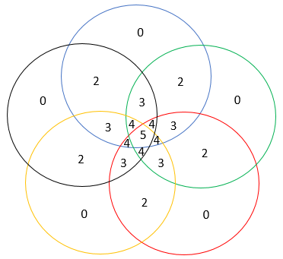
3.4 Scalability
Is it possible to handle when the number of BAN is increased to 4,5,・・・?
3 BAN
4 BAN
5 BAN
0 overlap area → 3
2 overlap area → 3
3 overlap area → 1
0 overlap area → 4
2 overlap area → 4
3 overlap area → 4
4 overlap area → 1
0 overlap area → 5
2 overlap area → 5
3 overlap area → 5
4 overlap area → 5
5 overlap area → 1
the number of BAN increases
One overlapping area is added
It ’s possible to deal with the combination
Confirm with simulation (future work)

Slide 17
4. Measures against drawback

Slide 18
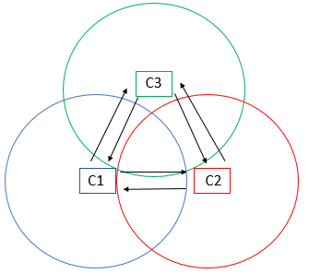
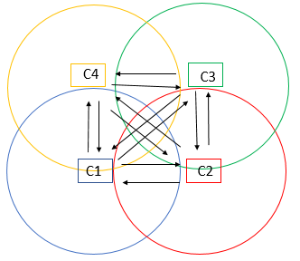
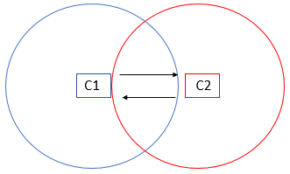
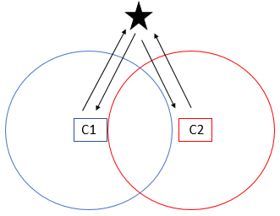
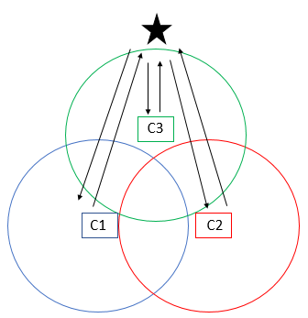
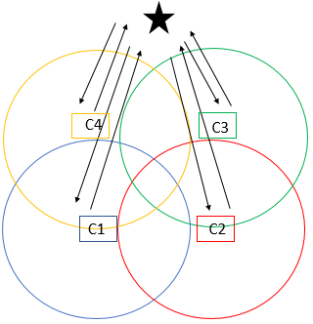
4.1 the number of negotiation
drawback
Assume that the number of BAN increases
Increase the number of negotiations
Set the coordinator of the coordinator
(parent coordinator)
2 BAN
3 BAN
4 BAN
negotiation
2times
6times
12times
Parent coordinator
4times
6times
8times
When extending a proposal , The number of communications can be reduced

Slide 19
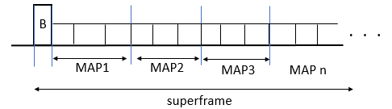
4.2 Ratio of CAP and CFP of superframe
drawback
Assume that the number of BAN increases
the merits and drawbacks of CAP and CFP is cleared
Change the ratio of CAP and CFP of superframe by offerload
Problems of CFP
The waiting time until the transmission possible period increases as the number of phases increases
When the offeredload is low, the characteristics are very bad
Problems of CAP
Change the ratio of CAP and CFP in the superframe
When the offeredload is high , the large amount of collisions occur

Slide 20
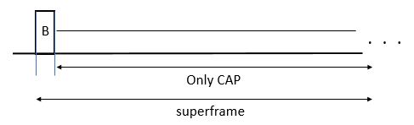
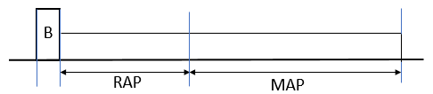
4.2.1 Ratio of CAP and CFP
Low offeredload
Middle offeredload
High offeredload
Future works
Find the boundary between 1 and 2 , 2 and 3
Find by simulation and theoretical analysis
How to maintain continuity in case 2

Slide 21
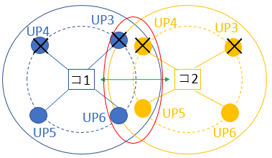
4.3 Control to make the priority higher
We propose a MAC protocol not only giving average performance as a whole, but also differentiating between high UP and low UP
RAP
MAP
If it is low UP (4 or less) irrespective of interference or non-interference, do not compete transmission right
If it is high UP (5 or more) irrespective of interference or non-interference, compete transmission right as usual
How to assign transmission rights
The one with the largest
UP value × elapsed time
We changed the weighting value called UP value
C1
C2
Weighting to make the priority more dominant
Fig8. RAP
By changing parameters, we can cope with each design policy (giving average performance , differentiating between high UP and low UP)

Slide 22
5. Performance evaluation by simulation

Slide 23
5.1 Simulation characteristics
Determining parameters based on the standard (IEEE 802.15.6)
The probability of occurrence for each UP is the same
One type of packet is generated from one node
RAP, MAP handle all packets
The condition for discarding the packet is the case where the number of retransmissions is 4 or more and the case where the number of packets to be crowded becomes 3 or more
There is no EAP for simplicity
Fig9. Superframe structure
Table1. simulation characteristics
Number of nodes | 4(UP高2,低2)
Data rate | 242.9 [kbps]
Payload length | 128 [octets]
Number of BANs | 2
Superframe length | 115 [ms]
Number of slots | RAP=5,MAP=12
Simulation time | 30 [s]
Number of trials | 100
Content of evaluation
Overall network throughput characteristics
Throughput characteristics per UP
Delay characteristics per UP
Evaluation is made in two ways such as average performance, differentiating between high UP and low UP

Slide 24
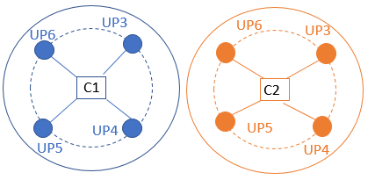
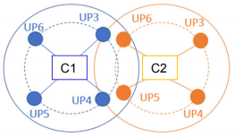
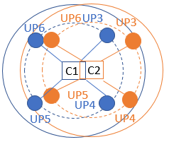
5.2 Simulation scenario
1, there are no interference node each
2, there are two interference nodes each
3, there are four(all) interference nodes each

Slide 25
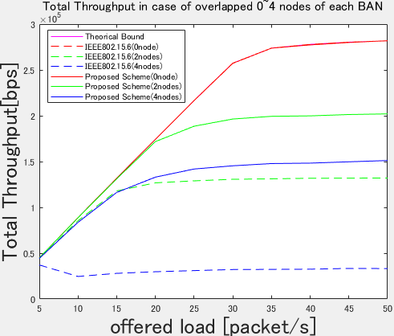
5.3 Simulation result(Total throughput)
Average performance
Differentiating between low UP and high UP
Fig11. Overall network throughput
Fig12. Overall network throughput
The theorical bound is the throughput of the entire network in the absence of interference
Compared to the standard, the throughput of the whole network is improved in the proposed method in each case
Since there is no difference in overall throughput by design policy, both are valid

Slide 26
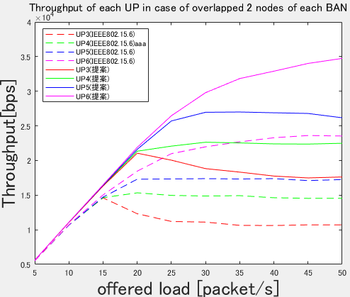
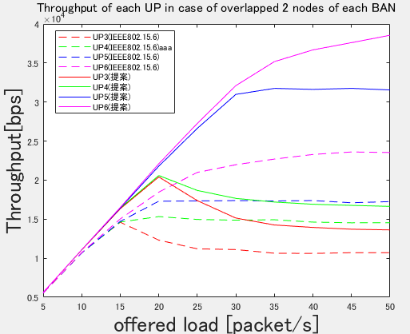
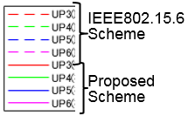
5.3 Simulation result(Throughput of each UP overlapped 2 nodes)
Average performance
Differentiating between low UP and high UP
Solid line: proposed method
Dashed line: Standard
Solid line: proposed method
Dashed line: Standard
Solid line: proposed method
Dashed line: Standard
Fig13. Throughput of each UP overlapped 2 nodes
Fig14. Throughput of each UP overlapped 2 nodes
Similarly, the proposed method is superior to the throughput for each UP
We can cope with the case where average performance is given and the case where difference is given for each UP

Slide 27
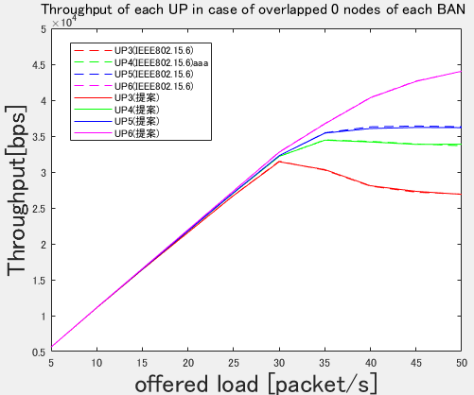
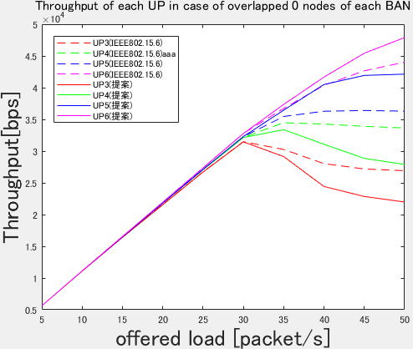
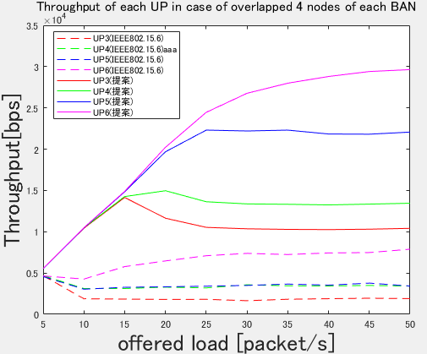
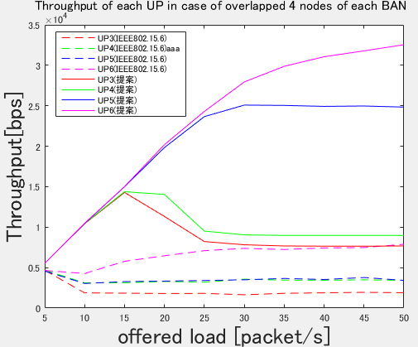
5.3 Simulation result(Throughput of each UP overlapped 0,4 nodes)
Average performance
Differentiating between low UP and high UP
Fig15. Throughput of each UP overlapped 0 node
Fig16. Throughput of each UP overlapped 0 node
Fig17. Throughput of each UP overlapped 4 nodes
Fig18. Throughput of each UP overlapped 4 nodes

Slide 28
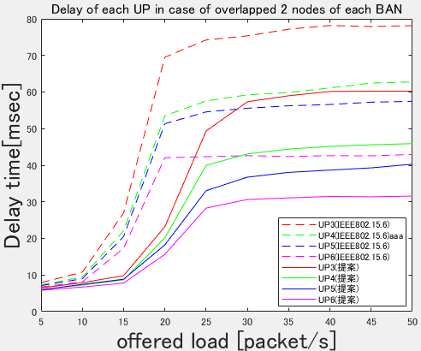
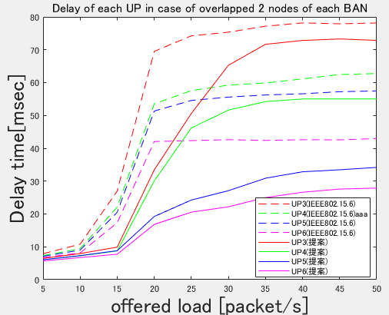
5.3 Simulation result(Delay of each UP overlapped 2 nodes)
Average performance
Differentiating between low UP and high UP
Solid line: proposed method
Dashed line: Standard
Fig19. Delay of each UP overlapped 2 nodes
Fig20. Delay of each UP overlapped 2 nodes
Similarly, the proposed method is superior to the throughput for each UP
We can cope with the case where average performance is given and the case where difference is given for each UP

Slide 29
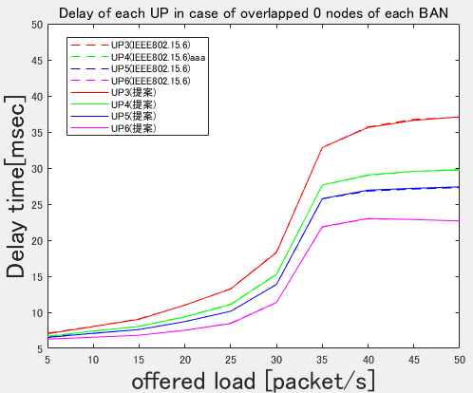
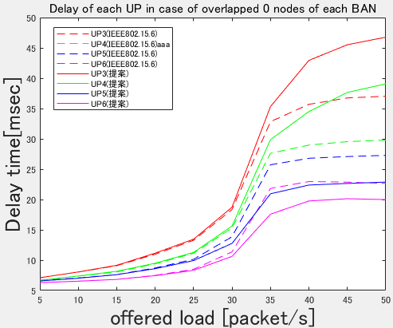

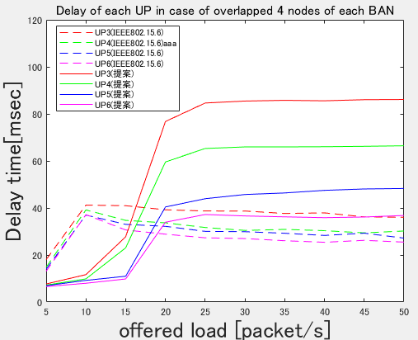
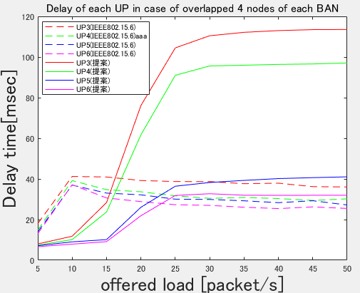
5.3 Simulation result(Throughput of each UP overlapped 0,4 nodes)
Average performance
Differentiating between low UP and high UP
Fig21. Delay of each UP overlapped 0 node
Fig22. Delay of each UP overlapped 0 node
Fig23. Delay of each UP overlapped 4 nodes
Fig24. Delay of each UP overlapped 4 nodes

Slide 30
6. Conclusion

Slide 31
6.1 Conclusion and Future works
Conclusion
We conducted research to mitigate interference against the international standard MAC protocol
In order to reduce interference in multiple BAN environments, we propose to communicate between coordinators to identify and share interfering nodes, and the proposed protocol has improved throughput and delay characteristics over international standards
We showed that we can deal with by changing parameters according to design policy
Future works
Simulate when the number of BAN becomes 3 or more
The way how to negotiate and synchronize among coordinators in detail
Theoretical analysis on optimum values of various parameters
MAP 1 and MAP 2 ratio, UP weighting etc.

Slide 32
Thank you for your attention

