Slide 1
Project: IEEE P802.15 Working Group for Wireless Specialty Networks (WSN)
Submission Title: Spectrum Sensing Based Deferral
Submitted: March 15, 2023
Source: Benjamin Rolfe (Blind Creek Associates), Dries Neirynck (Ultra Radio Ltd), Frederic Nabki, Larry Zakaib (Spark), Frank Leong (NXP), Peng Liu, Ziyang Guo, Lei Huang, David Xun Yang (Huawei)
Contact:
E-Mail: ben.rolfe@ieee.org
Voice: NA
Re: Enhanced channel access for UWB
Abstract: A variation on channel access that includes spectrum sensing and potentially deferring transmission in a time-bounded way to improve performance, reliability and bound latency
Purpose: Consideration for inclusion in the draft amendment
Notice: This document has been prepared to assist the IEEE 802. It is offered as a basis for discussion and is not binding on the contributing individual(s) or organization(s). The material in this document is subject to change in form and content after further study. The contributor(s) reserve(s) the right to add, amend or withdraw material contained herein.
Release: The contributor acknowledges and accepts that this contribution becomes the property of IEEE and may be made publicly available by 802.15.
Notes:
Jul 12, 2010
Page 1

Slide 2
Spectrum Sensing Based Deferral
Summary of SSBD proposal

Slide 3
PAR Objective | Proposed Solution (how addressed)
Safeguards so that the high throughput data use cases will not cause significant disruption to low duty-cycle ranging use cases | SSBD uses channel sensing (CCA) with time bounded deferral to reduce collisions and mitigate hidden node scenarios
Interference mitigation techniques to support higher density and higher traffic use cases | Linear increase of contention window when CCA detects channel not clear or when collisions occur
Other coexistence improvement | Can improve coexistence in the presence of UWB and non-UWB spectrum users through Energy Detection
Backward compatibility with enhanced ranging capable devices (ERDEVs) | Has no impact on backward compatibility. It is an optional feature in 4ab capable devices.
Improved link budget and/or reduced air-time | Reduces airtime through collision avoidance
Additional channels and operating frequencies
Improvements to accuracy / precision / reliability and interoperability for high-integrity ranging | Reliability can be enhanced by CCA based deferral of transmission
Reduced complexity and power consumption
Hybrid operation with narrowband signaling to assist UWB
Enhanced native discovery and connection setup mechanisms
Sensing capabilities to support presence detection and environment mapping
Low-power low-latency streaming | Reduced latency via linear backoff and collision reduction
Higher data-rate streaming allowing at least 50 Mbit/s of throughput
Support for peer-to-peer, peer-to-multi-peer, and station-to-infrastructure protocols | Yes
Infrastructure synchronization mechanisms

Slide 4
SSBD Overview
SSBD is a channel access method for applications that use the UWB PHY
  SSBD enables channel access latency to be bounded
  Employs channel sensing using CCA and bounded deferral using linearly growing random backoff at each deferral.
  For unscheduled random access or with one of the scheduled access schemes.
  SSBD attributes settings for various use cases.
  SSBD is an optional feature for all 4ab device types.
  Optional persistence mechanism
    Employs persistence to mitigate hidden node scenarios
    Increase range of backoff delay when SSBD is invoked by packet retransmission following unsuccessful transmission attempt

Slide 5
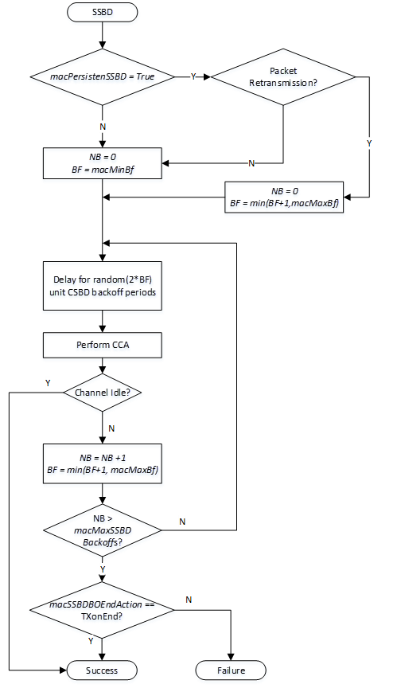
SSBD Algorithm overview
NB shall be initialized to zero for each new SSBD attempt
BF is the backoff factor. Prior to each CCA, the algorithm shall delay for a random delay value between 0 and 2*BF, using the backoff period defined by macSSBDUnitBackoffPeriod.
NB is the number of times the SSBD algorithm was required to backoff due to channel busy condition.

Slide 6
Algorithm overview
The algorithm shall terminate with Success when CCA returns idle.
The action when NB exceeds macMaxSSBDBackoffs depends on macSSBDBOEndAction:
  When set to TXonEnd, end with Success.
  When set to FailOnEnd, end with Failure.

Slide 7
SSBD Persistence
SSBD Persistence Option
Persistence, when enabled, provides a mechanism for mitigating hidden node problems by starting from a higher back off factor
When Persistence is enabled and channel access is part of a retransmission attempt, the last value of BF+1 is used in the initialization of BF
In all other cases, BF is initialized to macMinBF

Slide 8
SSBD Attributes
The timing and behavior of SSBD is controlled by the following attributes
Attribute | Type | Range | Description | Default
macMaxBf | Integer | 1 - 63 | The maximum value of the backoff factor (BF) in the SSBD algorithm as described in 6.2.5.x. | 5
macMaxSSBDBackoffs | Integer | 1 – 255 | The maximum number of deferral iterations the SSBD algorithm will attempt before exiting. | 5
macMinBf | Integer | 1 - macMaxBf | The minimum value of the backoff factor (BF) in the SSBD algorithm as described in 6.2.5.x. | 1
macSSBDBOEndAction | Enumeration | TxOnEnd, FailOnEnd | Determines the termination result of the SSBD algorithm upon exceeding the maximum back-off count, as described in 6.2.5.x. | TxOnEnd
macSSBDUnitBackoffPeriod | Integer | 1 - 31 | The unit time period use for deferral in the SSBD algorithm, in microseconds | 1
macSSBDCcaDuration | Integer | 1 - 31 | CCA Duration in microseconds | 9
macPersistenSSBD | Enumeration | True False | Enables Persistence when True | TBD

Slide 9
SSBD Latency Examples
Example 1: Default values from Table 8-94:
macMinBF = 1
macMaxBf = 5
macMaxSSBDBackoffs = 5
macSSBDUnitBackoffPeriod = 1
macSSBDCcaDuration = 1
Assuming worse case of maximum random delay at each iteration, the Channel Access Latency will not exceed 46 usec.
Example 2: To bound the maximum delay to about 2 ms, the follow parameters can be used:
macMinBF = 3
macMaxBf = 10
macMaxSSBDBackoff = 7
macSSBDUnitBackoffPeriod = 20
macSSBDCcaDuration = 1
Assuming worse case of maximum random delay at each iteration, the Channel Access Latency will not exceed 2.088 ms .
Note: These examples do not include additional latency due to persistence

Slide 10
Conclusion
SSBD Provides an effective means to reduce collisions and bound channel access latency
SSBD Linear backoff provides an effective means to reduce latency and jitter
Persistence mechanism (optional) provides an effective means to contend with packet transmission failures
  For example in hidden node scenarios

Slide 11
References
Benjamin Rolfe et al., “SSBD Technical Specification Framework Contribution”, 15-22-0486-01-04ab-ssbd-channel-access-tfd-text
Peng Liu, Ziyang Guo, “Spectrum Sensing Based Deferral Evaluation and Enhancement”, 15-22-0606-00-04ab-spectrum-sensing-based-deferral-evaluation-and-enhancement

