Slide 1
Project: P802.15 Working Group for Wireless Specialty Networks
Submission Title: Harmonization with 4ab: data rates & FEC
Date Submitted: November 15th, 2022
Source: Marco Hernandez^{1,3}, Ryuji Kohno^{1,2}, Takumi Kobayashi^{1,2}, Minsoo Kim¹
Company: ¹Yokosuka Research Park International Alliance Institute (YRP-IAI), Japan; ²Yokohama National University (YNU), Japan. ³CWC, Oulu Univ. Finland.
Address: 3-4 Hikarino-oka, Yokosuka, 239-0847, Japan.
E-Mail: Marco.Hernandez@ieee.org; kohno@ynu.ac.jp; Kobayashi-Takumi-ch@ynu.ac.jp; Minsoo@minsookim.com;
Abstract: UWB harmonization.
Purpose: In response to the call for technical contributions.
Notice: This document has been prepared to assist P802.15.6ma. It is offered as a basis for discussion and is not binding on the contributing individual(s) or organization(s). The material in this document is subject to change in form and content after further study. The contributor(s) reserve(s) the right to add, amend or withdraw material contained herein.
Release: The contributor acknowledges and accepts that this contribution becomes the property of IEEE and may be made publicly available by P802.15.6ma.

Slide 2
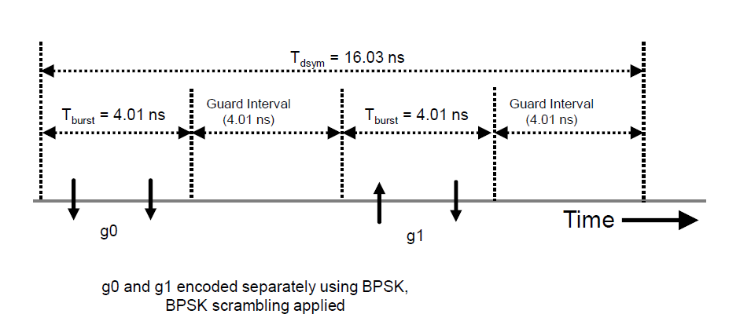
UWB modulation and 64.2 Mb/s data rate
For interoperability, 15.6ma will adopt the 15.4ab UWB modulation and high data rates [15-22-0517-00-4ab]:
  Two bursts of pulses (BPSK) per symbol, with mean PRF=249.6 MHz @ 64.2 Mb/s

Slide 3
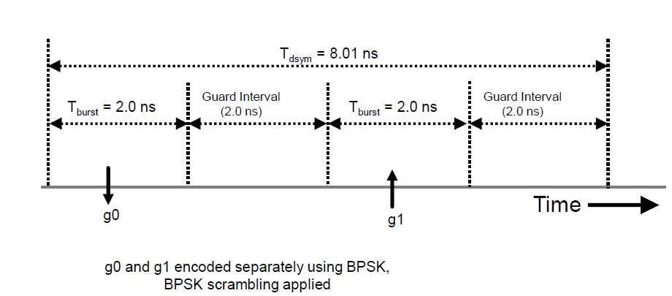
UWB modulation and 124.8 Mb/s data rate
  Two bursts of pulses (BPSK) per symbol, with mean PRF=249.6 MHz @ 124.8 Mb/s
Complemented with other data rates, 6ma will address communication use cases and ranging use cases.

Slide 4
FEC harmonization
4ab agreement FEC:
  Mode-A: PSDU data rate > 7.8 Mb/s use either BCC or LDPC.
  Mode-B: PSDU data rate =1.95 Mb/s use BCC only and data rate > 1.95 Mb/s use either BCC or LDPC.
  Mode-C: PSDU data rate ≥1.95 Mb/s use either BCC or LDPC.
What has change is that LDPC is no longer optional
  An implementation can use either BCC or LDPC indicated in the PHR and set up during association with a receiver.
  Mode-B uses only BCC.
For 6ma, the proposal is to use BCC and LDPC (same as 4ab) for certain coexistence environment classes.

Slide 5
FEC harmonization for HARQ
Compatibility with 4ab FEC, the HARQ should be compatible with BCC of rate ½ and K=7.
  Chip makers do not have to change the radio front-end.
  There may be other optional modes of operation: different coding rates and constrained lengths, like the ones proposed by Kento.

Slide 6
Preamble sequences
Especially important for awareness of 4ab transmissions
15.6-2012 use Kasami sequences
  Agreement in 4ab is Ipatov 91 (communications)
  We need a comparison between Kasami vs Ipatov.
  SYN length (Preamble Symbol Repetition).
  This would cover CCA too.
  Ben suggested to form subgroups to address issues like this.

