Slide 1
Project: IEEE P802.15 Working Group for Wireless Specialty Networks
Submission Title: MAC Protocol Proposal for Multiple BAN Environment (Level 1)
Date Submitted: March 14th, 2023
Source: Minsoo Kim, Takumi Kobayashi, Marco Hernandez, Ryuji Kohno
Company: (1)Yokohama National University (2) YRP International Alliance Institute
Address: (1)79-5 Tokiwadai, Hodogaya-ku, Yokohama, 240-8501 Japan,
(2) YRP1 Blg., 3-4 HikarinoOka, Yokosuka-City, Kanagawa, 239-0847 Japan
Voice:[+81-90-5408-0611] E-Mail:[minsoo@minsookim.com, kobayashi-takumi-ch@ynu.ac.jp, marco.hernandez@ieee.org, kohno@ynu.ac.jp]
Re: In response to call for proposal
Abstract: MAC Protocol Proposal for Multiple BAN Environment (Level 1)
Purpose: Material for discussion in P802.15.6ma TG
Notice: This document has been prepared to assist the IEEE P802.15. It is offered as a basis for discussion and is not binding on the contributing individual(s) or organization(s). The material in this document is subject to change in form and content after further study. The contributor(s) reserve(s) the right to add, amend or withdraw material contained herein.
Release: The contributor acknowledges and accepts that this contribution becomes the property of IEEE and may be made publicly available by P802.15.

Slide 2
MAC Proposal of TG15.6ma
(Revision of IEEE802.15.6-2012)
MAC Protocol Proposal for Multiple BAN Environment (Level 1)
March 14th, 2023
Minsoo Kim, Takumi Kobayashi, Marco Hernandez, and Ryuji Kohno
Yokohama National University(YNU),
YRP International Alliance Institute(YRP-IAI)

Slide 3
Introduction
This draft proposal focuses on providing high dependability in a situation where multiple BANs coexist.
We suggest allocating time slots (or periods) to each BAN to avoid frame collisions even between different BANs.
It is also important to ensure backward compatibility and support coexistence with devices based on the original standard.
Therefore, we also propose to use one of the channels for exchanging network control frames and coordinator to coordinator frames, in order to accomplish the time slot allocation to each BAN as well as more accurate clear channel assessment, especially in dense situation.

Slide 4
Channel dedicated to network control frames
In IEEE Std 802.15.6-2012, both network control and data exchange take place on the same channel.
  Network control and data exchange are distinguished by the frame type field.
We propose to set aside one of the channels for exchanging only network control frames.
  This helps Clear Channel Assessment (CCA) to be carried out more efficiently, because it only has to be done for one channel.
  This reduces control frame collisions, because the frames are transmitted on a less congested channel due to the absence of data frames.
  Some BAN devices designed to support extra level of dependability may support utilizing of this channel.

Slide 5
Possible frequency bands allocation
Band group | Channel number | Central frequency (MHz) | Bandwidth (MHz) | Channel attribute in 802.15.6-2012 | Channel attribute for the revision
Low band | 0 | 3494.4 | 499.2 | Optional | Control | Optional
 | 1 | 3993.6 | 499.2 | Mandatory | Control/Data | Mandatory
 | 2 | 4492.8 | 499.2 | Optional |  | Optional
High band | 3 | 6489.6 | 499.2 | Optional | Control/Data | Optional
 | 4 | 6988.8 | 499.2 | Optional |  | Optional
 | 5 | 7488.0 | 499.2 | Optional | Control | Optional
 | 6 | 7987.2 | 499.2 | Mandatory | Control/Data | Mandatory
 | 7 | 8486.4 | 499.2 | Optional |  | Optional
 | 8 | 8985.6 | 499.2 | Optional |  | Optional
 | 9 | 9484.8 | 499.2 | Optional |  | Optional
 | 10 | 9984.0 | 499.2 | Optional |  | Optional
One channel is mandatory for each band group. This is unchanged to maintain backwards compatibility with the original 2012 standard.
In this revision, one channel is designated as the control channel. This channel can be used as a common channel shared by multiple systems.

Slide 6
Frame assignments for Control/Data Channels
Channels | Periods | Frames (draft)
 |  | From coordinators | From nodes
Control | n/a | Control Beacon Coordinator-to-coordinator | Not allowed
Data | Network Management | Data Beacon
 | Contention Free | Scheduled Data | Scheduled Data
 | Contention Access | Connection Assignment Disconnection Response Unscheduled Data | Connection Request Disconnection Notification Unscheduled Data
Frame assignments should be determined in consideration of various factors, including the environment in which the system will be used and the differences in hardware limitations between the coordinator and the node.

Slide 7
Control Channel
Only coordinators shall transmit on control channel (C-Channel).
Control channel does not have time slot structure.
  Since BANs are mobile, there is always a possibility that BANs or groups of BANs having different synchronization timings will encounter each other.
  Therefore, it is reasonable to design MAC under the premise that reliable synchronization between multiple BANs is not possible.
  This is especially true when we consider the interoperability of BANs and other UWB systems.

Slide 8
Control Channel (cont.)
A coordinator shall transmit one control beacon frame (C-Beacon) on C-Channel every T_{C} seconds.
  The coordinator shall perform clear channel assessment (CCA) before emitting its first C-Beacon.
  The C-Beacon Period T_{C} shall be chosen randomly by the coordinator within the range from T_{C,min} to T_{C,max}.

Slide 9
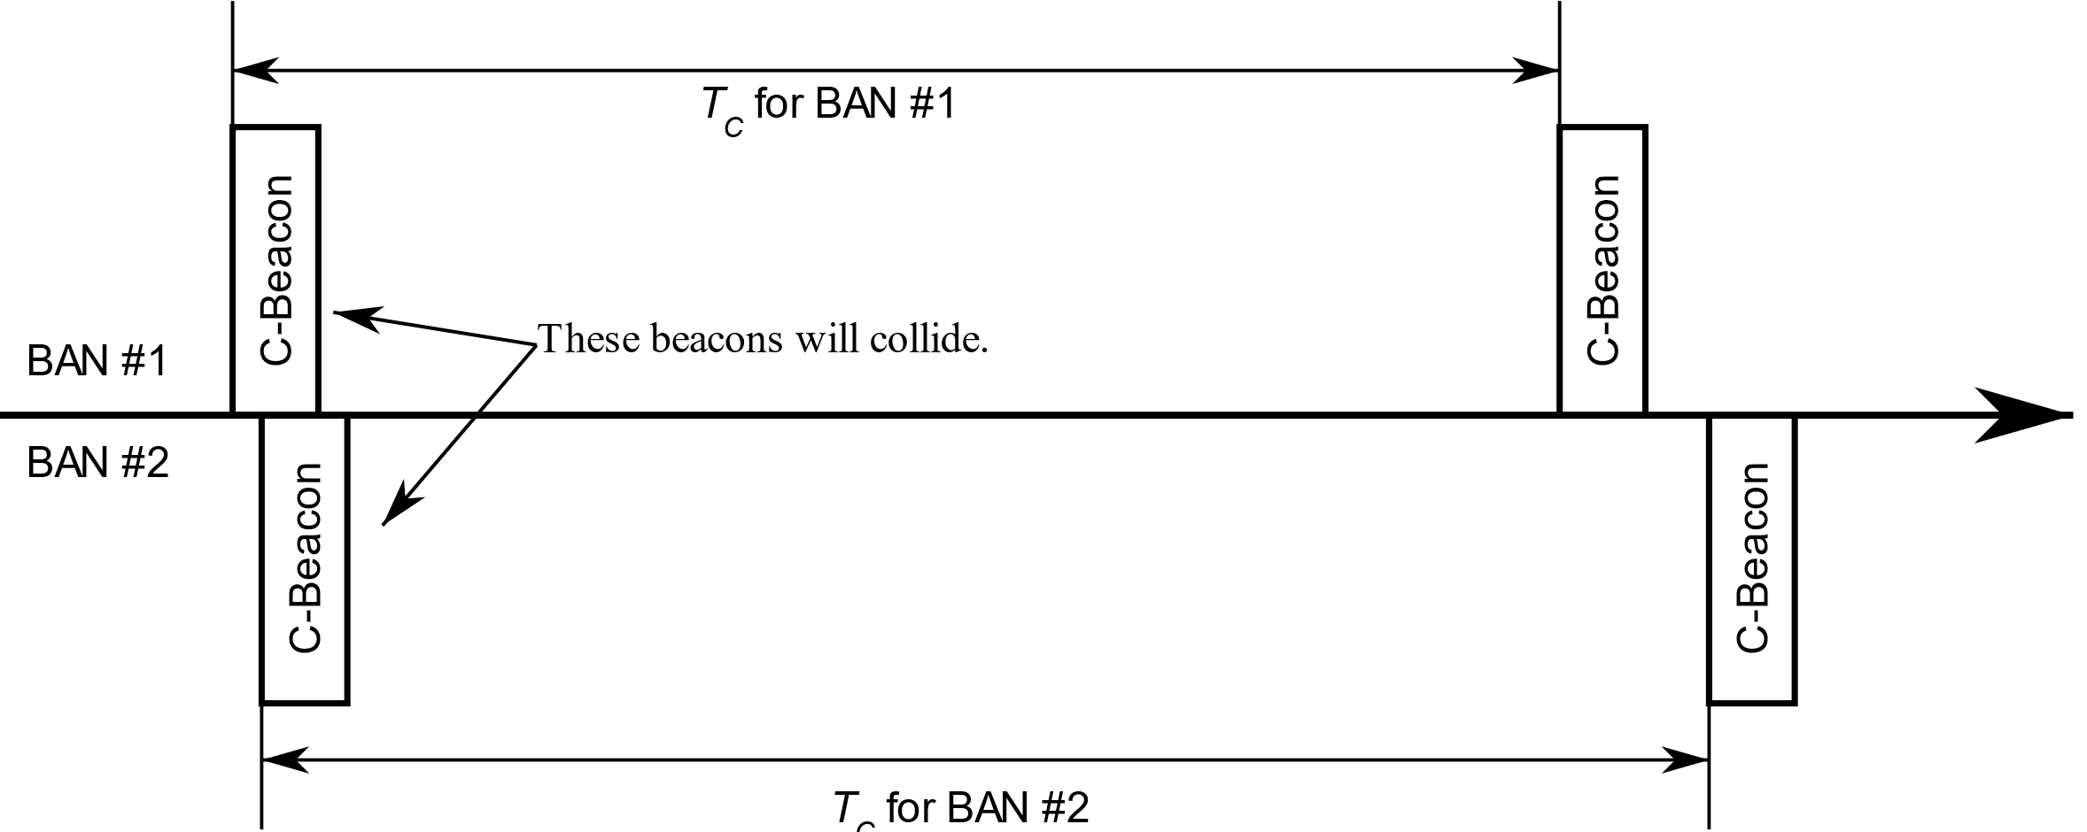
Why is the C-Beacon Period Random?
If all coordinators transmit their C-Beacons at the same interval, Once a C-Beacon collides, this collision continues forever.
However, if each coordinator transmits its beacon with a different interval, even if a collision occurs, the next beacon will not collide.
It may be desirable if the value are relatively prime or have a large greatest common multiple.

Slide 10
Data Channel
Coordinators and nodes may transmit on the data channel (D-Channel).
The time axis in a D-Channel is divided into superframes which have equal duration of T_{D} seconds.
Each superframe is composed of time slots which have equal duration of T_{S} seconds.
A superframe shall consist of four distinct periods:
  Network Management Period (NMP), consisting of N_{NMP} time slots, where the network management frames such as data beacons shall be transmitted,
  Contention Free Period (CFP), consisting of N_{CFP} time slots, where scheduled frames shall be transmitted,
  Contention Access Period (CAP), consisting of N_{CAP} time slots, where unscheduled frames shall be transmitted,
  Inactive Period, where no frames shall be transmitted.

Slide 11
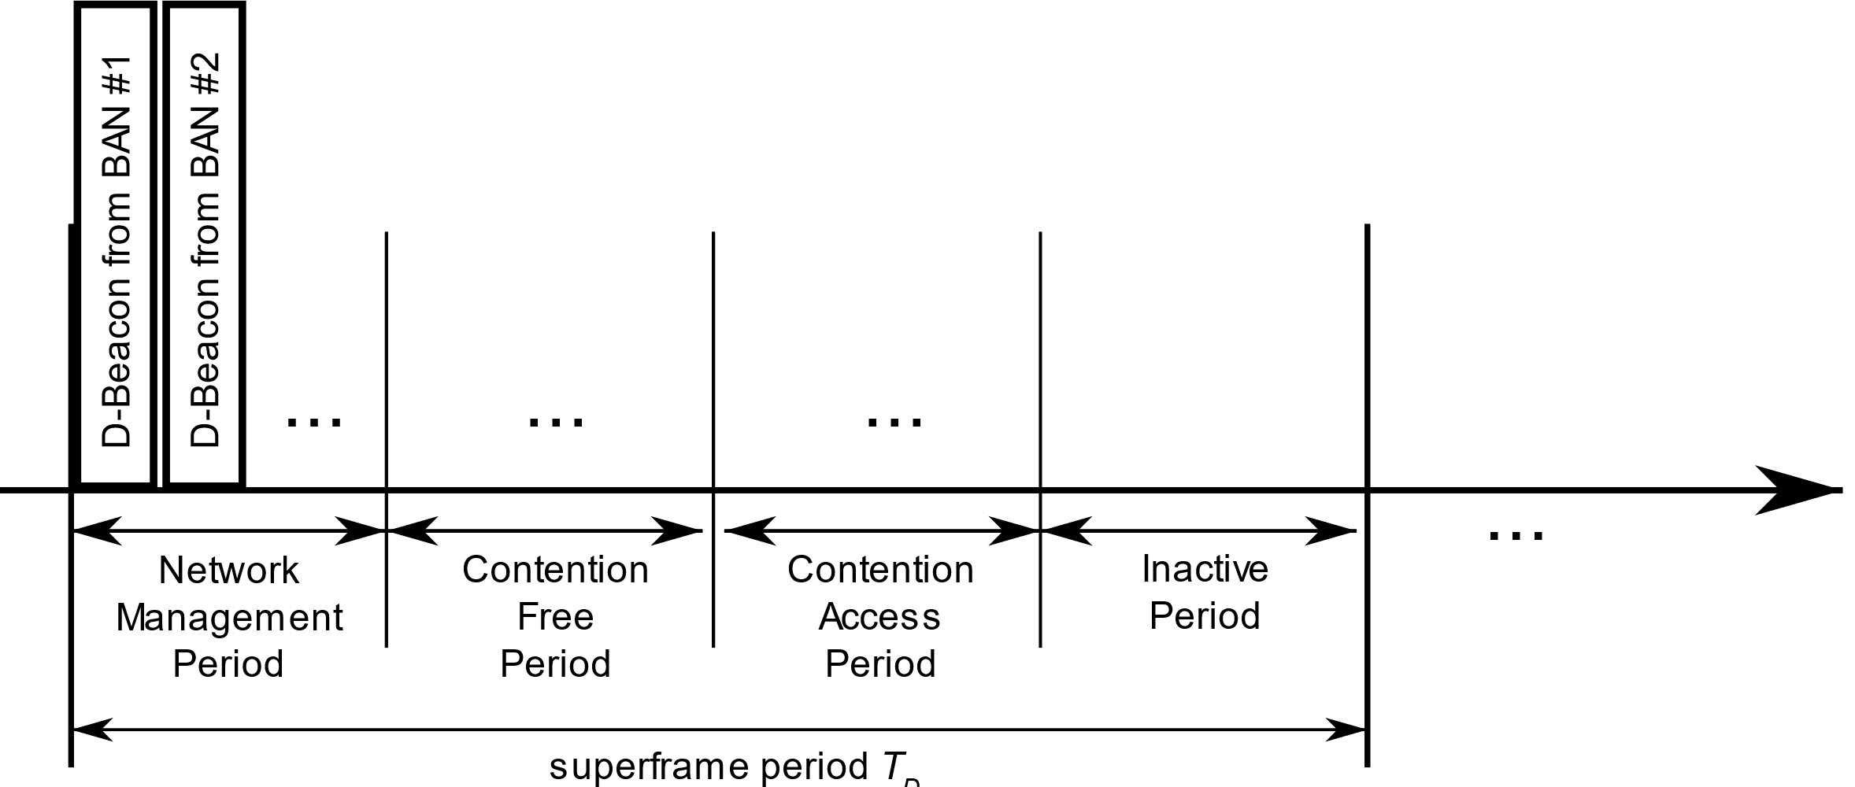
Data Channel (cont.)
A coordinator shall select one D-Channel.
A coordinator may support using two or more D-Channels simultaneously, to achieve higher dependability.
A coordinator shall transmit a data beacon frame (D-Beacon) on one time slot from NMP at every superframe of the D-Channel.

Slide 12
MAC Functions
BAN Creation
Superframe transition due to proximity of BAN piconets
Node Connection/Disconnection
Channel access
  CFP – TDMA
  CAP – Slotted aloha

Slide 13
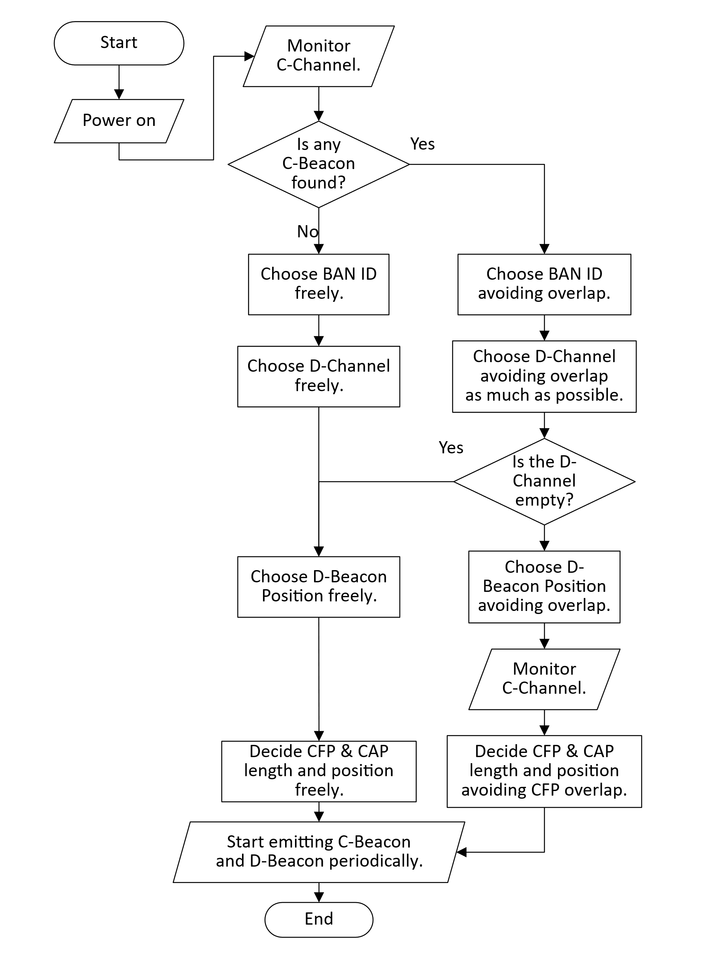
BAN Creation
A coordinator starts monitoring the C-Channel and checks whether there are neighboring BANs.
The coordinator chooses a BAN ID which is not currently in use by neighboring BANs.
The coordinator chooses a Data Channel (D-Channel).
  D-Channel Occupancy Indexes from C-Beacon of neighboring BANs can be used to determine which D-Channel to use.
  If there are other BAN using the same D-Channel, than the coordinator should synchronize to the other BAN’s superframe.
The coordinator chooses the D-Beacon Position in NMP.
  It must not overlap with those of other neighboring BANs using the same D-Channel.
The coordinator transmits Control Beacons (C-Beacon) periodically.
  The C-Beacon provides the BAN ID, D-Channel number, and D-Beacon Position in NMP.
The coordinator transmits Data Beacons (D-Beacon) periodically.
  The D-Beacon provides slot numbers where Contention Free Period (CFP) and Contention Access Period (CAP) begin.

Slide 14
Superframe transition due to proximity of BAN piconets
Because BANs are mobile, multiple BANs that have started independently can later come close to each other.
Since these BANs are likely to be using different superframes, each other's frames will interfere with each other.
To avoid this interference, BANs located close to each other must use common superframes.
After superframe transition

Slide 15
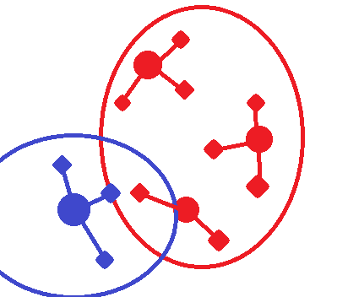
Superframe transition due to proximity of BAN piconets (cont.)
A coordinator keeps monitoring the C-Channel and checks whether there are neighboring BANs.
If the coordinator receives C-Beacon with different Superframe Reference BAN ID value, and if the Superframe Priority Index from the C-Beacon is greater than its own value,
  the coordinator must use the superframe of the newly met BAN.
BAN ID = 1
Superframe Reference BAN ID = 1
BAN ID = 2
Superframe Reference BAN ID = 1
BAN ID = 4
Superframe Reference BAN ID = 4
BAN ID = 3
Superframe Reference BAN ID = 1

Slide 16
Superframe transition due to proximity of BAN piconets (cont.)
Superframe Priority Index
  This index is used to determine which BAN should keep using the superframe and which BAN should transit to the other’s, when multiple BANs come close.
  This index should be defined so that BAN with many nodes with high priority can keep using its superframe, and BAN with lower priority nodes can transit to other BAN’s superframe.
Additional measure for enhanced reliability
  If a BAN with a low superframe priority index fails to receive C-beacon of another BAN, the interference cannot be avoided because superframe transition cannot not performed.
  In case the superframe transition according to the superframe priority index fails, it would be nice to have a safety measure that makes the high priority BAN be able to transit the superframe.

Slide 17
Node Connection/Disconnection
The node may monitor the C-Channels to acquire a C-Beacon.
The node may acquire the BAN ID, D-Channel number, and D-Beacon Position from the C-Beacon.
The node may monitor the D-Channels to acquire a D-Beacon.
The node may acquire the positions of Contention Free Period (CFP) and Contention Access Period (CAP).
The node may transmit a Connection Request (C-Request) frame during the CAP using the Contention Access procedure.
On successful reception of the C-Request frame, the coordinator shall transmit
  an Acknowledgement,
  and a Connection Assignment (C-Assignment) frame in the next available time slot.
    The C-Assignment frame shall contain details of allocated resources to the node, including the number of allocated time slot, and node’s allocated Node ID.

Slide 18
New fields in Control Beacon
BAN ID
D-Channel number
D-Beacon Position in Network Management Period (NMP)
D-Channel Occupancy Index
  To inform neighboring BANs of the congestion level of the channel.
Superframe Reference BAN ID
  To inform neighboring BANs of which superframe it is operating on.
  BANs that share superframes should have the same value and BANs that do not share superframes should have different values.
Superframe Priority Index

Slide 19
New field in Data Beacon
Position of Contention Free Period (CFP)
  In order to allow coexisting BANs to have CFPs that do not interfere with each other, this value may be different between BANs.
Position of Contention Access Period (CAP)

Slide 20
List of Frame Type
Channels | Periods | Frames | Sender | Receiver
Control | n/a | Control Beacon | Coordinator | Other Coordinators and Nodes
 |  | Coordinator-to-Coordinator |  | Other Coordinators
Data | Network Management | Data Beacon | Coordinator | Other Coordinators and Nodes
 | Contention Free | Scheduled Downlink Data | Coordinator | Specific Node
 |  |  | Coordinator | Relay Node
 |  |  | Relay Node | Relay Node
 |  |  | Relay Node | Specific Node
 |  | Scheduled Uplink Data | Node | Own Coordinator
 |  |  | Node | Relay Node
 |  |  | Relay Node | Relay Node
 |  |  | Relay Node | Own Coordinator
 | Contention Access | Connection Request | Node | Own Coordinator
 |  | Connection Assignment | Coordinator | Specific Node
 |  | Disconnection Notification | Node | Own Coordinator
 |  | Unscheduled Uplink Data | Specific Node | Own Coordinator

Slide 21
Summary
Allocating time slots (or periods) to each BAN is suggested to avoid frame collisions even between different BANs.
Using a Control Channel is suggested to accomplish the time slot allocation to each BAN as well as more accurate clear channel assessment.
Operating procedures of some MAC functions such as BAN creation are shown with a flowchart.
The newly required fields for performing this procedure have been explained.

Slide 22
References
[1] 15-22-0277-04-006a, MAC ideas for BAN with Enhanced Dependability

Slide 23
Thank you for your attention!

