Slide 1
Project: IEEE P802.15 Working Group for Wireless Specialty Networks
Submission Title: MAC Protocol Proposal for Multiple BAN Environment (Level 1)
Date Submitted: May 15th, 2023
Source: Minsoo Kim, Takumi Kobayashi, Marco Hernandez, Ryuji Kohno
Company: (1)Yokohama National University (2) YRP International Alliance Institute
Address: (1)79-5 Tokiwadai, Hodogaya-ku, Yokohama, 240-8501 Japan,
(2) YRP1 Blg., 3-4 HikarinoOka, Yokosuka-City, Kanagawa, 239-0847 Japan
Voice:[+81-90-5408-0611] E-Mail:[minsoo@minsookim.com, kobayashi-takumi-ch@ynu.ac.jp, marco.hernandez@ieee.org, kohno@ynu.ac.jp]
Re: In response to call for proposal
Abstract: MAC Protocol Proposal for Multiple BAN Environment (Level 1)
Purpose: Material for discussion in P802.15.6ma TG
Notice: This document has been prepared to assist the IEEE P802.15. It is offered as a basis for discussion and is not binding on the contributing individual(s) or organization(s). The material in this document is subject to change in form and content after further study. The contributor(s) reserve(s) the right to add, amend or withdraw material contained herein.
Release: The contributor acknowledges and accepts that this contribution becomes the property of IEEE and may be made publicly available by P802.15.

Slide 2
MAC Proposal of TG15.6ma
(Revision of IEEE802.15.6-2012)
MAC Protocol Proposal for Multiple BAN Environment (Level 1)
May 15th, 2023
Minsoo Kim, Takumi Kobayashi, Marco Hernandez, and Ryuji Kohno
Yokohama National University(YNU),
YRP International Alliance Institute(YRP-IAI)

Slide 3
Introduction
In this draft proposal, we are focusing on ensuring high dependability in scenarios where multiple Body Area Networks (BANs) are operating together.
One of our key strategies is to allocate specific time slots (or periods) to each BAN, which helps to prevent frame collisions, even among different BANs.
To achieve this, we are proposing the use of a dedicated channel for exchanging network control frames and coordinator-to-coordinator frames.
This strategy will not only enable efficient time slot allocation to each BAN, but also allow for more precise Clear Channel Assessment (CCA), especially in dense environments.
It is also crucial to maintain backward compatibility and ensure coexistence with devices based on the original standard. We would also like to consider ways to ensure this.

Slide 4
Dedicating a channel for control frames
In the original IEEE Std 802.15.6-2012, both network control and data exchange happen on the same channel, with different frame types distinguishing between the two.
In our proposal, we suggest dedicating one channel exclusively for the exchange of network control frames. There are a few key advantages to this approach:
  Efficient Clear Channel Assessment (CCA): With just one channel to monitor, CCA can be conducted more efficiently.
  Reduced Control Frame Collisions: By transmitting control frames on a less congested channel (where data frames are absent), we can significantly reduce the likelihood of frame collisions.
  Enhanced Dependability: Devices designed for an extra level of dependability may be able to utilize this dedicated control channel, thereby enhancing the overall reliability of the network.

Slide 5
Channel configuration
Band group | Channel number | Central frequency (MHz) | Bandwidth (MHz) | Channel attribute in 802.15.6-2012 | Channel attribute for the revision
Low band | 0 | 3494.4 | 499.2 | Optional | Control | Optional
 | 1 | 3993.6 | 499.2 | Mandatory | Control/Data | Mandatory
 | 2 | 4492.8 | 499.2 | Optional |  | Optional
High band | 3 | 6489.6 | 499.2 | Optional | Control/Data | Optional
 | 4 | 6988.8 | 499.2 | Optional |  | Optional
 | 5 | 7488.0 | 499.2 | Optional | Control | Optional
 | 6 | 7987.2 | 499.2 | Mandatory | Control/Data | Mandatory
 | 7 | 8486.4 | 499.2 | Optional |  | Optional
 | 8 | 8985.6 | 499.2 | Optional |  | Optional
 | 9 | 9484.8 | 499.2 | Optional |  | Optional
 | 10 | 9984.0 | 499.2 | Optional |  | Optional
In the original IEEE Std 802.15.6-2012, one specific channel is designated as mandatory for each band group.
To maintain backward compatibility with the original standard, the mandatory channel configuration remains unchanged in the proposed revision.
Additionally, in the proposed revision, one channel is designated as the control channel, which can be utilized as a common channel shared by multiple systems.

Slide 6
Frame assignments for Control/Data Channels
Channels | Periods | Frames (draft)
 |  | From coordinators | From nodes
Control | n/a | Control Beacon Coordinator-to-coordinator | Not allowed
Data | Network Management | Data Beacon
 | Contention Free | Scheduled Data | Scheduled Data
 | Contention Access | Connection Assignment Disconnection Response Unscheduled Data | Connection Request Disconnection Notification Unscheduled Data
The frame assignments have been developed to account for hardware limitations between the coordinator and the nodes, including processing power, transmitting power, memory capacity, and energy efficiency.

Slide 7
Control Channel
Only coordinators are allowed to transmit on the control channel (C-Channel).
The control channel does not follow a time slot structure.
  Due to the mobility of BANs, there is a possibility that BANs or groups of BANs with different synchronization timings may come across each other.
  Therefore, it is reasonable to design MAC protocol with the assumption that reliable synchronization between multiple BANS is not possible.
  This is particularly important when considering the interoperability of BANs with other UWB systems.

Slide 8
Control Channel (cont.)
A coordinator is required to transmit a control beacon frame (C-Beacon) on the control channel (C-Channel) at regular intervals of T_{C} seconds.
  Prior to emitting the first C-Beacon, the coordinator must perform Clear Channel Assessment (CCA) to ensure the channel is clear.
  The C-Beacon Period, T_{C}, is randomly selected by the coordinator within the range of T_{C,min} to T_{C,max}.

Slide 9
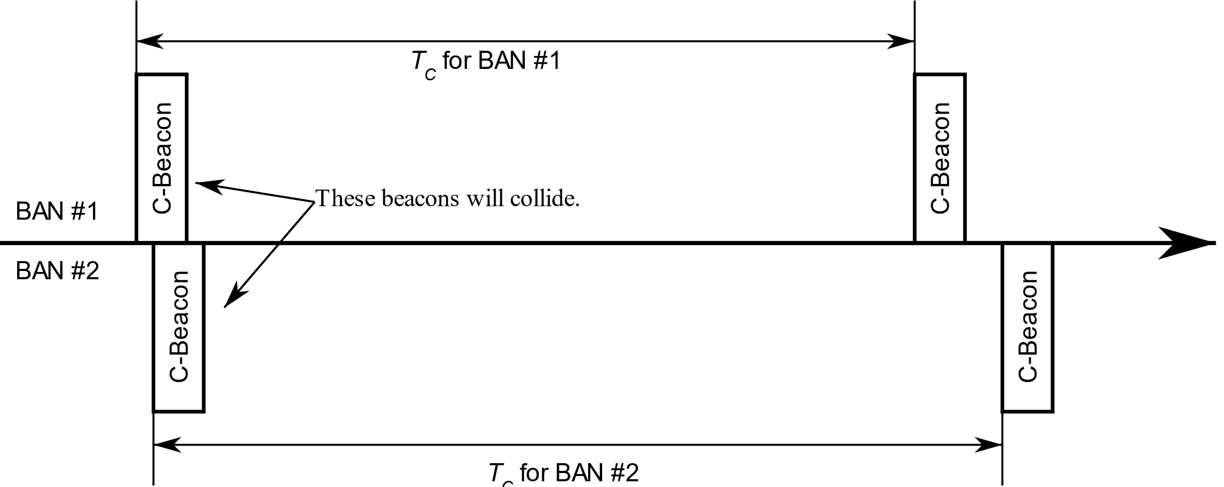
Why is the C-Beacon Period Random?
When all coordinators transmit their C-Beacons at the same interval, a collision between C-Beacons will persist indefinitely, causing ongoing interference.
However, by assigning each coordinator a different interval, collisions can be minimized or eliminated.
It is desirable to choose intervals that are relatively prime or have a large greatest common multiple, as this reduces the likelihood of future collisions and enhances overall network performance.

Slide 10
Data Channel
Both coordinators and nodes have the capability to transmit on the data channel (D-Channel).
The time axis in a D-Channel is divided into superframes, each with a fixed duration of T_{D} seconds.
Within each superframe, the time axis is further divided into time slots, each with a fixed duration of T_{S} seconds.
The superframe consist of four distinct periods:
  Network Management Period (NMP): This period consist of N_{NMP} time slots, which are dedicated to transmitting network management frames, such as data beacons.
  Contention Free Period (CFP): This period consist of N_{CFP} time slots, which are reserved for transmitting scheduled frames.
  Contention Access Period (CAP): This period consist of N_{CAP} time slots, which are used for transmitting unscheduled frames.
  Inactive Period: During this period, no frames are transmitted.

Slide 11
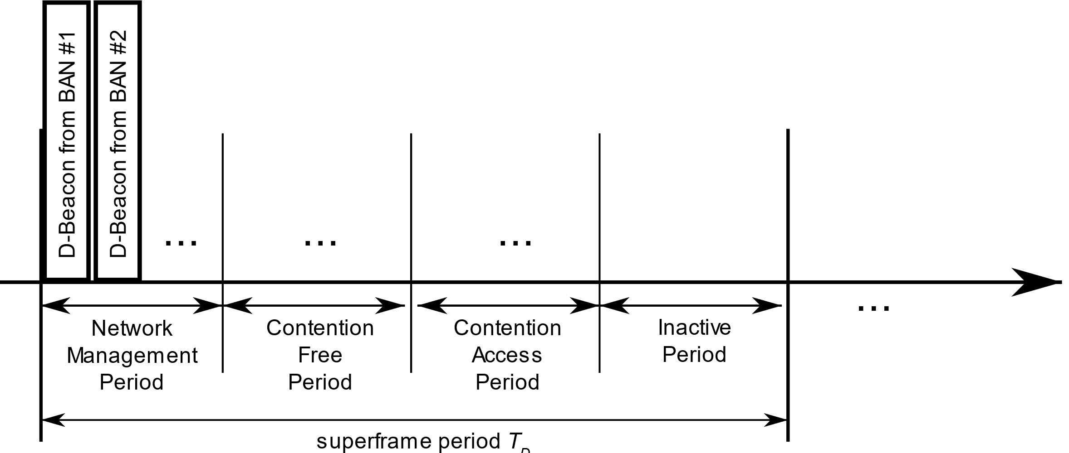
Data Channel (cont.)
Each coordinator is required to select one D-Channel.
To achieve higher dependability, a coordinator may support the use of multiple D-Channels simultaneously.
Within each superframe of the selected D-Channel, a coordinator transmits a data beacon frame (D-Beacon) on a single time slot from the Network Management Period (NMP).

Slide 12
MAC Functions
BAN Creation
Superframe transition due to proximity of BAN piconets
Node Connection/Disconnection
Channel access
  Contention Free Period – TDMA
  Contention Access Period – Slotted aloha

Slide 13
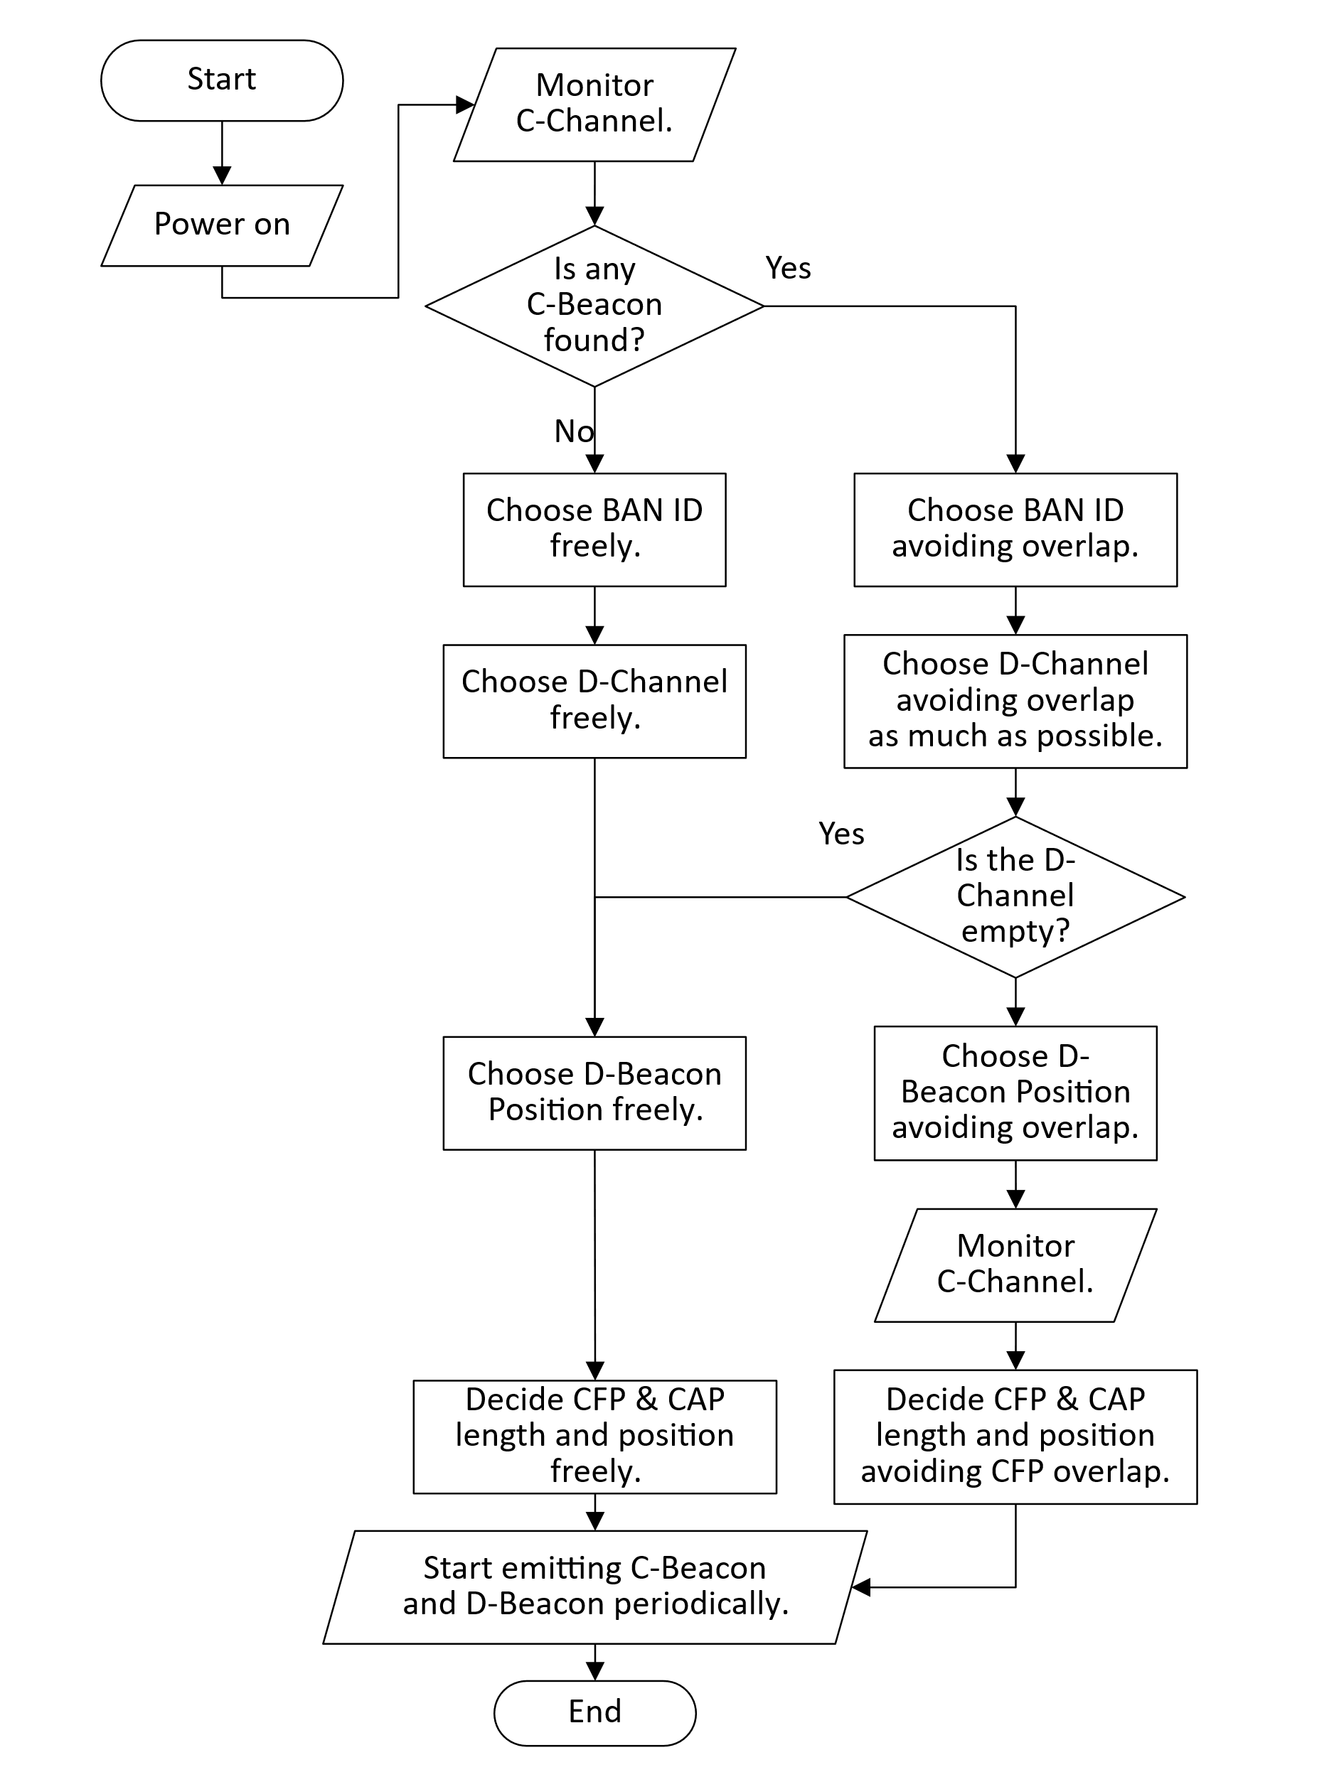
BAN Creation
Neighbor BAN Detection: The coordinator monitors the C-Channel to identify neighboring BANs and determine their presence.
BAN ID Selection: The coordinator selects an available BAN ID that is not currently in use by neighboring BANs to ensure uniqueness within the network.
Data Channel (D-Channel) Selection: The coordinator chooses a suitable D-Channel for communication. D-Channel Occupancy Indexes obtained from neighboring BAN’s C-Beacons can be used to determine which D-Channel to use.
D-Channel Synchronization: If other BANs are using the same D-Channel, the coordinator synchronizes to the superframe of the BAN(s) already using that D-Channel.

Slide 14
BAN Creation (cont.)
D-Beacon Position Selection: The coordinator selects a specific position for the D-Beacon transmission within the Network Management Period (NMP) of the superframe. It ensures that the chosen position does not overlap with neighboring BANs using the same D-Channel.
Periodic Control Beacon (C-Beacon) Transmission: The coordinator transmits Control Beacons periodically on the C-Channel. The C-Beacon includes essential information such as the BAN ID, D-Channel number, and D-Beacon Position in NMP.
Periodic Data Beacon (D-Beacon) Transmission: The coordinator transmits Data Beacons periodically on the D-Channel. The D-Beacon provides slot numbers indicating the start of the Contention Free Period (CFP) and the Contention Access Period (CAP) within each superframe.

Slide 15
Superframe transition due to proximity of BAN piconets
As BANs are mobile, it is possible for multiple BANs that have started independently to come into close proximity with each other.
Since these BANs are likely using different superframes, their frames will interfere each other, causing performance degradation.
To avoid this interference, BANs located in close proximity must transition to using common superframes.
After superframe transition

Slide 16
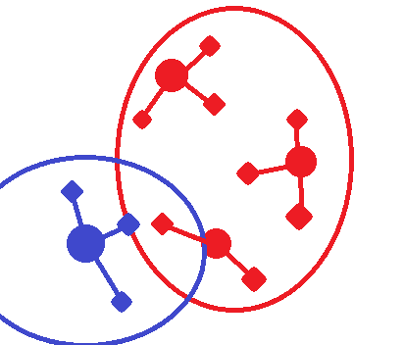
Superframe transition due to proximity of BAN piconets (cont.)
A coordinator continuosly monitors the C-Channel to detect neighboring BANs.
When a coordinator receives a Control Beacon (C-Beacon) with a different Superframe Reference BAN ID value and a Superframe Priority Index grater than its own, it indicates that a new BAN is nearby.
In such cases, the coordinator must transition to using the superframe of the newly met BAN to avoid interference and ensure efficient communication.
BAN ID = 1
Superframe Reference BAN ID = 1
BAN ID = 2
Superframe Reference BAN ID = 1
BAN ID = 4
Superframe Reference BAN ID = 4
BAN ID = 3
Superframe Reference BAN ID = 1

Slide 17
Superframe transition due to proximity of BAN piconets (cont.)
The Superframe Priority Index is used to determine which BAN should continue using its current superframe and which BAN should transition to the superframe of another BAN when multiple BANs come into close proximity.
  The index should be defined in a way that allows BANs with many nodes of high priority to maintain their superframes, while BANs with lower priority nodes can transition to other BAN’s superframe.
Fallback Mechanism: In scenarios where a BAN with a low Superframe Priority Index fails to receive the C-beacon of another BAN, interference cannot be avoided due to the inability to perform superframe transition.
  To address this situation, implementing a fallback mechanism allowing high-priority BANs to initiate superframe transition would be advantageous.

Slide 18
Node Connection/Disconnection
The node monitors the C-Channels to acquire a C-Beacon, which provides essential information.
By receiving the C-Beacon, the node can obtain the BAN ID, D-Channel number, and D-Beacon Position for further communication.
The node also monitors the D-Channels to acquire a D-Beacon, which provides details about the positions of Contention Free Period (CFP) and Contention Access Period (CAP).
During the CAP, the node initiates the Connection Request (C-Request) frame using the Contention Access procedure.
Upon successful reception of the C-Request frame, the coordinator responds by transmiting
  an Acknowledgement,
  and a Connection Assignment (C-Assignment) frame in the next available time slot.
The C-Assignment frame provides information of the allocated resources to the node, including the number of time slots allocated, and the node’s allocated Node ID.

Slide 19
Fields in Control Beacon
BAN ID
  This is a unique identifier assigned to each Body Area Network (BAN).
  It is used to distinguish between BANs operating in the vicinity and facilitate communication between them.
D-Channel number
  This refers to the specific channel utilized for data transmission within a BAN.
  Each BAN is assigned a particular D-Chanel number to avoid interference with other BANs and enable efficient communication.
D-Beacon Position in Network Management Period (NMP)
  This indicates the specific time slot within the NMP where the D-Beacon, which provides network management information, is transmitted.
D-Channel Occupancy Index
  This index is a measure used to inform neighboring BANs about the congestion level of the D-Channel.
  It provides an indication of how busy the channel is, helping BANs make informed decisions regarding D-Channel selection.

Slide 20
Fields in Control Beacon (cont.)
The Superframe Reference BAN ID
  This serves the purpose of informing neighboring BANs about the BAN with which they share the same superframe.
  BANs that share superframes should have the same Superframe Reference BAN ID, allowing synchronization and coordinated operation within the shared superframe.
The Superframe Priority Index
  This is an index used to determine the priority of a BAN in relation to other BANs when multiple BANs come into proximity.
  It enables the orderly transition of superframes, ensuring that BANs with higher priority can maintain their superframes while lower-priority BANs transition to other BAN’s superframes.

Slide 21
Fields in Data Beacon
Position of Contention Free Period (CFP)
  This refers to the specific time slots within the superframes where the Contention Free Period occurs.
  The CFP is a dedicated period during which scheduled frames are transmitted without contention.
  To ensure coexistence an minimize interference among coexisting BANs, the position of the CFP may vary between BANs.
  By assigning different CFP position, BANs can have non-overlapping CFPs, allowing for interference-free transmission of scheduled frames.

Slide 22
Fields in Data Beacon (cont.)
Position of Contention Access Period (CAP)
  This refers to the specific time slots within the superframes where the Contention Access Period occurs.
  The CAP is a period during which unscheduled frames are transmitted using the slotted aloha access mechanism, where nodes contend for access to the channel.
  The specific position of the CAP within the superframe allows nodes to know when to transmit unscheduled frames and participate in the contention process.
  The CAP provides a mechanism for nodes to access the channel when their transmissions are not pre-scheduled during the Contention Free Period (CFP).

Slide 23
List of Frame Type
Channels | Periods | Frames | Sender | Receiver
Control | n/a | Control Beacon | Coordinator | Other Coordinators and Nodes
 |  | Coordinator-to-Coordinator |  | Other Coordinators
Data | Network Management | Data Beacon | Coordinator | Other Coordinators and Nodes
 | Contention Free | Scheduled Downlink Data | Coordinator | Specific Node
 |  |  | Coordinator | Relay Node
 |  |  | Relay Node | Relay Node
 |  |  | Relay Node | Specific Node
 |  | Scheduled Uplink Data | Node | Own Coordinator
 |  |  | Node | Relay Node
 |  |  | Relay Node | Relay Node
 |  |  | Relay Node | Own Coordinator
 | Contention Access | Connection Request | Node | Own Coordinator
 |  | Connection Assignment | Coordinator | Specific Node
 |  | Disconnection Notification | Node | Own Coordinator
 |  | Unscheduled Uplink Data | Specific Node | Own Coordinator

Slide 24
Summary
The proposed solution emphasizes the allocation of time slots to each Body Area Network (BAN) to prevent frame collisions, even when multiple BANs are present.
It suggest utilizing a Control Channel for precise time slot allocation and improved clear channel assessment.
The operating procedures of essential MAC functions, including BAN creation, are presented through a flowchart, along with an explanation of the required fields to facilitate the procedure.

Slide 25
References
[1] 15-22-0277-04-006a, MAC ideas for BAN with Enhanced Dependability

Slide 26
Thank you for your attention!

