Slide 1
        doc.: 15-22-00651-00-04ab
Project: IEEE P802.15 Working Group for Wireless Personal Area Networks (WPANs)
Submission Title: Recap and New Considerations on NBA MMS Ranging Integrity Fragments
Date Submitted: 17 November 2022
Source: Boris Danev (3db Access), David Barras (3db Access)
Address: 3db Access AG, Lavaterstrasse 76, Zurich, Switzerland
E-Mail: david.barras@3db-access.com, boris.danev@3db-access.com
Abstract: Additional considerations on ranging integrity
Purpose: Recap and important future considerations on ranging integrity
Notice: This document has been prepared to assist the IEEE P802.15. It is offered as a basis for discussion and is not binding on the contributing individual(s) or organization(s). The material in this document is subject to change in form and content after further study. The contributor(s) reserve(s) the right to add, amend or withdraw material contained herein.
Release: The contributor acknowledges and accepts that this contribution becomes the property of IEEE and may be made publicly available by P802.15.

Slide 2
Recap and New Considerations on
NBA MMS Ranging Integrity Fragments
        doc.: 15-22-0651-00-04ab
Notes:
affiliation

Slide 3
        doc.: 15-22-0651-00-04ab
PAR Objective | Proposed Solution (how addressed)
Safeguards so that the high throughput data use cases will not cause significant disruption to low duty-cycle ranging use cases
Interference mitigation techniques to support higher density and higher traffic use cases
Other coexistence improvement
Backward compatibility with enhanced ranging capable devices (ERDEVs)
Improved link budget and/or reduced air-time | NBA-MMS and new regulatory changes in EU to improve link budget
Additional channels and operating frequencies
Improvements to accuracy / precision / reliability and interoperability for high-integrity ranging | Quantifiable integrity levels that are not channel-dependent to allow interoperability
Reduced complexity and power consumption | distance commitment approach on challenge/response messages, real time and reduced post-processing
Hybrid operation with narrowband signaling to assist UWB | Exploit tightly coupled concurrent operation of NB for secure ranging
Enhanced native discovery and connection setup mechanisms
Sensing capabilities to support presence detection and environment mapping
Low-power low-latency streaming
Higher data-rate streaming allowing at least 50 Mbit/s of throughput
Support for peer-to-peer, peer-to-multi-peer, and station-to-infrastructure protocols
Infrastructure synchronization mechanisms

Slide 4
References
        doc.: 15-22-0651-00-04ab
[0571] 15-22-0571-00-04ab-nba-uwb-technical-framework-proposal-2022-nov
[0074] 15-22-0074-00-04ab-link-budget-analysis-for-nba-mms
[0076] 15-22-0076-00-04ab-extending-nbuwb-for-secure-ranging
[0392] 15-22-0392-00-04ab-more-on-mixed-mms-for-ranging-integrity
[0413] 15-22-0413-00-04ab-performance-analysis-of-ranging-integrity-fragment-with-distance-commitment
[18-22-0141] 802.18/dcn/22/18-22-0141-00-0000-new-uwb-regulation-in-europe.pptx

Slide 5
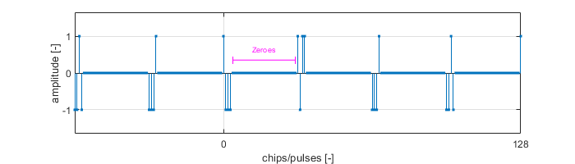
RIF format for Ranging Integrity
        doc.: 15-22-0651-00-04ab
Ranging Integrity for the updated NBA-MMS framework 4ab [0571]
  RIF message for ranging integrity based on distance commitment
  RIF is built from bursts which each carry 1-bit of cryptographic information

Slide 6
Hardness Assumption for Ranging Integrity
        doc.: 15-22-0651-00-04ab
Hardness assumption in integrity ranging = bring the integrity of the measured distance to the probability of guessing cryptographic bits
  “E.g., If one decodes 20 bits (burst) the probability of guessing the cryptographic bits carried by the RIF bursts is 2⁻²⁰ (≈1/1’000’000)”
1 0 1 0 0 1 1

Slide 7
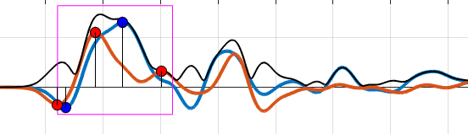
Distance Commitment & Hardness Assumption
        doc.: 15-22-0651-00-04ab
Distance commitment consists in verifying the hardness assumption at the Time-of-Arrival (ToA) of the RIF bursts
ToA
ToA
ToA
0 1 0 0 1
ToA

Slide 8
Example of a failing distance decrease on RSF
        doc.: 15-22-0651-00-04ab
Distance commitment consists in verifying the hardness assumption at the Time-of-Arrival (ToA) of the RIF bursts
When attacker advances the ToA during RSF phase, the bursts won’t be correctly decoded
(attacker can only make guesses
with an overall success of 2⁻²⁰)
ToA
ToA
ToA
0 1 0 0 1
ToA

Slide 9
Practical implementation of RIF verification
        doc.: 15-22-0651-00-04ab
How distance commitment works in NBA-MMS ?
  Sending only 20 bursts ( = verifying 20 bits with no errors)
    Require high peak power (regulation issues)
    Requires high SNR at the receiver
  In NBA MMS we send more bits (1024) and tolerate a defined number of errors (435) for same 20 bits of security

Slide 10
Advantages of RIF with distance commitment
        doc.: 15-22-0651-00-04ab
NBA MMS RIF with distance commitment enables quantifiable ranging integrity
Interoperability b/w vendors
Open and well-defined method
Formally proven in literature
White-box security certification

Slide 11
Current limitations and future expectations
        doc.: 15-22-0651-00-04ab
Current limitations:
  Latency in MMS integrity ranging is becoming critical in some applications
  (access control & localization+access control, “wall” effect)
Recent updates on EU regulations ([18-22-0141]→ -31.3 dBm / MHz, generic indoor) will solve this issue by enabling 8 MMRS within one millisecond and 8 RIFs within the next millisecond
  Only possible in indoor access (not for car access)
Can we further combine RSF and RIF in order to reduce latency of NBA MMS integrity ranging with similar link budget and integrity level?
1ms
(Y-2) ms
NB
RSF/RIF
1
RSF/RIF
2
RSF/RIF
Y
NB ← → UWB

