Slide 1
doc.: IEEE 802.15-22-0652-00-06ma
Project: IEEE P802.15 Working Group for Wireless Personal Area Networks (WPANs) Submission Title: [Soft Spectrum Adaptation(SSA) Based on Pulse Shaping for Interference Mitigation between UWB radio and Other Coexisting Radio]
Date Submitted: [17 November 2022]
Source: [Ryuji Kohno, Takumi Kobayashi] [1;Yokohama National University(YNU), 2;YRP International Alliance Instiitute(YRP-IAI)]
Address [1; 79-5 Tokiwadai, Hodogaya-ku, Yokohama, Japan 240-8501
2; YRP1 Blg., 3-4 HikarinoOka, Yokosuka-City, Kanagawa, Japan 239-0847 ] Voice:[1; +81-90-5408-0611], FAX: [+81-45-383-5528],
Email:[1:kohno@ynu.ac.jp, kobayashi-takumi-ch@ynu.ac.jp, 2:kohno@yrp-iai.jp,]
Abstract: [This document is a copy of the original document “SSA-UWB and Cognitive Radio: a suggestion for global harmonization and compromise in IEEE 802.15.3a WPAN” doc.: IEEE 802.15-04/0253r0 submitted in IEEE802.15.3a May 2004. This Soft Spectrum Adaptation(SSA) technology may be applicable to mitigate interference among IEEE802.15.6ma UWB dependable BAN and other coexisting radio. The SSA can be generally useful in coexistence between UWB radio and other narrow band radio.]
Purpose: [information]
Notice: This document has been prepared to assist the IEEE P802.15. It is offered as a basis for discussion and is not binding on the contributing individual(s) or organization(s). The material in this document is subject to change in form and content after further study. The contributor(s) reserve(s) the right to add, amend or withdraw material contained herein.
Release: The contributor acknowledges and accepts that this contribution becomes the property of IEEE and may be made publicly available by P802.15.
Slide 1
Ryuji Kohno, Takumi Kobayashi(YNU/YRP-IAI)

Slide 2
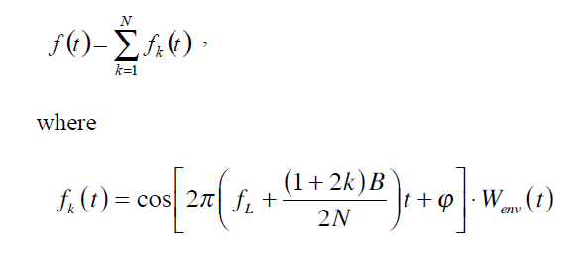
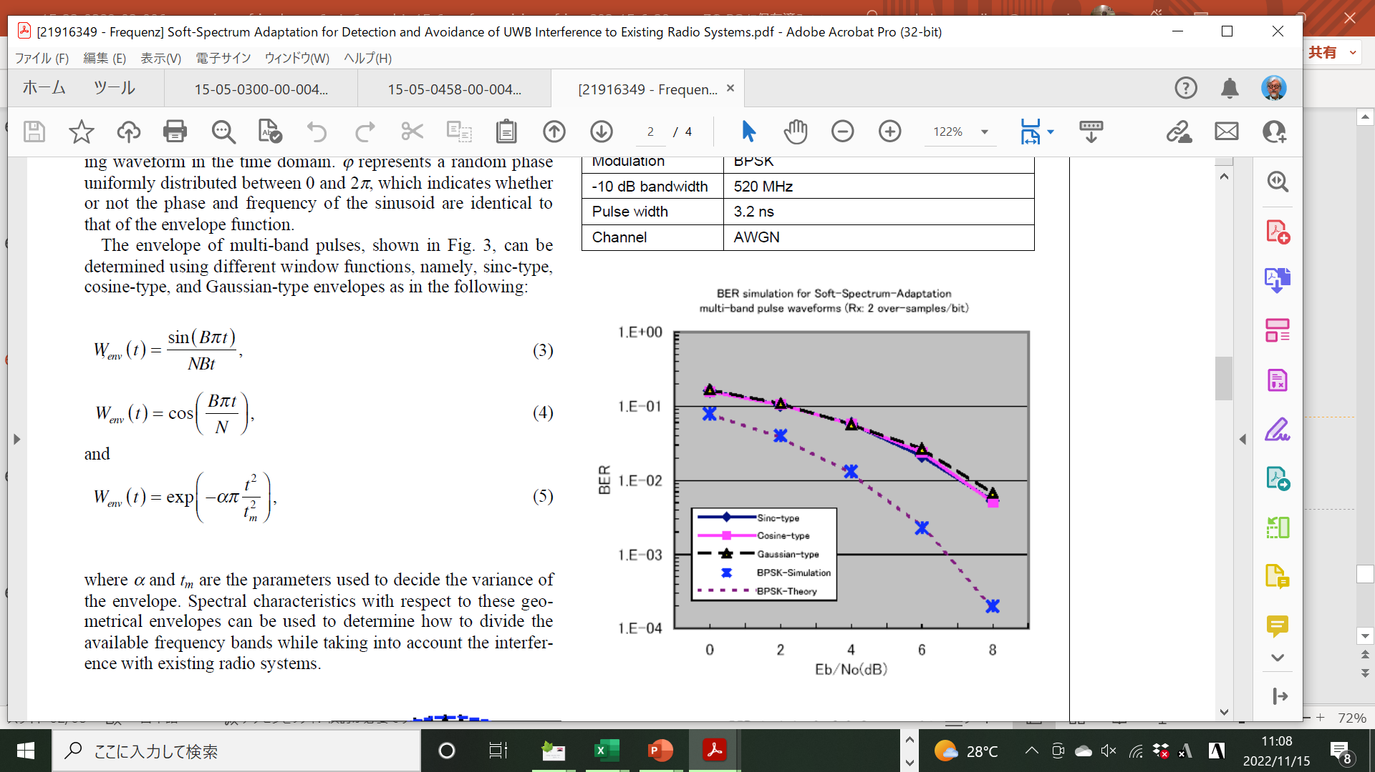
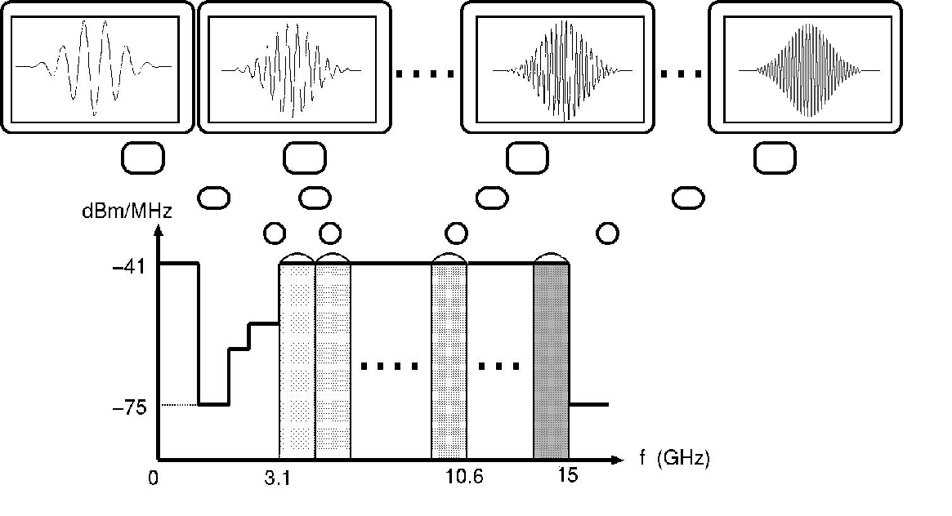
doc.: IEEE 802.15-22-0652-00-06ma
Soft Spectrum Adaptation(SSA); Synthesizing Pulse Shape Way to Avoid Interference with Coexisting Radios
Ref.[1] H. Zhang, K.Y. Yazdandoost, K.Li, R. Kohno, "SSA-UWB and Cognitive Radio: A Suggestion for Global Harmonization and Compromise in IEEE 802.15.3a WPAN," doc.: IEEE802-15-04-0253-00-003a, May 2004
[2] Ryuji Kohno. Ken-ichi Takizawa, “Soft-Spectrum Adaptation for Detection and Avoidance of UWB
Interference to Existing Radio Systems,” pp.88-91, Frequenz 60 (2006) 5-6
Slide 2
Ryuji Kohno, Takumi Kobayashi(YNU/YRP-IAI)

Slide 3
Project: IEEE P802.15 Working Group for Wireless Personal Area Networks (WPANs)
Submission Title: [SSA-UWB and Cognitive Radio: a suggestion for global harmonization and compromise in IEEE 802.15.3a WPAN]
Date Submitted: [11 May, 2004]
Source: [Honggang Zhang, Kamya Y. Yazdandoost, Keren Li, Ryuji Kohno ]
Company [ National Institute of Information and Communications Technology (NICT)]
Connector’s Address [3-4, Hikarino-oka, Yokosuka, 239-0847, Japan]
Voice:[+81-468-47-5101], FAX: [+81-468-47-5431],
E-Mail: ［honggang@nict.go.jp, yazdandoost@nict.go.jp, keren@nict.go.jp, kohno@nict.go.jp]
Re: [IEEE P802.15 Alternative PHY Call For Proposals, IEEE P802.15-02/327r7]
Abstract: [In order to realize the global harmonization and compromise in IEEE 802.15.3a UWB WPAN, PSWF-based SSA-UWB systems with improved Common Signaling Mode (CSM) are investigated in NICT and the recent investigation results are briefly summarized. ]
Purpose: [For investigating the characteristics of High Rate Alternative PHY standard in 802.15TG3a, based on the Soft-Spectrum Adaptation (SSA) proposal by NICT.]
Notice: This document has been prepared to assist the IEEE P802.15. It is offered as a basis for discussion and is not binding on the contributing individual(s) or organization(s). The material in this document is subject to change in form and content after further study. The contributor(s) reserve(s) the right to add, amend or withdraw material contained herein.
Release: The contributor acknowledges and accepts that this contribution becomes the property of IEEE and may be made publicly available by P802.15.

Slide 4
SSA-UWB and Cognitive Radio:
A Suggestion for Global Harmonization and Compromise in IEEE 802.15.3a WPAN
Honggang ZHANG, Kamya Y. YAZDANDOOST,
Keren LI, Ryuji KOHNO
National Institute of Information and Communications Technology (NICT)

Slide 5
Outline of presentation
Brief historical retrospect of SSA-UWB PHY proposal
Description of Cognitive Radio (CR) concept
Global harmonization and compromise based on SSA-UWB and Cognitive Radio
→ Improved Common Signaling Mode (ICSM) using PSWF-type SSA pulse wavelets
4. Design and implementation of PSWF-type SSA pulse wavelets
5. Conclusion remarks
6. Backup materials

Slide 6
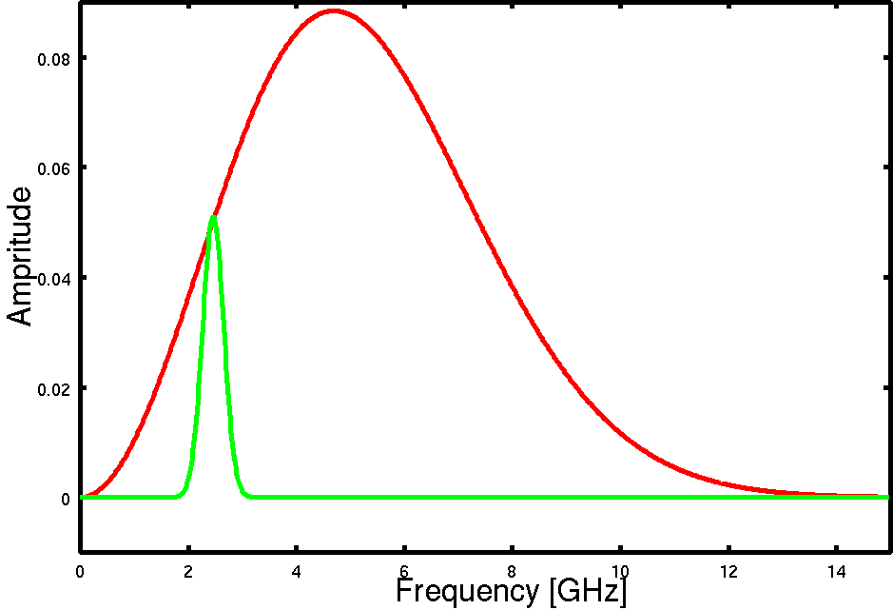
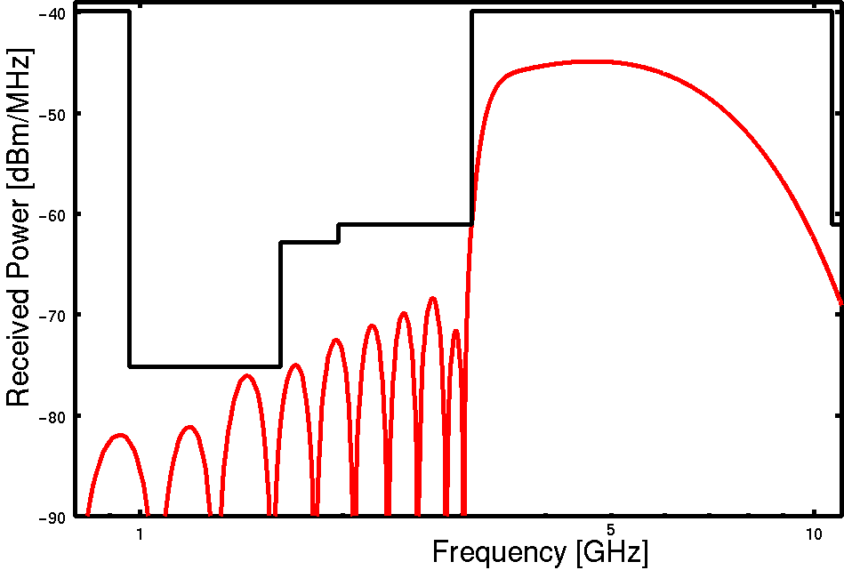
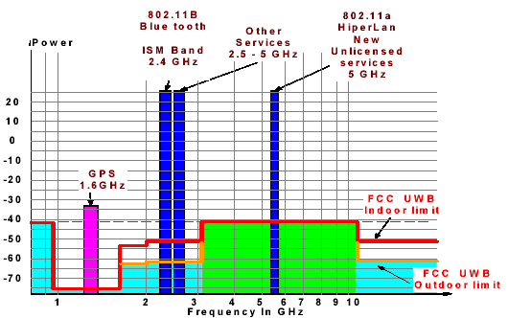
1. Basic philosophy of Soft-Spectrum Adaptation
Design a proper pulse waveform and code with higher frequency efficiency corresponding to any spectral mask
Adjust transmitted signal’s spectrum with flexibility, so as to minimize interference to/from coexisting systems
Employ optimized pulse wavelet and code to achieve higher system performance

Slide 7
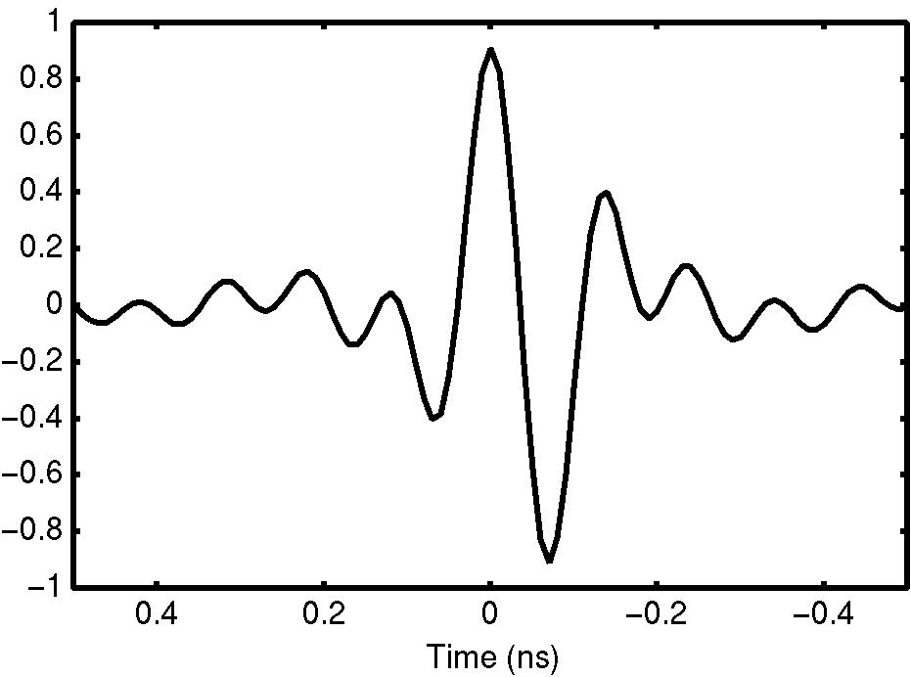
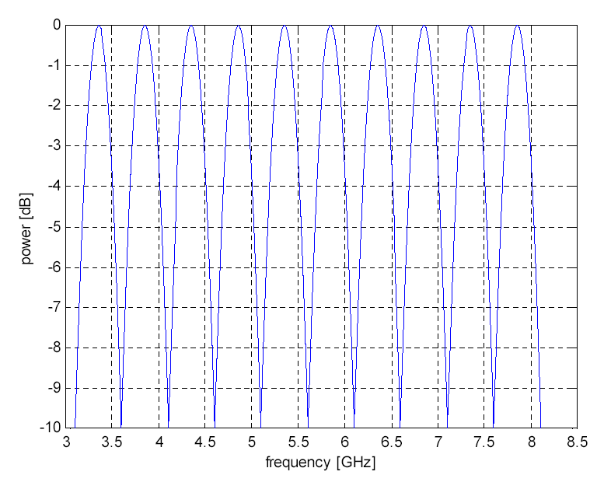
Basic SSA-UWB philosophy (cont.)
Exchangeable
Modified SSA pulse
Modified SSA pulse
5 GHz
W-LAN
Harmonized
with each
through
Power Spectrum
1
2
3
4
5
6
7
8
9
10
11
f
Dual- or three-band
Multi-band or Multi-carrier
SSA-UWB pulse wavelet and code

Slide 8
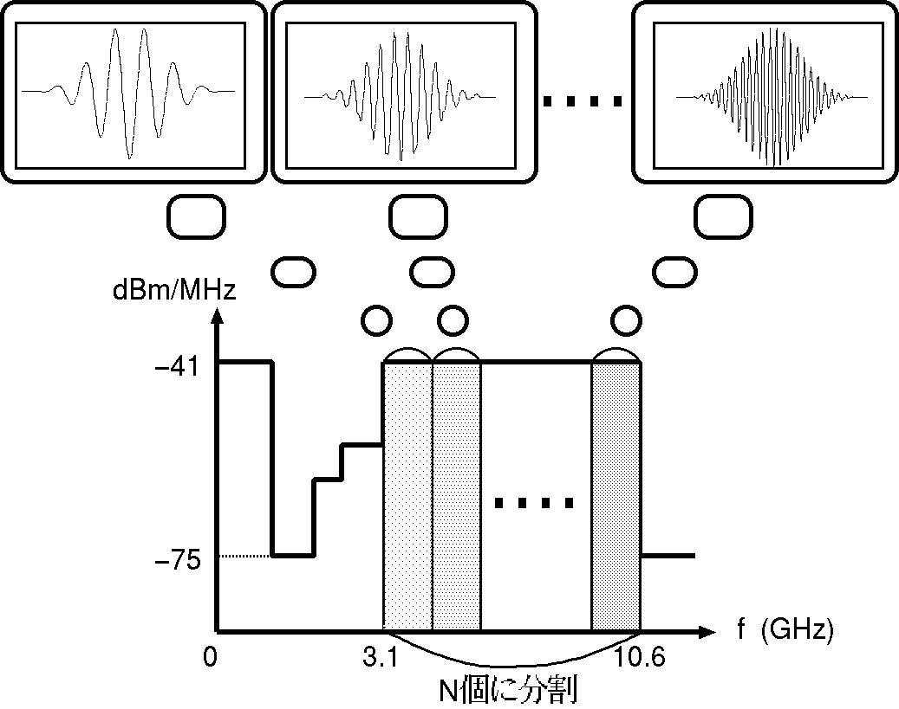
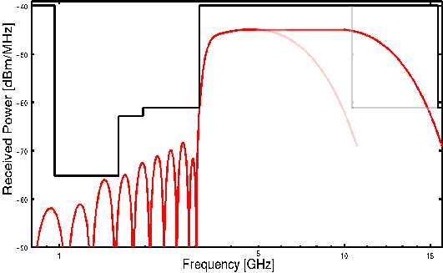
SSA-UWB with flexible band plan
Single-band
Dual- or Triple-band
Multi-band
5 GHz
W-LAN
Power Spectrum
1
2
3
4
5
6
7
8
9
10
11
f [GHz]
N division
In the future, if the restricting ruggedness of regional spectral mask (e.g. FCC mask) is eased, band allocation can be extended below 3.1 GHz or above 10.6 GHz.
N+α division
Soft-Spectrum Adaptation (SSA) can correspond freely

Slide 9
Features of SSA-UWB
SSA-UWB with flexible pulse waveform, code and frequency band can be applied to single and multi-band/multi-carrier UWB.
Interference avoidance for co-existence, harmonization for various systems, and global implementation can be realized.
→ SSA-UWB can flexibly adjust UWB signal spectrum so as to match with any spectral restriction, i.e. spectral masks in both cases of single and multiple bands.
Scalable, adaptive performance improvement.
Smooth system version-up similar to Software Defined Radio (SDR) and Cognitive Radio (CR).

Slide 10

Global harmonization and compromise based on SSA-UWB
Kernel functions
SSA type
ST Microelectronics
Adaptive
Mitsubishi
Free-
verse
Gaussian
Adaptive-band
Optimized
SSA
Soft-Spectrum Adaptation
(SSA)
Modulated
modified SSA pulse
Global standard
Dual-band
Motorola/XSI
XSI Wavelet
TF Hopping
Geo-
metrical
Multiband with carrier
Intel, Wisair
TF Coding
GA, Philips
MB-OFDM
Sinusoidal
OFDM
Multi-carrier
TI

Slide 11
2. Improving spectrum usage through Cognitive Radio (CR) technology
“ A Cognitive Radio is a radio frequency transmitter/receiver that is designed to intelligently detect whether a particular segment of the radio spectrum is currently in use, and to jump into (and out of, as necessary) the temporarily-unused spectrum very rapidly, without interfering with the transmissions of other authorized users.”
http://www.ieeeusa.org/forum/POSITIONS/cognitiveradio.html

Slide 12
Examples of Cognitive Radio technology
At MAC level:
CSMA algorithm
Energy detect channel scan
Active channel scan
Passive channel scan
PAN identifier conflict resolution
Re-transmissions
Dynamic channel selection
At PHY level:
Multi-mode CCA capability
Adjustable TX power
Link quality indication
SSA-UWB is twin of Cognitive Radio

Slide 13
3. Improved Common Signaling Mode (ICSM) using PSWF-type SSA pulse wavelets
DS-UWB operating bands
Low Band
High Band
3
4
5
6
7
8
9
10
11
3
4
5
6
7
8
9
10
11
GHz
GHz
MB-OFDM operating bands

Slide 14
Overview of band division and multi-piconets in DS-UWB and MB-OFDM
  DS-UWB has two band group: low band and high band
    2x center frequency and bandwidth in high band
    Support for 6 piconets in each of low band and high band
  MB-OFDM has added full FDM support for multiple piconets using band groups
    New band groups have higher frequencies
    All use same Time-Frequency-Codes (TFC)

Slide 15
Compatibility and interoperability for multiple modes in a united IEEE 802.15.3a PHY layer
Beacon
(CSM)
MB-OFDM
Slot
DS-UWB
Slot
CSM
Slot
Super-frame
CSM is used for beacon in default mode
CSM can also be used for data exchange in assigned time slots between different class devices (DS-UWB and MB-OFDM)
CSM is designed to be of sufficient data rate to cause minimal impact to super-frame overhead

Slide 16
Cooperative coexistence and interoperability by Common Signaling Mode (CSM)
Tx
DS-UWB
Rx
DS-UWB
Tx
MB-OFDM
Rx
MB-OFDM

Slide 17
MB-OFDM & DS-UWB signal spectrum with CSM compromise solution
Proposed Common
Signaling Mode Band
(500 MHz bandwidth)
Relative
PSD (dB)
0
-3
DS-UWB Low Band
Pulse Shape (RRC)
1
2
3
-20
3432
3960
4488
3100
5100
Frequency (MHz)
FCC Mask
MB-OFDM (3-bands)
Theoretical Spectrum
Reference: IEEE 802.15-04/163r0

Slide 18
Time-Frequency-Coding in MB-OFDM
Frequency domain spreading (frequency spreading rate ‘2’)
f₃
B1
A3
(B1)*
(A3)*
piconet_{A}
f₂
A2B2
piconet_{B}
(A2B2)*
f₁
A1
B3
(A1)*
(B3)*
t
Collision
Piconet A, IS = {f1,f2,f3,f1,f2,f3,repeat}
Piconet B, IS = {f3,f2,f1,f3,f2,f1,repeat}
Reference: IEEE 802.15-03/343r1

Slide 19
Time-Frequency-Coding in MB-OFDM (cont.)
Time domain spreading (time spreading rate ‘2’)
Remove conjugate symmetric spreading in frequency domain
200 coded bits per OFDM symbol with each symbol repeated in a different band according to the IS pattern.
f₃
B1
A2
B2
A3
f₂
A1B1
A3B3
f₁
A1
B2
A2
B3
t
piconet_{A}
Collision
piconet_{B}
Piconet A, IS = {f1,f2,f3,f1,f2,f3,repeat}
Piconet B, IS = {f3,f2,f1,f3,f2,f1,repeat

Slide 20
Compatibility and coexistence by improved CSM in a united IEEE 802.15.3a PHY layer
Super-frame
Beacon
(CSM)
MB-OFDM
Time Slot
DS-UWB
Time Slot
CSM
Time Slot
DS-UWB
Time Slot
MB-OFDM
Time Slot
DS-UWB Tx
DS-UWB Rx
MB-OFDM Tx
MB-OFDM Rx

Slide 21
Improved Common Signaling Mode based on PSWF-type SSA pulse wavelets
1+2
2+3
1
3
3.960GHz
572MHz
572MHz
572MHz
572MHz
572MHz
572MHz
3.120GHz
4.264GHz
3.692GHz
4.836GHz
3.120GHz
4.836GHz
0
-3
1
2
3
-20
3.120GHz
3.692GHz
4.264GHz
4.836GHz
3432
3960
4488
3100
5100
Frequency (MHz)

Slide 22
Realization of SSA-UWB pulse wavelet design
Prolate Spheroidal Wave Functions (PSWF)
Not just trying to construct a pulse waveform in order to satisfy the FCC spectral mask, on the contrary, first starting from considering a required spectral mask in frequency domain (band-limited), and then finding its corresponding pulse waveform in time domain (time-limited).
Just as C. E. Shannon has asked a question once upon a time, “To what extent are the functions which confined to a finite bandwidth also concentrated in the time domain? ”, which has given rise to the discovery and usage of Prolate Spheroidal Wave Functions (PSWF) in the sixties.
Designing a time-limited & band-limited pulse waveform is extremely important in UWB system.

Slide 23
Characteristics of PSWF-based pulse wavelets
Pulse waveforms are doubly orthogonal to each other.
Pulse-width and bandwidth can be simultaneously controlled to match with arbitrary spectral mask adaptively.
Pulse-width can be kept same for all orders of m.
Pulse bandwidth is same for all orders of m.
They can be utilized for simple transceiver implementation since frequency shift, e.g., up-conversion or down-conversion with mixer as in former MB-OFDM and DS-UWB of IEEE 802.15.3a is no longer necessary.

Slide 24
PSWF-type SSA-UWB transceiver achieving Common
Signaling Mode for MB-OFDM and DS-UWB
Base
Band
Processor
Ｘ
Ｘ
Ｘ
LNA
Ｘ
GCA
A/D
GCA
Frequency-Time-Hopping code with CSM
T/R
SW
Ｘ
Ｘ
Ｘ
Ｘ
Output
Driver
PSWF-type SSA pulse bank
DS-UWB Tx
DS-UWB Rx
MB-OFDM Tx
MB-OFDM Rx

Slide 25
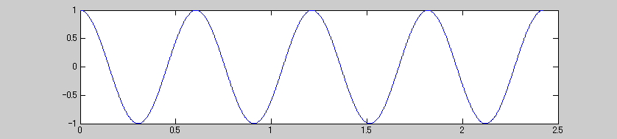
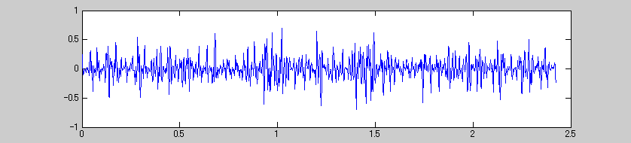
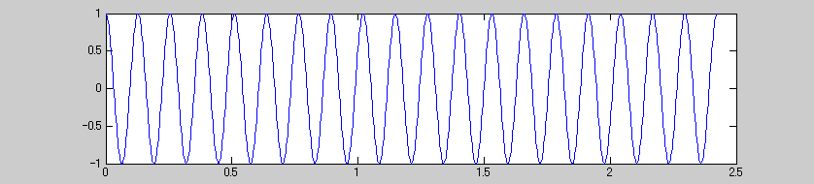
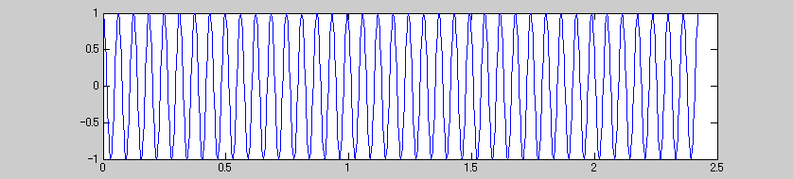
MB-OFDM proposal as reference
2bit
IDFT
FEC coding
Interleaver
S/P
QPSK mapping
X
Σ
100bits
QPSK mapping
X
GI
X
・・・・・
QPSK mapping
X
T-H code
・・・

Slide 26
PSWF-type SSA-UWB transceiver achieving Common
Signaling Mode for MB-OFDM and DS-UWB (transmitter)
１
FEC coding
Interleaver
Σ
2
Binary
Data
L
TFC with CSM
PSWF-type SSA pulse bank

Slide 27
PSWF-type SSA-UWB transceiver achieving Common
Signaling Mode for MB-OFDM and DS-UWB (receiver)
Binary data
1
2

Slide 28
Orthogonal PSWF pulse wavelet generation
(3.120-4.264 GHz, order of 1, 2, 3 and 4)

Slide 29
Orthogonal PSWF pulse wavelet generation
(3.692-4.836 GHz, order of 1, 2, 3 and 4)

Slide 30
Dual-band PSWF pulse wavelet generation
(3.120-3.692 GHz, 4.264-4.836 GHz)

Slide 31
4. Design and implementation of PSWF-type SSA pulse wavelets
Effects of UWB antennas on implementation of PSWF-type SSA pulse wavelets

Slide 32
4.1 Effects of T-type UWB antenna on PSWF pulse wavelets
Orthogonal PSWF-based SSA pulse wavelets (3.1-5.6 GHz, order of 1, 2, 3 and 4)

Slide 33
Spectral characteristics of PSWF-based SSA pulse wavelets (3.1-5.6 GHz, order of 1, 2, and 3)

Slide 34
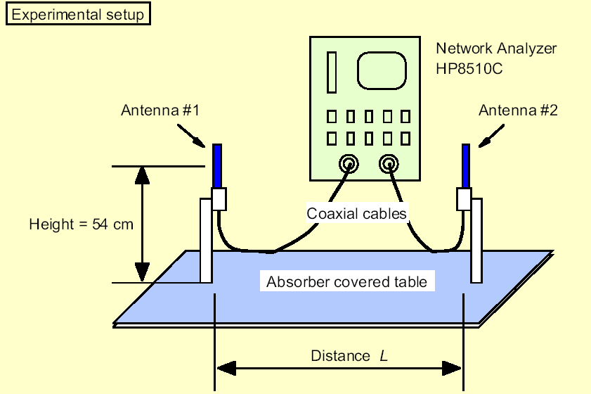
Characteristics of T-type UWB antenna
Transfer function (S11) characteristics of T-type antenna
0
-5
-10
-15
Return Loss (dB)
-20
-25
-30
-35
-40
-45
0
50
100
150
200
250
300
350
400
450
2.32GHz
3.695GHz
5.070GHz
6.44GHz
7.82GHz
9.195GHz
10.57GHz
11.945GHz
Frequency (samples)
T-type UWB antenna designed in NICT

Slide 35
Characteristics of T-type UWB antenna (cont.)
Phase feature of T-type antenna transfer function (S11)
Impulse response of T-type antenna transfer function (S11)
0
0.06
0.04
-5
0.02
-10
0
Relative phase (degree)
-0.02
Relative amplitude
-15
-0.04
-0.06
-20
-0.08
-25
-0.1
-0.12
-30
0
50
100
150
200
250
300
350
400
450
-0.14
0
20
40
60
80
100
120
140
Frequency (samples)
Time (samples)

Slide 36
Effects of T-type UWB antenna on orthogonal PSWF pulse shape (order 1)
___ reflected PSWF waveform
___ original PSWF waveform
___ reflected PSWF waveform
___ original PSWF waveform

Slide 37
Effects of T-type UWB antenna on orthogonal PSWF pulse shape (order 2)
___ reflected PSWF waveform
___ original PSWF waveform
___ reflected PSWF waveform
___ original PSWF waveform

Slide 38
Effects of T-type UWB antenna on orthogonal PSWF pulse shape (order 3)
___ reflected PSWF waveform
___ original PSWF waveform
___ reflected PSWF waveform
___ original PSWF waveform

Slide 39
4.2 Effects of K-type UWB antenna on PSWF pulse wavelets
Transfer function (S11) characteristics of K-type antenna
Phase feature of K-type antenna transfer function (S11)
0
0
-20
-5
-40
-10
-60
Return Loss (dB)
Relative phase (degree)
-80
-15
-100
-20
-120
-140
-25
0
20
40
60
80
100
120
140
160
180
-160
3.0GHz
3.9GHz
4.9GHz
5.9GHz
6.9GHz
7.9GHz
8.9GHz
9.9GHz
10.9GHz
0
20
40
60
80
100
120
140
160
180
Frequency (samples)
Frequency (samples)
K-type UWB antenna designed in NICT

Slide 40
Impulse response characteristics of K-type UWB antenna
Impulse response of K-type antenna transfer function (S11)
0.08
0.06
0.04
0.02
Relative amplitude
0
-0.02
-0.04
-0.06
-0.08
0
20
40
60
80
100
120
140
160
180
Time (samples)

Slide 41
Effects of K-type UWB antenna on orthogonal PSWF pulse shape (order 1)
___ reflected PSWF waveform
___ original PSWF waveform
___ reflected PSWF waveform
___ original PSWF waveform

Slide 42
Effects of K-type UWB antenna on orthogonal PSWF pulse shape (order 2)
___ reflected PSWF waveform
___ original PSWF waveform
___ reflected PSWF waveform
___ original PSWF waveform

Slide 43
Effects of K-type UWB antenna on orthogonal PSWF pulse shape (order 3)
___ reflected PSWF waveform
___ original PSWF waveform
___ reflected PSWF waveform
___ original PSWF waveform

Slide 44
4.3 Effects of multipath fading on PSWF pulse wavelets
___ PSWF waveform in fading channel
___ original PSWF waveform
___ in channel
___ original PSWF waveform
___ Rake or Pre-Rake
___ original PSWF waveform

Slide 45
Effects of multipath fading channel on PSWF pulse wavelets (cont.)
___ PSWF waveform in fading channel
___ original PSWF waveform
___ PSWF waveform in fading channel
___ original PSWF waveform
___ Rake or Pre-Rake
___ original PSWF waveform
___ Rake or Pre-Rake
___ original PSWF waveform

Slide 46
5. Conclusion remarks
A combined SSA-UWB and Cognitive Radio scheme has been suggested for global harmonization and compromise in IEEE 802.15.3a, based on Common Signaling Mode with PSWF-type pulse wavelets.
We also have investigated the effects of two specific Ultra Wideband antennas on the implementation issue of PSWF-type pulse wavelets.
→ Measurement and simulation results are very encouraging as well.
Scalable and adaptive performance improvement with multi-mode (DS-UWB & MB-OFDM) can be further expected by utilizing the PSWF-based SSA-UWB and Cognitive Radio.

Slide 47
6. Background materials

Slide 48
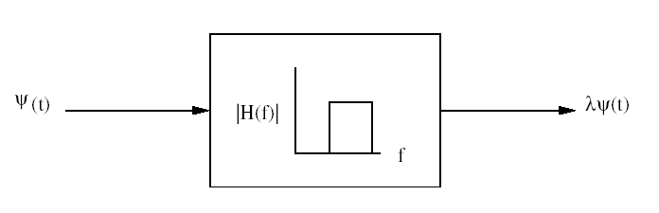
Design PSWF-based SSA pulse wavelets
N division

Slide 49
Realization of SSA-UWB pulse wavelet design
Prolate Spheroidal Wave Functions (PSWF)
Not just trying to construct a pulse waveform in order to satisfy the FCC spectral mask, on the contrary, first starting from considering a required spectral mask in frequency domain (band-limited), and then finding its corresponding pulse waveform in time domain (time-limited).
Just as C. E. Shannon has asked a question once upon a time, “To what extent are the functions which confined to a finite bandwidth also concentrated in the time domain?”, which has given rise to the discovery and usage of Prolate Spheroidal Wave Functions (PSWF) in the sixties.
Designing a time-limited & band-limited pulse waveform is extremely important in UWB system.

Slide 50
Designing method of optimized SSA-UWB wavelets using PSWF
5 GHz
W-LAN
Power Spectrum
1
2
3
4
5
6
7
8
9
10
11
f [GHz]

Slide 51
Designing method of optimized SSA-UWB wavelets using PSWF (cont.)

Slide 52
What’s Prolate Spheroidal Wave Functions (PSWF)?

Slide 53
Characteristics of PSWF-based pulse wavelets
Pulse waveforms are doubly orthogonal to each other.
Pulse-width and bandwidth can be simultaneously controlled to match with arbitrary spectral mask adaptively.
Pulse-width can be kept same for all orders of m.
Pulse bandwidth is same for all orders of m.
They can be utilized for simple transceiver implementation since frequency shift, e.g., up-conversion or down-conversion with mixer as in MB-OFDM and DS-UWB of IEEE 802.15.3a is no longer necessary.

Slide 54
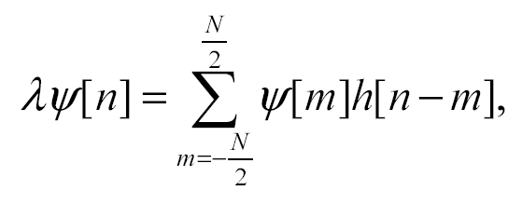
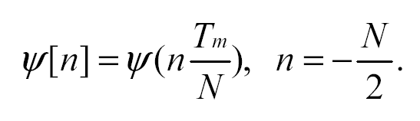
Numerical solution of PSWF

Slide 55
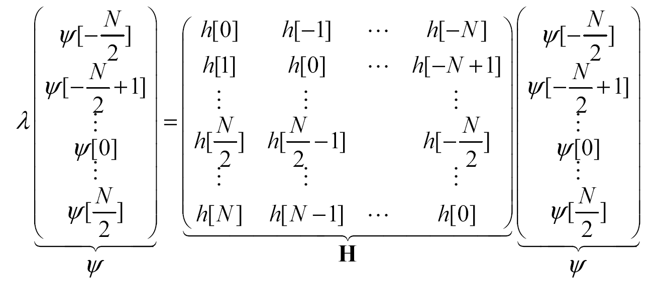


Numerical solution of PSWF (cont.)
Discrete-time solution of Prolate Spheroidal Wave Functions (PSWF) with eigenvalue decomposition

Slide 56
Orthogonal pulse waveform generation based on PSWF (3.1-10.6 GHz, order of 1, 2 and 3).
Optimized pulse waveform generation based on PSWF
0.4
0.3
0.2
5 GHz
W-LAN
0.1
Relative Amplitude
Power Spectrum
0
-0.1
1
2
3
4
5
6
7
8
9
10
11
-0.2
f [GHz]
____ order of 1
_ _ _ order of 2
........ order of 3
-0.3
-0.4
-5
-4
-3
-2
-1
0
1
2
3
4
5
Time (sec)
x 10
-10

Slide 57
Orthogonal pulse waveform generation based on PSWF (3.1-5.6 GHz, order of 1, 2, 3 and 4).
Optimized pulse waveform generation based on PSWF
Optimized pulse waveform generation based on PSWF
0.4
0.3
0.3
0.2
0.2
0.1
0.1
Relative Amplitude
0
0
Relative Amplitude
-0.1
-0.1
-0.2
-0.2
___ order of 1
…... order of 2
___ order of 3
…... order of 4
-0.3
-0.3
-0.4
-1.5
-1
-0.5
0
0.5
1
1.5
-0.4
Time (second)
x 10
-9
-1.5
-1
-0.5
0
0.5
1
1.5
Time (second)
x 10
-9

Slide 58
doc.: IEEE 802.15-22-0652-00-06ma
7. Conclusion
Soft Spectrum Adaptation(SSA) for UWB pulse shaping is a general technology to avoid interference between a UWB radio such as UWB WPAN of IEEE802.15 and a narrow band radio such as WLAN of IEEE802.11, WiFi, BT, BLE etc.
SSA can be applied for a UWB pulse shape so as to be matched with spectrum mask in radio regulation.
Slide 58
Ryuji Kohno, Takumi Kobayashi(YNU/YRP-IAI)

