Slide 1
Project: IEEE P802.15 Working Group for Wireless Personal Area Networks (WPANs)
Submission Title: [An updated PHY Header Proposal]
Date Submitted: [27th January 2023]
Source: [Billy Verso, Jarek Niewczas, Carl Murray (Qorvo)]
Address [ ]
E-Mail:[billy.verso (at) qorvo.com]
Re: [Proposals for TG4ab next generation UWB project]
Abstract: [A proposed PHR for the 4ab HRP UWB PHY enhanced data rates supporting dynamic data rate selection.]
Purpose: [To promote further discussion and convergence on the content for the IEEE 802.15.4ab amendment.]
Notice: This document has been prepared to assist the IEEE P802.15. It is offered as a basis for discussion and is not binding on the contributing individual(s) or organization(s). The material in this document is subject to change in form and content after further study. The contributor(s) reserve(s) the right to add, amend or withdraw material contained herein.
Release: The contributor acknowledges and accepts that this contribution becomes the property of IEEE and may be made publicly available by P802.15.

Slide 2
Introduction
Document 15-22-0467 proposed an efficient way of supporting dynamic data rate by introducing an initial rate header (PHR1) sent at a low rate and a main header (PHR2) transmitted at the payload modulation rate (or slower depending on the required strength vs. the payload coding).
This submission is an evolution of that idea that incorporates a number of considerations from 15-22-0475-01 and focuses upon the modulation rates specified by the consensus document 15-22-0517 and the PHY header modulation rates that this implies.
Additionally, based on discussions with interested parties, and further development of the ideas of earlier revision(s) we update this submission to examine encoded mapping of PHR1 in more detail.

Slide 3
A two-stage approach to PHR for dynamic data rates:
PHR is split into two parts
  First comes a “short” rate header, PHR1, sent at a low rate to robustly and efficiently select from the full set of supported modulation and coding combinations
  Then PHR2, sent at the highest rate consistent with the target modulation indicated by PHR1, includes everything else we need to indicate in the PHR
To ease the transition between the different modulation rates of PHR1 and PHR2 we can include a fixed short gap between them.
  We leave this as a TBD (expect to be ≤ ~1 µs), if the group agrees a gap is needed

Slide 4
PHR1: short, efficient & robust selection of rate/code
PHR1 consists of 3 bits to select data rate and 1 bit to select BCC vs LDPC code for the PSDU
Encoding this PHR1 with BCC ½ rate K=7 code with 6 tail symbols, makes it 10 symbols long…
Let’s look more closely at PHR1 and mapping it as uncoded bits. We can map the combinations of data rate + LDPC across these in a way that makes the hamming distance sufficiently strengthen the combinations that need the most robustness

Slide 5
PHR1 variable distance mapping
PHR1 will indicate data-rate and coding used in PHR2 and the data mode/coding
This PHR1 needs to be at least as strong as the weaker of PHR2 and the data.
With 23-bit PHR2, the Es/No requirement for 1% PER is approx. +1.9dB (at the decoder input), however using 2 repetitions can improve the performance by 3dB. If CCK7 was used for PHR1, without any repetition, Es/No is -0.3dB, which is too weak to match PHR2 with 2x repetition.
To achieve this, we code PHR1 to strengten those cases which require higher performance (like 1.95Mbps with LDPC). The mapping makes the Hamming distance higher for the combinations that need the most robustness and lower the Hamming distances for combinations which require higher Es/No to operate (like 7.8Mbps, 31.2Mbps or faster modes). Sufficient performance can be obtained with PHR1 of 5 µs duration.

Slide 6
PHR1 variable distance mapping
Es/No performance requirement for the strongest code index is -1.0dB to match 1.9Mbps with LDPC (and 23-bit PHR2 with 2 repetitions) at 1% PER.
Es/No performance requirement for the other code indexes is +2.3dB to match other data-modes (including 1.9Mbps with CCK7 and with 5-bytes payload), also at 1% PER.
Three well-performing candidate PHR1 encoded bit-sequences (20-bits long) are proposed here.
Bit-sequences encoding PHR1 index 1, which we assign to LDPC-coded 1.95Mbps, have an increased Hamming distance to all the other indexes.
Since there is tradeoff in performance between the codes, the presented proposals offer slightly different compromises.

Slide 7
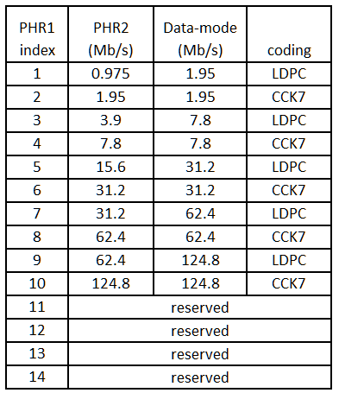
PHR1 variable distance mapping
We target fourteen PHR1 values, these select one of ten data rate with LDPC combinations with a four spare values for future expansion.
These are referenced by PHR1 Index 1 to 14, where index 1 is the one strengthened to suit 1.9Mbps with LDPC (and PHR2 with 2 repetitions) at 1% PER.
An example mapping of the fourteen PHR1 Indexes to the data rate / LDPC combinations is shown (right).

Slide 8
PHR1 variable distance mapping
Factors we consider in the design process:
HD13 satisfies PHR2 criteria (at 50% data-rate) for code index-1 at PER=1%, but not at PER=0.1%.
HD14 is needed to match the PHR2 performance at PER=0.1%.
Having code index-2 with HD12 is not required now, but „future-proofs” the standard. Unlike PHR2, which can have version numbers and different mappings, PHR1 cannot be easily changed in the future. Having one strong index saved for the future could be useful. It could map to a next-generation strongly coded data-mode or indicate a new PHR2 structure which embeds completely different data-mode structures.
1.9Mbps CCK7 is OK with HD8 (even at PER=0.1%)
7.8Mbps or faster modes are OK with HD6.
Having more than 14 indexes is an added bonus, provided it does not degrade other metrics.

Slide 9
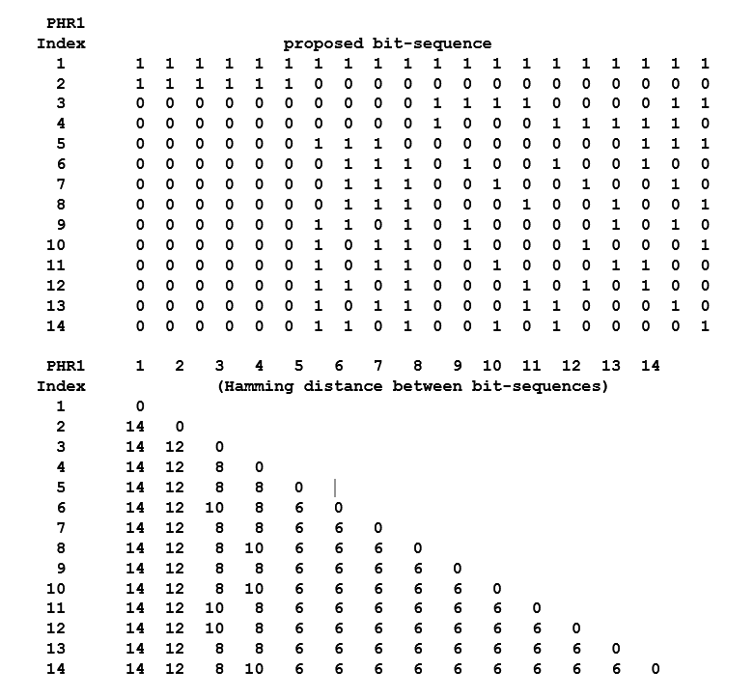
PHR1 variable distance mapping: Proposal-1
The set consists of 14 codes: HD=14 for code index-1, HD=12 for code index-2, HD>=8 for code indexes 3-4 and for the remaining codes HD is 6.
This gives a performance of -1.9dB for for code index-1, -1.3dB for code index-2, 0.4dB for code indexes 3-4, 1.8dB for codes 5-14 (all at 1% PER).
Code index-2 and code index-4 could be reserved for the future. Code index-3 could be used for 1.9Mbps with CCK7.
Code indexes 5-14 could be used for 7.8Mbps and faster modes (since they are 6dBs weaker than 1.9Mbps).
Performance requirements are satisfied with a wide margin.

Slide 10
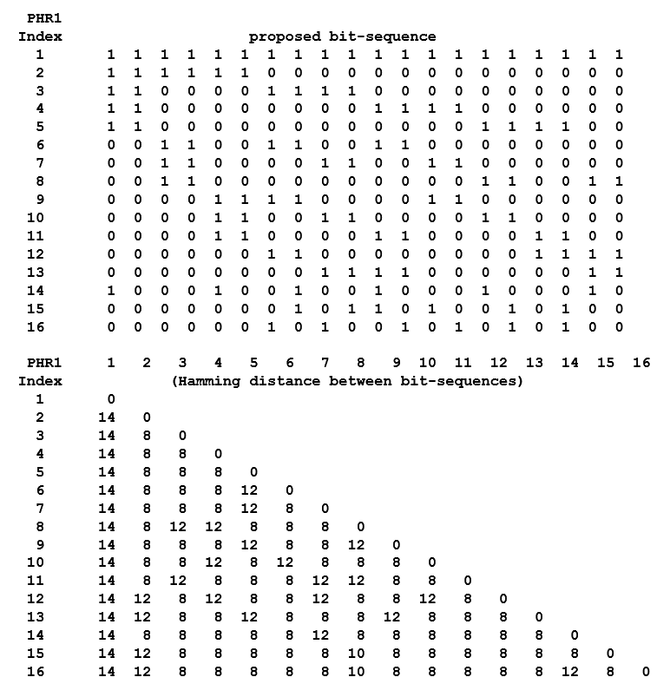
PHR1 variable distance mapping: Proposal-2
The set consists of 16 codes: HD=14 for code index-1, HD>=8 the remaining codes.
This gives a performance of -1.8dB for for code index-1, 0.6-0.8dB for code indexes 2-16 (all at 1% PER).
Performance requirements are satisfied with a wide margin.
The set offers increased number of codes for future expansion

Slide 11
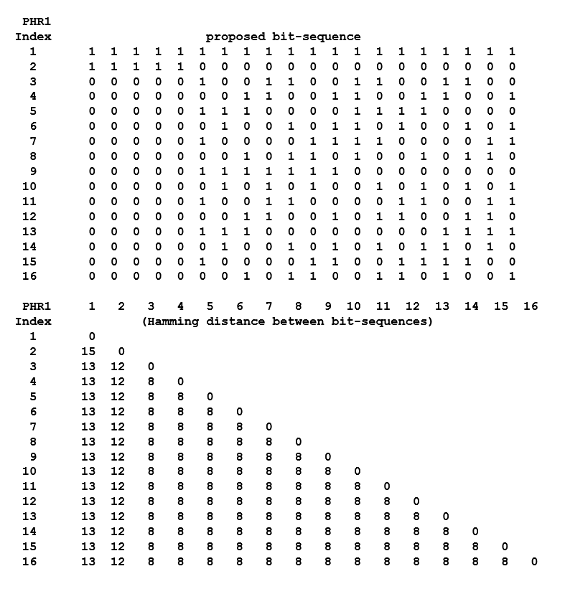
PHR1 variable distance mapping: Proposal-3
The set consists of 16 codes: HD>=13 for code index-1, HD=12 for code index-2, HD=8 the remaining codes.
This gives performance of -1.4dB for for code index-1, -1.15dB for code index-2, 0.8dB for code indexes 3-16 (all at 1% PER).
The set offers both a strong code to be reserved for future expansion and increased number of codes.
Compared to previous proposals, code index-1 with HD13 is a bit weaker, but still satisfying the PER=1% criteria with 0.4dB margin.

Slide 12
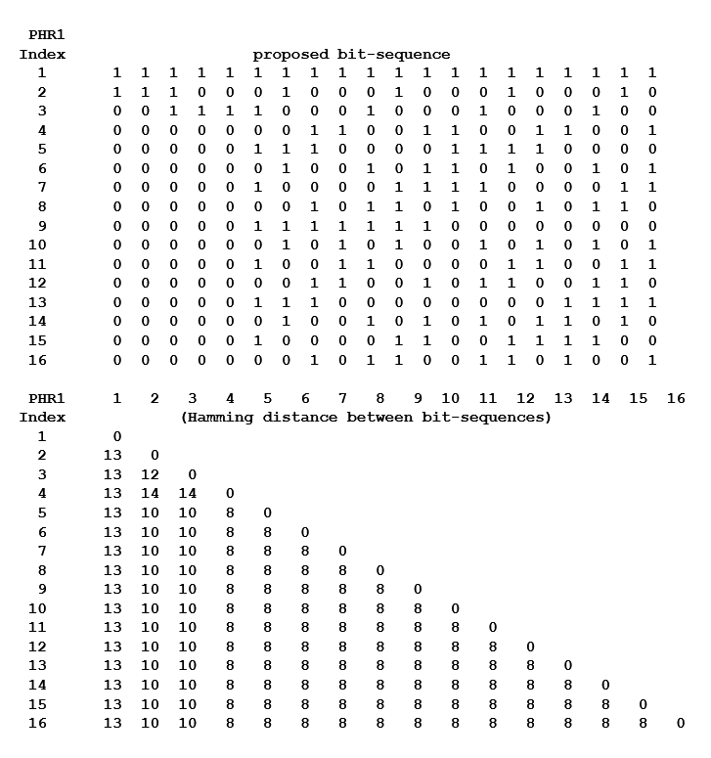
PHR1 variable distance mapping: Proposal-4
The set consists of 16 codes: HD=13 for code index-1, HD>=10 for code indexes 2-3, HD=8 the remaining codes.
This gives performance of -1.4dB for for code index-1, -0.3dB for code indexes 2-3, 0.8dB for code indexes 4-16 (all at 1% PER).
The set offers code index-1 with HD13, two quite strong codes which could be reserved for future expansion and increased number of codes.
Other variants with for example three HD10 code indexes are also available

Slide 13
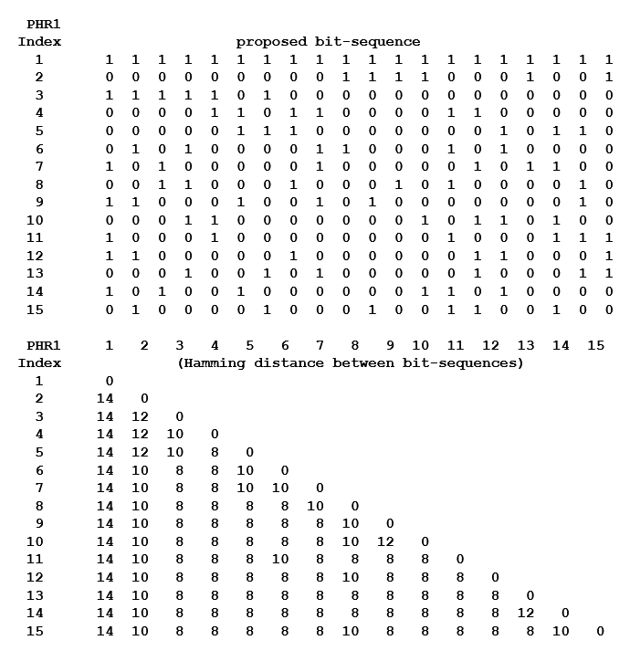
PHR1 variable distance mapping: Proposal-5
The set consists of 15 codes: HD=14 for code index-1, HD>=10 for code index 2, HD>=8 the remaining codes.
This gives performance of -1.8dB for code index-1,
-0.3dB for code index-2, 0.8dB for code indexes
3-15 (all at 1% PER).
The set combines a very-strong HD14 code index-1 and one quite strong HD10 code index which could be reserved for future expansion.

Slide 14
PHR1 variable distance mapping: conclusion
Variable distance mapping provides extra robustness only to those data-modes that require it.
  Alternative schemes with fixed distance cannot be optimized in this way.
The coding proposed reduces PHR1 duration (thus overhead) to 5µs.
Decoding of this PHR1 sequence can be achieved by simple pattern matching.
The performance criteria are satisfied with a wide margin
Currently, only 10 code indexes are assigned. The remaining code indexes can be reserved for future expansion.
We are happy to have a fixed gap (e.g., 512 chips), between PHR1 and PHR2.

Slide 15
PHR2 rate consistent with PSDU modulation
PHR2 is sent using the K=7 code (with 6 tail bits) at the highest rate consistent with the target modulation indicated by PHR1 and chosen for the correct level of robustness.
When using the BCC K=7 code for the PSDU, we send PHR2 at the same rate as the PSDU, i.e., with 1 symbol for each bit.
When using the LPDC code we tailor the strength of PHR2 (mapping each bit across 2, 3 or 4 symbols), depending on the necessary robustness
  This is a TBD that the group should converge on based on simulation results.
  Note that this mapping does not necessarily need to be the same for all rates.

Slide 16
PHR2 content
With PHR2 being sent at the highest rate consistent with the data modulation, it is not very expensive to include additional content.
  So, for example, could include version bits inexpensively
This submission is not proposing specific PHR2 content.
  This can be agreed later.

Slide 17
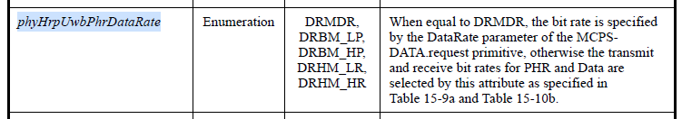
How to incorporate into 802.15.4z
Dynamic data rate selection is already partially covered by the 802.15.4 text (from 4a days)
Once it is agreed it is relatively easy to add text to define the 4ab dynamic PHR format.
Can then have configurations to support 4z type PHR at the data rate for the new 4ab data rates and a configuration to enable the dynamic PHR format, i.e., update table 15-10b to add the dynamic mode and expand to five static rates as follows:
  Replace the two rates DRHM_LR, DRHM_HR with five easier to understand rate definitions:
    DRHM_1p95, DRHM_7p8, DRHM_31p2, DRHM_62p4 and DRHM_124p8
  Add (pre-existing) DRMDR into the table to enable the 4ab dynamic PHR operating mode.
Table 11-2—PHY PIB attributes

Slide 18
A note on SYNC length
The SYNC length to be used when employing the dynamic data rate needs to be fixed in the transmitter depending on the needs of the remote receiver.
The transmitter also needs to know what data rates the remote receiver supports.
We envisage this information is communicated either via OOB means or via an in-band IE exchange at an initial low rate, perhaps with a default setting so that this exchange is not needed for some agreed common use case.

Slide 19
Conclusion
This submission builds upon 15-22-0467, 15-22-0475 and 15-22-0517 to propose and efficient way of dynamically supporting all the new HPRF mode data rates proposed for 4ab.
The data rate can be dynamically selected across the whole proposed range of 1.95 Mb/s to 124.8 Mb/s via an initial rate header (PHR1) which determines both the main (PHR2) header modulation rate and the coding and modulation rate for the PHY Payload.

Slide 20
THE END.

