Slide 1
Project: IEEE P802.15 Working Group for Wireless Specialty Networks (WSN)
Submission Title: TG 15.4ab November 2022 Interim Session Closing Reports
Date Submitted: 17 November 2022
Source: Benjamin A. Rolfe (Blind Creek Associates)
Contact:
Voice: +1 408 395 7207, E-Mail: ben.rolfe @ ieee.org
Re: Task Group 4ab: 802.15.4 UWB Next Generation
Abstract: Teleconference (WebEx) Agenda and Meeting Slides
Purpose: Emulate organization, encourage participation and make further progress
Notice: This document has been prepared to assist the IEEE P802.15. It is offered as a basis for discussion and is not binding on the contributing individual(s) or organization(s). The material in this document is subject to change in form and content after further study. The contributor(s) reserve(s) the right to add, amend or withdraw material contained herein.
Release: The contributor acknowledges and accepts that this contribution becomes the property of IEEE and may be made publicly available by P802.15.
Notes:
Jul 12, 2010
Page 1

Slide 2
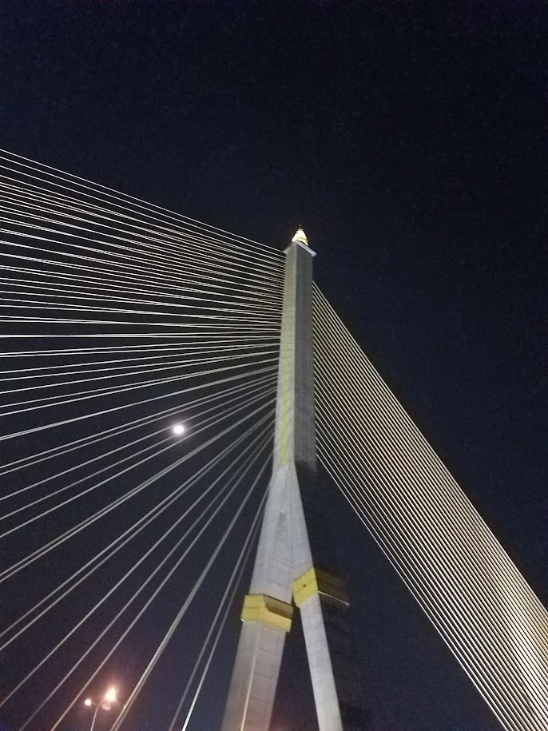
Mixed Mode Interim, Live from Bangkok Thailand
November 2022
Task Group 15.4ab
Next Generation UWB Amendment

Slide 3

Task Group 15.4ab
Next Generation UWB Amendment
Objective: enhancements to 802.15.4 Ultra Wideband (UWB) physical layers (PHYs) medium access control (MAC) and associated ranging techniques while retaining backward compatibility with enhanced ranging capable devices (ERDEVs).

Slide 4
5.2.b Scope of the project (As approved):
This amendment enhances the Ultra Wideband (UWB) physical layers (PHYs) medium access control (MAC), and associated ranging techniques while retaining backward compatibility with enhanced ranging capable devices (ERDEVs).
Areas of enhancement include:
  additional coding, preamble and modulation schemes to additional coding, preamble and modulation schemes to support improved link budget and/or reduced air-time relative to IEEE Std 802.15.4 UWB;
  additional channels and operating frequencies;
  interference mitigation techniques to support greater device density and higher traffic use cases relative to the IEEE Std 802.15.4 UWB;
  improvements to accuracy, precision and reliability and interoperability for high-integrity ranging; schemes to reduce complexity and power consumption;
  definitions for tightly coupled hybrid operation with narrowband signaling to assist UWB;
  enhanced native discovery and connection setup mechanisms;
  sensing capabilities to support presence detection and environment mapping;
  and mechanisms supporting low-power low-latency streaming as well as high data-rate streaming allowing at least 50 Mb/s of throughput.
Support for peer-to-peer, peer-to-multi-peer, and station-to-infrastructure protocols are in scope, as are infrastructure synchronization mechanisms. This amendment includes safeguards so that the high throughput data use cases do not cause significant disruption to low duty-cycle ranging use cases.
https://development.standards.ieee.org/myproject-web/app#viewpar/9081

Slide 5
Task Group Organization
Chair: Benjamin Rolfe (BCA)¹
Vice Chair: Clint Powell (Meta)
Vice Chair: Clint Chaplin (SRA)
Vice Chair and Recording Secretary: David Xun Yang (Huawei)
Lead Technical Editor: Billy Verso (Qorvo)
  Thank you to all the volunteers!
¹ Affiliation Details here: https://mentor.ieee.org/802-ec/dcn/22/ec-22-0061-00-00EC-rolfe-affiliations-by-802-activity.pdf

Slide 6
Task Group Agenda
https://mentor.ieee.org/802.15/dcn/22/15-22-0541-11-04ab-tg4ab-agenda-november-2022.xlsx
Mtg. Local Time | SUNDAY |  | MONDAY |  |  |  | TUESDAY |  |  |  | WEDNESDAY |  |  |  | THURSDAY
Bangkok | 13-Nov-2022 |  | 14-Nov-2022 |  |  |  | 15-Nov-2022 |  |  |  | 16-Nov-2022 |  |  |  | 17-Nov-2022
 | Virtual Rm 1 |  | Virtual Rm 1 | Virtual Rm 2 | Virtual Rm 3 | Virtual Rm 4 | Virtual Rm 1 | Virtual Rm 2 | Virtual Rm 3 | Virtual Rm 4 | Virtual Rm 1 | Virtual Rm 2 | Virtual Rm 3 | Virtual Rm 4 | Virtual Rm 1 | Virtual Rm 2 | Virtual Rm 3 | Virtual Rm 4
07:00-07:30 |  |  | CONTINENTAL BREAKFAST |  |  |  | CONTINENTAL BREAKFAST |  |  |  | CONTINENTAL BREAKFAST |  |  |  | CONTINENTAL BREAKFAST
07:30-08:00 |  |  |  |  |  |  |  |  |  |  | 802.15 AC Meeting (Virtual Rm 1)
08:00-08:30 |  |  | 802 EC OPENING MEETING |  |  |  | TG4ab NG-UWB |  | TG3mb HDR |  |  |  |  |  | TG4ab NG-UWB | SC IETF |  | TG6ma BAN/ VAN
08:30-09:00 |  |  |  |  |  |  |  |  |  |  | TG4ab NG-UWB (09:00) | TG4me | TG3mb HDR
09:00-09:30
09:30-10:00
10:00-10:30 |  |  | Break |  |  |  | Break |  |  |  | Break |  |  |  | Break
10:30-11:00 |  |  | 802.15 WG Opening Plenary (Virtual Rm 1) |  |  |  |  | TG4me | SC-M | TG6ma BAN/ VAN | 802.15 WG Midweek Plenary (Virtual Rm 1) |  |  |  | TG4ab NG-UWB | TG6ma BAN/ VAN | SC-M | TG13 OWC
11:00-11:30
11:30-12:00 |  |  |  |  |  |  |  |  |  |  | WNG (Virtual Rm 1)
12:00-12:30
12:30-13:00 |  |  | LUNCH ON YOUR OWN |  |  |  | LUNCH ON YOUR OWN |  |  |  | LUNCH ON YOUR OWN |  |  |  | LUNCH ON YOUR OWN
13:00-13:30
13:30-14:00 |  |  | TG4ab NG-UWB | IG Privacy |  | TG7a OCC | 802 LMSC ISO JTC1 Rm TBD |  | TG16t LicNB | TG13 OWC | TG6ma BAN/ VAN | TG4me | TG16t LicNB | TG7a OCC | TG4ab NG-UWB | IG Privacy | TG16t LicNB | TG7a OCC
14:00-14:30
14:30-15:00
15:00-15:30
15:30-16:00 |  |  | Break |  |  |  | Break |  |  |  | Break |  |  |  | Break
16:00-16:30 | WIRELESS CHAIRS MEETING |  | TG4ab NG-UWB | TG4me |  |  | TG4ab NG-UWB |  | TG3mb HDR |  | TG4ab NG-UWB |  | TG3mb HDR | TG13 OWC |  | TG4me |  | TG7a OCC
16:30-17:00
17:00-17:30
17:30-18:00 | 802.15 AC MEETING (Virtual Rm 1)
18:00-18:30 |  |  | Break |  |  |  | Break |  |  |  | Break |  |  |  | Break
18:30-19:00 | Dinner on your own |  | Tutorial 1 |  | Dinner on your own |  | 802.15/802.1 Joint Mtg (Virtual Rm 1) |  |  |  | Social |  |  |  | 802.15 WG Closing Plenary (Virtual Rm C)
19:00-19:30
19:30-20:00 |  |  |  |  |  |  | Dinner on your own
20:00-20:30 |  |  | Tutorial 2
20:30-21:00 |  |  |  |  |  |  |  |  |  |  | Dinner on your own
21:00-21:30
21:30-22:00 |  |  | Tutorial 2
22:00-22:30
22:30-23:00

Slide 7
Session Objectives
Hear technical contributions and develop technical content for the draft
Converge and build consensus
Consider proposed text for draft
Map the path to a technically complete draft

Slide 8
Session Objectives
Hear technical contributions and develop technical content for the draft
Converge and build consensus
Consider proposed text for draft
Map the path to a technically complete draft

Slide 9
Session Objectives
Hear technical contributions and develop technical content for the draft
Converge and build consensus
Consider proposed text for draft
Map the path to a technically complete draft

Slide 10
Session Accomplishments
Major progress converging and consolidating proposals
  All major topic areas have progressed
Much technical detail added
Many TFD contributions added or updated

Slide 11
Presentations
1 | 15-22-0593 | https://mentor.ieee.org/802.15/dcn/22/15-22-0593-00-04ab-flexible-block-structure-updates.ppt
2 | 15-22-0585 | https://mentor.ieee.org/802.15/dcn/22/15-22-0585-00-04ab-one-to-many-ranging-using-nba-mms.pptx
3 | 15-22-0568 | https://mentor.ieee.org/802.15/dcn/22/15-22-0568-01-04ab-improvements-on-scheduling-ie-design-in-802-15-4ab.pptx
4 | 15-22-0588 | https://mentor.ieee.org/802.15/dcn/22/15-22-0588-00-04ab-time-domain-mask-for-pulse-shape-in-802-15-4ab.pptx
5 | 15-22-0604 | https://mentor.ieee.org/802.15/dcn/22/15-22-0604-00-04ab-nba-mms-uwb-compressed-psdu.pptx
6 | 15-22-0592 | https://mentor.ieee.org/802.15/dcn/22/15-22-0592-00-04ab-pulse-burst-sensing-phase-noise-proof-supercomplementary-set-of-sequences.pptx
7 | 15-22-0602 | https://mentor.ieee.org/802.15/dcn/22/15-22-0602-00-04ab-sensing-sequence-metrics.pptx
8 | 15-22-0606 | https://mentor.ieee.org/802.15/dcn/22/15-22-0606-00-04ab-spectrum-sensing-based-deferral-evaluation-and-enhancement.pptx
9 | 15-22-0506 | https://mentor.ieee.org/802.15/dcn/21/15-21-0506-04-04ab-advanced-coding-for-data-comm.pptx
10 | 15-22-0608 | https://mentor.ieee.org/802.15/dcn/22/15-22-0608-01-04ab-header-ie-extension.pptx

Slide 12
Presentations
11 | 15-22-0609 | https://mentor.ieee.org/802.15/dcn/22/15-22-0609-00-04ab-nb-channel-hopping-for-nb-assisted-uwb.pptx
12 | 15-22-0547 | https://mentor.ieee.org/802.15/dcn/22/15-22-0574-00-04ab-channels-for-frequency-stitching.pptx
13 | 15-22-0573 | https://mentor.ieee.org/802.15/dcn/22/15-22-0573-00-04ab-follow-up-on-uwb-channel-usage-coordination.pptx
14 | 15-22-0593 | https://mentor.ieee.org/802.15/dcn/22/15-22-0593-00-04ab-flexible-block-structure-updates.ppt
15 | 15-22-0632 | https://mentor.ieee.org/802.15/dcn/22/15-22-0632-00-04ab-scz-code-blocks-a-good-candidate-for-the-sensing-sequences-in-4ab.pptx
16 | 15-22-0613 | https://mentor.ieee.org/802.15/dcn/22/15-22-0613-00-04ab-co-scheduling-ranging-and-sensing-continued.ppt
17 | 15-22-0570 | https://mentor.ieee.org/802.15/dcn/22/15-22-0570-00-04ab-rsf-and-mmrs-in-multi-millisecond-uwb.pptx
18 | 15-22-0514 | https://mentor.ieee.org/802.15/dcn/22/15-22-0514-01-04ab-non-coherent-phy-layer-proposal-for-15-4ab-tfd.docx
19 | 15-22-0642 | https://mentor.ieee.org/802.15/dcn/22/15-22-0642-01-04ab-ssbd-enabled-uwb-radio-coexistence-with-wi-fi-6e-demo.pptx
20 | 15-22-0645 | https://mentor.ieee.org/802.15/dcn/22/15-22-0645-00-04ab-inter-frame-spacing-follow-up.pptx

Slide 13
Presentations
21 | 15-22-0646 | https://mentor.ieee.org/802.15/dcn/22/15-22-0646-00-04ab-uwb-in-band-discovery.ppthttps://mentor.ieee.org/802.15/dcn/22/15-22-0646-00-04ab-uwb-in-band-discovery.ppt
22 | 15-22-0650 | https://mentor.ieee.org/802.15/dcn/22/15-22-0650-02-04ab-consensus-on-uwb-sensing-for-802-15-4ab.pptx
23 | 15-22-0651 | https://mentor.ieee.org/802.15/dcn/22/15-22-0651-00-04ab-recap-and-new-considerations-on-nba-mms-ranging-integrity-fragments.pptx
24 | 15-22-0649 | https://mentor.ieee.org/802.15/dcn/22/15-22-0649-00-04ab-coherent-phy-layer-proposal-for-15-4ab-tfd.docx
25 | 15-22-0659 | https://mentor.ieee.org/802.15/dcn/22/15-22-0659-01-04ab-further-thoughts-on-the-mac-of-the-nba-mms-uwb.pptx
26 | 15-22-0616 | https://mentor.ieee.org/802.15/dcn/22/15-22-0616-00-04ab-interference-analysis-of-initial-synchronization-sequence.pptx
27 | 15-22-0616 | https://mentor.ieee.org/802.15/dcn/22/15-22-0616-00-04ab-interference-analysis-of-initial-synchronization-sequence.pptx
28 | 15-22-0660 | https://mentor.ieee.org/802.15/dcn/22/15-22-0660-00-04ab-code-length-selection-of-11n-based-ldpc-codes-for-15-4ab.pptx
29 | 15-22-0571 | https://mentor.ieee.org/802.15/documents?is_dcn=571&is_group=04ab
30 | 15-22-0654 | https://mentor.ieee.org/802.15/dcn/22/15-22-0654-00-04ab-draft-text-for-uwb-wake-up-radio.pdf
31 | 15-22-0653 | https://mentor.ieee.org/802.15/dcn/22/15-22-0653-00-04ab-an-updated-phy-header-proposal.pptx

Slide 14
Schedule Major Milestones
Near Term Working Milestones
Call for proposals | November 2021
Cut-off for new features (high level feature set), PHY | May 2022
Cut-off for new features (high level feature set), MAC | September 2022
Continue converging and TFD text preparation | November-January 2022
Assembling Draft 0 | January-March 2022
TG draft review and revision complete | March-May
Working Group pre-ballot review and comment collection | Post May meeting
First letter ballot | Julu 2023 (following meeting)
…

Slide 15

Next Steps

Slide 16
Interim Webex Schedule
November '22
S | M | T | W | T | F | S
 |  | 1 | 2 | 3 | 4 | 5
6 | 7 | 8 | 9 | 10 | 11 | 12
13 | 14 | 15 | 16 | 17 | 18 | 19
20 | 21 | 22 | 23 | 24 | 25 | 26
27 | 28 | 29 | 30
December '22
S | M | T | W | T | F | S
 |  |  |  | 1 | 2 | 3
4 | 5 | 6 | 7 | 8 | 9 | 10
11 | 12 | 13 | 14 | 15 | 16 | 17
18 | 19 | 20 | 21 | 22 | 23 | 24
25 | 26 | 27 | 28 | 29 | 30 | 31
First Call @ 0600 PT
Proposed: On the dates shown (29 Nov, 13-Dec, 3-Jan and 10-Jan)
Time: 06:00 PT Duration: 1.5 hours
Commence 29-November-2022 at 06:00 PT

Slide 17
Interim Webex Schedule
January ‘23
S | M | T | W | T | F | S
1 | 2 | 3 | 4 | 5 | 6 | 7
8 | 9 | 10 | 11 | 12 | 13 | 14
15 | 16 | 17 | 18 | 19 | 20 | 21
22 | 23 | 24 | 25 | 26 | 27 | 28
29 | 30 | 31
Wireless Interim

Slide 18
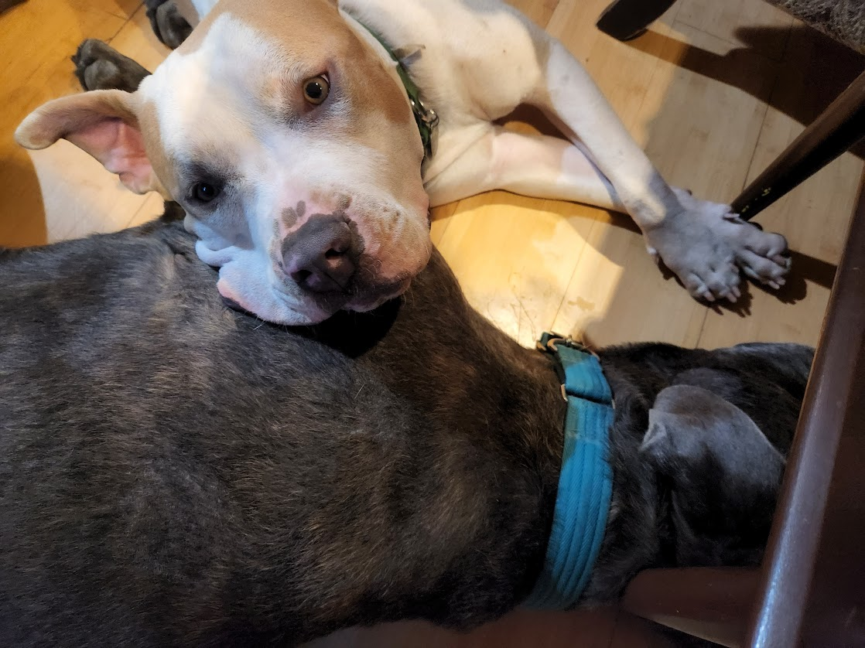
Thanks for your Attention

