Slide 1
Project: IEEE P802.15 Working Group for Wireless Personal Area Networks (WPANs)
Submission Title: [TG15.6ma Closing Report for November 2022]
Date Submitted: [17th November 2022]
Source: [Ryuji Kohno1,2,] [1;Yokohama National University, 2;YRP International Alliance Institute(YRP-IAI)]
Address [1; 79-5 Tokiwadai, Hodogaya-ku, Yokohama, 240-8501 Japan
2; YRP1 Blg., 3-4 HikarinoOka, Yokosuka-City, Kanagawa, 239-0847 Japan]
Voice:[1; +81-90-5408-0611], FAX: [+81-45-383-5528],
Email:[1: kohno@ynu.ac.jp, 2: kohno@yrp-iai.jp] Re: []
Abstract: [This document contains closing report for TG15.6ma for Revision of P802.15.6-2012 with Enhanced Dependability November 2022.]
Purpose: [information]
Notice: This document has been prepared to assist the IEEE P802.15. It is offered as a basis for discussion and is not binding on the contributing individual(s) or organization(s). The material in this document is subject to change in form and content after further study. The contributor(s) reserve(s) the right to add, amend or withdraw material contained herein.
Release: The contributor acknowledges and accepts that this contribution becomes the property of IEEE and may be made publicly available by P802.15.

Slide 2
IEEE 802.15 TG6ma
(Revision of IEEE802.15.6-2012)
Closing Report
In Personal and Virtual Hybrid Plenary Session
Bangkok, Thailand
November 17th, 2022
Ryuji Kohno
Yokohama National University(YNU),
YRP International Alliance Institute(YRP-IAI)

Slide 3
Objectives of TG 6ma – Enhanced Dependability Body Area Network (ED-BAN)
Objective: Enhancements to the BAN Ultra Wideband (UWB) physical layer (PHY) and media access control (MAC) to support enhanced dependability to a human BAN (HBAN) and adds support for vehicle body area networks (VBAN), a coordinator in a vehicle with devices around the vehicular cabin.
Action:
Submission of Draft Proposals Corresponding Call for Proposals
Update of Channel and Coexisting Models
Discussion on Feasibility and satisfaction in market of the TRD
Discussion on Feasibility of TSN of 802.1 in MAC and interference mitigation in PHY and MAC
Joint Meeting with other groups for harmonization to resolve common problems
Next Things to Do：
Accept Proposals to Satisfy Technical Requirements

Slide 4
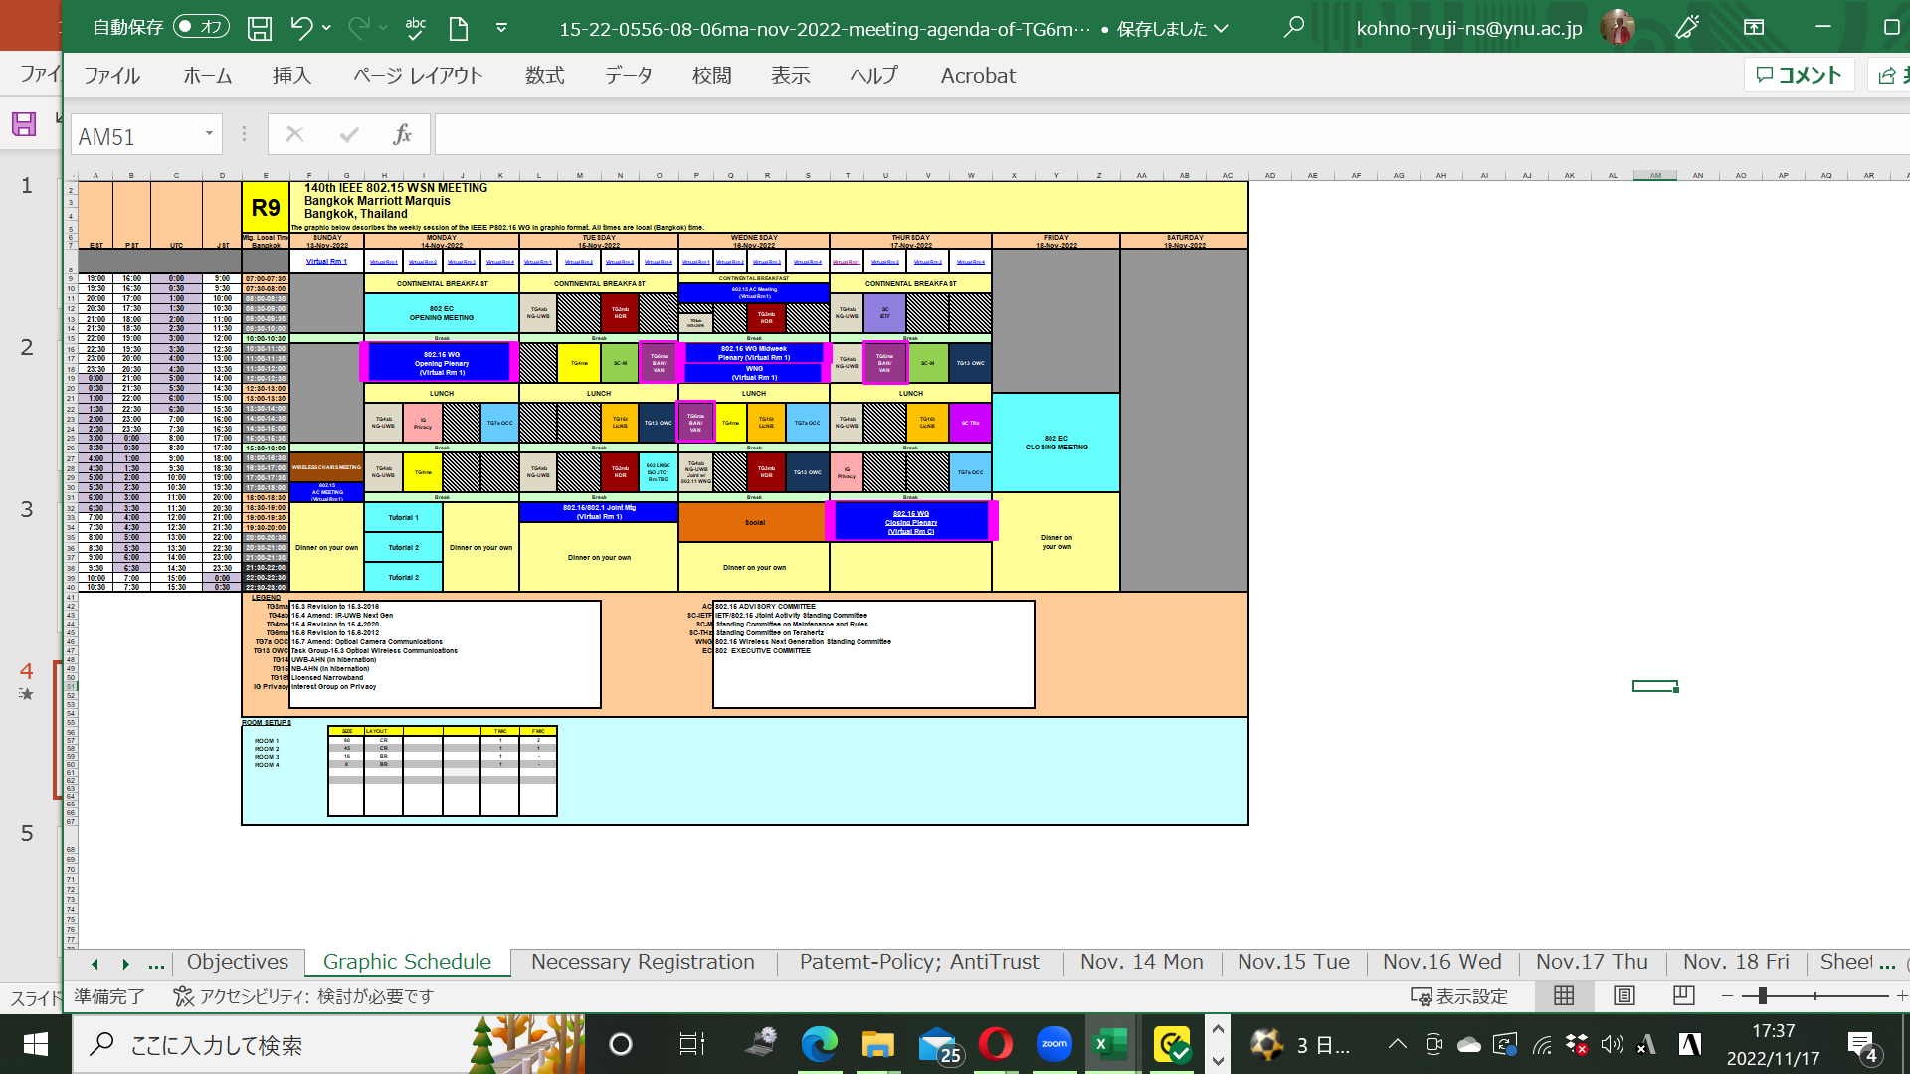
TG15.6ma Plenary Session Schedule for 13-17th, November 2022
TG15.6ma has three own sessions such as
Session1(Virtual RM#4) AM2 10:30-12:30 in local time 22:30-01:30 +1day EDT, Nov.15(TUE), 12:30-14:30 JST
Session2(Virtual RM#1) PM1 15:30-17:30 in local time 1:30-3:30 EDT, Nov. 16(WED), 15:30-17:30 JST
Session3(Virtual RM#2) AM2 10:30-12:30 in local time 22:30-01:30 +1day EDT, Nov.17(THU), 12:30-14:30 JST

Slide 5
TG15.6ma Plenary Session Schedule for 13-17th, November 2022
TG15.6ma has three own sessions such as
Session1(Virtual RM#4) AM2 10:30-12:30 in local time 22:30-01:30 +1day EDT, Nov.15(TUE), 12:30-14:30 JST
Session2(Virtual RM#1) PM1 15:30-17:30 in local time 1:30-3:30 EDT, Nov. 16(WED), 15:30-17:30 JST
Session3(Virtual RM#2) AM2 10:30-12:30 in local time 22:30-01:30 +1day EDT, Nov.17(THU), 12:30-14:30 JST
1.Session1(Virtual RM#4) AM2 10:30-12:30 in local time 22:30-01:30
+1day EDT, Nov.15(TUE), 12:30-14:30 JST
https://ieeesa.webex.com/ieeesa/j.php?MTID=mb884a0f3d7d2d4ef463797a991898c12
Meeting number: 2338 389 2474
Password: 80215mtgrm4
2. Session2(Virtual RM#1) PM1 15:30-17:30 in local time 1:30-3:30
EDT, Nov. 16(WED), 15:30-17:30 JST
https://ieeesa.webex.com/ieeesa/j.php?MTID=m5dff7eac804a555afce33031902f8b9e
Meeting number: 2332 311 7560
Password: 80215mtgrm1
3. Session3(Virtual RM#2) AM2 10:30-12:30 in local time 22:30-01:30
+1day EDT, Nov.17(THU), 12:30-14:30 JST
https://ieeesa.webex.com/ieeesa/j.php?MTID=m95604532074fae572029cf2fd8c9f2e3
Meeting number: 2336 549 8412
Password: 80215mtgrm2

Slide 6
Agenda items for the week
TG15.6ma meeting call to order
Call for essential patents and policies & procedures reminder
Approve last meeting minutes: TG 15.6ma Meeting Minutes for Nov. 2022 doc.#15-22-0556-02-06ma
Agenda of TG15.6ma September Meeting doc.#15-22-0557-08-06ma
Review and Summary
  IG DEP, SG & TG15.6a Activity for Amendment of IEEE802.15.6 Wireless BAN with Enhanced Dependability 339-02
  2. Summary of Channel and Environment Models doc.#15-22-0269-02-06ma
  3 Technical Requirement Document of TG15.6ma doc.#15-21-0577-06-006a
  Call for Proposals doc.#15-22-0488-01-06ma
  Presentation
  QoS-aware Hybrid ARQ Scheme Utilizing Decomposable Error Correcting Codes for Wireless Body Area Networks
  doc.#15-22-0561-00-06ma
  2.. Evaluation of IEEE 802.15.6 Ultra-wideband Physical Layer Utilizing Super Orthogonal Convolutional Code
  doc.#15-22-0562-00-06ma
  3. Harmonization with 4ab: data rates & FEC doc.#15-22-0zzz-00-06ma
  Propagation Characteristics of UWB Communication Applications for BCI Use Case doc.#15-22-0583-00-06ma
  Propagation Characteristics of UWB Communication Applications for Passengers Bus Use Case 0584-00-06ma
  Definition of Coexistence Levels and How to Support Higher Levels doc.#15-22-0631-00-06ma
  MAC Protocol Proposal for Multiple BAN environment(Level 1) doc.#15-22-0ddd-00-06ma
  MAC Protocol Using Negotiation among Coordinators in Coexistence of Multiple Wireless BANs 0633-00-o6ma
  Coordinator-to-Coordinator(C2C) Negociation among Coexisting BANs doc.#15-22-0388-00-06ma
  MAC proposal for coexisting dependable BANs doc.#15-22-0594-00-06ma
  MAC Preliminary harmonization with 4ab: MAC operation doc.#15-22-0634-00-06ma
  MAC Bridging for Time-Sensitive Networking of 802.15.6ma doc.#15-22-0024-00-06a
  Interference reduction technique under Coexistence with other wireless and EMI for HBAN and VBAN on UWB using code and pulse orthogonality doc.#15-22-06575-00-06ma
  Soft Spectrum Adaptation(SSA) Based on Pulse Shaping for Interference Mitigation between UWB radio and Other Coexisting Radio doc.#15-22-0652-00-06ma
  Summary of Channel and Environmental Modeling Activities for BANs on TG15.6a doc.#15-22-0658-00-06ma
Discussion
1. . Remained Issues for PHY and MAC Specification doc.#15-22-0663-00-06ma
2. Revision of Call for Proposals doc.#15-22-0488-03-06ma
3. Timeline 0of TG15.6ma doc.#15-22-0522-01-06ma

Slide 7
Task Group Motion
Motion to approve the TG6ma Call for Proposals, Document 15-22-0488-01, to be postpone until March 10th, 2023.
  Move: Marco Hernandez Second: Seong Soon Joo
Unanimous consent. Motion carries..

Slide 8
Task Group Motion
Motion to approve the addition of Daisuke Anzai of Nagoya Institute of Technology as secretary of 15.6ma.
  Move: Marco Hernandez Second: Seong Soon Joo
Unanimous consent. Motion carries.

Slide 9
TG 6ma Timeline
Tech Req Doc July 2022
Chan Mod Doc. Call Proposals Sept 2022
Harmon Proposals March 2023
Specification Framework Doc January 2023
1st Draft Doc March 2023
WG Letter Ballot May 2023
Comment Resolution Sept 2023
Sponsor Ballot Nov 2023
Comment Resolution Mar 2024
Revcom May 2024
All dates indicate deadlines

Slide 10
Timeline details.
Note: the deadlines are subject to change.

Slide 11
Contributions
・TG15.6ma opening report for November 2022 meeting 15-22-0557-02-06ma
・TG15.6ma Agenda of November Meeting in 2022 15-22-0556-08-06ma
・Overview of IG-DEP, SG6a, TG6a, and TG15.6ma for Revision of IEEE802.15.6-2012 Wireless BAN with Enhanced Dependability 15-22-0389-02-06ma
・Summary of Channel Model Documents for TG6ma 15-22-0658-00-06ma
・Overview of MAC proposals for 15.6ma 15-22-0656-00-06ma
・Overview of FEC proposals for 15.6ma 15-22-0611-00-06ma
・Propagation Characteristics of UWB Communication Applications for Passengers Bus Use Case 584-02
・Soft Spectrum Adaptation(SSA) Based on Pulse Shaping for Interference Mitigation between UWB radio and Other Coexisting Radio 15-22-0652-00-06ma
・Definition of Coexistence Levels and How to Support Higher Levels 15-22-0631-01-06ma
・Hybrid ARQ Scheme Utilizing Decomposable Error Correcting Code for Dependable WBAN 15-22-0375-00
・Propagation characteristics of UWB communication applications including medical implants, BCI and Passenger Bus 15-22-0469-01-06ma
・Propagation Characteristics of UWB Communication Applications for BCI Use Case 15-22-0583-01-06ma
・Preliminary harmonization with 4ab: MAC operation 15-22-0634-00-06ma
・ Harmonization with 4ab: data rates & FEC 15-22-0610-00-06ma
・MAC proposal for coexisting dependable BANs 15-22-0594-00-06ma
・Interference reduction technique under coexistence with other wireless and EMI for HBAN and VBAN on UWB using code and pulse orthogonality 15-22-0575-00-06ma
TG6ma Call for Proposals 15-22-0488-00-06ma
・Evaluation of IEEE 802.15.6ma Ultra-wideband Physical Layer Utilizing Super Orthogonal Convolutional Code 15-22-0562-00-06ma
・QoS-aware Hybrid ARQ Scheme Utilizing Decomposable Error Correcting Codes for Wireless Body Area Networks 15-22-0561-00-06ma
・TG6ma Call for Proposals 15-22-0488-03-06ma
・TTG 15.6ma timeline 15-22-0423-03-06ma
・ TG15.6ma Meeting Minutes for November 2022 15-22-0668-00-06ma
・ TG15.6ma Closing Report for November 2022 15-22-0670-00-06ma

Slide 12
Contacts and Conference call
Chair; Ryuji Kohno, YNU/YRP-IAI
kohno@ynu.ac.jp, kohno@yrp-iai.jp
Vice-Chair; Marco Hernandez, YRP-IAI/CWC
Marco.Hernandez@ieee.org
Secretary; Daisuke Anzai, NIT
anzai@nitech.ac.jp
Takumi Kobayashi, YNU/TCU
kobayashi-takumi-ch@ynu.ac.jp
Technical Editor; Minsoo Kim, YRP-IAI
minsoo@minsookim.com

Slide 13
Thank You !
Any Questions ?

