Slide 1
IEEE 802.15 TG13
Multi-Gbit/s Optical Wireless Communication
November 2022 Closing Report
Date: 2022-11-17
Author:

Slide 2
Abstract
This presentation contains the IEEE 802.15 TG13 Multi- Gbit/s Optical Wireless Communication Closing Resport for the November 2022 hybrid meeting in Bangkok.

Slide 3
TG13 plan for November
Agenda in doc. 15-22/0590r3
    resolved all comments against D9.0
    approved comment resolutions
    request ITU-T to reserve frame type for TG13
    Motion for conditional approval to start recirculation
    prepared EC package for submitting draft to RevCom
    discuss timeline
3 slots this week
    TUE Nov-15 PM1
    WED Nov-16 PM2
    THUR Nov-17 AM2

Slide 4
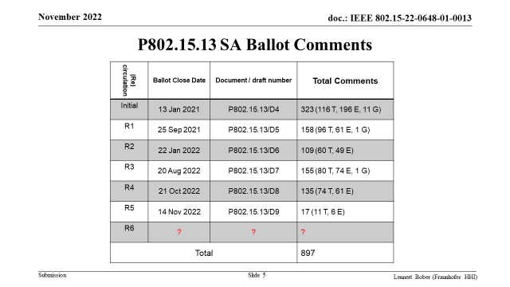

Slide 5
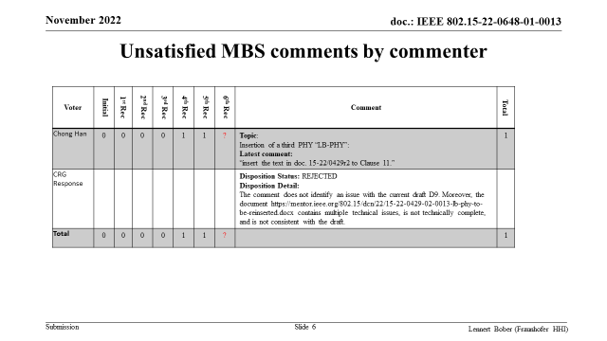

Slide 6
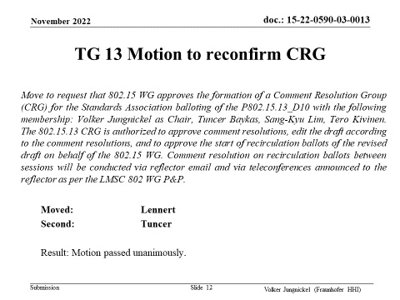

Slide 7
WG Motion to reconfirm CRG
Move that 802.15 WG approves the formation of a Comment Resolution Group (CRG) for the Standards Association balloting of the P802.15.13_D10 with the following membership: Volker Jungnickel as Chair, Tuncer Baykas, Sang-Kyu Lim, Tero Kivinen. The 802.15.13 CRG is authorized to approve comment resolutions, edit the draft according to the comment resolutions, and to approve the start of recirculation ballots of the revised draft on behalf of the 802.15 WG. Comment resolution on recirculation ballots between sessions will be conducted via reflector email and via teleconferences announced to the reflector as per the LMSC 802 WG P&P.
  Moved: Volker Jungnickel
  Second:
  Result: Motion passed unanimously.

Slide 8
Plan for CRG Telcos
TG13 CRG Telco dates
  28 Nov. 2022, 11:00-12.30 CET (5:00-6:30 ET, 18:00-19:30 KT)
  5 Dec. 2022, 11:00-12.30 CET (5:00-6:30 ET, 18:00-19:30 KT)
  12 Dec. 2022, 11:00-12.30 CET (5:00-6:30 ET, 18:00-19:30 KT)
  19 Dec. 2022, 11:00-12.30 CET (5:00-6:30 ET, 18:00-19:30 KT)
  9 Jan 2023, 11:00-12.30 CET (5:00-6:30 ET, 18:00-19:30 KT)
  meetings to be cancelled if not needed

Slide 9
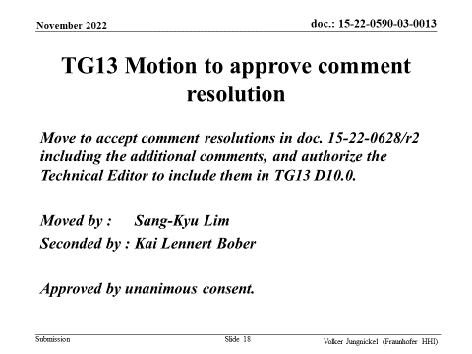

Slide 10
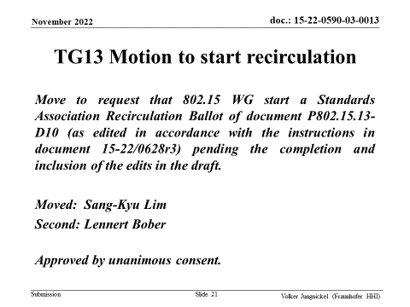

Slide 11
WG15 Motion to start recirculation
Move that 802.15 WG starts a Standards Association Recirculation Ballot of document P802.15.13-D10 (as edited in accordance with the instructions in document 15-22/0628r3) pending the completion and inclusion of the edits in the draft.
Moved: Volker Jungnickel
Second:
Approved by …

Slide 12
WG15 Motion to submit D10 to RevCom
Motion: that 802.15 WG has reviewed and affirms the CSD https://mentor.ieee.org/802-ec/dcn/21/ec-21-0199-00-ACSD-p802-15-13.pdf and requests conditional approval from the LMSC to submit P802.15.13-D10 (or current revision) to RevCom.
Moved: Volker Jungnickel
Second:
Approved by unanimous consent.

Slide 13
TG13 Next steps
D10 goes to recirculation out of November
  prepare D10 until 30 Nov.
  Aim to get at RevCom agenda for January
  Two meeting slots for January
  Final presentation of 802.15.13 in IEEE 802

Slide 14
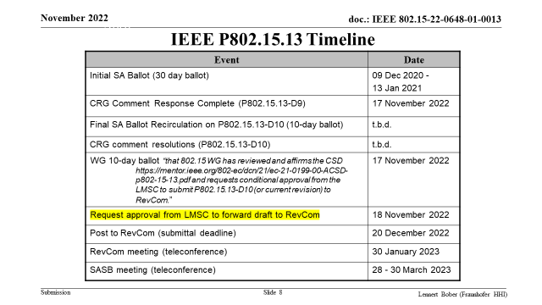

Slide 15
Thanks WG15 for hosting this project
The Optical Wireless Communication community thanks WG15 for hosting this project.
  It has had a slow start since 2015, due to the legacy of 802.15.7-2011
  After around 2018, it really took off
  Main success factors were
    Decicion to implement handover/interference management as distributed MIMO
    Hiring a new Technical Editor (Lennert Bober) who was knowledgeable about MAC
    Spring Cleaning: Move all legacy stuff to the appendix, accept new contents only after careful consideration to be complete and integrable into the draft
    Support from the working group to improve the draft during SA ballot (Tero Kivinen)
    Support from WG Chairs and Vice Chairs over the whole time
    Numerous accidential contributions from academia
    A handfull of long-term contributors: Sang-Kyu Lim, Tuncer Baykas, Lennert Bober, Chong Han, Tero Kivinen, Volker Jungnickel

