Slide 1
Project: IEEE P802.15 Working Group for Wireless Specialty Networks (WSN)
Submission Title: Licensed Narrowband Amendment TG16t November Closing Report
Date Submitted: 2022-11-17
Source: Tim Godfrey, EPRI
Abstract: Meeting Agenda and Presentation
Purpose: Chair’s presentation for task group meeting
Notice: This document has been prepared to assist the IEEE P802.15. It is offered as a basis for discussion and is not binding on the contributing individual(s) or organization(s). The material in this document is subject to change in form and content after further study. The contributor(s) reserve(s) the right to add, amend or withdraw material contained herein.
Release: The contributor acknowledges and accepts that this contribution becomes the property of IEEE and may be made publicly available by P802.15.

Slide 2
TG16t November Plenary Agenda
Meeting Slots – Tuesday, Wednesday, Thursday PM1
Introductions, Secretary, Review and Approve Agenda
Policy Review
Presentation and Review of Draft and Contributions for Draft
Adjourn

Slide 3
Document Status
SRD Status
Approved clean version with 2022 number is 802.15-22-0033r3
SDD Status
Approved clean version with 2022 number is 802.15-22-0084r2
Released Call for Contributions for Draft – 802.15-22-0112r0

Slide 4
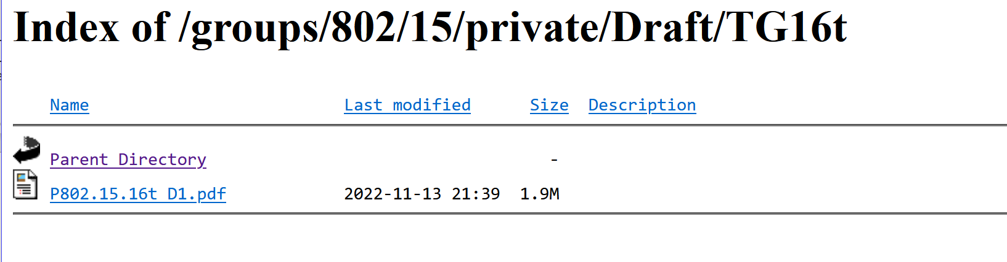
Contributions for November Plenary
Draft D0.1 for review
in 802.15 private area
Date | Document | Title | Author
14-Nov-2022 ET | 615r0 | ieee802.16t MAC Layer | Menashe Shahar (Ondas)
14-Nov-2022 ET | 630r0 | Filtering result with fixed point math | Juha Juntunen (MCC)
15-Nov-2022 ET | 512r0 | Air Interface Protocol - PHY Layer | Menashe Shahar (Ondas)
16-Nov-2022 ET | 643r0 | Direct Peer to Peer | Vishal Kalkundrikar (Ondas)
17-Nov-2022 ET | 665r0 | Air Interface Protocol MAC Layer | Vishal Kalkundrikar (Ondas)
17-Nov-2022 ET | 664r0 | Air Interface Protocol - PHY Layer | Menashe Shahar (Ondas)

Slide 5
Next Steps
Update to PHY Air Interface to be posted as 664r1
Update to MAC to be posted as 665r1
Update to DPP to be posted to 643r1
Consider what might go into Annex R – informative material. Move BSC into the informative material.
From those updates, Harry will update draft to 0.2
Review D0.2 on Teleconference

Slide 6
Teleconference planning
Monday 19 December, 8am PST, 11am EST, 9:30pm India

Slide 7
Project Timeline
Milestone | Date
Task Group Start | Jan 2020
SRD Approval | April 2021
SDD Approval | Jan 2022
Draft Development
Informal TG review of draft | Jan 2023
Working Group Letter Ballot | May 2023
Working Group Recirculation Letter Ballot | Sep 2023
SA Ballot | Nov 2023
Forward to RevCom | Mar 2024
PAR Expiration Date: 31 Dec 2024
If needed, request PAR extension July 2024

