Slide 1
Project: IEEE P802.15 Working Group for Wireless Personal Area Networks (WPANs)
Submission Title: Rule for using control IEs in 802.15.4ab
Date Submitted: December, 2022
Source: Kuan Wu, Lei Huang, Bin Qian, David Xun Yang (Huawei Technologies)
Email: wukuan2@huawei.com
Abstract: Introducing rule for using control IEs in 802.15.4ab applications
Purpose: To mitigate the message redundancy drawback(s) in current 4ab control IE design
Notice: This document has been prepared to assist the IEEE P802.15. It is offered as a basis for discussion and is not binding on the contributing individual(s) or organization(s). The material in this document is subject to change in form and content after further study. The contributor(s) reserve(s) the right to add, amend or withdraw material contained herein.
Release: The contributor acknowledges and accepts that this contribution becomes the property of IEEE and may be made publicly available by P802.15.

Slide 2
PAR Objective | Proposed Solution (how addressed)
Safeguards so that the high throughput data use cases will not cause significant disruption to low duty-cycle ranging use cases
Interference mitigation techniques to support higher density and higher traffic use cases
Other coexistence improvement
Backward compatibility with enhanced ranging capable devices (ERDEVs) | Introducing the rule for using AC IE and ARC IE in one-to-many/many-to-many ranging scenarios
Improved link budget and/or reduced air-time
Additional channels and operating frequencies
Improvements to accuracy / precision / reliability and interoperability for high-integrity ranging
Reduced complexity and power consumption
Hybrid operation with narrowband signaling to assist UWB
Enhanced native discovery and connection setup mechanisms
Sensing capabilities to support presence detection and environment mapping
Low-power low-latency streaming
Higher data-rate streaming allowing at least 50 Mbit/s of throughput
Support for peer-to-peer, peer-to-multi-peer, and station-to-infrastructure protocols
Infrastructure synchronization mechanisms

Slide 3
Previous Contributions and references
1. DCN 500r0 (September 2022) “New Control IE for 4ab applications”
  New control IE is proposed to support the configuration for multiple 4ab applications.
2. DCN 646r0 (November 2022) “UWB In-band Discovery”
3. IEEE Standard for Low-Rate Wireless Networks–Amendment 1: Enhanced Ultra Wideband (UWB) Physical Layers (PHYs) and Associated Ranging Techniques, IEEE Standard 802.15.4z-2020 (Amendment to IEEE Standard 802.15.4-2020), IEEE SA, pp. 1–174, Aug. 25, 2020
4. DCN 585r1 (November 2022) “One-to-Many Ranging using NBA-MMS”
  Extending NBA-MMS usage to one-to-many use cases by concatenating multiple responders
5. DCN 205r0 (July 2022) “Multi-millisecond Ranging”
  Non-interlacing MMS ranging is proposed for long-range line-of-sight, and short-range highly attenuated first path
6. DCN 255r1 (May 2022) “MAC considerations on unified control for UWB sensing and ranging”
  Preliminary study on unified MAC design for UWB sensing and ranging

Slide 4
Recap: Application Control IE design
Application Control IE (AC IE) [1]-[2] is proposed to configure the control parameters for various 4ab applications, including ranging, data comm., sensing, and TDOA.
  For Ranging Control field, re-using some fields from the legacy 4z Advanced Ranging Control IE (ARC IE) [1]: Mutli-node Mode, Ranging Round Usage, STS Packet Config, Deferred Mode, MMRCR
Bits: 0-1 | 2-3 | 4-5 | 6 | 7 | 8 | 9-15 | Octets: 1
Multi-node Mode | Ranging Round Usage | STS Packet Config | Deferred Mode | MMRCR | Number of Preamble Fragments Present | Reserved | Number of Preamble Fragments
Octets: TBD | Bits: 0 | 1 | 2 | 3 | 4-7 | Octets: Variable | Variable | Variable | Variable
Common Control | Ranging Control Present | Data Comm Control Present | Sensing Control Present | TDoA Control Present | Reserved | Ranging Control | Data Comm Control | Sensing Control | TDoA Control

Slide 5
Recap: Application Control IE design (cont.)
In a one-to-many ranging or many-to-many ranging
  An initiator may perform ranging exchange with multiple responders, each of which is either 4ab ERDEV(s) or 4z ERDEV(s).
  Response frames from multiple different responders can be scheduled for transmissions in a sequential order [3]-[4].
A Ranging Control Message (RCM) transmitted at the beginning of a ranging round may include both AC IE and ARC IE, so that all ranging responders are able to obtain necessary control information due to the following facts:
  4z device is able to decode ARC IE, but is unable to decode AC IE.
  4ab device is able to decode both ARC IE and AC IE.
Observation & Problem:
Some control information are included both in AC IE and ARC IE, especially some common ranging parameters
  These overlapping information may cause additional signaling overhead and increased processing complexity of 4ab ERDEVs.
Motivation:
In this contribution, we introduce the rule for using AC IE and ARC IE in one-to-many/many-to-many ranging scenarios

Slide 6
Rule for using AC IE and ARC IE
Introducing the Common Ranging Control Presence and Common Ranging Control fields in the Ranging Control field of AC IE.
If both AC IE and ARC IE are present in the same RCM, then Common Ranging Control Present field is set to zero to indicate that the Common Ranging Control field is not present.
  Effect: The AC IE can carry only supplemental control information to the ARC IE for ranging procedures configuration→ reducing overhead and complexity for receiver(s)
Bits: 0 | 1 | 2-7 | Octets: 0/1 | 0/1
Common Ranging Control Present | Number of Preamble Fragments Present | Reserved | Number of Preamble Fragments | Common Ranging Control
Bits: 0-1 | 2-3 | 4-5 | 6 | 7
Multi-node Mode | Ranging Round Usage | STS Packet Config | Deferred Mode | MMRCR

Slide 7
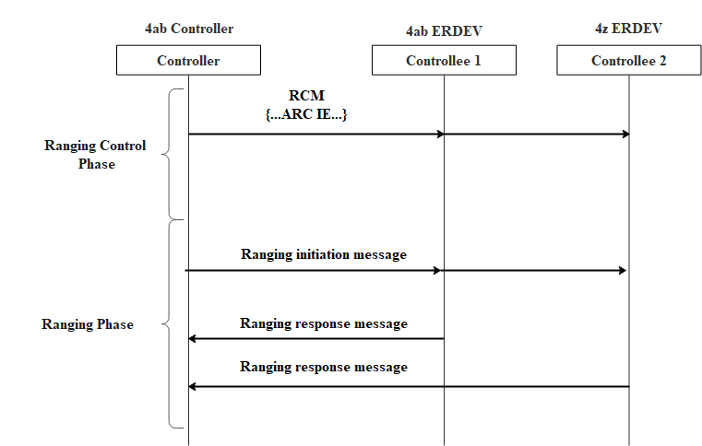
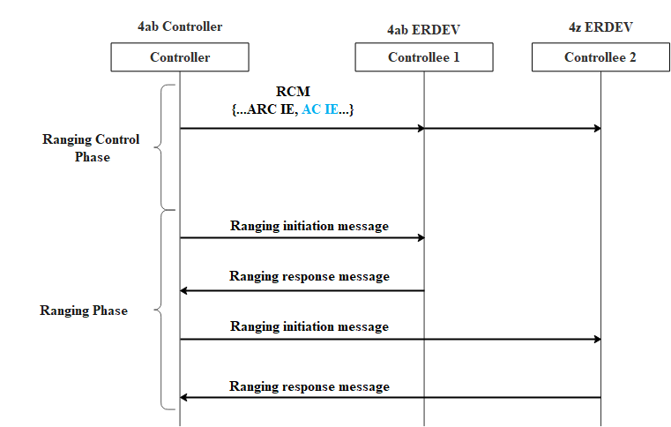
Rule for using AC IE and ARC IE (cont.)
In a one-to-many/many-to-many ranging, if multiple responders include both 4z devices and 4ab devices
  Case (a): If RCM contains ARC IE but does not contain AC IE, then only 4z ranging is performed between initiator and responder(s).
  → (NBA)-MMS UWB procedure is disallowed in this case.
  Case (b): If RCM contains ARC IE and the AC IE which carries supplemental control information to the ARC IE, then 4z ranging procedure is performed between initiator and 4z responder(s), while 4ab ranging procedure is performed between initiator and 4ab responder(s). The ranging parameters for 802.15.4ab-compliant ERDEV(s) are jointly configurated by the AC IE and the ARC IE.
Case (a)
Case (b)

Slide 8
Summary
  In this contribution, we introduce the Common Ranging Control Presence and Common Ranging Control fields in the Ranging Control field of the AC IE.
    The Common Ranging Control field contains Multi-node Mode, Ranging Round Usage, STS Packet Config, Deferred Mode and MMRCR fields, which are overlapping with ARC IE
  If both AC IE and ARC IE are present in the same RCM, then Common Ranging Control Present field is set to zero to indicate the Common Ranging Control field is not present.

