Slide 1
Project: IEEE P802.15 Working Group for Wireless Specialty Networks (WSN)
Submission Title: More on PHR considerations
Source: Bin Qian, Rani Keren, Chenchen Liu, Lei Huang, Wei Lin, David Xun Yang (Huawei Technologies)
Address : [Huawei Bantian Base, Longgang District, Shenzhen, 518129 China]
E-Mail: [qianbin14@huawei.com]
Re: Task Group 4ab: UWB Next Generation for 802.15.4
Abstract: [UWB, PHR]
Purpose:
Notice: This document has been prepared to assist the IEEE P802.15. It is offered as a basis for discussion and is not binding on the contributing individual(s) or organization(s). The material in this document is subject to change in form and content after further study. The contributor(s) reserve(s) the right to add, amend or withdraw material contained herein.
Release: The contributor acknowledges and accepts that this contribution becomes the property of IEEE and may be made publicly available by P802.15.
Notes:
Jul 12, 2010
Page 1

Slide 2
PHR Content
Data rate field:
  Indicate the data rate of the payload field, probably 3 bits
LDPC indication field
  Signal whether LDPC encoding is enabled, 1 bit
PHY payload length field
  Indicate the number of octets in the PSDU field, 12 bits
Sensing indication field
  Signal whether the packet is to be used for sensing, 1 bit
2 Reserved bits
8-bit CRC
There are totally 27 bits in PHR if the data rate field contains 3 bits

Slide 3
Recap of PHR Proposals
Single PHR proposal in [1-2]
  PHR data rate and preamble symbol repetition (PSR) are configured by OOB method
  Do not support dynamic PHR data rate
4-bit PHR1 proposal in [3]
  PHR is split into PHR1 and PHR2, where PHR1 is sent at a low rate and the data rate of PHR2 depends on the PHY payload modulation rate and FEC applied
  PHR1 contains data rate field and LDPC indication field
  PHR2 contains PHY payload length field, sensing indication field, 2 reserved bits and 8-bit CRC
  Support dynamic PHR data rate
  Dilemma: PHR1 reliability and PHR1 air time
    PHR1 at 1.95 Mbps is limiting LDPC gains
    PHR1 at 0.975 Mbps leads to ~10us in duration, which increases the latency
[1] IEEE 15-22-0475-01-04ab-phr-content-and-rate
[2] IEEE 15-22-0546-01-04ab-legacy-4z-phr-for-several-new-data-rates
[3] IEEE 15-22-0653-00-04ab-an-updated-phy-header-proposal

Slide 4
Proposed Compromise: 3-bit PHR1
PHR1 contains 3 bits of the data rate field, i.e., R0, R1, and R2
PHR2 contains the LDPC indication field, PHY payload length field, sensing indication field, 2 reserved bits and 8-bit CRC
PHR1 format
  R0, R1 and R2 indicate the data rate of PHR2 and PSDU
PHR2 format
Bits: 0 | 1 | 2
R0 | R1 | R2
Bits: 0 | 1-12 | 13 | 14-15 | 16-23
LDPC | Payload Length | Sensing | Reserved | CRC

Slide 5
Example of Data Rate Mapping
R0, R1, R2 in PHR1 | LDPC field in PHR2 | PHR2 Data Rate (Mbps) | PHR2 Symbol Structure | PSDU Data Rate (Mbps) | LDPC Enabled
000 | 0 | 0.4875 | Repeat 4 times on the basis of the PSDU symbol structure | Reserved | Reserved
 | 1 |  |  | 1.95 | Yes
001 | 0 | 1.95 | Same as PSDU symbol structure | 1.95 | No
 | 1 |  |  | Reserved | Reserved
010 | 0 | 1.95 | Repeat 4 times on the basis of the PSDU symbol structure | Reserved | Reserved
 | 1 |  |  | 7.8 | Yes
011 | 0 | 7.8 | Same as PSDU symbol structure | 7.8 | No
 | 1 |  |  | Reserved | Reserved
100 | 0 | 7.8 | Repeat 4 times on the basis of the PSDU symbol structure | Reserved | Reserved
 | 1 |  |  | 31.2 | Yes
101 | 0 | 31.2 | Same as PSDU symbol structure | 31.2 | No
 | 1 |  |  | Reserved | Reserved
110 | 0 | 15.6 | Repeat 4 times on the basis of the PSDU symbol structure | 62.4 | No
 | 1 |  |  | 62.4 | Yes
111 | 0 | 31.2 | Repeat 4 times on the basis of the PSDU symbol structure | 124.8 | No
 | 1 |  |  | 124.8 | Yes
There is no data rate switching point between PHR2 and PSDU
The data rate of PHR2 could be further optimized

Slide 6
Options for PHR1 Transmission
Option 1: 3-bit PHR1 is encoded by a pre-defined 3-bit-to-32-bit mapping and transmitted at 1.95 Mbps
  The code length 32 is the best in terms of performance metrics: (1) SNR margin; (2) PHR air time
  The codewords are chosen such that the minimum Hamming distance is maximized
Option 2: 3-bit PHR1 is encoded to a 18-bit codeword using K=7 BCC and transmitted at 0.975 Mbps (option 2.1) or 1.95 Mbps (option 2.2)
Option 3: 4-bit PHR1 is encoded to a 20-bit codeword using K=7 BCC and transmitted at 0.975 Mbps (option 3.1) or 1.95 Mbps (option 3.2)
R0, R1, R2 in PHR1 | Codeword
000 | 0 0 0 0 0 0 0 0 0 0 0 0 0 0 0 0 0 0 0 0 0 0 0 0 0 0 0 0 0 0 0 0
001 | 1 0 1 0 1 0 1 1 0 1 0 1 0 1 1 0 1 0 1 0 1 1 0 1 0 1 0 1 1 0 0 1
010 | 0 1 1 0 0 1 1 0 1 1 0 0 1 1 0 1 1 0 0 1 1 0 1 1 0 0 1 1 0 1 0 1
011 | 1 1 0 0 1 1 0 1 1 0 0 1 1 0 1 1 0 0 1 1 0 1 1 0 0 1 1 0 1 1 0 0
100 | 0 0 0 1 1 1 1 0 0 0 1 1 1 1 0 0 0 1 1 1 1 0 0 0 1 1 1 1 0 0 1 1
101 | 1 0 1 1 0 1 0 1 0 1 1 0 1 0 1 0 1 1 0 1 0 1 0 1 1 0 1 0 1 0 1 0
110 | 0 1 1 1 1 0 0 0 1 1 1 1 0 0 0 1 1 1 1 0 0 0 1 1 1 1 0 0 0 1 1 0
111 | 1 1 0 1 0 0 1 1 1 0 1 0 0 1 1 1 0 1 0 0 1 1 1 0 1 0 0 1 1 1 1 1

Slide 7
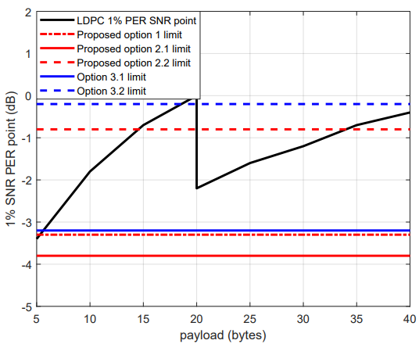
LDPC Performance under Different PHR Proposals
For option 1 and option 2, PHR2 is assumed to be transmitted at rates shown in slides 5
For option 3, PHR2 is assumed to be transmitted at 25% of payload modulation rate
LDPC 648 is used for 20 bytes or less, 1296 for payloads between 21 and 40 bytes as in DCN 506r4
Option 1, option 2.1 and option 3.1 can guarantee LDPC gains

Slide 8
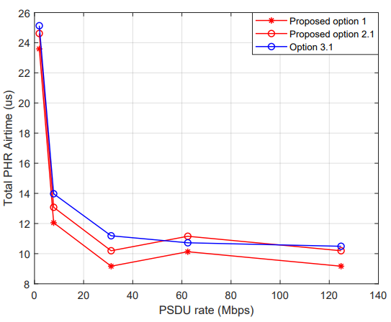
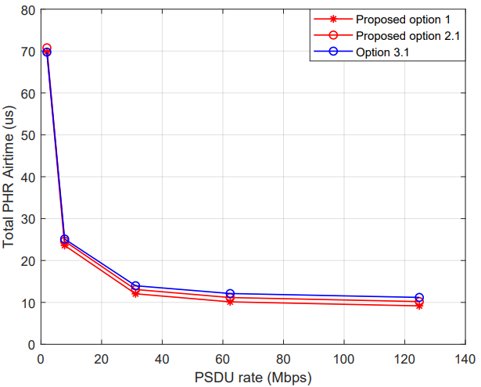
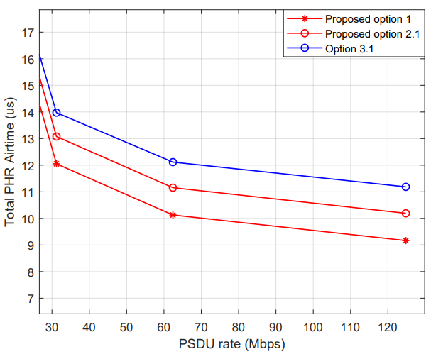
PHR Duration Comparison
For option 1 and option 2, PHR2 is assumed to be transmitted at rates shown in slides 5
For option 3, PHR2 is assumed transmitted at 25% of payload modulation rate when LDPC is applied, and transmitted at the same modulation rate of payload when BCC is applied
The options ensuring LDPC gains are considered
BCC is applied for PSDU
LDPC is applied for PSDU

Slide 9
Observation and Recommendation
Observation
  When LDPC is applied for PSDU
    Both option 2.2 and option 3.2 cannot satisfy the SNR margin requirement especially for small PSDU size.
    Option 2.1 has a better SNR margin than option 1 and option 1 has slightly better SNR margin than option 3.1.
    Option 1 has a shorter PHR airtime than option 2.1, and option 2.1 has a shorter PHR airtime than option 3.1.
  When BCC is applied for PSDU
    Option 1 has a shorter PHR airtime than option 2.1 and option 3.1.
Recommendation: We prefer option 1 since option 1 achieves better tradeoff between SNR margin and PHR airtime.

Slide 10
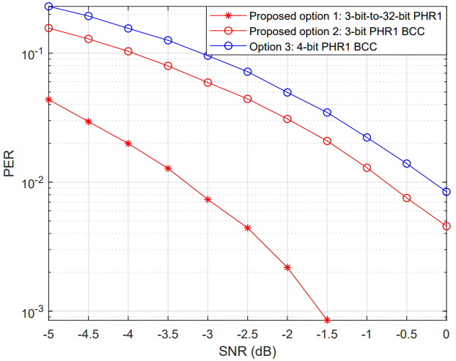
Appendix: PHR1 Performance Comparison

