Slide 1
Project: IEEE P802.15 Working Group for Wireless Personal Area Networks (WPANs)
Submission Title: [Pulse shape and time domain mask for 802.15.4ab]
Date Submitted: []
Source: Xiaohui Peng, Bin Qian, Lei Huang, Kuan Wu, David Xun Yang (Huawei), Frank Leong, Bernhard Großwindhager, Wolfgang Küchler (NXP)
E-Mail: pengxiaohui5@huawei.com, frank.leong@nxp.com
Re: [Input to the Working Group]
Abstract: [Sensing, UWB in 802.15.4ab, pulse shape, time domain mask]
Purpose: []
Notice: This document has been prepared to assist the IEEE P802.15. It is offered as a basis for discussion and is not binding on the contributing individual(s) or organization(s). The material in this document is subject to change in form and content after further study. The contributor(s) reserve(s) the right to add, amend or withdraw material contained herein.
Release: The contributor acknowledges and accepts that this contribution becomes the property of IEEE and may be made publicly available by P802.15.

Slide 2
PAR Objective | Proposed Solution (how addressed)
Safeguards so that the high throughput data use cases will not cause significant disruption to low duty-cycle ranging use cases
Interference mitigation techniques to support higher density and higher traffic use cases
Other coexistence improvement
Backward compatibility with enhanced ranging capable devices (ERDEVs) | Unified pulse shape for ranging and sensing
Improved link budget and/or reduced air-time
Additional channels and operating frequencies
Improvements to accuracy / precision / reliability and interoperability for high-integrity ranging
Reduced complexity and power consumption
Hybrid operation with narrowband signaling to assist UWB
Enhanced native discovery and connection setup mechanisms
Sensing capabilities to support presence detection and environment mapping | Pulse shape design for sensing
Low-power low-latency streaming
Higher data-rate streaming allowing at least 50 Mbit/s of throughput
Support for peer-to-peer, peer-to-multi-peer, and station-to-infrastructure protocols
Infrastructure synchronization mechanisms

Slide 3
Related Submissions
15-19-0443-01-004z text to address comment id r1-0820 (Michael McLaughin)
15-20-0084-00-004z pulse shaping considerations (Jochen Hammerschmidt)
15-20-0086-00-004z proposed pulse shape text changes for HRP UWB PHY (Michael McLaughin)
15-20-0089-01-004z pulse shape text changes for HRP UWB PHY (Michael McLaughin)
15-22-0040-04-04ab waveform design for UWB sensing (Xiaohui Peng)
15-22-0418-00-04ab sensing pulse shape consideration in 802.15.4ab (Xiaohui Peng)
15-22-0175-00-04ab sensing device (Dag T. Wisland )
15-22-0061-00-04ab sensing – continued (Frank Leong)
15-22-0305-00-04ab a summary of proposals and interests (Billy Verso)
15-22-0418-00-04ab-sensing-pulse-shape-consideration-in-802-15-4ab–continued (Xiaohui Peng)
15-22-0588-00-04ab-time-domain-mask-for-pulse-shape-in-802-15-4ab (Xiaohui Peng)

Slide 4
Recap
For sensing application, a pulse shape should be designed to minimize both precursors and postcursors.
The pulse shape should be designed to support both ranging and sensing applications.
The specific criteria for sensing pulse shape include range resolution, PSLR (Peak to sidelobe ratio) of the cross-correlation function, spectrum efficiency (or root mean square bandwidth).
Pulse shape does not change in the middle of packet. Sensing pulse shape is used for entire packet in sensing applications.
An ideal reference pulse shape should be defined.
A more restrictive time-domain mask should be specified for the sensing pulse shape than ranging

Slide 5
Motivation
We agree on a two-step definition for sensing pulse shape.
  An ideal reference pulse shape should be defined
  A restrictive sensing “time-domain” mask needs to be defined in 15.4ab.
Reference pulse shape: The pulse shape should be designed to support both ranging and sensing applications, thus the pulse shape defined in 4ab shall be able to meet the mask defined in 4z.
  [Consensus]: Pulse shape does not change in the middle of packet. Sensing pulse shape is used for entire packet in sensing applications.
Time-domain mask:
  Last meeting majority prefer to use a symmetric time-domain mask
A symmetric time-domain mask shall be defined based on the mask in 15.4z.

Slide 6

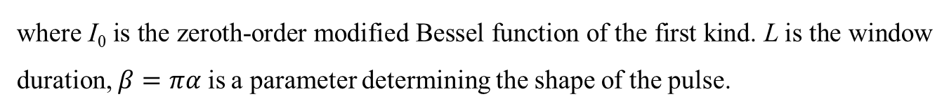
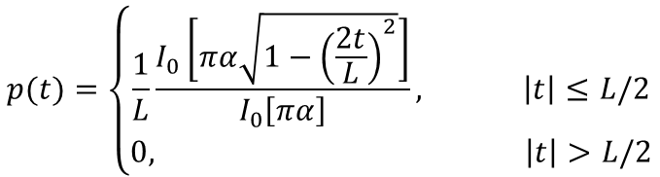
Reference pulse shape
For sensing, it is recommended to use a time-bounded Kaiser pulse shape as the reference
A Kaiser pulse is shaped as a Kaiser-Bessel window also with no precursor and postcursor, which can be expressed as:
It is recommended to set L = 3 chips and $β=πα$ =10
$$p(t)=\left\{\begin{aligned}\frac{1}{L}\frac{I_{0}\left[πα\sqrt{1−{\left(\frac{2t}{L}\right)}^{2}}\right]}{I_{0}\left[πα\right]}, \left|t\right|≤L/2 \\ 0, \left|t\right|>L/2\end{aligned}\right.$$
where I₀ is the zeroth-order modified Bessel function of the first kind. L is the window duration, $β=πα$ is a parameter determining the shape of the pulse.

Slide 7
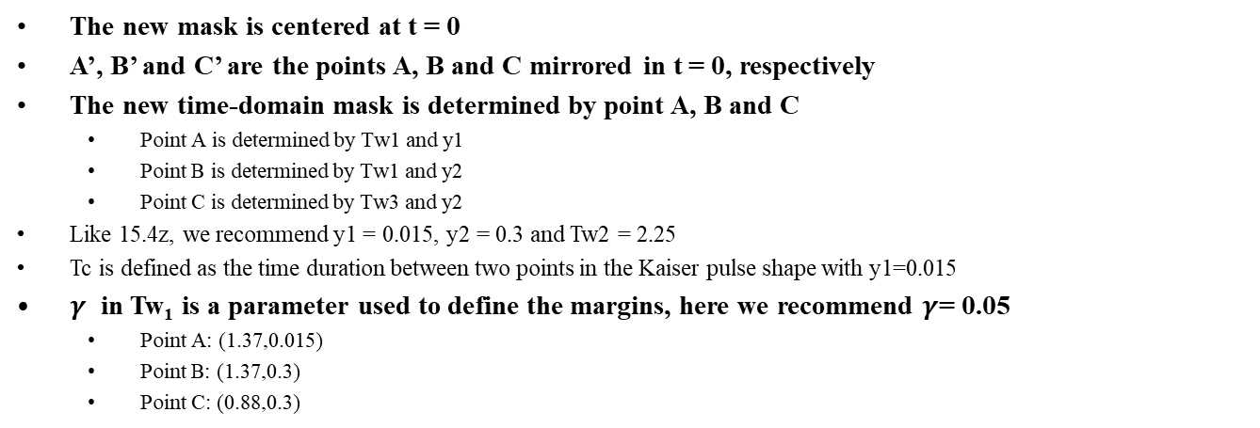

Symmetric time-domain mask
Tw₃=Tw₁-2(Tw₁-Tw₂)
New mask
4z mask
Tw₂=2.25
C:(Tw₃ /2,y2)
B’
C’
B:(Tw₁ /2,y2)
Tw₁=(1+2$γ$) Tc
A’
Tc=2.5
A:(Tw₁ /2,y1)
y=-y1
The new mask is centered at t = 0
A’, B’ and C’ are the points A, B and C mirrored in t = 0, respectively
The new time-domain mask is determined by point A, B and C
  Point A is determined by Tw1 and y1
  Point B is determined by Tw1 and y2
  Point C is determined by Tw3 and y2
  Like 15.4z, we recommend y1 = 0.015, y2 = 0.3 and Tw2 = 2.25
  Tc is defined as the time duration between two points in the Kaiser pulse shape with y1=0.015
  $γ$ in Tw₁ is a parameter used to define the margins, here we recommend $γ$= 0.05
  Point A: (1.37,0.015)
  Point B: (1.37,0.3)
  Point C: (0.88,0.3)

Slide 8
Summary
We recommend to use a time-bounded Kaiser pulse shape as the reference
We recommend to use the symmetric time-domain mask shown in slides 7.

Slide 9
References
Amendment1: Enhanced ultra wideband (UWB) physical layers (PHYs) and associated ranging techniques
IEEE standard for low-rate wireless networks
UWB spectral mask and FFC part 15 limits
15-19-0443-01-004z text to address comment id r1-0820 (Michael McLaughin)
15-20-0084-00-004z pulse shaping considerations (Jochen Hammerschmidt)
15-20-0086-00-004z proposed pulse shape text changes for HRP UWB PHY (Michael McLaughin)
15-20-0089-01-004z pulse shape text changes for HRP UWB PHY (Michael McLaughin)
15-22-0040-04-04ab waveform design for UWB sensing (Xiaohui Peng)
15-22-0175-00-04ab sensing device (Dag T. Wisland )
15-22-0061-00-04ab sensing – continued (Frank Leong)
15-22-0305-00-04ab a summary of proposals and interests (Billy Verso)
15-22-0418-00-04ab-sensing-pulse-shape-consideration-in-802-15-4ab–continued (Xiaohui Peng)
15-22-0588-00-04ab-time-domain-mask-for-pulse-shape-in-802-15-4ab (Xiaohui Peng)

