Slide 1
Project: IEEE P802.15 Working Group for Wireless Personal Area Networks (WPANs)
Submission Title: Latest Consensus on UWB Sensing for 802.15.4ab
Date Submitted: January 19, 2023
Authors: Pooria Pakrooh, Bin Tian, Steve Shellhammer, Koorosh Akhavan (Qualcomm), Xiaohui Peng, David Xun Yang, Bin Qian, Lei Huang, Li Sun (Huawei), Frank Leong, Wolfgang Küchler, Riku Pirhonen (NXP Semiconductors), Dag Wisland, Håkon Hjortland, Kristian Granhaug, Jan Roar Pleym (Novelda), Dries Neirynck (Ultra Radio Ltd), Claudio da Silva, Carlos Aldana, Kangjin Yoon (Meta), Billy Verso, Carl Murray, Igor Dotlic, Michael McLaughlin (Qorvo), Xiliang Luo, Vinod Kristem, Jinjing Jiang (Apple), Aniruddh Rao, Mingyu Lee (Samsung)
Abstract: Latest consensus among co-authors on UWB sensing topics for 802.15.4ab
Notice: This document has been prepared to assist the IEEE P802.15. It is offered as a basis for discussion and is not binding on the contributing individual(s) or organization(s). The material in this document is subject to change in form and content after further study. The contributor(s) reserve(s) the right to add, amend or withdraw material contained herein.
Release: The contributor acknowledges and accepts that this contribution becomes the property of IEEE and may be made publicly available by P802.15.

Slide 2
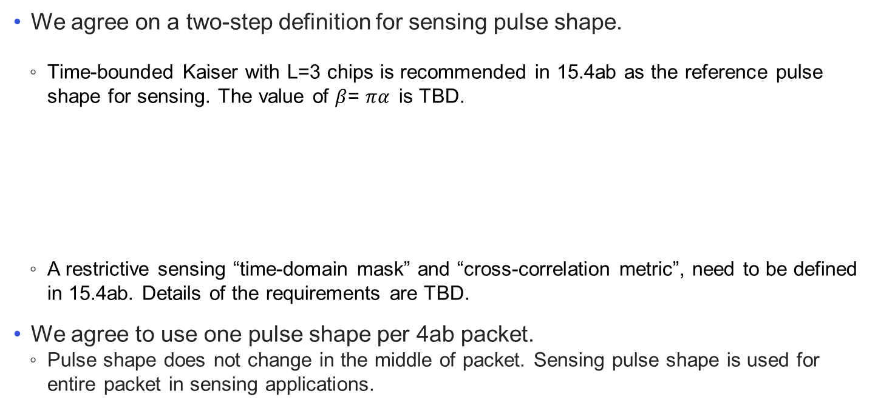
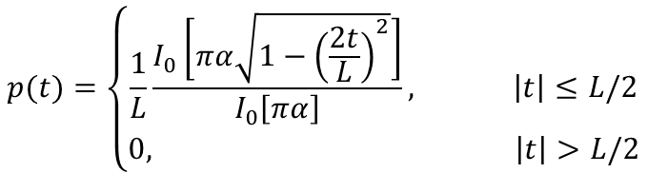
Sensing Pulse Shape
We agree on a two-step definition for sensing pulse shape.
  Time-bounded Kaiser with L=3 chips is recommended in 15.4ab as the reference pulse shape for sensing. The value of $β$= $πα$is TBD.
  A restrictive sensing “time-domain mask” and “cross-correlation metric”, need to be defined in 15.4ab. Details of the requirements are TBD.
We agree to use one pulse shape per 4ab packet.
  Pulse shape does not change in the middle of packet. Sensing pulse shape is used for entire packet in sensing applications.
$$p(t)=\left\{\begin{aligned}\frac{1}{L}\frac{I_{0}\left[πα\sqrt{1−{\left(\frac{2t}{L}\right)}^{2}}\right]}{I_{0}\left[πα\right]}, \left|t\right|≤L/2 \\ 0, \left|t\right|>L/2\end{aligned}\right.$$
Slide 2
Pakrooh et al. (Qualcomm)

Slide 3
Sensing Sequence and Pulse Pattern
We agree on the HPRF pulse pattern for sensing.
We agree on the Ipatov sequences as the mandatory sequences for sensing.
  Other sequences like SZC can be added as optional scheme upon convergence.
We agree on mandatory support of Ipatov sequences of length 91, with spreading factor of L=4 for sensing.
  Ipatov sequences of length 121 and/or spreading factors of L=8,16, 32 can be added as optional schemes upon convergence.
Slide 3
Pakrooh et al. (Qualcomm)

Slide 4
Sensing Packet Format
We agree to define the following PPDUs for bi/multi-static sensing.
  SENS0: Mandatory sensing packet format, SHR + sensing
  SENS1: Optional packet format, sensing + data comm
  SENS2: Optional packet format, data comm + sensing
SENS0
SYNC
SFD
SEN
Mandatory
SENS1
SYNC
SFD
SEN
PHR
Payload
Optional
SENS2
SYNC
SFD
PHR
Payload
SEN
Optional
Slide 4
Pakrooh et al. (Qualcomm)

Slide 5





Sensing Report
We agree to have window-based CIR report, as shown in the figure below.
  A sensing report bitmap is used to signal the taps present in the CIR report. The bitmap length is equal to the CIR window length.
Additionally, we agree that other processed results may be included in the sensing report.
  For monostatic sensing, or for bi-static sensing with external synchronization, CIR report may be optionally processed, to generate range/velocity for each object. The definition of computation method is TBD.
  Angle of Arrival (AoA) for each object may be reported.
Reference Point: Earliest detected tap
Noise Threshold
$$t_{0}$$
$$t_{0}+W_{offset}$$
$t_{0}+W_{offset}$+ $W_{length}$
$$W_{offset}$$
$$W_{length}$$
Sensing window parameters defined relative to the earliest detected tap
Slide 5
Pakrooh et al. (Qualcomm)

Slide 6
Sensing Report
We agree on the following parameters for the window-based CIR report.
  Reference: The earliest detected tap can be specified as the mandatorily supported reference for the CIR report. Other reference options under consideration, to be supported optionally:
    Other specific time instances can be specified as reference points (for example via OOB) when there is external synchronization.
    The strongest detected tap, if there are multiple equally strongest taps, then the earliest one is selected.
  CIR sampling rate: We agreed on OSR=2, to balance reasonable accuracy, complexity and report overhead. OSR is defined with respect to signal BW.
    For frequency stitching, OSR is defined with respect to the aggregated BW.
  Bit-width: Bit-width is defined for encoding signed I/Q values each, normalized per Rx chain.
    16 bits (mandatory), 10, 12 bits, and other values are under consideration as optional values.
Slide 6
Pakrooh et al. (Qualcomm)

Slide 7
Sensing Report
We agree on the following points for the window-based CIR report.
  The CIR report window has configurable duration and position, to cover a large sensing area.
  Further agreements regarding CIR report bitmap
    Single CIR window with bitmap of a fixed length is specified through OOB means.
    The bitmap length is negotiated and determined through other means, and it is fixed during sensing session.
    In the mandatory mode, initiator proposes the bitmap, based on its sensing area of interest, from a limited set of bitmap options.
      Bitmap is fixed during the session and does not change from packet to packet.
    For the optional modes, the following choice is under consideration
      Variable bitmap from packet to packet
Slide 7
Pakrooh et al. (Qualcomm)

Slide 8
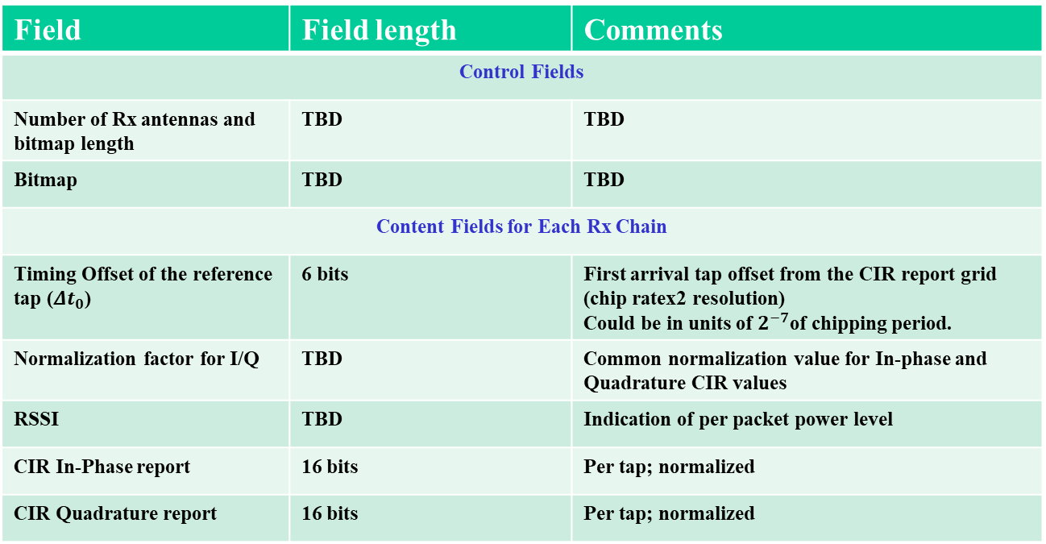
Baseline Sensing Report Parameters
We agree that the baseline CIR report contain the following fields
Field | Field length | Comments
Control Fields
Number of Rx antennas and bitmap length | TBD | TBD
Bitmap | TBD | TBD
Content Fields for Each Rx Chain
Timing Offset of the reference tap (${Δt}_{0}$) | 6 bits | First arrival tap offset from the CIR report grid (chip ratex2 resolution) Could be in units of $2^{−7}$of chipping period.
Normalization factor for I/Q | TBD | Common normalization value for In-phase and Quadrature CIR values
RSSI | TBD | Indication of per packet power level
CIR In-Phase report | 16 bits | Per tap; normalized
CIR Quadrature report | 16 bits | Per tap; normalized
Slide 8
Pakrooh et al. (Qualcomm)

Slide 9
Other Topics
Details of sensing procedure need to be discussed.
  Definition of block/round/slot structure for sensing
  Control message for sensing: IE structure and content for sensing
We agree to adopt frequency stitching across carrier frequencies to improve sensing link budget and accuracy, as an optional feature for mono-static, bi/multi-static modes.
  Consider to limit channels where this option is available to avoid interference with multiple UWB channels

