Slide 1
Project: IEEE P802.15 Working Group for Wireless Personal Area Networks (WPANs)
Submission Title: Discussion on the Issues of Draft D3 comments
Date Submitted: March 2023
Source: Huy Nguyen, Yeong Min Jang [Kookmin University].
Contact: +82-2-910-5068 E-Mail: yjang@kookmin.ac.kr
Re:
Abstract: Response to the Issues of Draft D3 comments
Purpose: Response to the Issues of Draft D3 comments
Notice: This document has been prepared to assist the IEEE P802.15. It is offered as a basis for discussion and is not binding on the contributing individual(s) or organization(s). The material in this document is subject to change in form and content after further study. The contributor(s) reserve(s) the right to add, amend or withdraw material contained herein.
Release: The contributor acknowledges and accepts that this contribution becomes the property of IEEE and may be made publicly available by P802.15.

Slide 2
Discussion on the Issues of Draft D3 comments

Slide 3
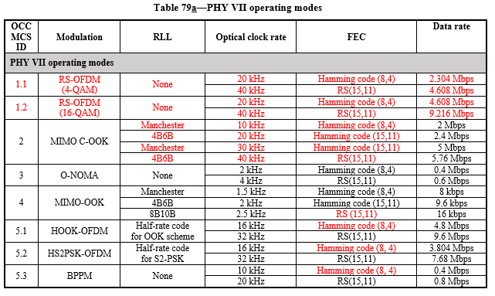
Issue #1: Technical issue
8. PHY specification

Slide 4
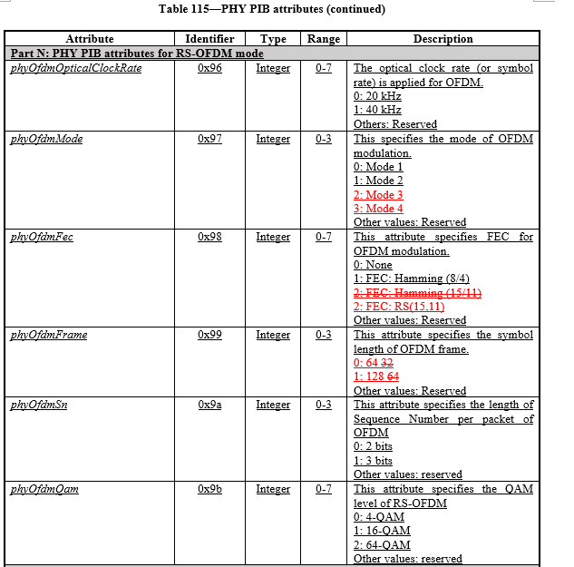
Issue #2: Technical issue
9.5.2 PHY PIB attributes

Slide 5
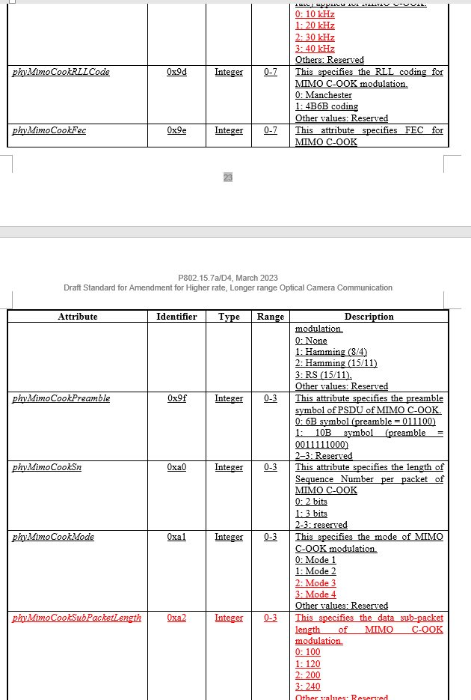
Issue #3: Technical issue
9.5.2 PHY PIB attributes

Slide 6
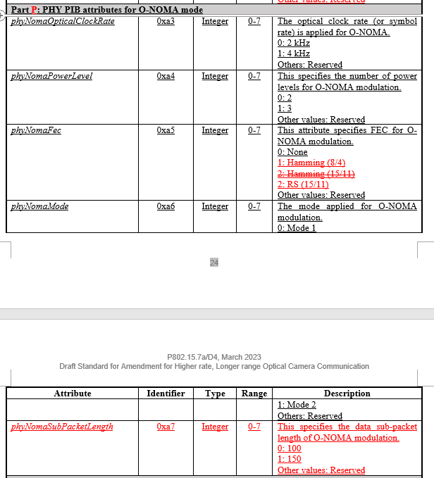
Issue #4: Technical issue
9.5.2 PHY PIB attributes

Slide 7
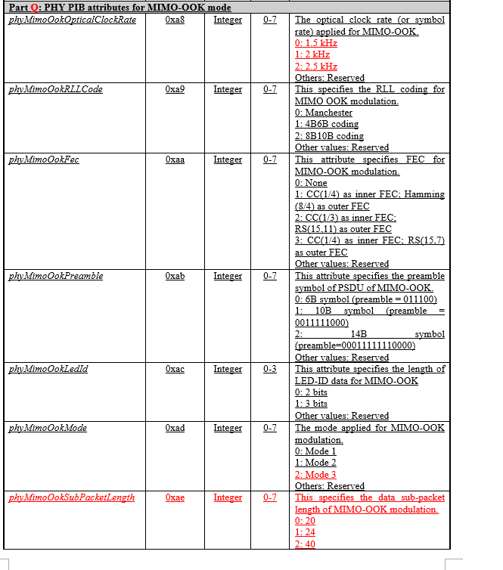
Issue #5: Technical issue
9.5.2 PHY PIB attributes

Slide 8
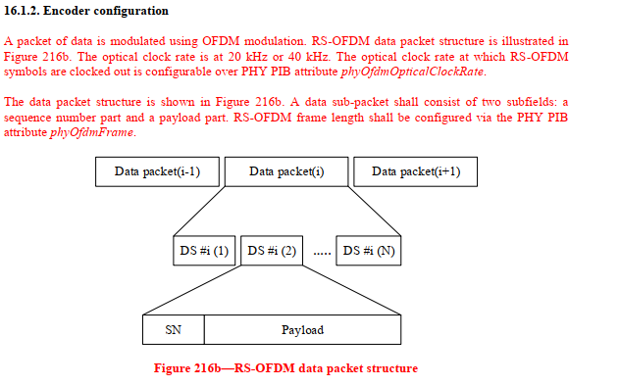
Issue #6: Technical issue
16.1.2. Encoder configuration

Slide 9
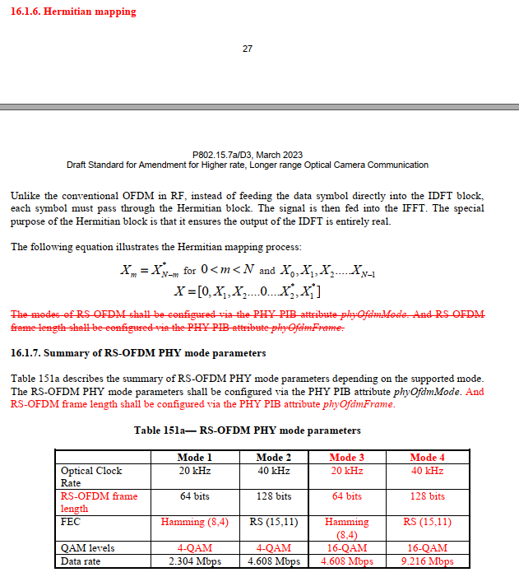
Issue #7: Technical issue
16.1.6. Hermitian mapping
16.1.7. Summary of RS-OFDM PHY mode parameters

Slide 10
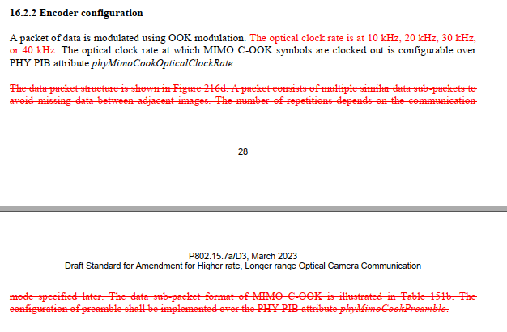
Issue #8: Technical issue
16.2.2 Encoder configuration

Slide 11
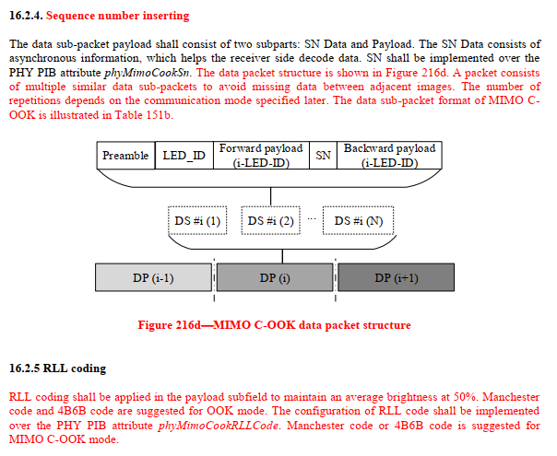
Issue #9: Technical issue
16.2.4. Sequence number inserting
16.2.5 RLL coding

Slide 12
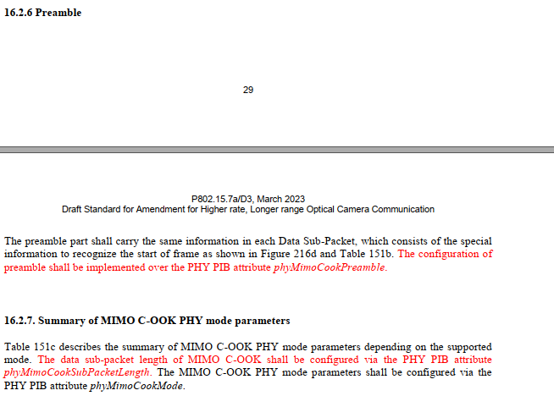
Issue #10: Technical issue
16.2.6 Preamble
16.2.7. Summary of MIMO C-OOK PHY mode parameters

Slide 13
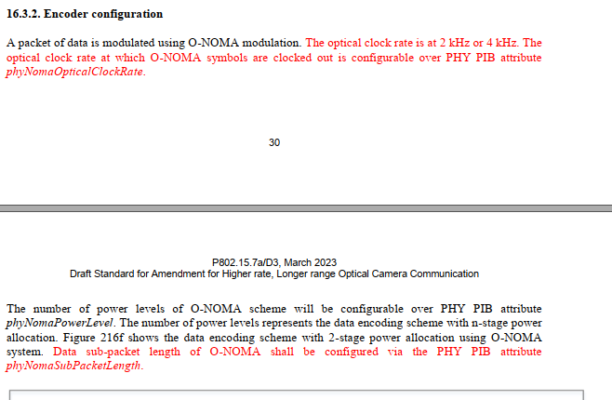
Issue #11: Technical issue
16.3.2. Encoder configuration

Slide 14
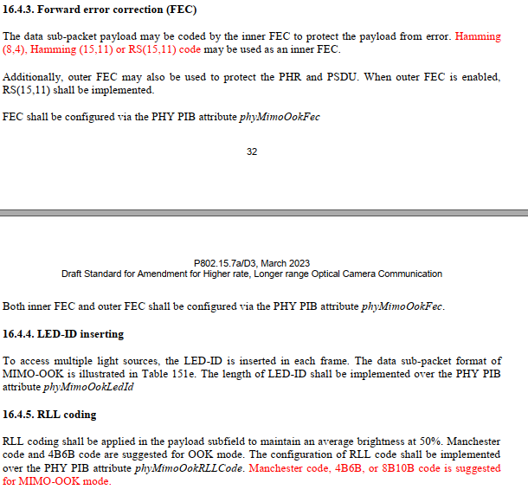
Issue #12: Technical issue
16.4.3. Forward error correction (FEC)
16.4.5. RLL coding

Slide 15
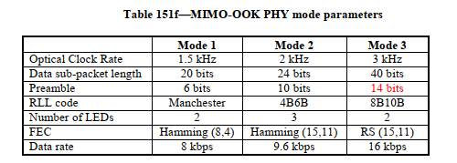
Issue #13: Technical issue
16.4.7. Summary of MIMO-OOK PHY mode parameters

