Slide 1
Project: IEEE P802.15 Working Group for Wireless Personal Area Networks (WPANs)
Submission Title: Importance of NBA-MMS-UWB and 802.11 Coexistence
Date Submitted: March 13, 2023
Source: Steve Shellhammer, Pooria Pakrooh, Bin Tian, and Menzo Wentink (Qualcomm)
E-Mail:{sshellha, ppakrooh, btian, mwentink}@qti.qualcomm.com
Abstract: Here we discuss the importance of coexistence between NBA-MMS-UWB and 802.11.
Notice: This document has been prepared to assist the IEEE P802.15. It is offered as a basis for discussion and is not binding on the authoring individual(s) or organization(s). The material in this document is subject to change in form and content after further study. The authors(s) reserve(s) the right to add, amend or withdraw material contained herein.

Slide 2
PAR Objective | Proposed Solution (how addressed)
Safeguards so that the high throughput data use cases will not cause significant disruption to low duty-cycle ranging use cases
Interference mitigation techniques to support higher density and higher traffic use cases
Other coexistence improvement | Here we discuss the coexistence of NBA-MMS-UWB and 802.11
Backward compatibility with enhanced ranging capable devices (ERDEVs)
Improved link budget and/or reduced air-time
Additional channels and operating frequencies
Improvements to accuracy / precision / reliability and interoperability for high-integrity ranging
Reduced complexity and power consumption
Hybrid operation with narrowband signaling to assist UWB
Enhanced native discovery and connection setup mechanisms
Sensing capabilities to support presence detection and environment mapping
Low-power low-latency streaming
Higher data-rate streaming allowing at least 50 Mbit/s of throughput
Support for peer-to-peer, peer-to-multi-peer, and station-to-infrastructure protocols
Infrastructure synchronization mechanisms

Slide 3
Background
NBA-MMS-UWB utilizes the O-QPSK narrowband PHY operating in the UNI-3 and UNI-5 frequency bands
Other technologies, including IEEE 802.11, also operates in those frequency bands
We think it is important that these technologies coexist well in those frequency bands
A Coexistence Assessment (CA) document is required for the first WG Letter Ballot
  So, it is important for 802.15.4ab group to investigate the coexistence issue and develop a mitigation method

Slide 4
Background
The NBA-MMS-UWB MAC technical framework document [1] provides a good description of NBA-MMS-UWB
There are several possible mechanisms for coexistence between Narrowband operation and other technologies
  Listen-before-talk (LBT)
    Document [1] describes how LBT can be applied in NBA-MMS-UWB
  Channel switching
    Also covered in [1]
  Duty cycle
    To be meaningful for coexistence duty cycle needs to be specified over a short period of time (e.g., one second)

Slide 5
Listen Before Talk (LBT)
Listen before talk is an excellent coexistence mechanism, that is widely used for the coexistence between multiple technologies
  In some regulatory domains it is required
  Standards like 802.11 use both carrier sense and energy detection to identify if the channel is Idle before transmitting in the channel
  It is also beneficial for coexistence between Narrowband PHYs
  When the channel is Busy there is no benefits to transmitting since the packet will not get through to the intended receiver
  Frame-based LBT, as described in [1], fits narrowband operation very well
Our strong recommendation is that LBT always be used in NBA-MMS-UWB Ranging
LBT and other coexistence mechanisms were discussed previously in [3]

Slide 6
Initial Coexistence PHY Testing Study
Here we are focusing on the coexistence of NB O-QPSK and 802.11
We should consider both the PHY and the MAC layers
These can be considered using simulations
We start with PHY-layer testing to demonstrate the impact of the NB transmission on the WLAN packet error rate
  Here we provide some PHY layer results of the effect of a 2 MHz waveform on a 20 MHz 802.11 link
  We have BLE waveforms available, which have approximately the same bandwidth as the O-QPSK PHY

Slide 7
PHY Layer Testing
For reference we show the bandwidths of BLE and O-QPSK provided in [2]
  Below graphs compare 802.15.4 O-QPSK vs BLE 2M GMSK PHY (dashed line)

Slide 8
PHY Layer Testing
To do the testing we need to select the power level of the O-QPSK signal at the 802.11 receiver
We did some free space path loss calculations for the O-QPSK signal
From [2] we know
  For O-QPSK the maximum output power can go up to 20 dBm
  For UNII-3, the maximum output power for non-specific short-range device is 14 dBm (in ETSI)
  For UNII-3, if an adequate spectrum sharing mechanism (e.g., DFS and DAA) is implemented, the maximum output power can go up to 26dBm (in ETSI)
Higher power is allowed in other regulatory domains (e.g., FCC)

Slide 9
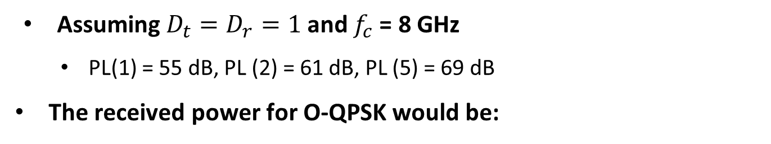
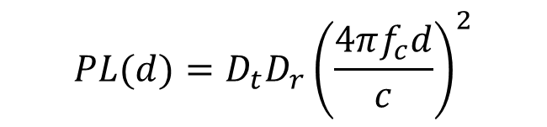
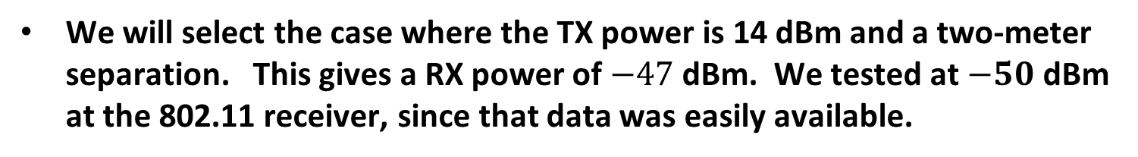
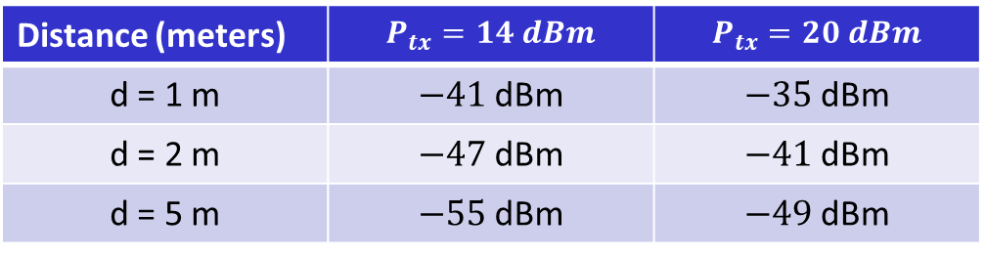
PHY Layer Testing
Free space path loss (d meters)
$$PL(d)={D_{t}D_{r}\left(\frac{4πf_{c}d}{c}\right)}^{2}$$
  Assuming $D_{t}=D_{r}=1$ and $f_{c}$= 8 GHz
    PL(1) = 55 dB, PL (2) = 61 dB, PL (5) = 69 dB
The received power for O-QPSK would be:
Distance (meters) | $$P_{tx}=14 dBm$$ | $$P_{tx}=20 dBm$$
d = 1 m | $−41$dBm | $−35$dBm
d = 2 m | $−47$dBm | $−41$dBm
d = 5 m | $−55$dBm | $−49$dBm
We will select the case where the TX power is 14 dBm and a two-meter separation. This gives a RX power of $−47$dBm. We tested at $−50$ dBm at the 802.11 receiver, since that data was easily available.

Slide 10
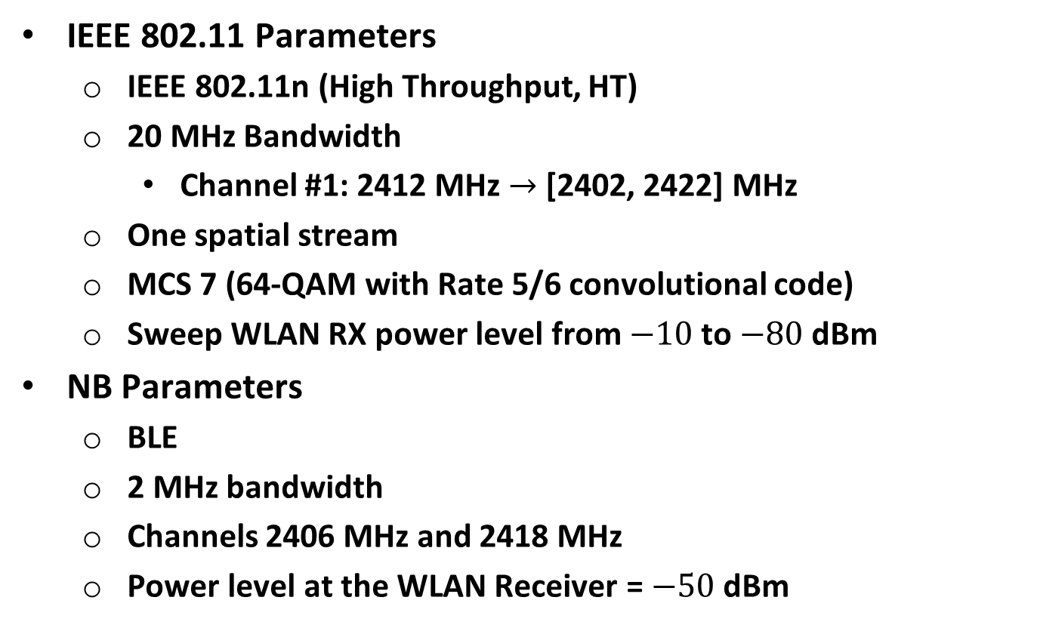
PHY Layer Testing
IEEE 802.11 Parameters
  IEEE 802.11n (High Throughput, HT)
  20 MHz Bandwidth
    Channel #1: 2412 MHz $→$ [2402, 2422] MHz
  One spatial stream
  MCS 7 (64-QAM with Rate 5/6 convolutional code)
  Sweep WLAN RX power level from $−10$to $−80$dBm
NB Parameters
  BLE
  2 MHz bandwidth
  Channels 2406 MHz and 2418 MHz
  Power level at the WLAN Receiver = $−50$dBm

Slide 11
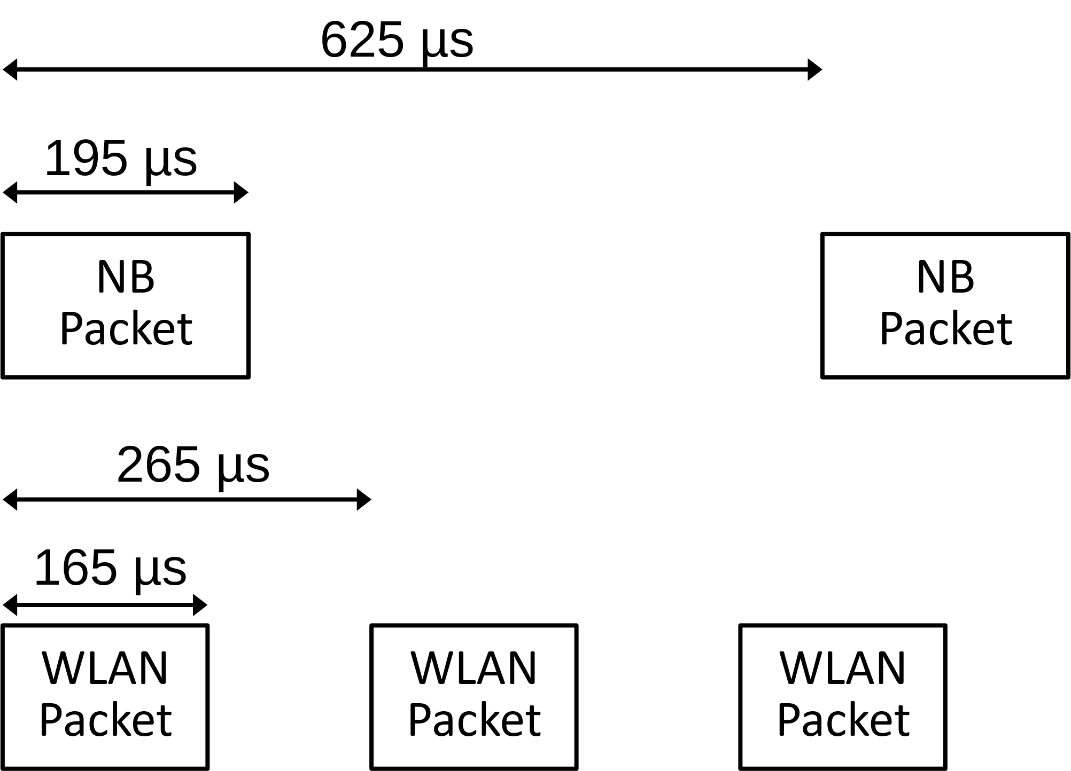
Packet Timing
Here is an illustration of the NB (BLE) and WLAN packet timing

Slide 12
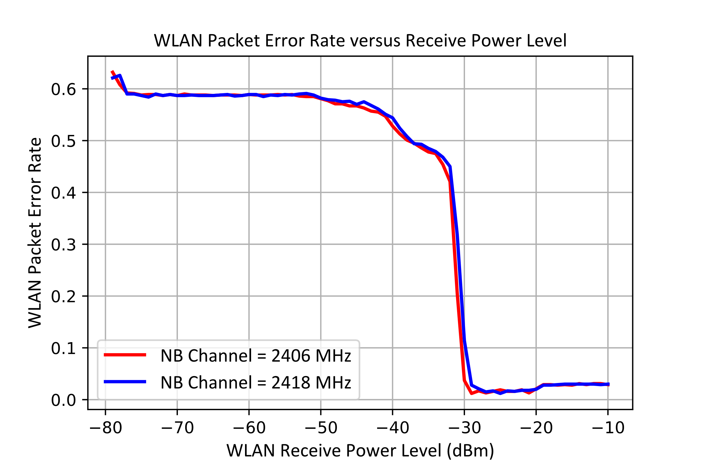
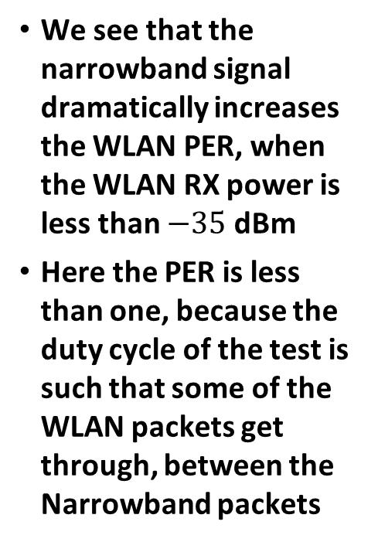

PHY Layer Testing Results
Here we plot the WLAN Packet Error Rate (PER) for two cases when the Narrowband signal is within the WLAN channel, at $−50$dBm
We see that the narrowband signal dramatically increases the WLAN PER, when the WLAN RX power is less than $−35$dBm
Here the PER is less than one, because the duty cycle of the test is such that some of the WLAN packets get through, between the Narrowband packets

Slide 13
Conclusions and Next Steps
Conclusions
  The NB signal causes high WLAN PER for signal-to-interference ratio (SIR) below around 15 dB to 20 dB
  We have provided some PHY Layer Testing results showing that if both the 802.11 signal and the NB O-QPSK signal are simultaneously received at the 802.11 receiver, that there is significant packet error rate, under normal receiver power levels for 802.11
Next Steps
  Mitigation methods need to be investigated (e.g., LBT)
  WE recommend everyone investigate this coexistence issue so we can conclude on a coexistence mechanism

Slide 14
References
Alexander Krebs, et. al., “NBA-MMS-UWB ranging text proposal for 15.4ab TFD,” IEEE 802.15-22/381r2, February 2023
Alexander Krebs, et. al., “Narrowband Channel Allocation for NBA-MMS-UWB,” IEEE 802.15-22/339r0, July 2022
Bin Tian, et. al., “Coexistence discussion on narrowband assisted UWB,” IEEE 802.15-22/261r0, May 2022

