Slide 1
Project: IEEE P802.15 Working Group for Wireless Personal Area Networks (WPANs)
Submission Title: Channel Impulse Response (CIR) Report Size
Date Submitted: March 13, 2023
Source: Steve Shellhammer, Pooria Pakrooh, Bin Tian, and Koorosh Akhavan (Qualcomm)
E-Mail:{sshellha, ppakrooh, btian, kakhavan}@qti.qualcomm.com
Abstract: Here we look at the maximum CIR Report size and discuss whether it makes sense to perform scaling and quantization to reduce the report size.
Notice: This document has been prepared to assist the IEEE P802.15. It is offered as a basis for discussion and is not binding on the authoring individual(s) or organization(s). The material in this document is subject to change in form and content after further study. The authors(s) reserve(s) the right to add, amend or withdraw material contained herein.

Slide 2
PAR Objective | Proposed Solution (how addressed)
Safeguards so that the high throughput data use cases will not cause significant disruption to low duty-cycle ranging use cases
Interference mitigation techniques to support higher density and higher traffic use cases
Other coexistence improvement
Backward compatibility with enhanced ranging capable devices (ERDEVs)
Improved link budget and/or reduced air-time
Additional channels and operating frequencies
Improvements to accuracy / precision / reliability and interoperability for high-integrity ranging
Reduced complexity and power consumption
Hybrid operation with narrowband signaling to assist UWB
Enhanced native discovery and connection setup mechanisms
Sensing capabilities to support presence detection and environment mapping | Here we look at the maximum CIR Report size
Low-power low-latency streaming
Higher data-rate streaming allowing at least 50 Mbit/s of throughput
Support for peer-to-peer, peer-to-multi-peer, and station-to-infrastructure protocols
Infrastructure synchronization mechanisms

Slide 3
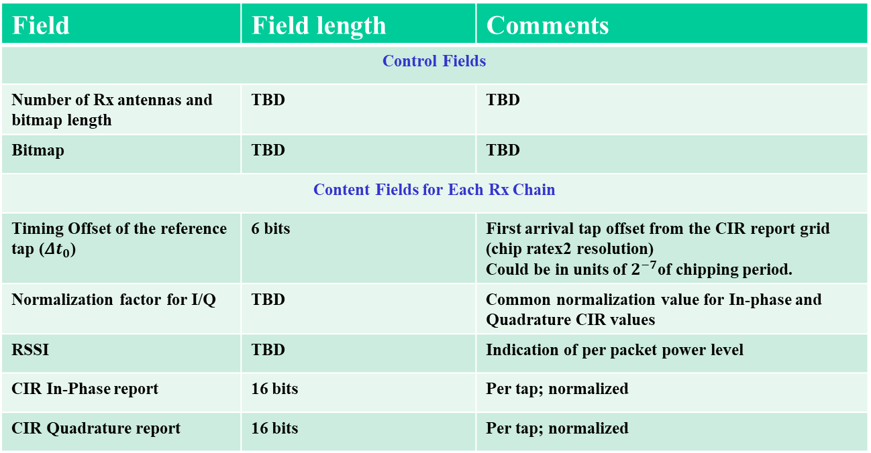
Background
The Latest Consensus on UWB Sensing for 802.15.4ab document [1] provides a table of the CIR elements (reproduced here)
Field | Field length | Comments
Control Fields
Number of Rx antennas and bitmap length | TBD | TBD
Bitmap | TBD | TBD
Content Fields for Each Rx Chain
Timing Offset of the reference tap (${Δt}_{0}$) | 6 bits | First arrival tap offset from the CIR report grid (chip ratex2 resolution) Could be in units of $2^{−7}$of chipping period.
Normalization factor for I/Q | TBD | Common normalization value for In-phase and Quadrature CIR values
RSSI | TBD | Indication of per packet power level
CIR In-Phase report | 16 bits | Per tap; normalized
CIR Quadrature report | 16 bits | Per tap; normalized

Slide 4
CIR Report Size Estimate – Control Field
The control subfields are rather short
  The Number of antennas and bitmap length is likely one or two octets
  If the bitmap is 256 bits, then it can be signaled in 32 octets

Slide 5
CIR Report Size Estimate – Content Field
There is a content field for each RX antenna
Here are some estimates of the content subfield sizes
  Timing offset reference: less than one octet
  Normalization reference: likely one octet
  RSSI: likely one octet
  CIR In-phase: two octets (16 bits) per tap times up to 256 taps = 512 octets
  CIR Quadrature: two octets (16 bits) per tap times up to 256 taps = 512 octets

Slide 6
Estimate of the Largest CIR Report Size
Field | Subfield | Subfield Size with one RX Antenna (Octets) | Subfield Size with four RX Antenna (Octets)
Control | Number of RX Antennas and Bitmap Length | 2 | 2
 | Bitmap | 32 | 32
Content | Timing Offset | 1 | 4
 | Normalization | 1 | 4
 | RSSI | 1 | 4
 | CSI In-Phase | 512 | 2048
 | CSI Quadrature | 512 | 2048
TOTAL |  | 1061 | 4142
The four-antenna case with 256-bit bitmap exceeds a payload of 4096 octets

Slide 7
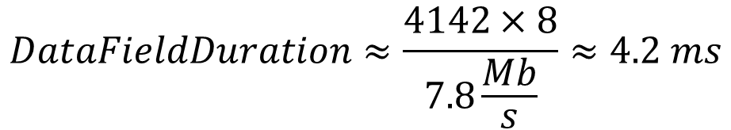
Data Field Duration
If the CIR Report is sent at 7.8 Mb/s the duration of the Data field, when there are four RX antennas, is around
$$DataFieldDuration≈\frac{4142×8}{7.8\frac{Mb}{s}}≈4.2 ms$$
In the case of multiple SENS segments (for multiple TX antennas) this size and duration increases approximately proportional to the number of SENS segments

Slide 8
Question
In IEEE 802.11bf, scaling and quantization are applied to reduce the size of the channel state information (CSI) so that the real and imaginary components of the CSI can be represented with either 8 or 10 bits, while still maintaining a high signal-to-quantization noise level
  This can save approximately 37% to 50% of the CIR report size depending on whether 8 or 10 bits is used
Scaling and quantization can be done with bit-shifts and rounding operations
Question: Do we want to introduce scaling and quantization into the CIR report to reduce the report size?

Slide 9
References
Pooria Pakrooh, et. al., “Latest Consensus on UWB Sensing for 802.15.4ab,” IEEE 802.15-23/79r0, January 2023

