Slide 1
Project: IEEE P802.15 Working Group for Wireless Specialty Networks (WSN)
Submission Title: Support of frequency stitching based sensing and sensing by proxy
Source: Bin Qian, Chenchen Liu, Xiaohui Peng, Lei Huang, David Xun Yang (Huawei Technologies)
Address : [Huawei Bantian Base, Longgang District, Shenzhen, 518129 China]
E-Mail: [qianbin14@huawei.com]
Re: Task Group 4ab: UWB Next Generation for 802.15.4
Abstract: [UWB, sensing, messages]
Purpose:
Notice: This document has been prepared to assist the IEEE P802.15. It is offered as a basis for discussion and is not binding on the contributing individual(s) or organization(s). The material in this document is subject to change in form and content after further study. The contributor(s) reserve(s) the right to add, amend or withdraw material contained herein.
Release: The contributor acknowledges and accepts that this contribution becomes the property of IEEE and may be made publicly available by P802.15.
Notes:
Jul 12, 2010
Page 1

Slide 2
PAR Objective | Proposed Solution (how addressed)
Safeguards so that the high throughput data use cases will not cause significant disruption to low duty-cycle ranging use cases
Interference mitigation techniques to support higher density and higher traffic use cases
Other coexistence improvement
Backward compatibility with enhanced ranging capable devices (ERDEVs)
Improved link budget and/or reduced air-time
Additional channels and operating frequencies
Improvements to accuracy / precision / reliability and interoperability for high-integrity ranging
Reduced complexity and power consumption
Hybrid operation with narrowband signaling to assist UWB
Enhanced native discovery and connection setup mechanisms
Sensing capabilities to support presence detection and environment mapping | Add information to configure the frequency stitching
Low-power low-latency streaming
Higher data-rate streaming allowing at least 50 Mbit/s of throughput
Support for peer-to-peer, peer-to-multi-peer, and station-to-infrastructure protocols | Identify the necessary information to accommodate sensing by proxy
Infrastructure synchronization mechanisms

Slide 3
Contribution Outline
The necessary information parameters are identified to be exchanged between UWB sensing devices for frequency stitching
Add necessary information to accommodate the sensing by proxy, including the basic proxy mode and hierarchical proxy mode

Slide 4
Frequency Stitching

Slide 5
Frequency Stitching
In [1-2], the concept of the frequency stitching is introduced to improve the effective bandwidth of sensing by stitching multiple frequency segments together.
The overlapping between adjacent frequency segments is desirable, e.g., the overlapping could be 124.8 MHz (25% overlap), 249.6 MHz (50% overlap), and 374.4 MHz (75% overlap)
In [3-5], the channel allocation for frequency stitching is discussed
The group has reached a consensus that the frequency stitching could be adopted as an optional feature [6]

Slide 6
Frequency Stitching Control
In [7], a single configuration is used for frequency stitching based sensing and non frequency stitching based sensing
Octets: 2 | 0/4 | 0/1 | 0/1 | 0/2 | 0/TBD | 0/TBD | 0/TBD | 0/TBD | Variable
Content Control | Session ID | Block Duration | Round Duration | Slot Duration | Ranging Control | Data Comm Control | Sensing Control | TDoA Control | Scheduling List
TBD | 1 bit | 4 bits | 2 bits | 2 bits | 1 bit | 0/2 bits
Sensing common control | Frequency stitching enabled | Base channel number or channel number | Carrier frequency grid configuration ID | Aggregated Bandwidth | Frequency stitching direction | Feedback Control
Frequency stitching direction
  0: Ascending, the base channel has the lowest carrier frequency
  1: Descending, the base channel has the highest carrier frequency
Feedback control: only present if the initiator is the transmitter
  00: feedback CIR of sensing fragment (SF) after each SF transmission (suitable for low-cost memory limited UWB device)
  01: feedback CIR of all SFs after the last SF transmission (suitable for continuous sensing measurement)
  10: feedback CIR of the aggregated channel after the last SF transmission (suitable for high processing capability UWB device and could reduce CIR overhead)

Slide 7
CIR Feedback for Frequency Stitching
In [6], the CIR feedback for non frequency stitching scenario is defined. The baseline CIR report contains control field and content field
  Control field: Rx antenna number, bitmap length, bitmap
  Content field: time offset of the reference tap, normalization factor, RSSI, CIR I/Q-component
In the frequency stitching scenario, some additional information is needed in the control field of the CIR report
  Indicate whether the CIR feedback corresponds to the individual sensing fragment or the aggregated frequency band
  Indicate which sensing fragment the CIR feedback is associated if the CIR feedback corresponds to the individual sensing fragment

Slide 8
Sensing by Proxy

Slide 9
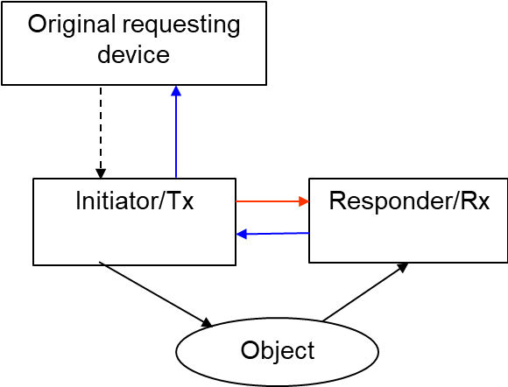
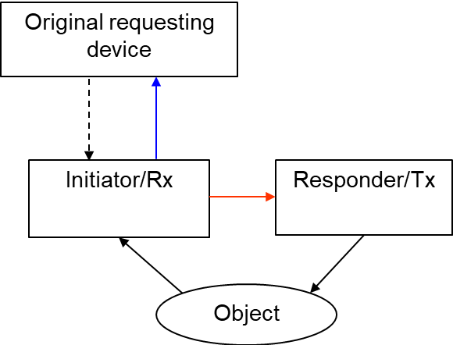
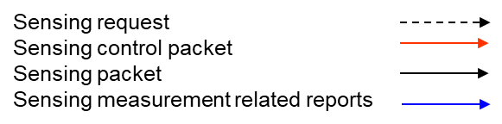
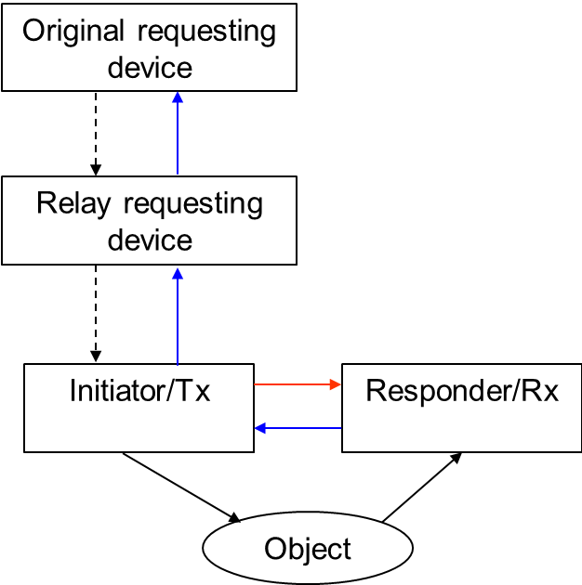
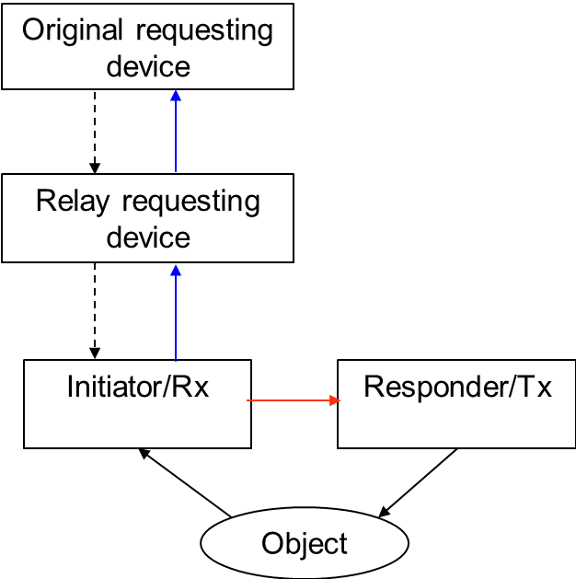
Sensing by Proxy
The sensing by proxy (SBP) is discussed as one of the basic sensing modes in [8], which includes the basic proxy mode and the hierarchical proxy mode
  The hierarchical proxy mode could extend the sensing coverage
Basic Proxy Mode
Hierarchical Proxy Mode

Slide 10
Messages in Proxy Mode
Sensing request message may include
  Address of the initiator. If the address of the recipient is same as the initiator address, the recipient is the initiator; otherwise, the recipient is the relay requesting device.
  Recommended responders involved in the proxy.
  Indication whether to feedback CIR data or the processed target information
SBP request status may include
  Success and use the recommended responders
  Success but not use the recommended responders
  Reject
The sensing control packet, the sensing packet, and the sensing measurement report are same as the non-proxy mode

Slide 11
Reference
[1] IEEE 802.15/22-061r0, “Sensing Continued”
[2] IEEE 802.15/22-422r0, “UWB Sensing - Scheduling”
[3] IEEE 802.15/22-520r1, “Expanded HRP Channel Plan”
[4] IEEE 802.15/22-574r0, “Channels for Frequency Stitching”
[5] IEEE 802.15/23-010r0, “Updated Proposal on Channels for Frequency Stitching”
[6] IEEE 802.15/23-079r0, “Latest Consensus on UWB Sensing for 802.15.4ab”
[7] IEEE 802.15/23-136r0, “Control and Scheduling information for UWB Sensing”
[8] IEEE 802.15/22-538r2, “Proposal of Sensing Framework”

Slide 12
Thank You

