Slide 1
Spectral Emission Mask Results
13.03.2023

Slide 2
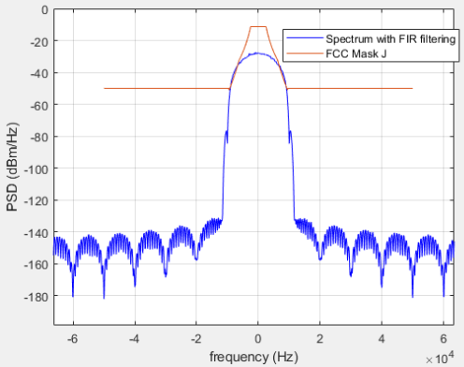
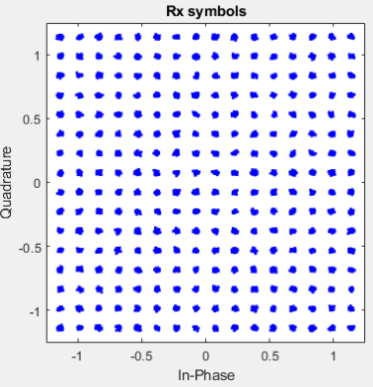
200 kHz Sampling Rate, FCC Mask J not passing
SNR : 34.85 dB

Slide 3
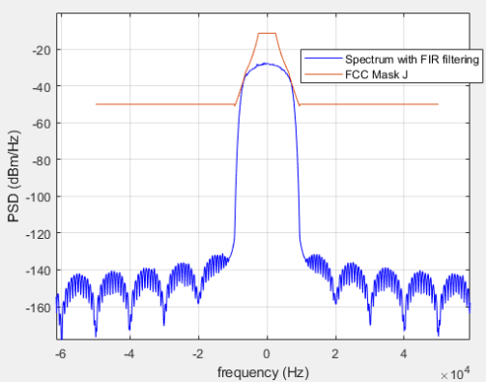
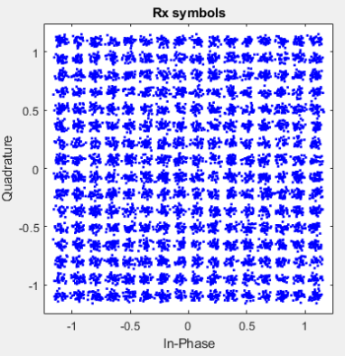
200 kHz Sampling Rate, FCC Mask J passing with narrow filter
SNR : 23.42 dB

